Slide 1
Titanic
Author: Warren Tseng

Slide 2
Outline
Data Pre-processing
Training Model
Result
Feature Selection
Feature Processing
NN Structure
Hyper-parameter

Slide 3
Data Processing

Slide 4
Feature Selection
Pclass, fare: social stratification
Sex: lady first
Age: baby first
Sibsp, parch: they are numeric value…

Slide 5
Feature Processing
Pclass, sex: from class to ‘one hot’ value. 1 → [ 1, 0, 0 ] male → [ 1, 0 ] 2 → [ 0, 1, 0 ] female → [ 0, 1 ] 3 → [ 0, 0, 1 ]

Slide 6
Feature Processing
Age: missing value → -100, normalization → age / 100
Fare: missing value → -200, normalization → fare / 200
Sibsp: normalization → sibsp / 200
Parch: normalization → Parch / 200

Slide 7
Feature Processing
Survived: from class to ‘one hot’ value. 0 → [ 1, 0 ] 1 → [ 0, 1 ]

Slide 8

Training Model

Slide 9
NN Structure
Input layer
Hidden layer
Output layer
9
128
128
.
.
.
.
.
.
.
.
.
Softmax
Dropout
Dropout

Slide 10
Hyper-parameters
Epoch = 2000
Learning rate = 1e-4
Dropout probability = 0.2
Loss function: cross-entropy
Optimizer: RMSprop

Slide 11
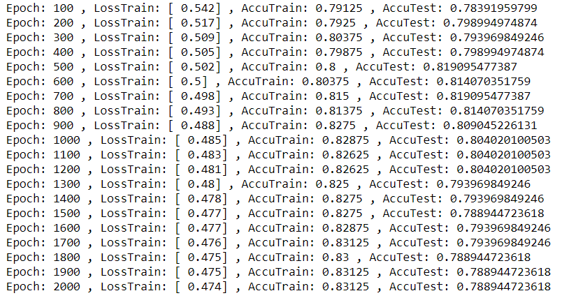
Result

Slide 12
Conclusion
Overfitting for 2000 epochs
The overfitting was occurred when the epoch was from 800 to 900. → 1. Epoch ↓ 2. Dropout probability ↑

Slide 13
Thanks for your attention

