Slide 1
Using Machine Theory of Mind to Learn
Agent Social Network Structures
from Observed Interactive Behaviors with Targets
Yun-Shiuan Chuang, Hsin-Yi Hung, Edwinn Gamborino, Joshua Oon Soo Goh,
Tsung-Ren Huang, Yu-Ling Chang, Su-Ling Yeh, Li-Chen Fu

Slide 2

Kawaii
Study Objective:
Infer Social Preference by Machine Theory of Mind
An Agent’s
Social Preference
Interactions
The Machine’s
Inference
E.g., socially assistive robots

Slide 3
Data: The Social Game For Human Participants
“Each step costs 1 point,
which person do you want to reach?”
One trajectory of interactions
Social
Support
Questionnaire
14 data sets, each with at least 150 interaction trajectories

Slide 4
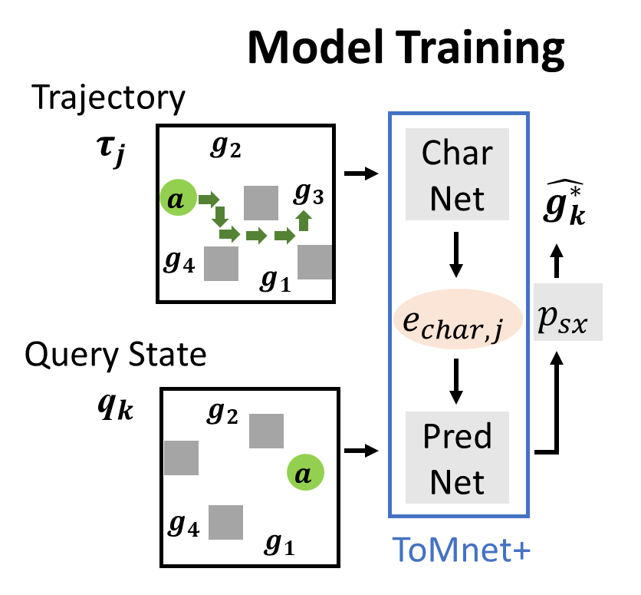
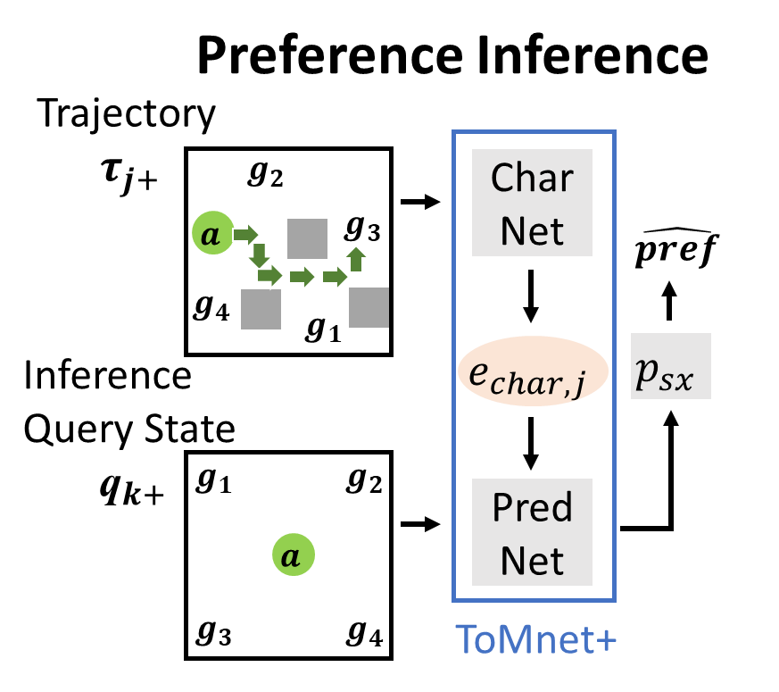
ToMnet+: Train the Machine Based on Interactions
Resnet + LSTM
Resnet

Slide 5
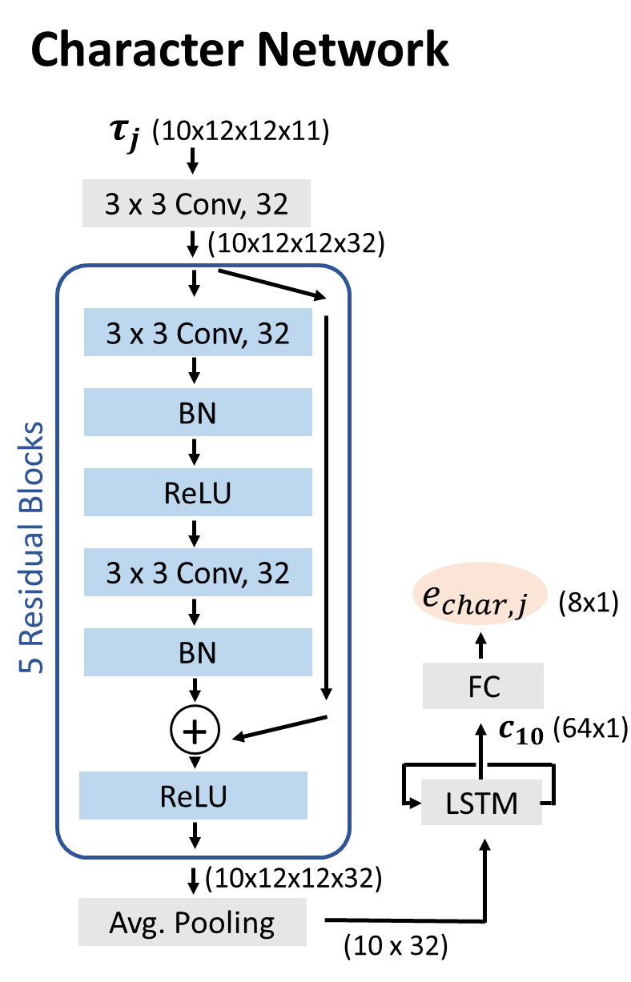
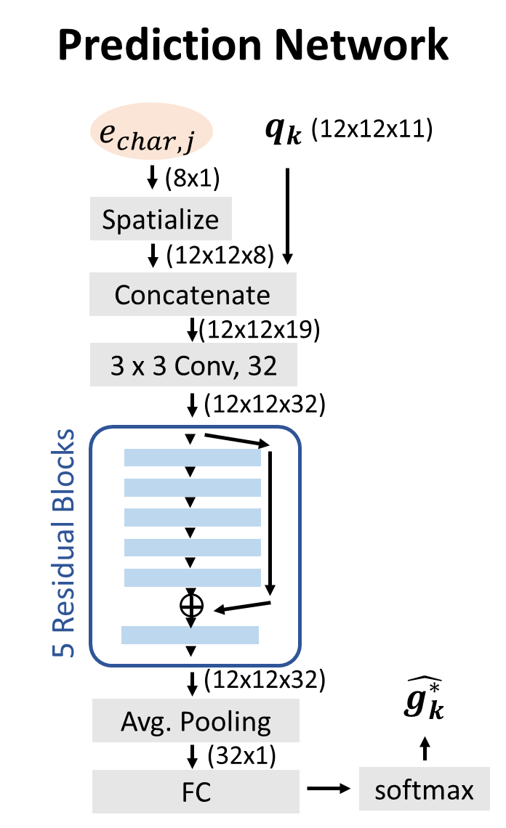

Slide 6
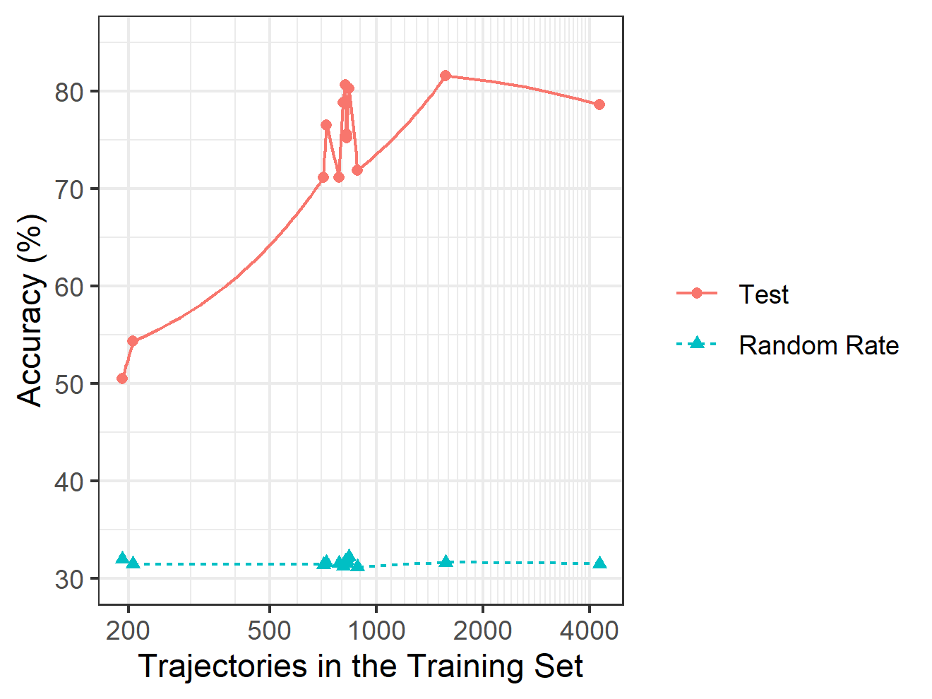
Results
Predict which target the person approaches with 50-82% accuracy
Reconstruct each participant’s social preference ranking
14 data sets, each with at least 150 interaction trajectories
W = 105, p = .0001
W = 105, p = .00103

Slide 7
Conclusions
The ToMnet+ model successfully infers humans’ hidden social preferences based on interactions in the social game.
We will extend to other data problems and apply it to improve human-machine interactions using virtual agents or robots.

Slide 8
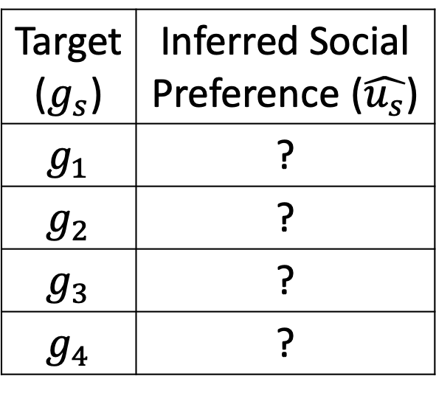
21
?
10
7
?
?
17
?
Target ($g_{s}$) | Inferred Social Preference ($\hat{u_{s}}$)
$$g_{1}$$ | ?
$$g_{2}$$ | ?
$$g_{3}$$ | ?
$$g_{4}$$ | ?

