Slide 1
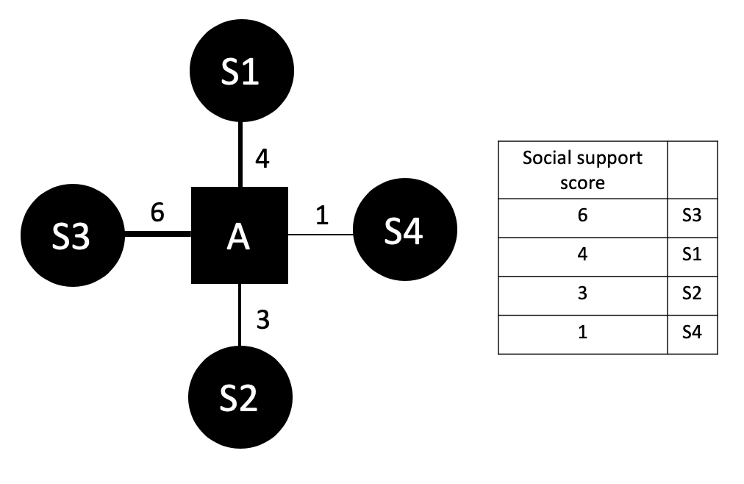

Slide 2

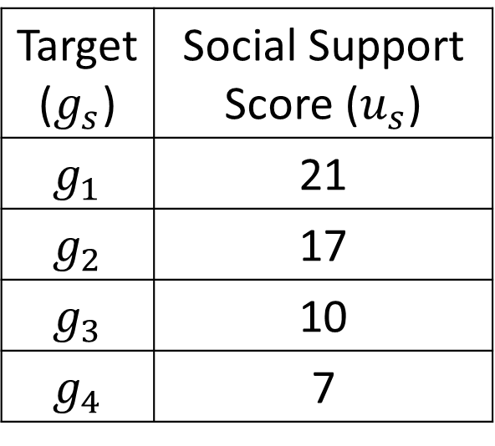




$$g_{1}$$
Target ($g_{s}$) | Social Support Score ($u_{s}$)
$$g_{1}$$ | 21
$$g_{2}$$ | 17
$$g_{3}$$ | 10
$$g_{4}$$ | 7
$$g_{3}$$
$$a_{i}$$
$$g_{4}$$
$$g_{2}$$

Slide 3
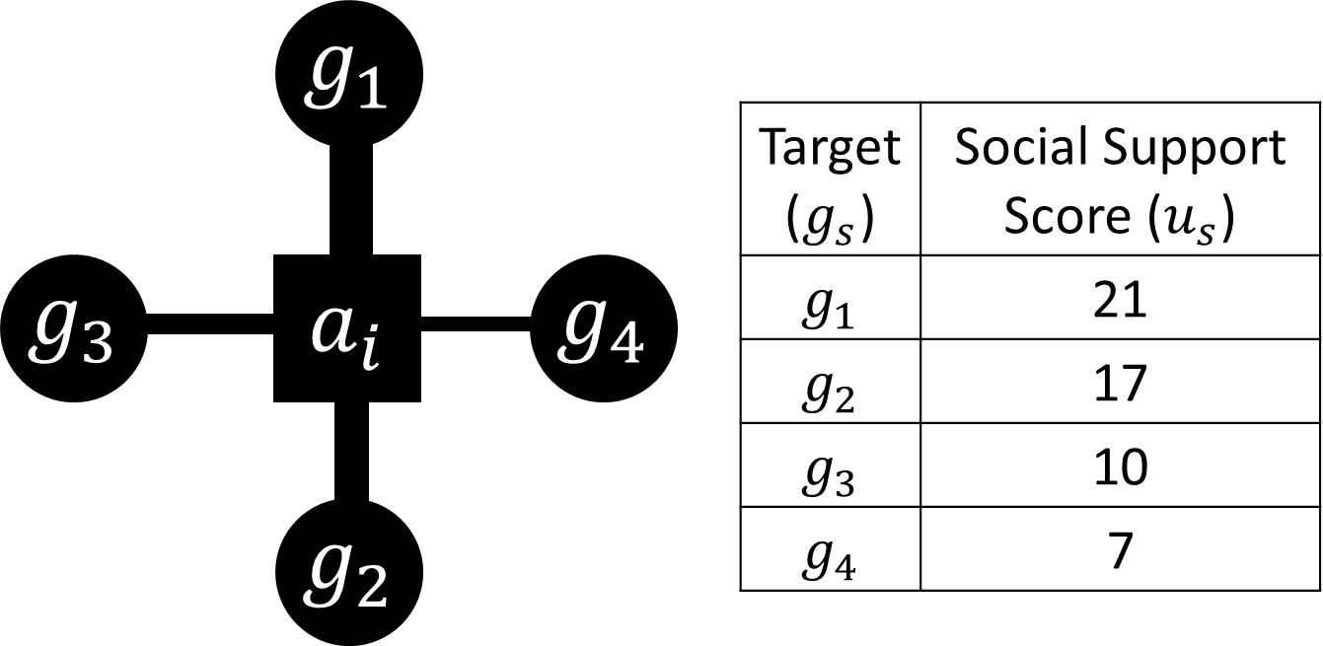

Slide 4
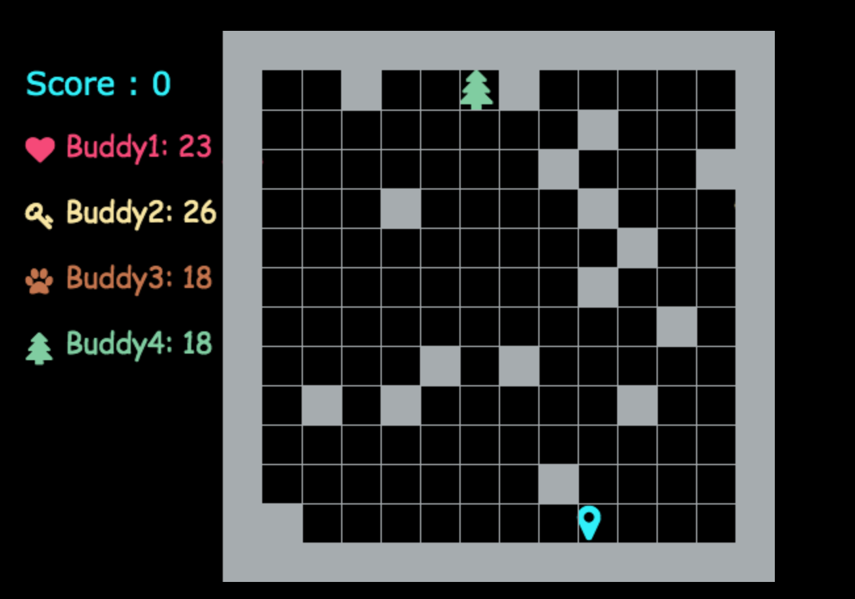
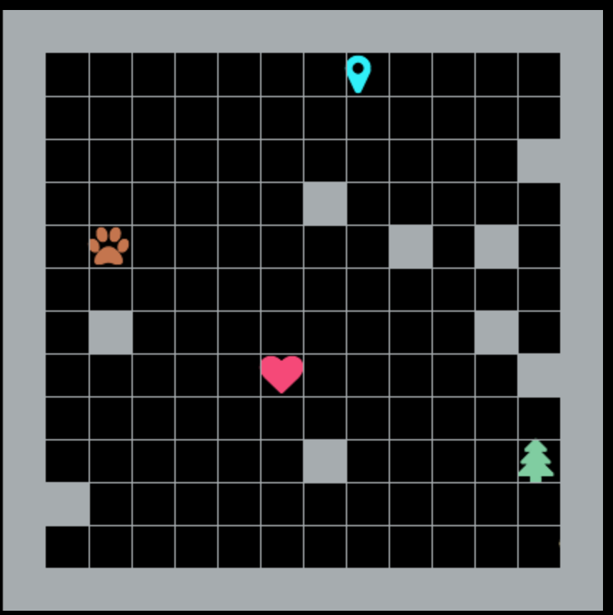






“Each step costs 1 point,
which target do you want to reach?”
Current Score: 0
小明: 23
小美: 26
小熊: 18
小樹: 18

Slide 5
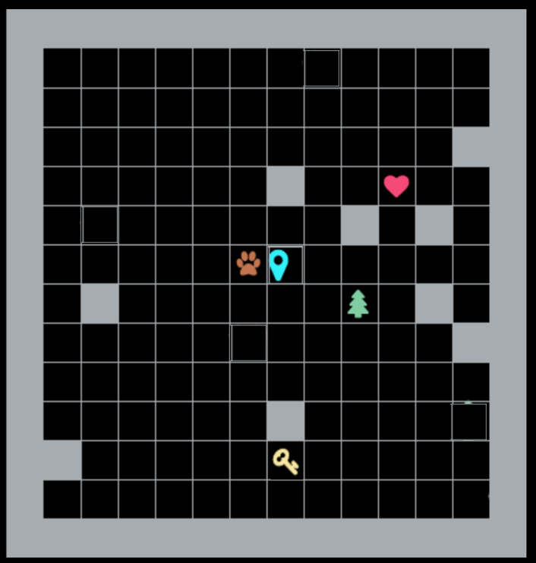
Final Score: 26-7=19
小明: 23
Anne: 23
Ben: 26
Matt: 18
小樹: 18
Amy: 18

Slide 6
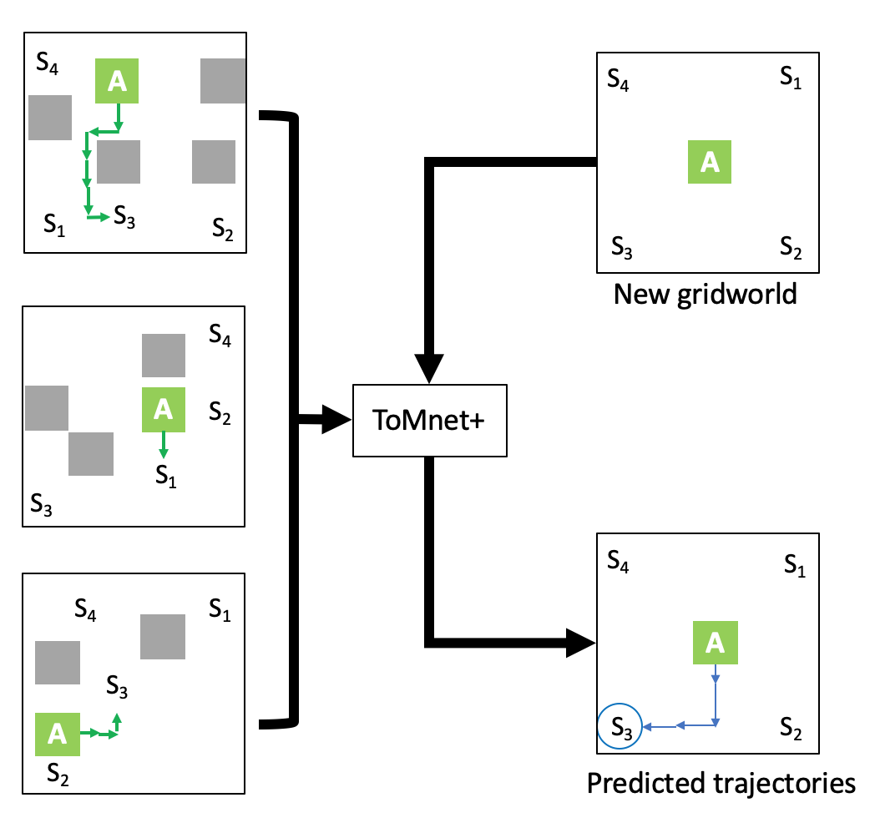
Model Training
Preference Prediction
Test Query State
Predicted Target

Slide 7















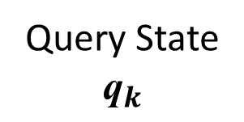
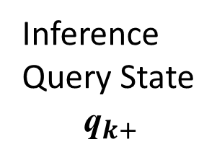








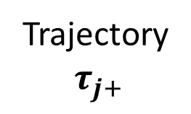


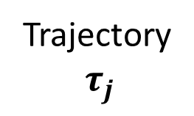
Model Training
Preference Inference
Trajectory
$$τ_{j}$$
Trajectory
$$τ_{j+}$$
$$g_{2}$$
Char
Net
$$g_{2}$$
Char
Net
$$a$$
$$g_{3}$$
$$\hat{g_{k}^{∗}}$$
$$a$$
$$g_{3}$$
$$\hat{pref}$$
$$g_{4}$$
$$g_{4}$$
$$g_{1}$$
$$g_{1}$$
$$e_{char, j}$$
$$p_{sx}$$
Inference
Query State
$${\text{q}}_{k+}$$
$$e_{char, j}$$
$$p_{sx}$$
Query State
$${\text{q}}_{k}$$
$$g_{2}$$
Pred
Net
$$g_{1}$$
$$g_{2}$$
Pred
Net
$$a$$
$$a$$
$$g_{4}$$
$$g_{1}$$
$$g_{3}$$
$$g_{4}$$

Slide 8
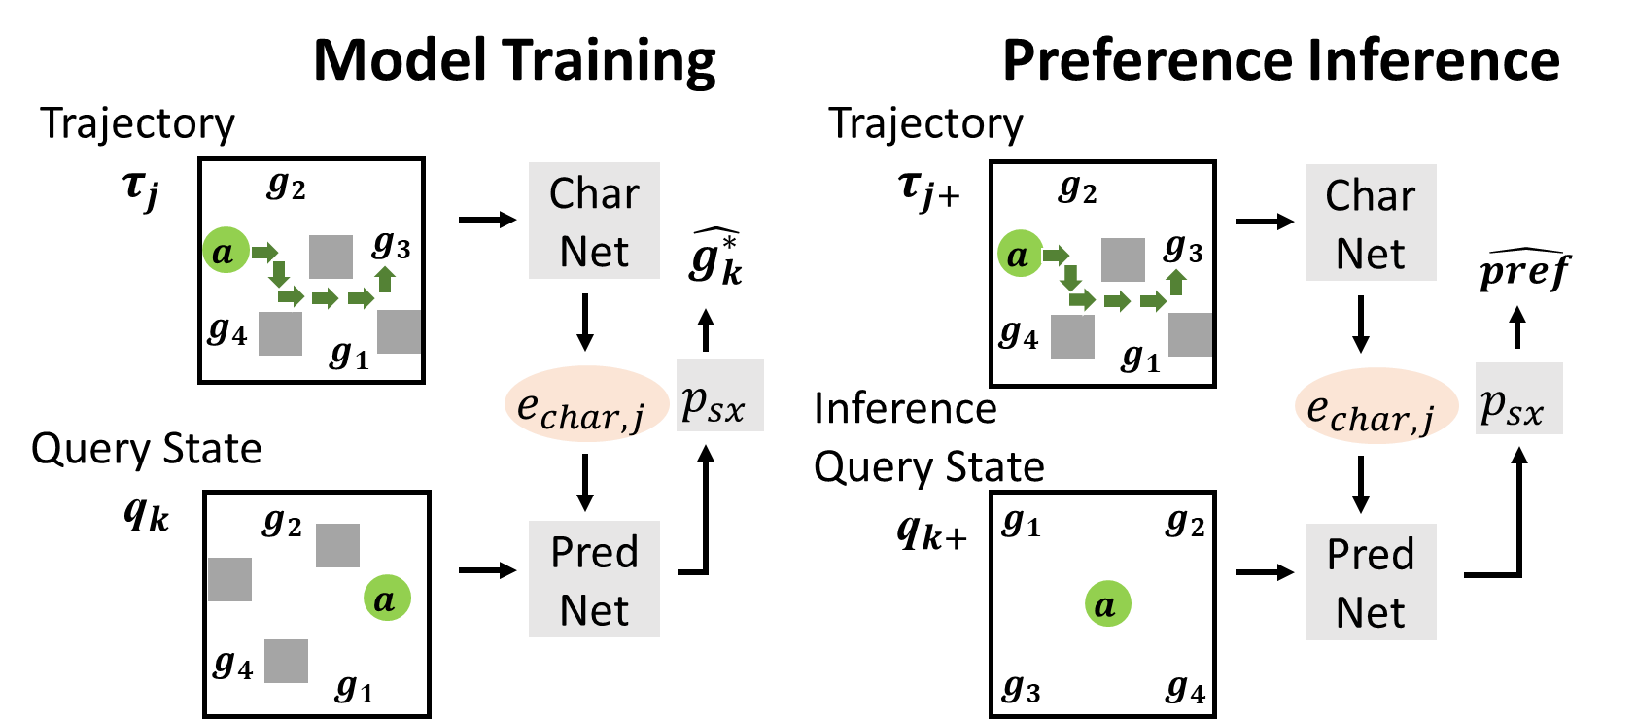

Slide 9


Model Training
Preference Inference
Trajectory
$$τ_{j}$$
Trajectory
$$τ_{j+}$$
$$g_{2}$$
Char
Net
$$g_{2}$$
Char
Net
$$a$$
$$g_{3}$$
$$\hat{g_{k}^{∗}}$$
$$a$$
$$g_{3}$$
$$\hat{pref}$$
$$g_{4}$$
$$g_{4}$$
$$g_{1}$$
$$g_{1}$$
$$e_{char, j}$$
$$p_{sx}$$
Inference
Query State
$${\text{q}}_{k+}$$
$$e_{char, j}$$
$$p_{sx}$$
Query State
$${\text{q}}_{k}$$
$$g_{2}$$
Pred
Net
$$g_{1}$$
$$g_{2}$$
Pred
Net
$$a$$
$$a$$
$$g_{4}$$
ToMnet+
ToMnet+
$$g_{1}$$
$$g_{3}$$
$$g_{4}$$

Slide 10
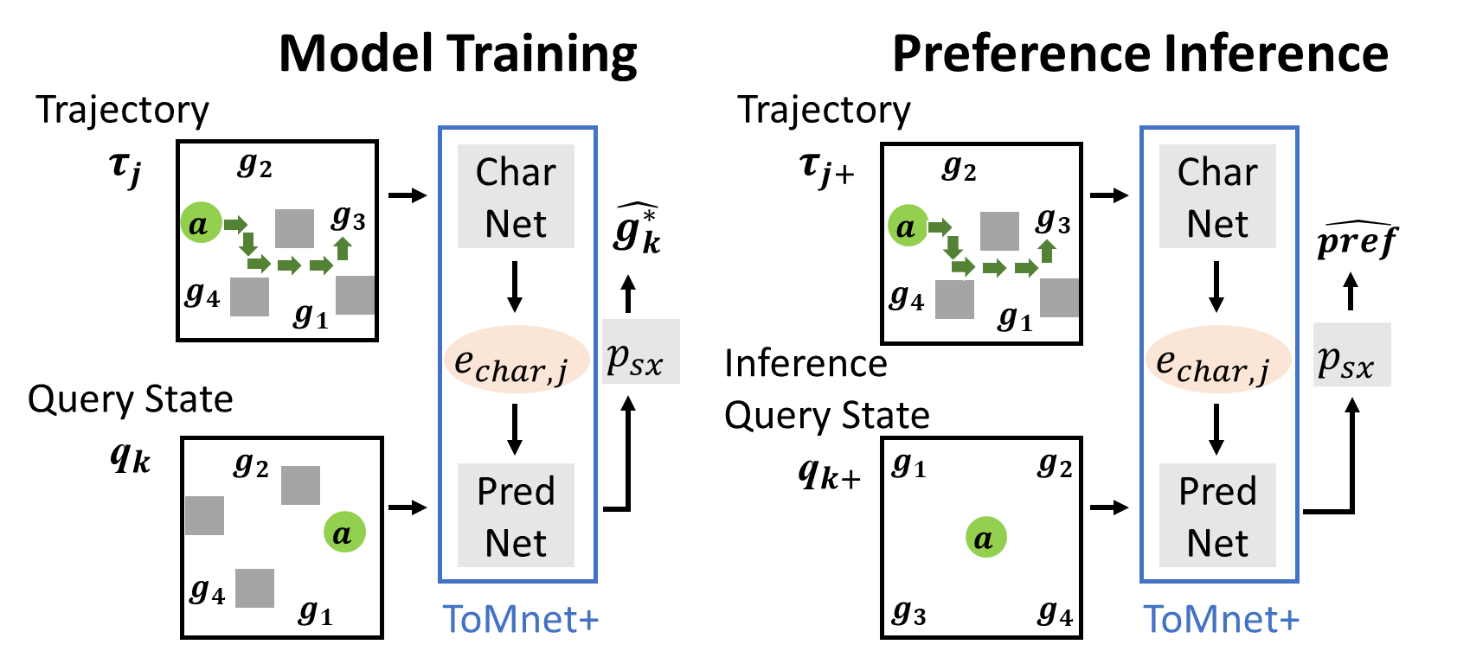

Slide 11






$τ_{j}$ (10x12x12x11)
$$e_{char, j}$$
$q_{k}$ (12x12x11)
(8x1)
3 x 3 Conv, 32
(10x12x12x32)
Spatialize
(12x12x8)
Concatenate
3 x 3 Conv, 32
(12x12x19)
3 x 3 Conv, 32
BN
(12x12x32)
ReLU
111
5 Residual Blocks
3 x 3 Conv, 32
$$e_{char, j}$$
5 Residual Blocks
(8x1)
BN
+
FC
+
$c_{10}$ (64x1)
(12x12x32)
$$\hat{g_{k}^{∗}}$$
Avg. Pooling
ReLU
LSTM
(32x1)
FC
softmax
(10x12x12x32)
Avg. Pooling
(10 x 32)

Slide 12
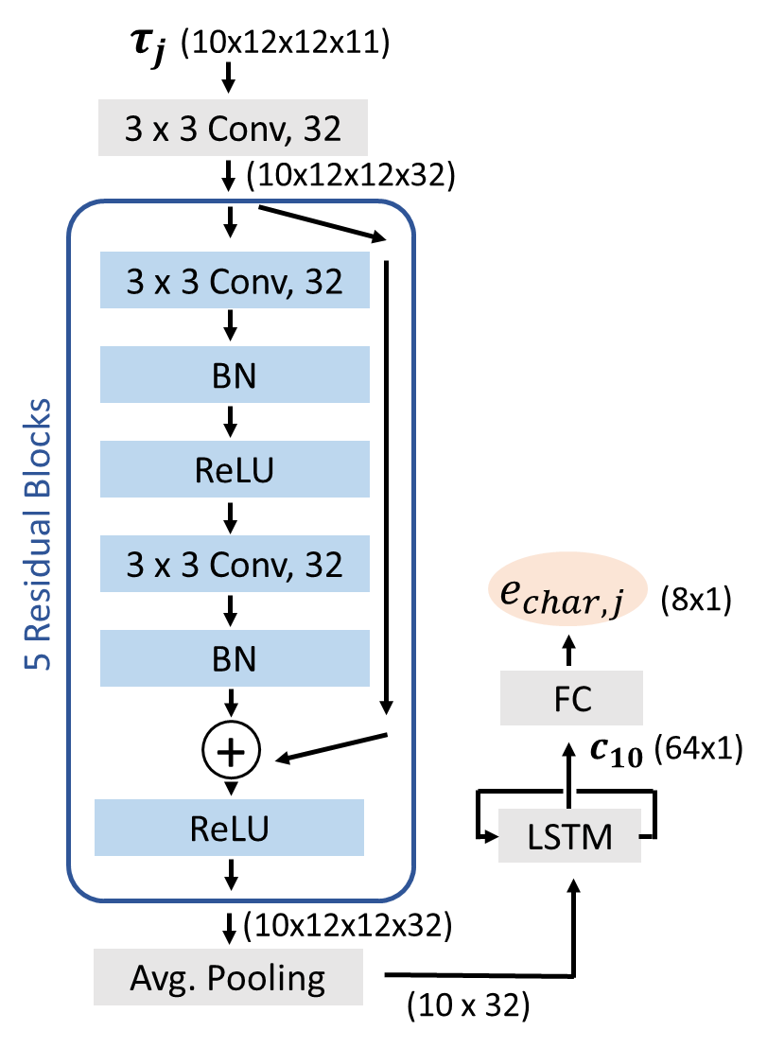
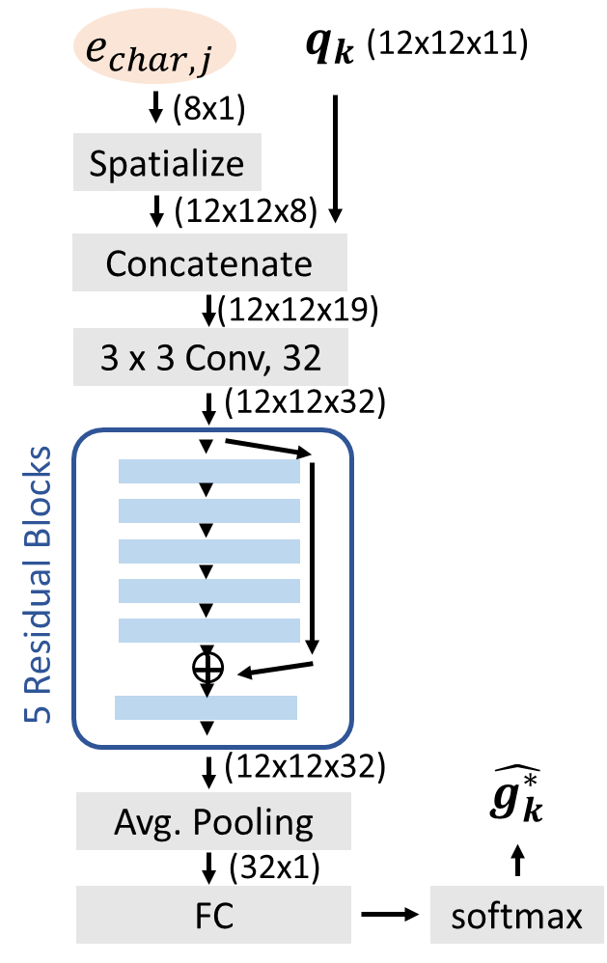

Slide 13
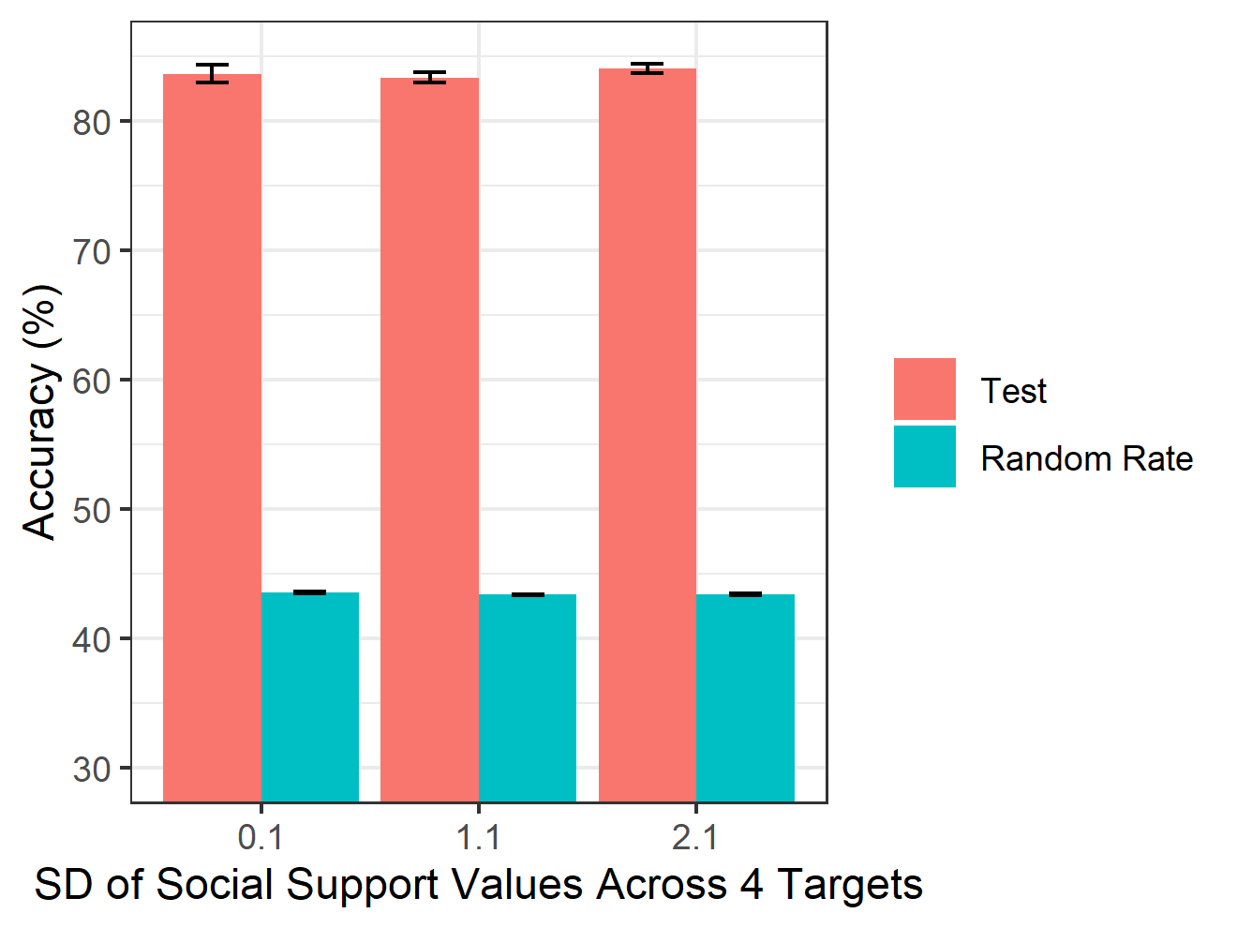
Notes:
Figure Simulation-accuracy. Accuracy in the test set as a function of the standard deviation (SD) of social support values across 4 targets in the training set for simulated data. Each red round dot is the average model test accuracy in test set (averaged across all the simulated data with the same SD). The blue triangle is the average random rate which should be the baseline to compared with. Random rate for each model is derived for each subject by dividing 100% by the average number of targets in the trajectories. The error bars represent the standard errors.

Slide 14
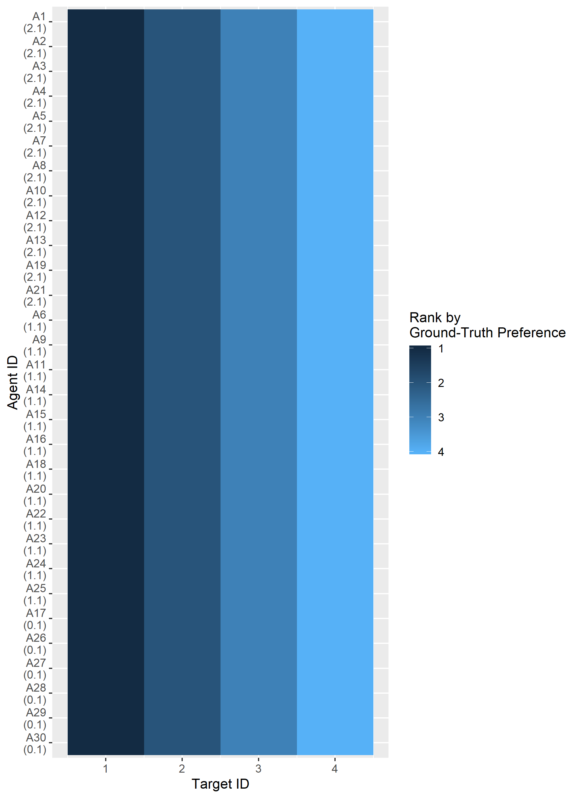
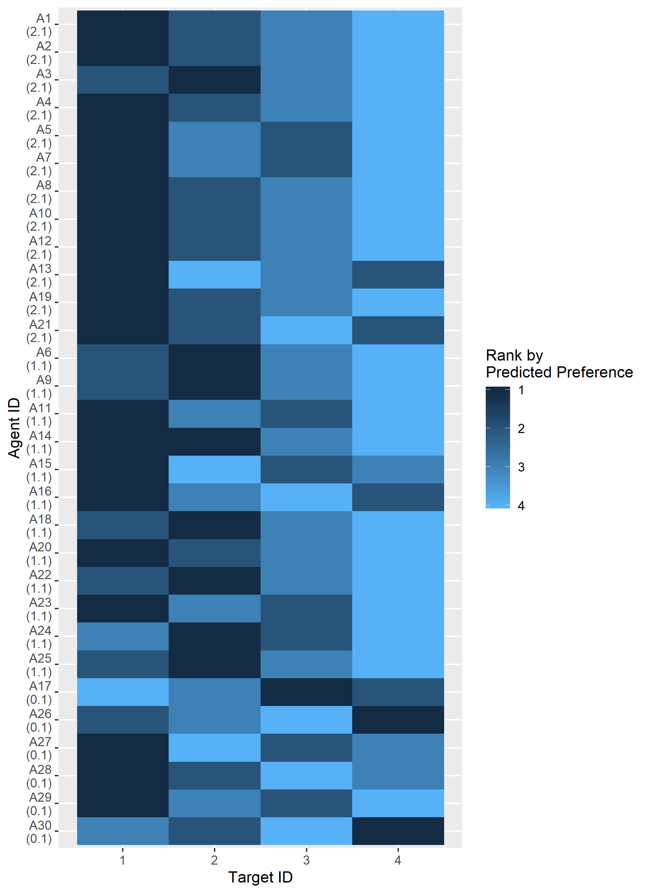
Notes:
Figure Simulation-preference-matrix. The ground-truth preference matrix and the reconstructed preference matrix for simulated data. Each row is a subject and each column is a target that the subject interacts with. The color of the cell_ij encodes the subject_i’s ranked preference (1-4; 1 being the favorite target and 4 being the less favorite one) for target_j. If there are tie(s) in the preference rank among targets (e.g., two or more targets share the same preference score), the targets with ties are assigned the average rank value (two targets share the second place in the preference score will have the rank value of 2.5). The ground-truth preference matrix is constructed by the rank-transformed simulated social support value of each target. The reconstructed preference matrix is constructed by the rank-transformed predicted preference score inferred by ToMNET+. The value in parenthesis below each subject ID is the standard deviation of the ground-truth preference scores (before rank-transformation) between the 4 targets.

Slide 15
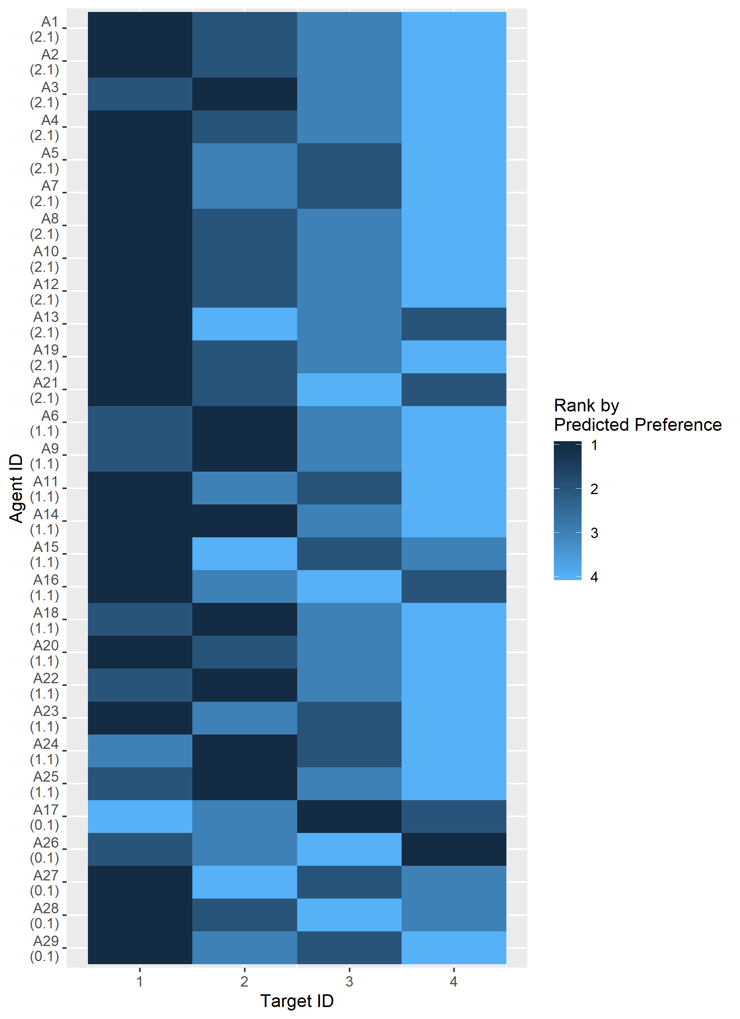
Ground-Truth
Reconstructed
SD = 2.1
Rank by
Preference
SD = 1.1
SD = 0.1
Notes:
Figure Simulation-preference-matrix. The ground-truth preference matrix and the reconstructed preference matrix for simulated data. Each row is a subject and each column is a target that the subject interacts with. The color of the cell_ij encodes the subject_i’s ranked preference (1-4; 1 being the favorite target and 4 being the less favorite one) for target_j. If there are tie(s) in the preference rank among targets (e.g., two or more targets share the same preference score), the targets with ties are assigned the average rank value (two targets share the second place in the preference score will have the rank value of 2.5). The ground-truth preference matrix is constructed by the rank-transformed simulated social support value of each target. The reconstructed preference matrix is constructed by the rank-transformed predicted preference score inferred by ToMnet+. The labels on the left are the standard deviations of the ground-truth preference scores (before rank-transformation) between the 4 targets.

Slide 16
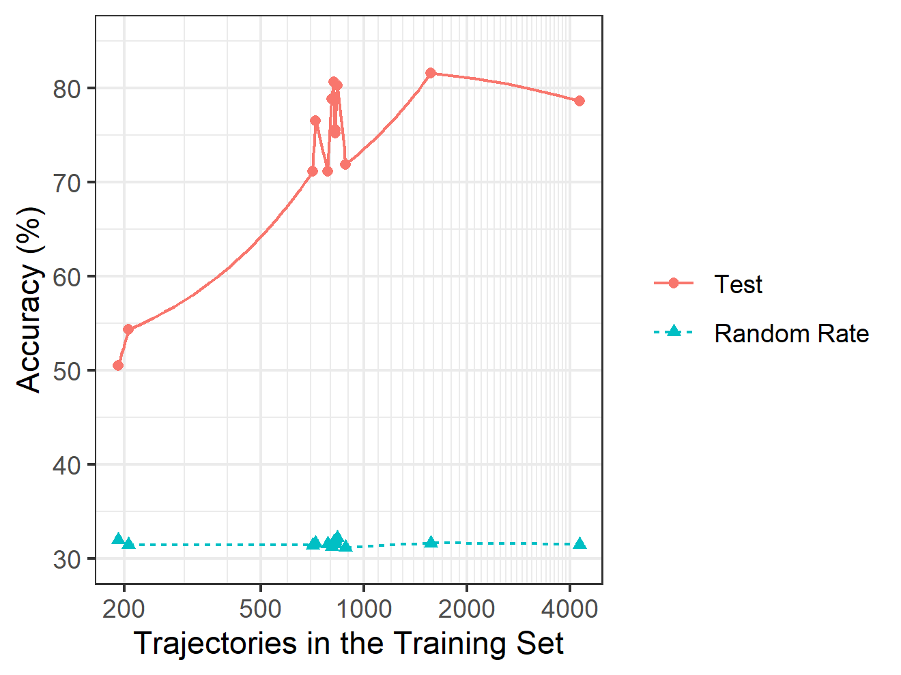
Notes:
Figure Human-accuracy. Accuracy in the test set as a function of the number of trajectories in the training set for human data set. Each red round dot is the model accuracy in test set for each human subject. The blue triangle is the random rate, which should be the baseline to compared with. Random rates are derived for each subject by dividing 100% by the average number of targets in the trajectories. The x-axis is log-transformed for clearer illustration. Each grid along the x-axis represents 100 trajectories. The label besides each red dot is the subject ID.

Slide 17
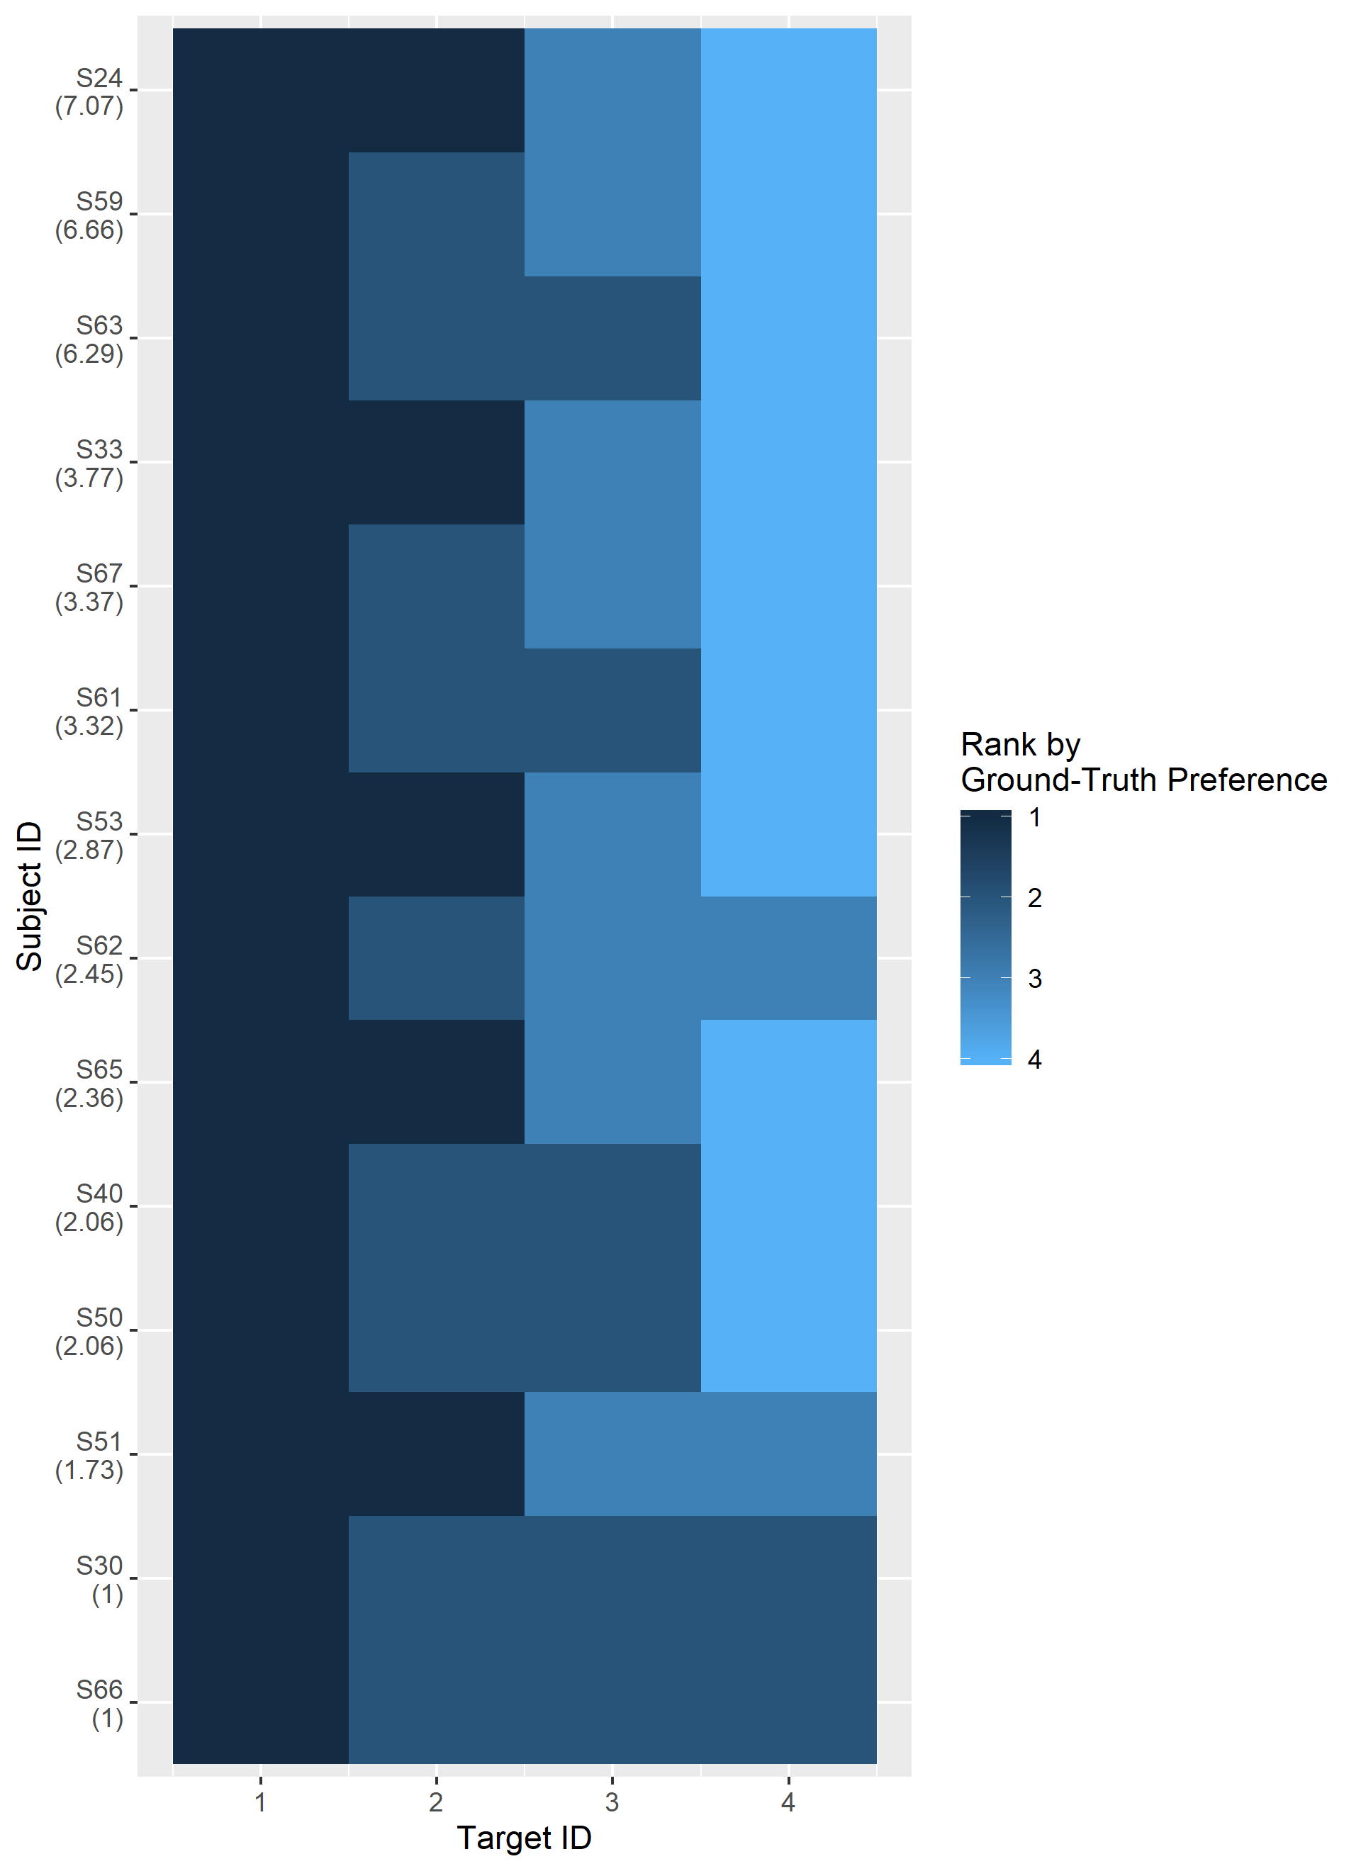
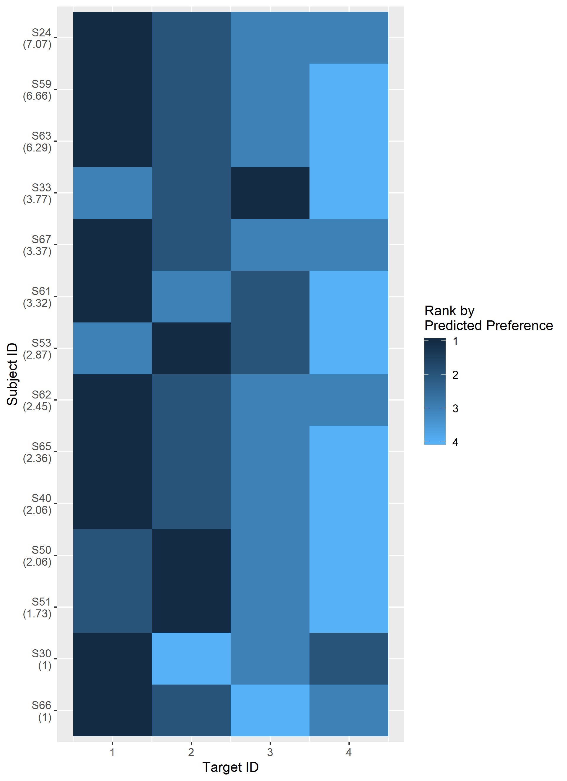
Notes:
Figure Human-preference-matrix. The ground-truth preference matrix and the reconstructed preference matrix for human data. Each row is a subject and each column is a target that the subject interacts with. The color of the cell_ij encodes the subject_i’s ranked preference (1-4; 1 being the favorite target and 4 being the less favorite one) for target_j. If there are tie(s) in the preference rank among targets (e.g., two or more targets share the same preference score), the targets with ties are assigned the average rank value (two targets share the second place in the preference score will have the rank value of 2.5). The ground-truth preference matrix is constructed by the rank-transformed score value of each of the four targets that human sees on the screen, which is decided by the social support questionnaire. The reconstructed preference matrix is constructed by the rank-transformed predicted preference score inferred by ToMnet+. The value in parenthesis below each subject ID is the standard deviation of the ground-truth preference scores (before rank-transformation) between the 4 targets.

Slide 18
Ground-Truth
Reconstructed
7.07
6.66
6.29
3.77
Rank by
Preference
3.37
3.32
2.87
2.45
2.36
2.06
1.73
1.00
1.00
Notes:
Figure Simulation-preference-matrix. The ground-truth preference matrix and the reconstructed preference matrix for simulated data. Each row is a subject and each column is a target that the subject interacts with. The color of the cell_ij encodes the subject_i’s ranked preference (1-4; 1 being the favorite target and 4 being the less favorite one) for target_j. If there are tie(s) in the preference rank among targets (e.g., two or more targets share the same preference score), the targets with ties are assigned the average rank value (two targets share the second place in the preference score will have the rank value of 2.5). The ground-truth preference matrix is constructed by the rank-transformed simulated social support value of each target. The reconstructed preference matrix is constructed by the rank-transformed predicted preference score inferred by ToMnet+. The labels on the left are the standard deviations of the ground-truth preference scores (before rank-transformation) between the 4 targets.

Slide 19
A
Ground-Truth
Reconstructed
B
Ground-Truth
Reconstructed
7.07
6.66
SD = 2.1
6.29
3.77
Rank by
Preference
3.37
3.32
2.87
2.45
SD = 1.1
2.36
2.06
2.06
1.73
SD = 0.1
1.00
1.00
Target ID
Target ID
Target ID
Target ID

Slide 20
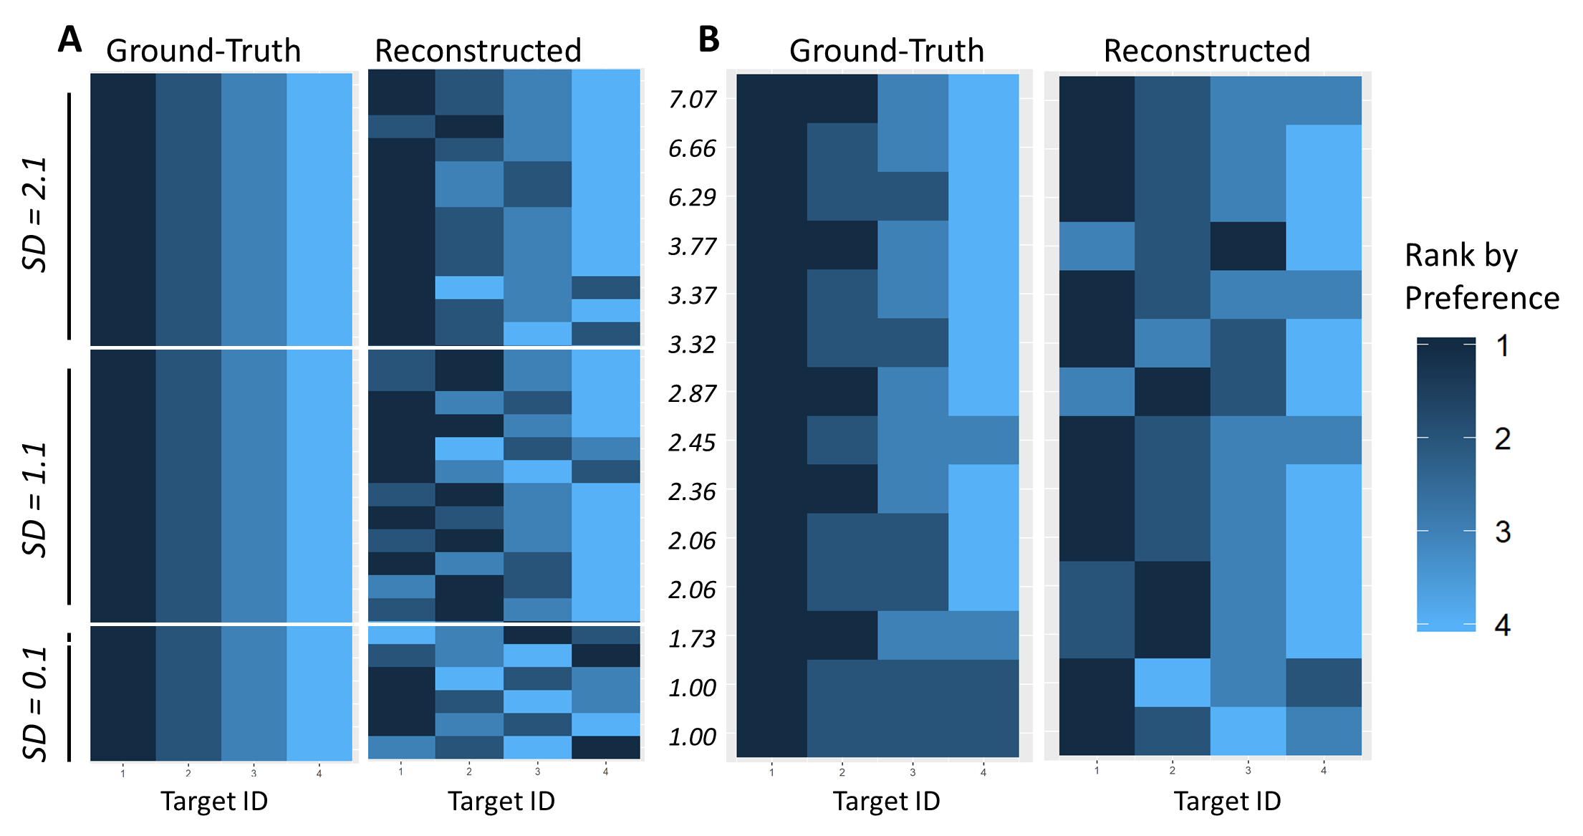

Slide 21
A
Ground-Truth
Reconstructed
B
Ground-Truth
Reconstructed
7.07
6.66
SD = 2.1
6.29
3.77
3.37
3.32
2.87
2.45
SD = 1.1
2.36
2.06
2.06
1.73
SD = 0.1
1.00
1.00
1
2
3
4
1
2
3
4
1
2
3
4
1
2
3
4
Target ID
Target ID
Target ID
Target ID
Rank by Preference
1
2
3
4

Slide 22
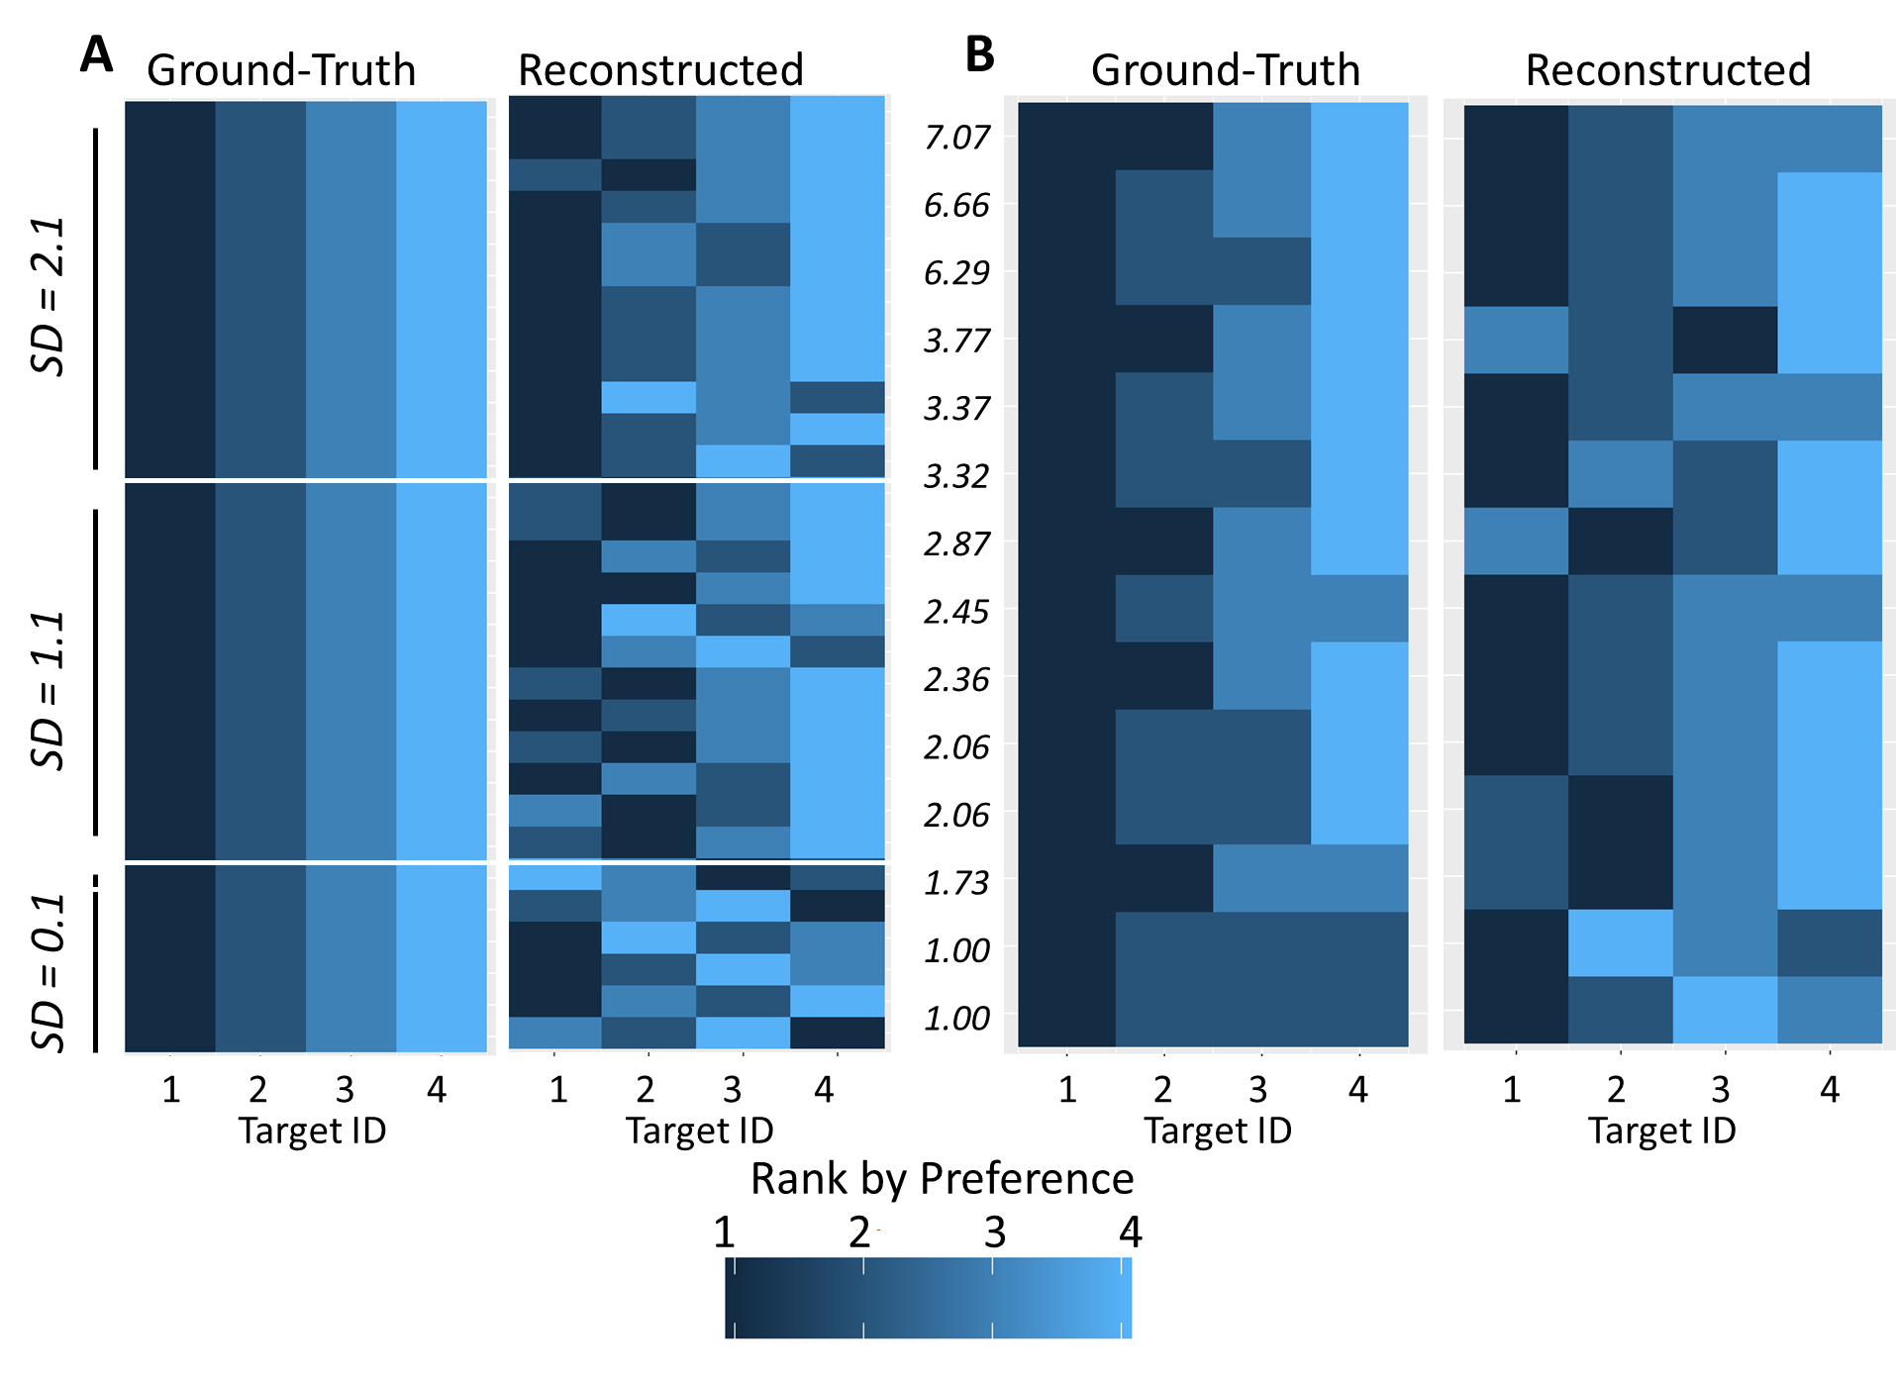

Slide 23
A
Ground-Truth
Reconstructed
SD = 2.1
SD = 1.1
SD = 0.1
Target ID
Target ID
B
Ground-Truth
Reconstructed
7.07
6.66
6.29
3.77
3.37
3.32
2.87
2.45
2.36
2.06
2.06
1.73
1.00
1.00
Target ID
Target ID
Rank by Preference
1
2
3
4

Slide 24
