Slide 1

solAr Inc.
南瓜香菜不加

Slide 2



Slide 3

損壞原因
外力損壞
溫度破壞

Slide 4

如何有效率檢測
太陽能發電板損壞情況

Slide 5
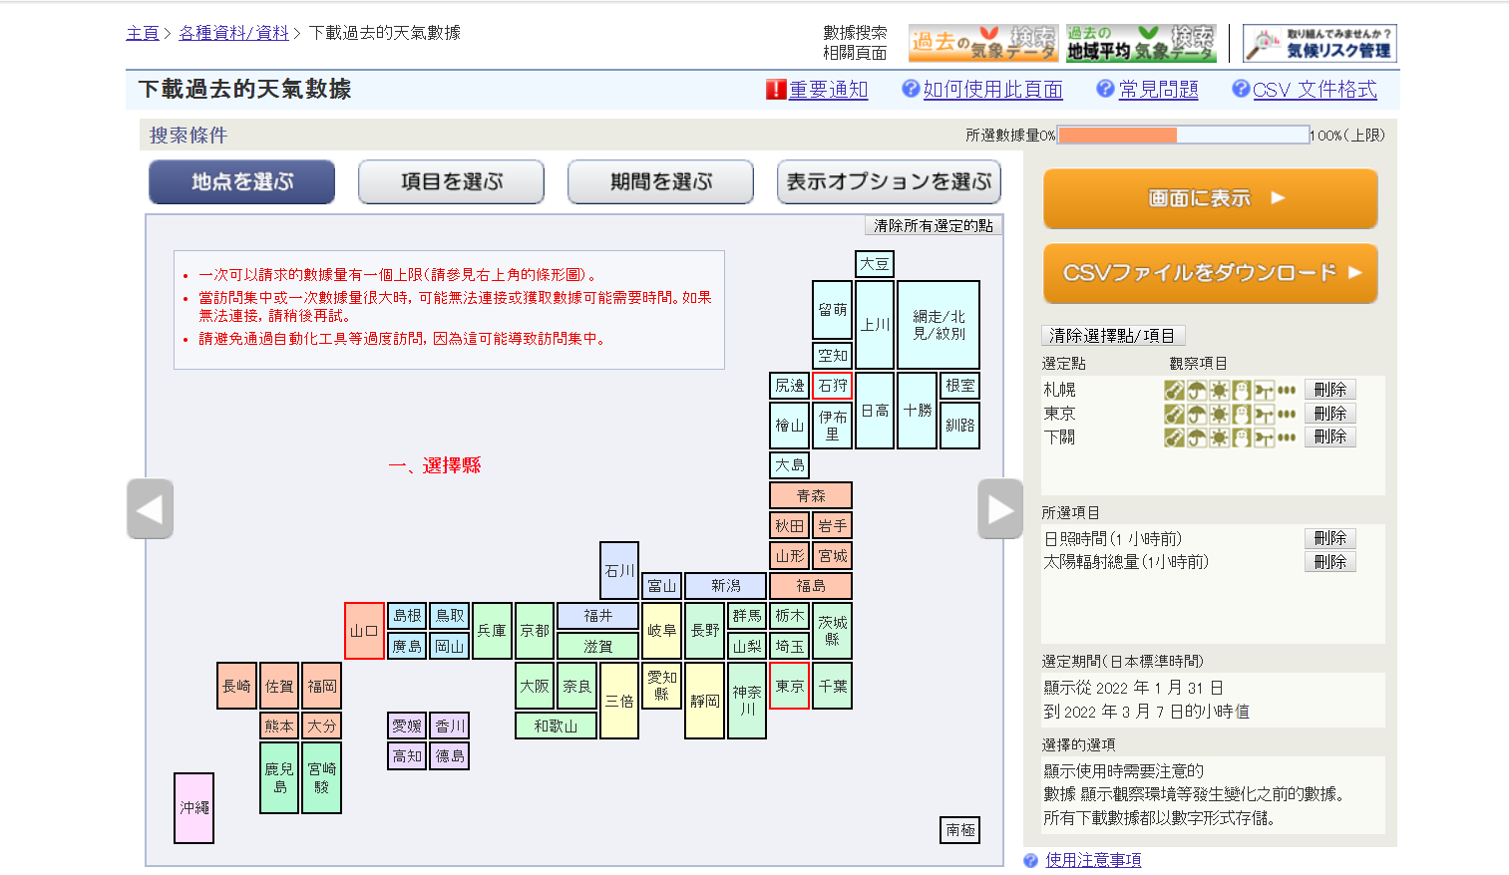
發電資料
相關數據

Slide 6
數據分析

Slide 7
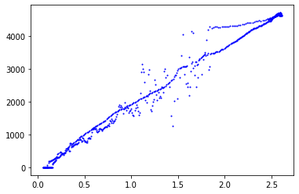
山口縣下關 2/14
Power – Sun Intensity
Power(W)
Sun Intensity (MJ/m^2)

Slide 8
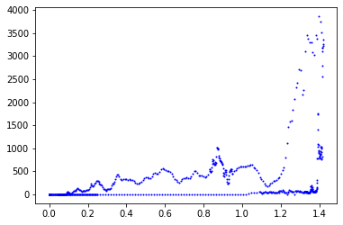
北海道札幌 2/20
Power-Intensity
Power (W)
Sun Intensity (MJ/m^2)

Slide 9
Method

Slide 10





DNN
Time
Weather
Location
Date
Notes:
normalization

Slide 11
結果分析

Slide 12
Predicted instance electricity generation vs. real scene for anomaly detection
Consider 3 standard deviation as well-predicted case
Compare general case to Sapporo’s special case

Slide 13

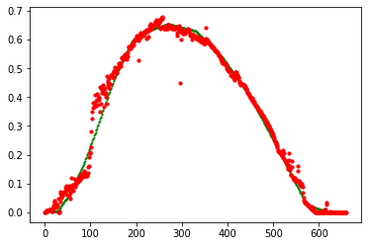
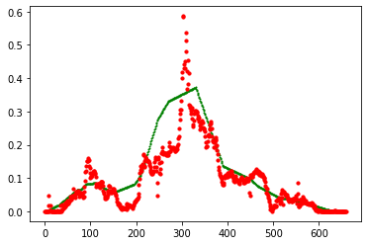
X：time [min]
Y：instance electricity generation [W/W]
Line：predicted data
Scatter：real data
2/2 Tokyo, sunny
2/20 Tokyo, cloudy

Slide 14
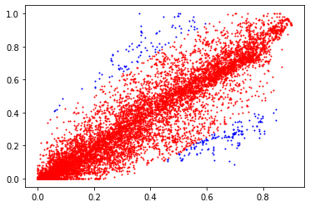
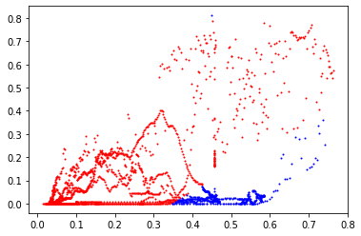
X：predicted instance electricity [W/W]
Y：real [W/W]
blue：abnormal point
Validation set
sunny + cloudy
2.3% abnormal
Validation set
Lightly snow
21.6% abnormal

Slide 15
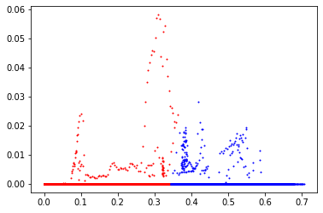
X：predicted instance electricity [W/W]
Y：real [W/W]
blue：abnormal point
Validation set
sunny + cloudy
2.3% abnormal
Validation set
Heavily snow
35% abnormal

Slide 16
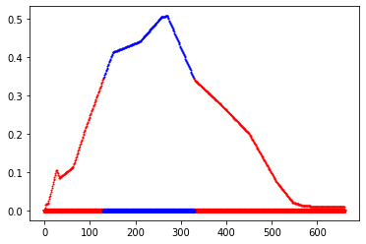
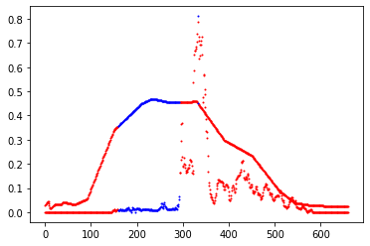
X：time [min]
Y：instance electricity generation [W/W]
Predicted data
Predicted data
real data
real data
2/1 Sapporo, heavily snow
24% abnormal
2/20 Sapporo, lightly snow
18.3% abnormal

Slide 17
Future

Slide 18

展望
資料量增加
更多合適 feature
更強的 model 架構(RNN, Transformer)

Slide 19

商業性
評估地區差異需求
整合應用程式

Slide 20
Thks ~
南瓜香菜不加

