Slide 1
ESLab Final Demo
謝宜展 高佑豪

Slide 2
動機
在網路上看到越來越多家科技公司在做個人語音助理，甚至有種百家爭鳴的感覺，不管是Google的Google Home還是Amazon的Echo，都讓人覺得很新潮，想要買一台來玩玩看，可是因為錢不夠而且取得不易，所以想說自己做做看。

Slide 3
Outline
虛擬管家(Rpi) + 智慧電風扇(Arduino)
透過講話下令
可以查詢天氣、時間、新聞
偵測室溫並透過BLE調節電風扇強度
可以播歌、控制音量
網路品質很重要

Slide 4
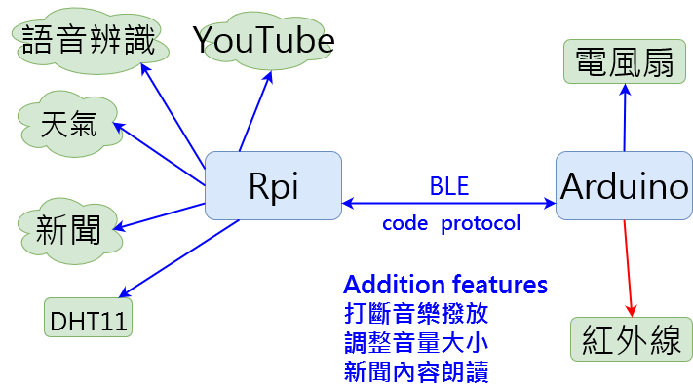
Project Overview

Slide 5
After progress report
Use Tizonia to search music on Youtube
Use Alsamixer to control volume
Solve BLE connection problem
Detect sound of claps to terminate music
Change the fan

Slide 6
After progress report
Use Tizonia to search music on Youtube
Use Alsamixer to control volume
Solve BLE connection problem
Detect sound of claps to terminate music
Change the fan

Slide 7
After progress report
Use Tizonia to search music on Youtube
Use Alsamixer to control volume
Solve BLE connection problem
Detect sound of claps to terminate music
Change the fan

Slide 8
After progress report
Use Tizonia to search music on Youtube
Use Alsamixer to control volume
Solve BLE connection problem
Detect sound of claps to terminate music
Change the fan

Slide 9
After progress report
Use Tizonia to search music on Youtube
Use Alsamixer to control volume
Solve BLE connection problem
Detect sound of claps to terminate music
Change the fan

Slide 10
After progress report
Use Tizonia to search music on Youtube
Use Alsamixer to control volume
Solve BLE connection problem
Detect sound of claps to terminate music
Change the fan

Slide 11
使用工具/套件
RedBear Shield
L298N
DHT11
USB音效卡
直流馬達(小電扇)

Slide 12
使用工具/套件
Speech Recognition / gtts
Tizonia
Pexpect / Gatttool
Requests / BeautifulSoup

Slide 13
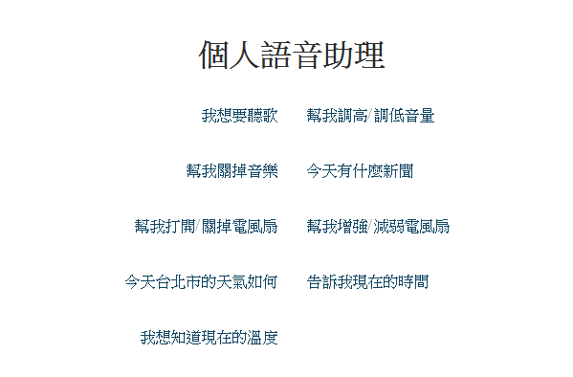
Project Overview
Use Tizonia to search music on Youtube
Use Alsamixer to control volume
Solve BLE connection problem
Detect sound of claps to terminate music
Tizonia
Subprocess
Tizonia
Noise measure
爬蟲
gTTs
BLE
Pexpect
BLE
Pexpect
Rpi system time
爬蟲
gTTs

Slide 14
參考資料
Rpi forum
Stack Overflow
Github
各套件 docunment

Slide 15
DEMO

Slide 16
DEMO
現在時間
現在溫度
音樂播放
天氣預報
新聞播報
家具控制(電風扇)

Slide 17
DEMO
現在時間
現在溫度
音樂播放
天氣預報
新聞播報
家具控制(電風扇)

Slide 18
DEMO
現在時間
現在溫度
音樂播放
天氣預報
新聞播報
家具控制(電風扇)

Slide 19
DEMO
現在時間
現在溫度
音樂播放
天氣預報
新聞播報
家具控制(電風扇)

Slide 20
DEMO
現在時間
現在溫度
音樂播放
天氣預報
新聞播報
家具控制(電風扇)

Slide 21
DEMO
現在時間
現在溫度
音樂播放
天氣預報
新聞播報
家具控制(電風扇)

Slide 22
DEMO
現在時間
現在溫度
音樂播放
天氣預報
新聞播報
家具控制(電風扇)

