Slide 1
BLE mouse with handwriting recognition
劉人廣 王奕倫

Slide 2
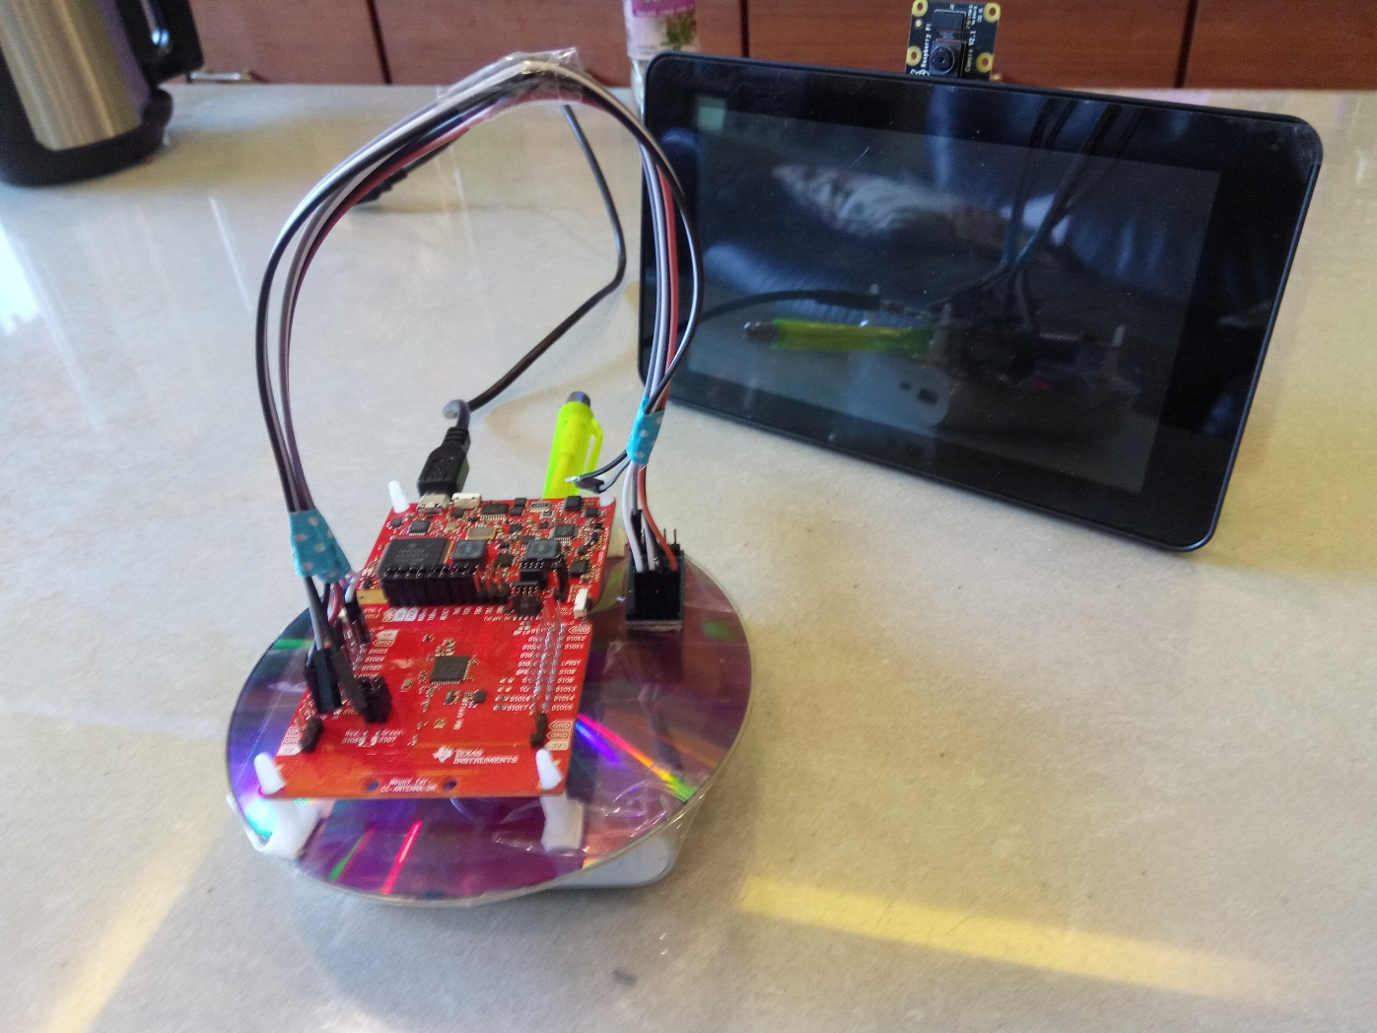

Slide 3
Components
Raspberry Pi
CC26X2
ADXL345
PiCamera

Slide 4
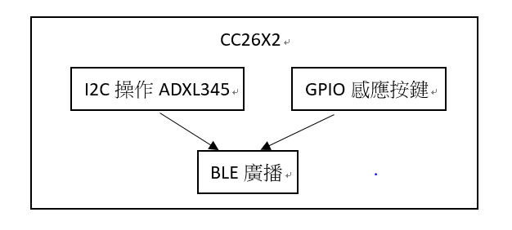
CC26X2

Slide 5
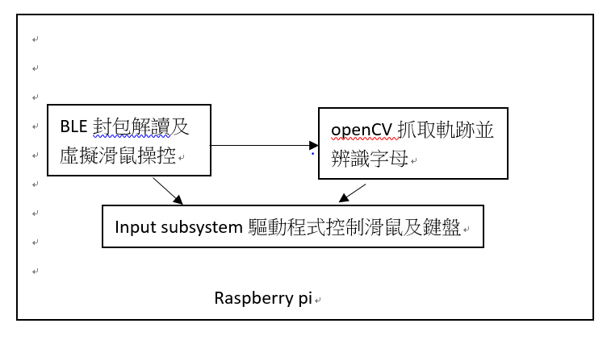
Raspberry Pi

Slide 6

Handwriting Recognitions
Use PiCamera to capture image.
Python + OpenCV + Tesseract
Object Movement Tracking
Output Trajectory Image
Word Recognitions with Tesseract

Slide 7


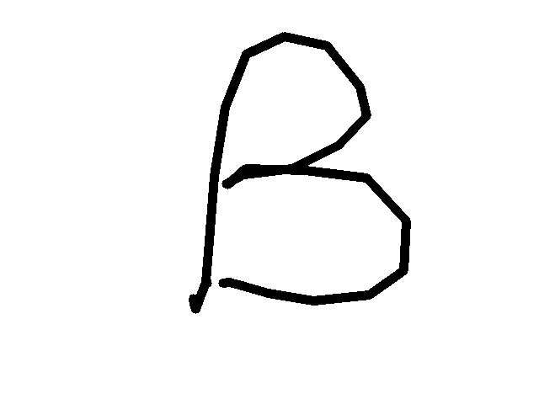



Object Trajectory => Handwritten Words

Slide 8
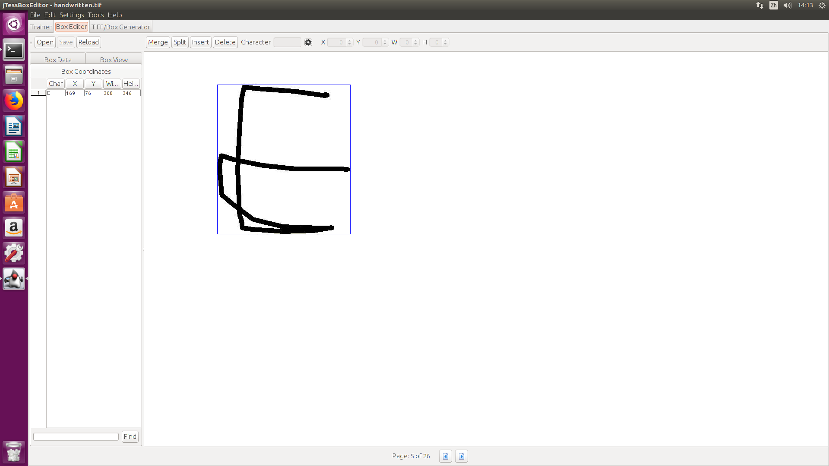
Tesseract Training

Slide 9
Future Works
Add lower case character and punctuation mark

