Slide 2
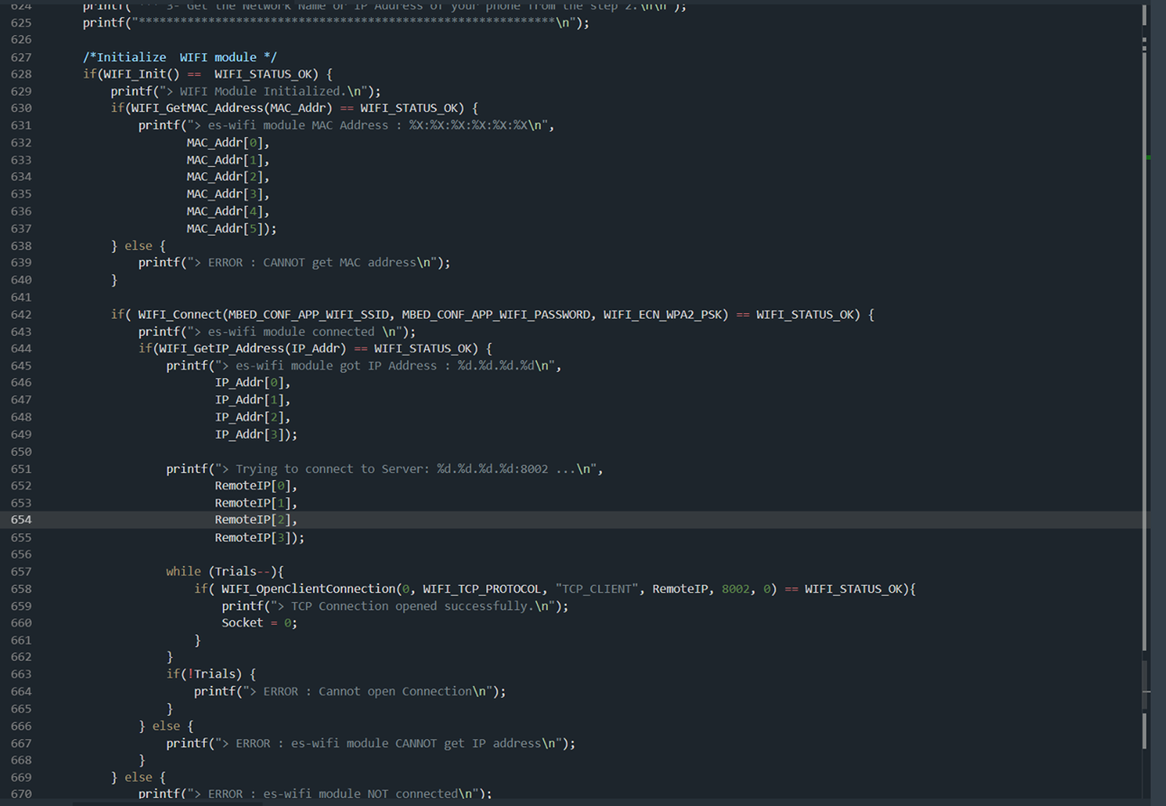
What we’ve done
Connect STM with Rpi via WI-FI

Slide 3
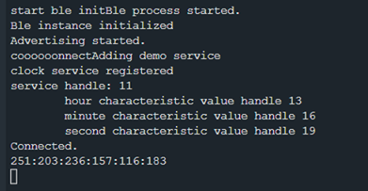
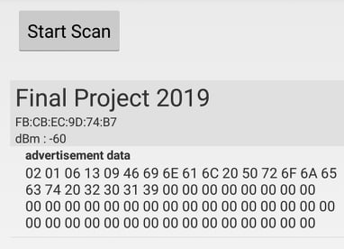
What we’ve done
Connect smartphone with STM via BLE

Slide 4
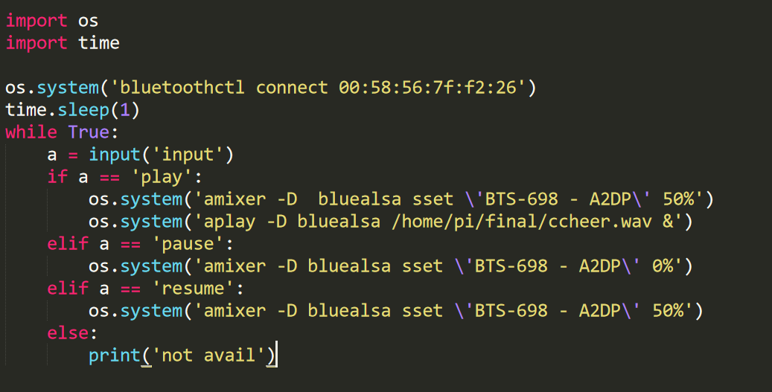
What we’ve done
Connect bluetooth speaker with rpi via rpi build in module

Slide 5
Difficulties
Trying to integrate tcp and ble on stm board

