Slide 1
自帶BGM

Slide 2
Motivation
Smart Home is a major part of the IOT application
When you’re listening music, and you want to move to another room
Our system enables the music “move with you” to another room

Slide 3
HTTP
Server
Application
TCP, UDP, BLE, Bluetooth
Room 1
Room N
Stereo
Stereo
Light
Light
Air con
Air con

Slide 4

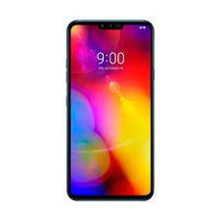
Server
Room 1
Room 2
BLE scanner
BLE scanner
ON
OFF
Stereo
Stereo

Slide 5
Server
Room 1
Room 2
BLE scanner
BLE scanner
OFF
ON
Stereo
Stereo

Slide 6
Materials
Rpi(Server)
STM32(BLE scanner) * 2
Bluetooth speaker * 2
Smartphone

Slide 7
Thanks for listening

Slide 8
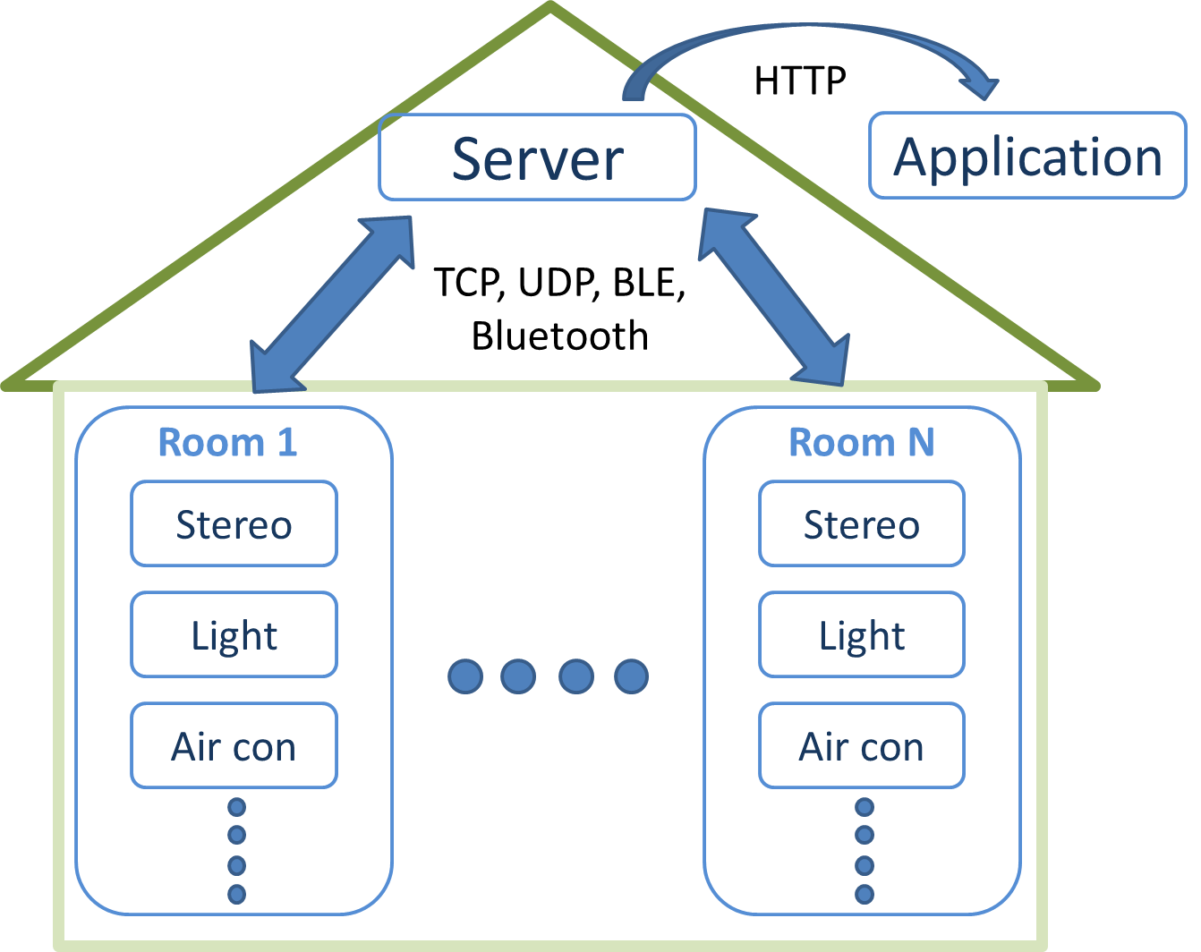

Slide 9
Server
Room 1
Room 2
BLE scanner
BLE scanner
ON
OFF
Stereo
Stereo

Slide 10
