Slide 1
Auto Watering
賴永玄 黃奕呈 李崇嘉

Slide 2
Motivation
Many people have plants in their home. The plants may die because the owner forgot to water it。Therefore, we built an device that is able to monitor the humidity of the soil and notify the user. The user can then control the device to water the plants using other devices.

Slide 3
Implementation

Slide 4
Structure
Request
Rpi (server & data base)
Request
STM32
(sensor & watering device)
user
Data
Humidity

Slide 5
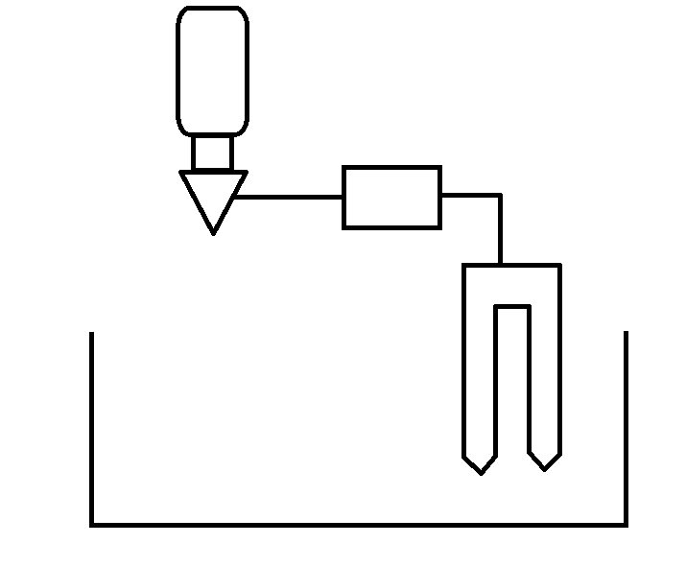
Structure
Water Bottle
Solenoid Valve
STM32
Soil humidity sensor
The Plant

Slide 6
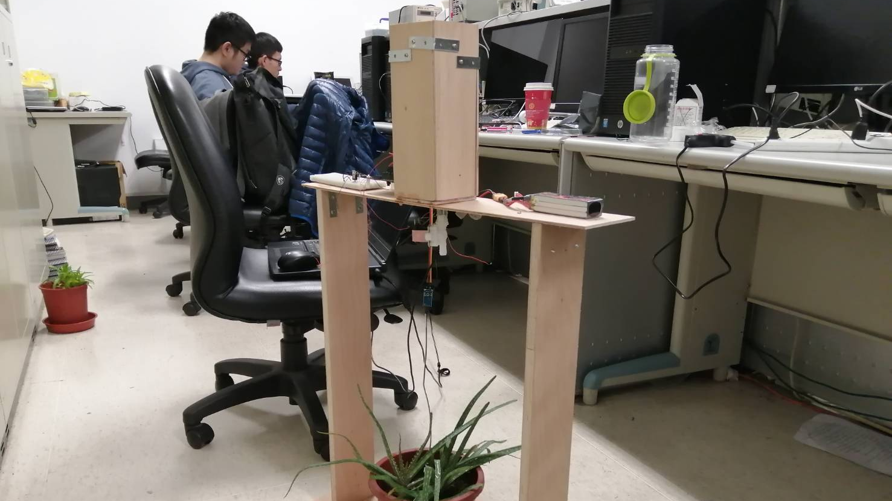
Water Bottle
Circuit board & STM32
Battery
Solenoid valve
Plant & sensor

Slide 7
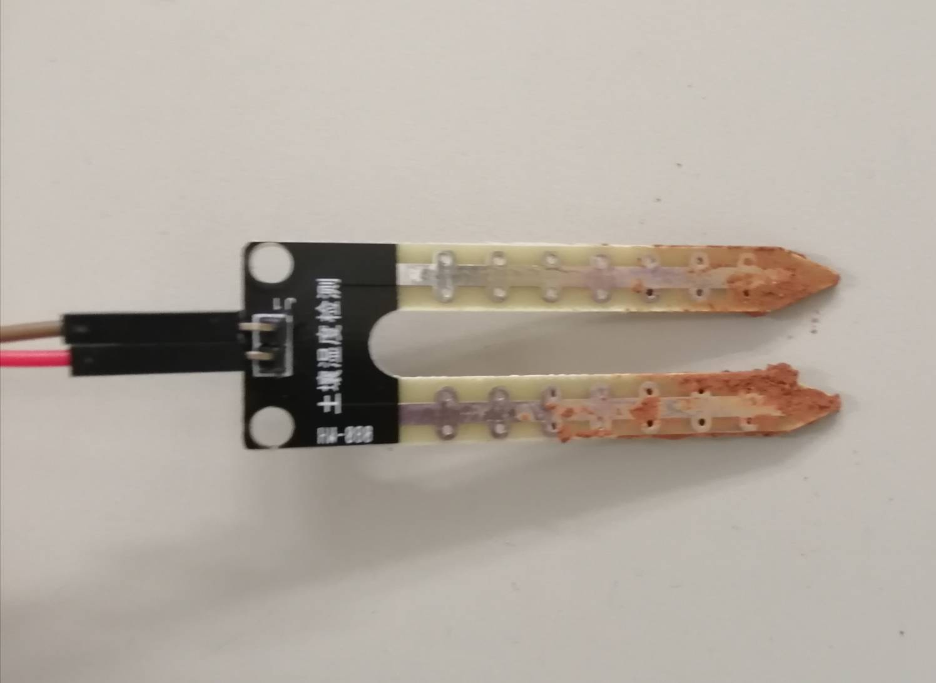
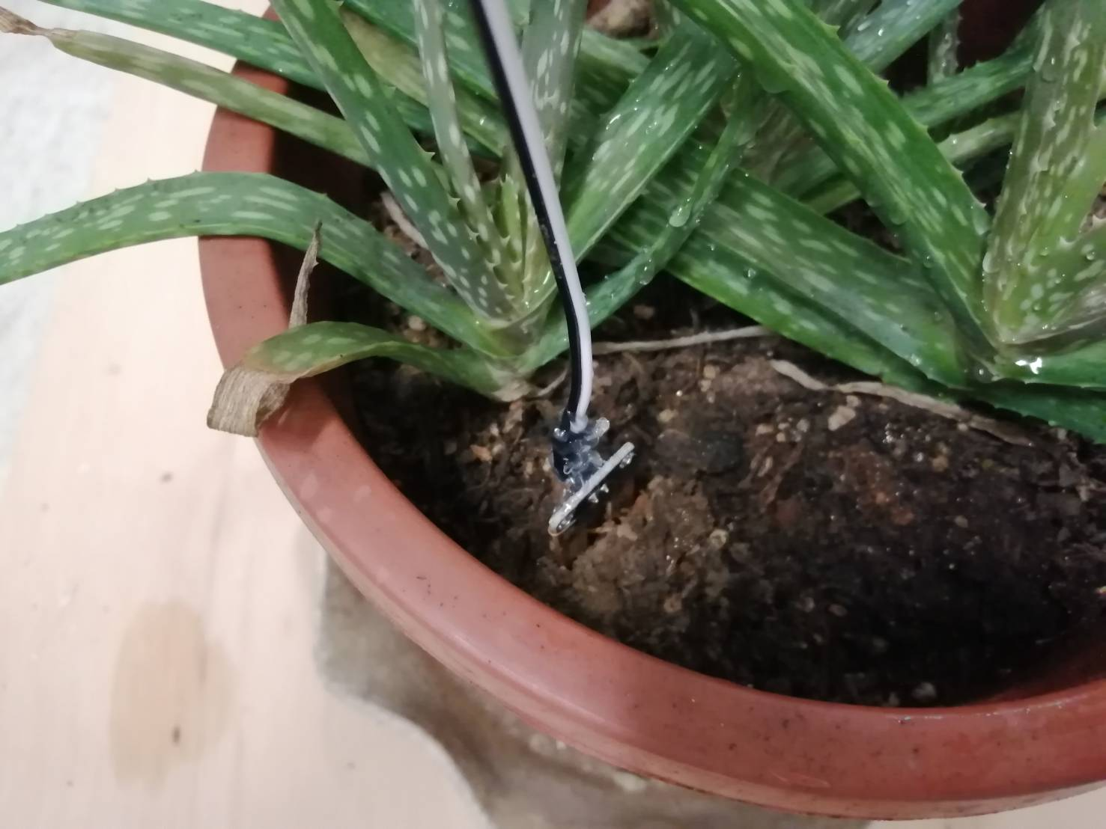
Soil humidity sensor

Slide 8
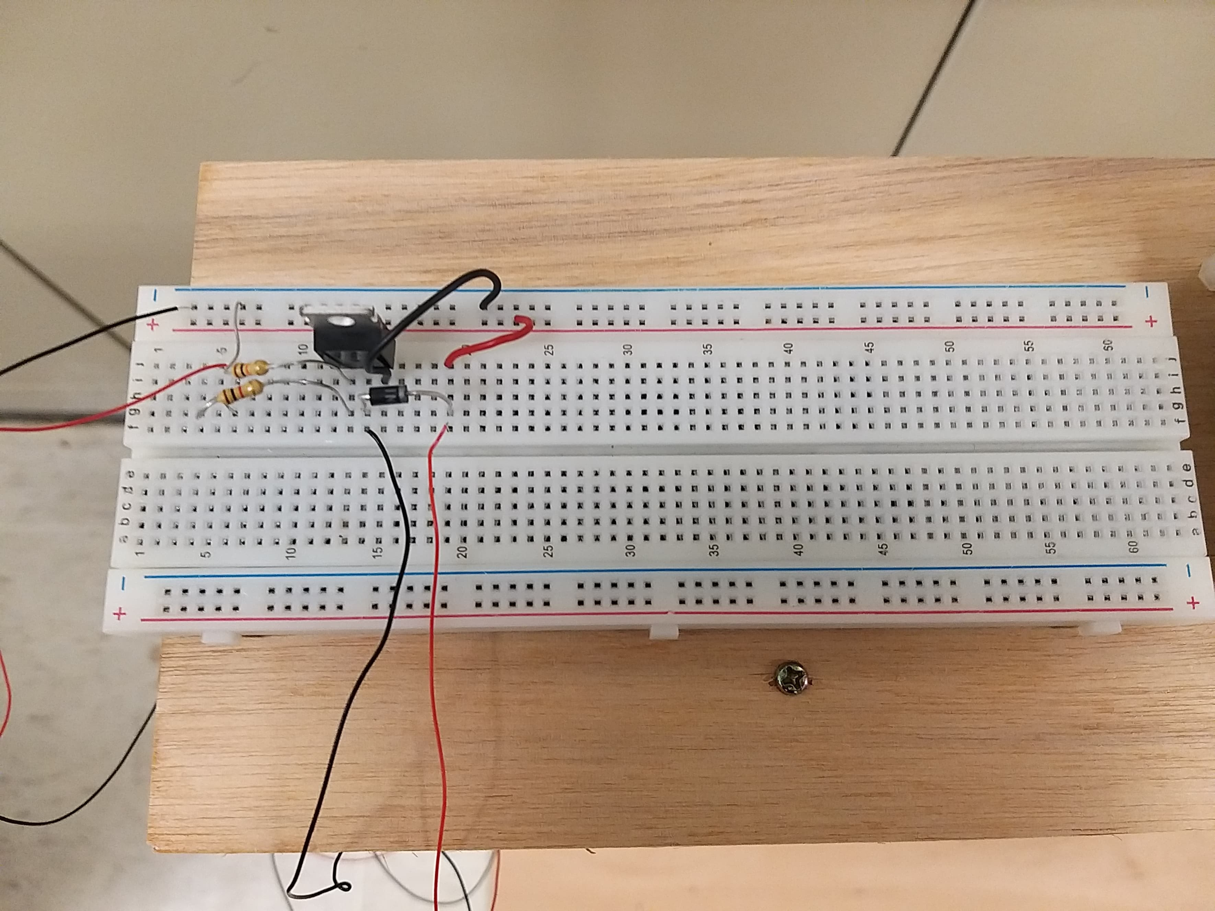
Control of the solenoid valve
We use a NMOS to control the solenoid valve.
When the user wants to water the plant, STM32 applies 3.3V to the gate of the NMOS, the valve will then open, letting the water to go through.

Slide 9
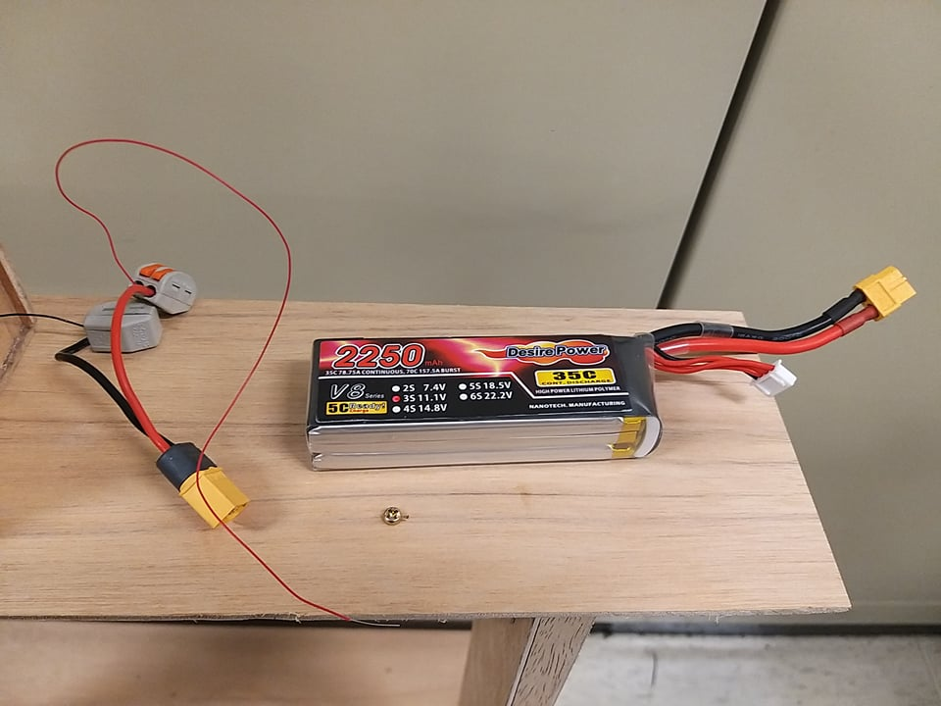
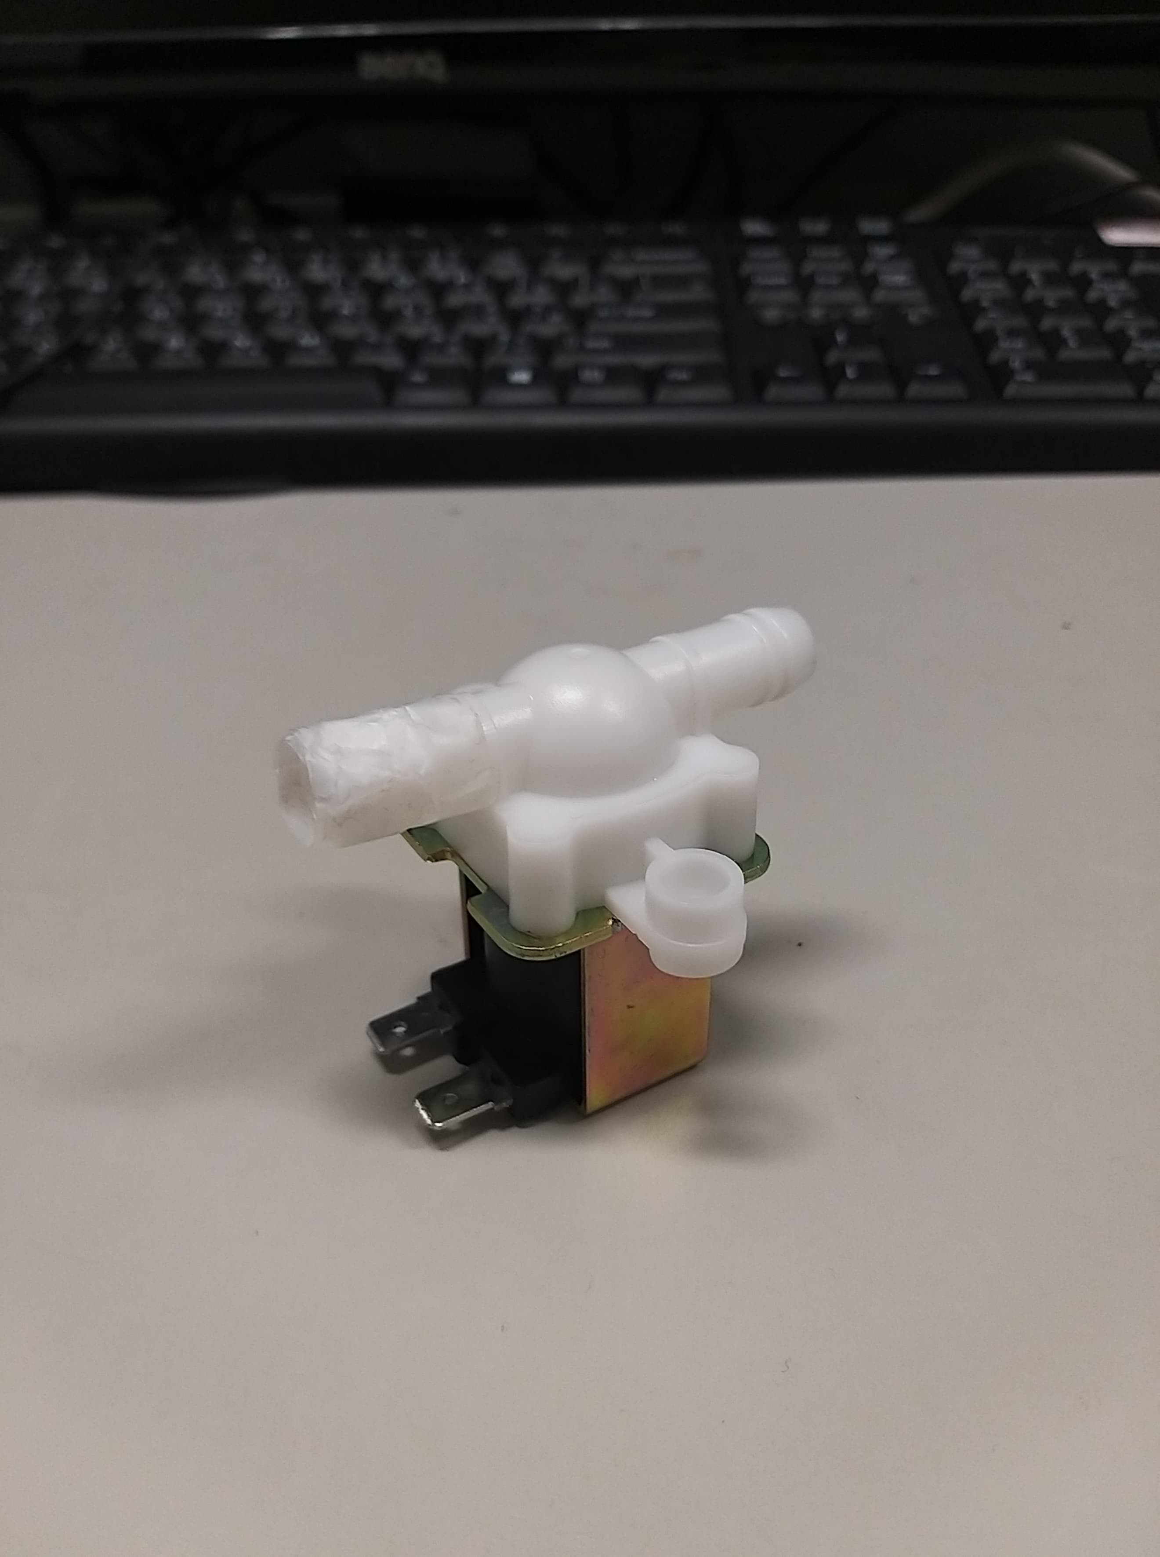
Control of the solenoid valve
Battery
Solenoid valve

Slide 10
Results

Slide 11
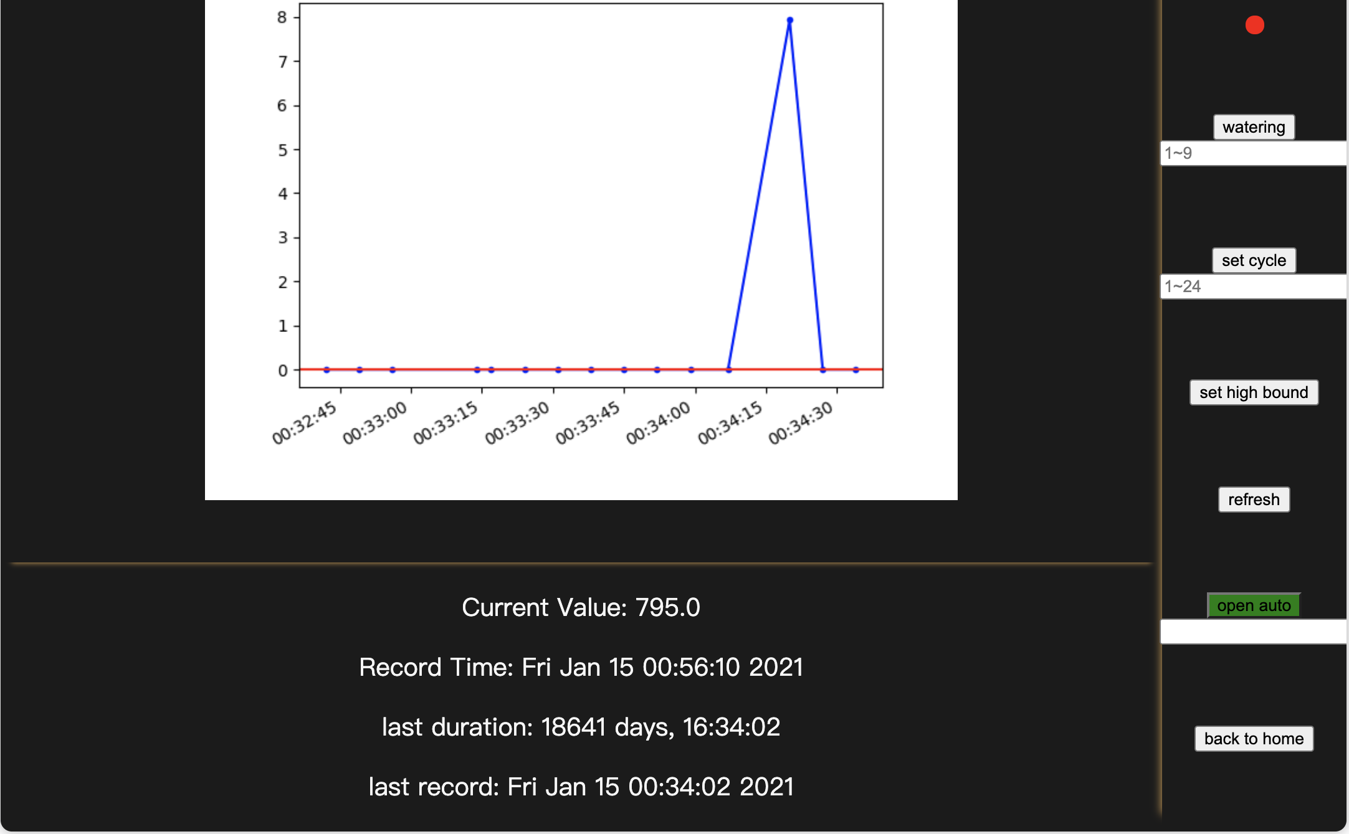
Monitoring the humidity of the soil
User can water the plant whenever and can decide the volume
User can set the measuring cycle
User can set “high bound”
Once the soil becomes too dry (measured number exceeding “high bound”), the device will automatically water the plant
High bound

Slide 12
Watering
https://youtu.be/73aWDA98Z_M

Slide 13
References
https://twsf.ntsec.gov.tw/activity/race-1/54/pdf/040801.pdf
https://os.mbed.com/docs/mbed-os/v6.6/introduction/index.html
https://blog.everlearn.tw/wp-content/uploads/2017/12/raspberry_pi_dc_motor_mosfet_bb.png

