Slide 1
GRD cultivator
cultivate your good habit of reading distance
周光照 李達緯

Slide 2
Motivation
We want to utilize the techniques we have learnt this semester to design a device helping people cultivate a good habit of reading.
Now that some people nowadays reading with the book holder, when the distance between our eyes and the book is shorter than 35 cm, our BLE client device will raise the alarm.
We can transmit data via BLE once in a while for further analysis or minitoring

Slide 3


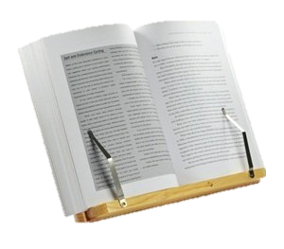
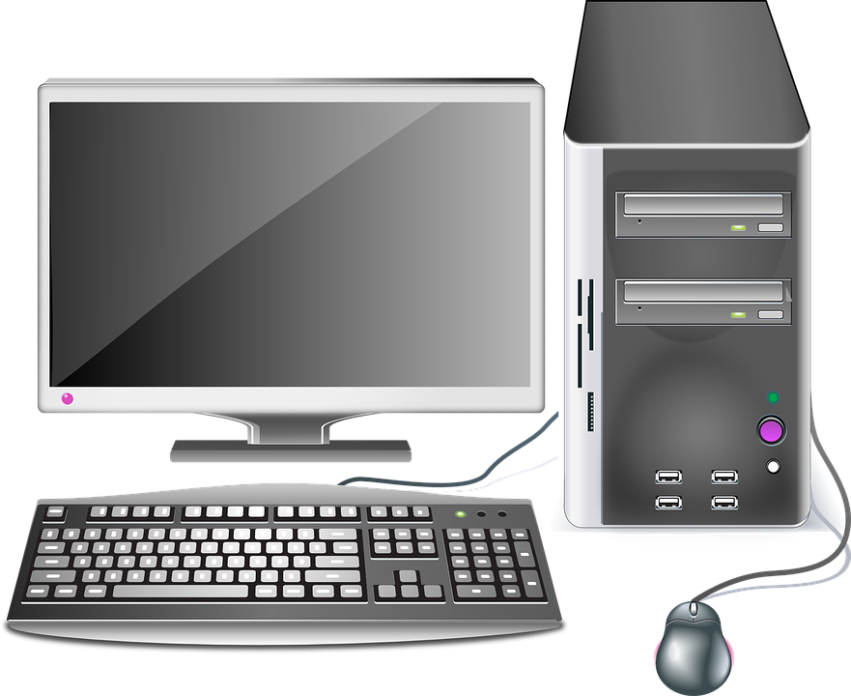

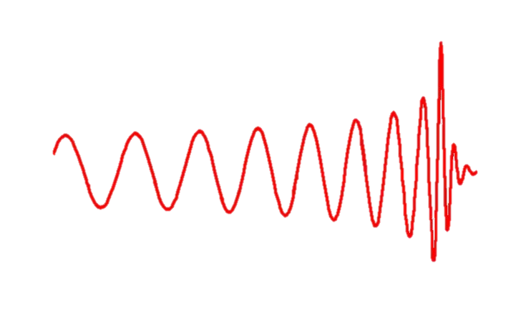
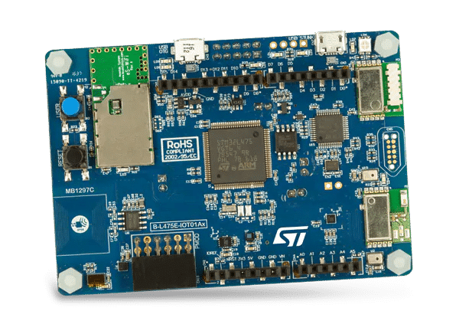
Scenario
BLE Server
BLE Client

Slide 4
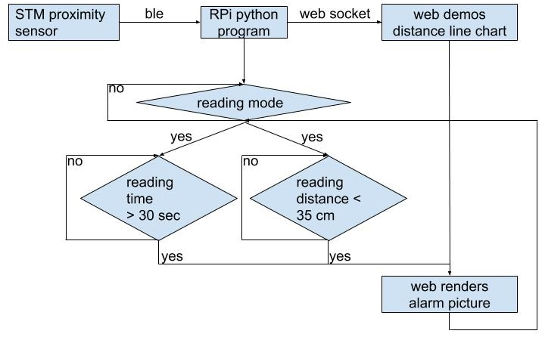
Flow Chart
Notes:
flow chart:
https://docs.google.com/document/d/17EiVGn_aQuJ83O2xruDPOz6xIR-BHW7MCjttB2zVFxE/edit

Slide 5
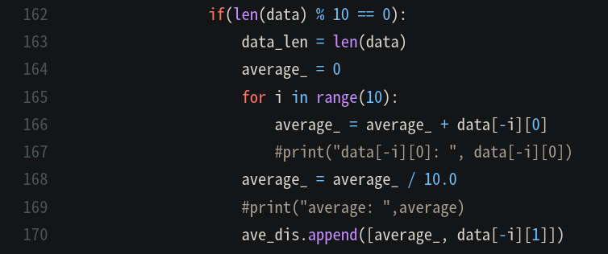
Simple Filter

Slide 6
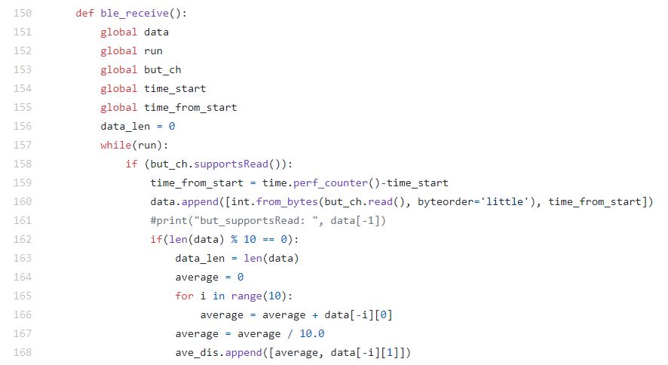

Multi-threading (1)
BLE receiving data

Slide 7
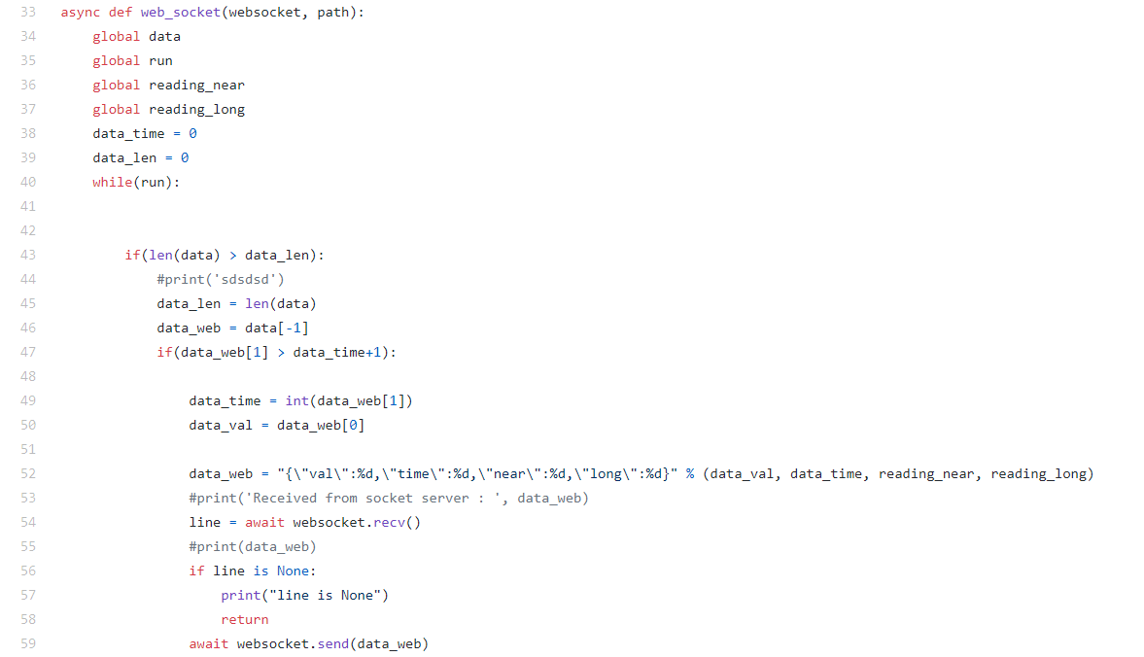
Multi-threading (2)
web socket

Slide 8
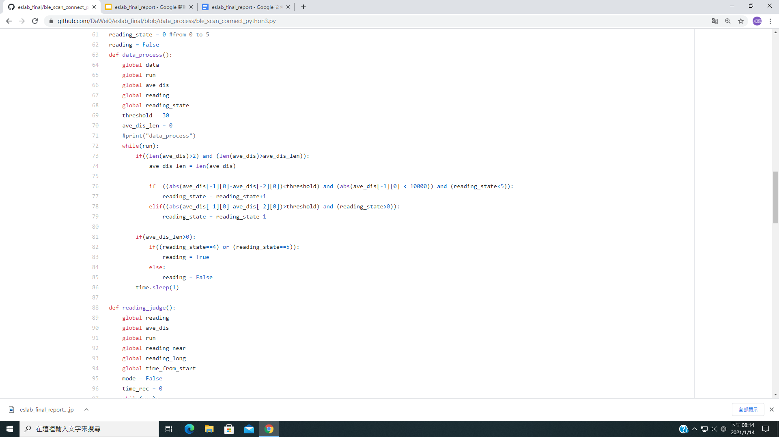
Multi-threading (3)
judgement of reading_mode

Slide 9
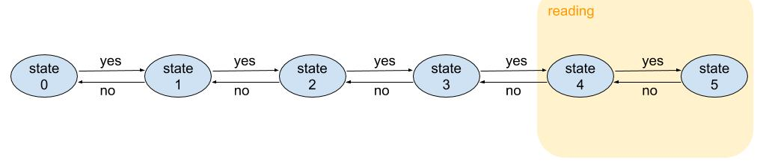
Finite States of Reading Mode
reading_mode

Slide 10
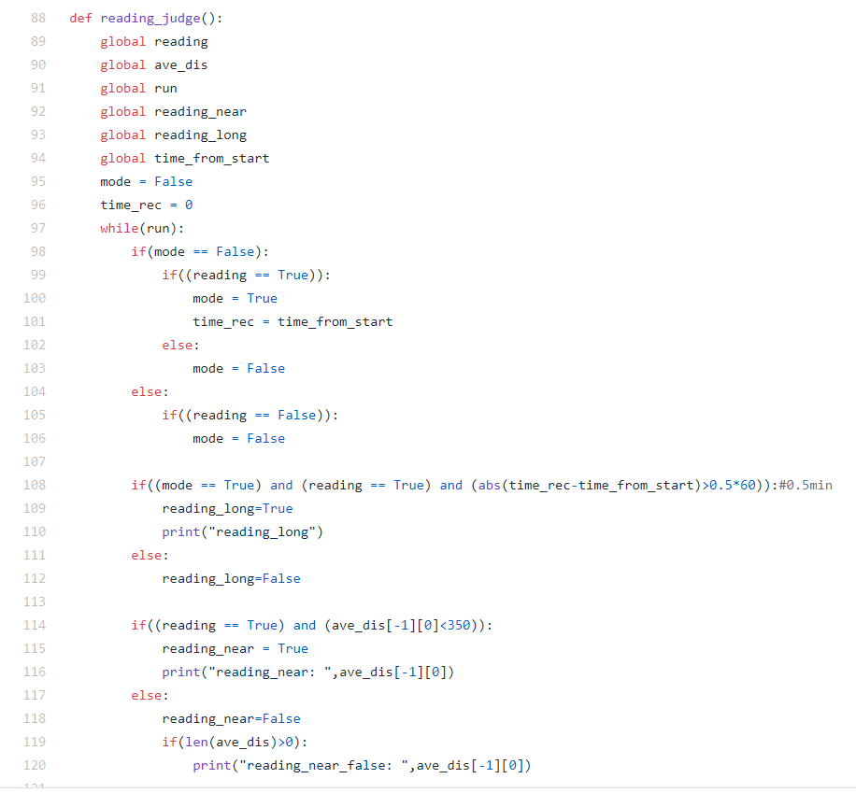
Multi-threading (4)
judgement of too near or too long

Slide 11
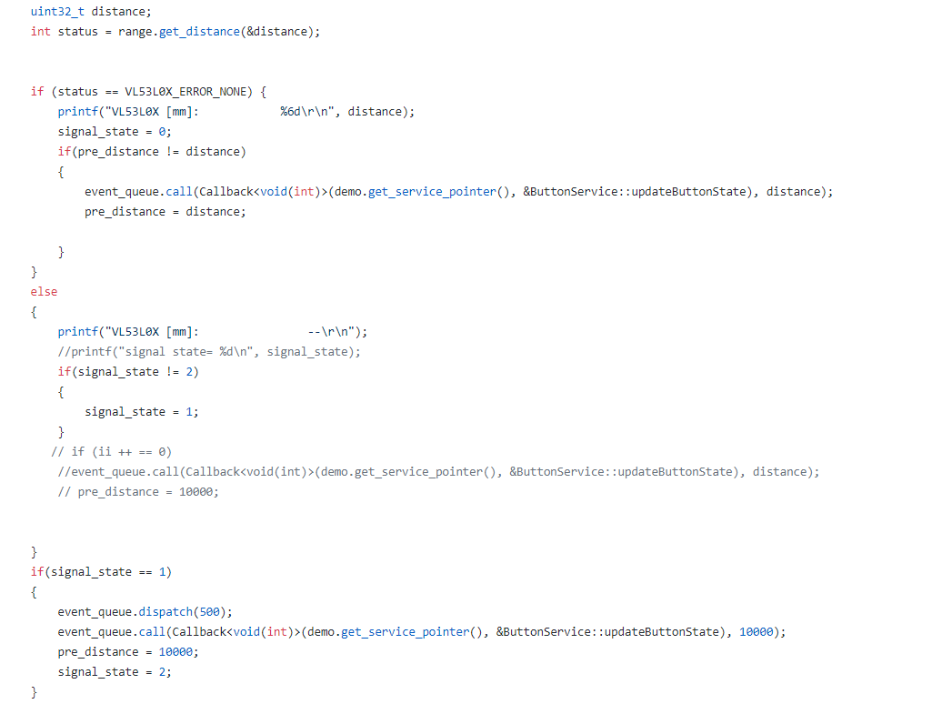
Ranging & BLE
Set 10000 if no signal detected
Once the distance changes, send new data

Slide 12
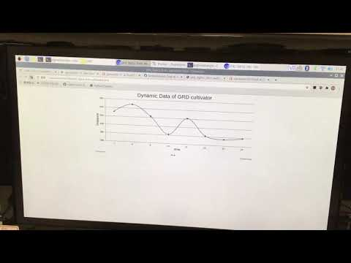
Demo: proper posture
https://youtu.be/_5SVkgfkps0

Slide 13
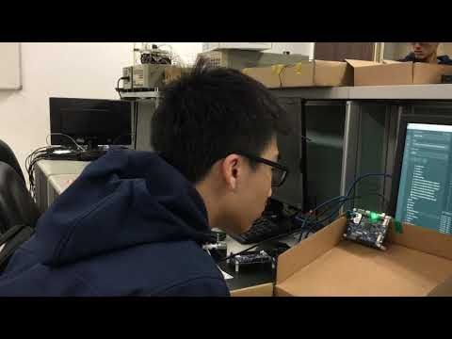
Demo: reading too near
https://youtu.be/xJ9MZhZMEdM

Slide 14
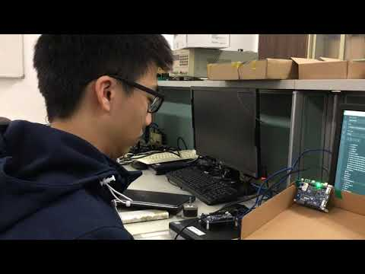
Demo: reading too long
https://youtu.be/fguUoNTII1U

Slide 15
Work Distribution
李達緯
Python data processing
Websocket implementation
Report
周光照
Mbed ranging sensor enablement
BLE server broadcast
Web design

Slide 16
Reference
http://os.mbed.com/teams/ST/code/HelloWorld_ST_Sensors/

