Slide 1
GRD cultivator
20201224 周光照 李達緯

Slide 2
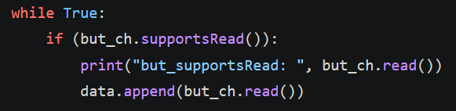
BLE: notification

Slide 3
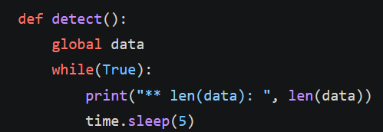
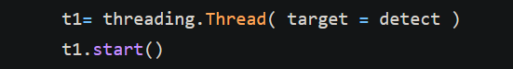
Multi-thread

Slide 4
Sensor Data Transmission
With HW5 source code, we can easily modify it to allow required data transmission
However, the single-minded design of the BLE source code make it complex to merge with ranging sensor source code
Current idea is to put the functionality of ranging in the BLE module, so we can operate measuring and sending data in a single function call

Slide 5
After sending data successfully
May add more device functionality
Create web socket server and web server to demonstrate the output

