Slide 1
嵌入式實驗
組員: 陳妍喻、廖耕毅、門玉仁

Slide 2
Topic – Mintendo Switch Online
Motivation : Use STM32 as game controller in Mario Kart game
Expected results :
Steering wheel :
Control the direction of kart
Handle some movements in the game, for example throwing objects to opponents, acceleration…, through some additional i/o buttons
Accelerator :
Tied on feet, the faster you move the quicker your kart will run

Slide 3
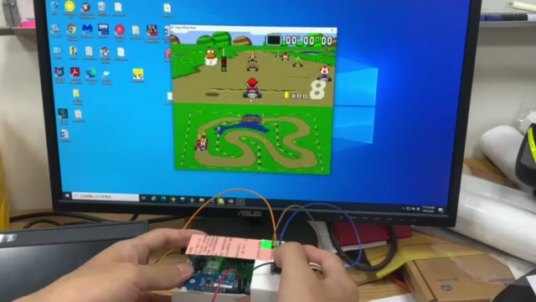
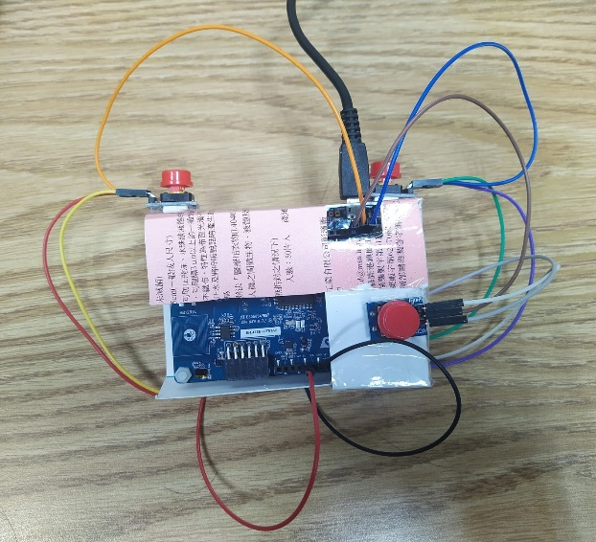
Structure and Demo Clip
Stm32 client computer server manipulate keyboard
wifi
keyboard api

Slide 4
Progress
Project function properly
Controller design
Parameters reading, modifying and transmission
Wifi server-client setting
Keyboard manipulation…
Shorten STM sensor calibration time
Solving lost of signals for too frequent pressing button issue
Solving server-client connection interruption issue
Program structure maintenance

Slide 5
Still Existing Problems
Low energy consumption data processing method
STM insensitive detection issue
Redirecting to unconnected server issue
User friendly setting for STM motion to correspond to keyboard button, which makes the controller to be universal

Slide 6
Future Work after Mario Kart game….
Design STM 32 to be a general purpose controller for video games, with accelerometer, gyroscope, buttons to enhance gaming experience
Novelty: General purpose game controller, ex: playing baseball, driving car, play flappy birds…

Slide 7
Thanks for your attention~

