Slide 1

B07901031 吳軍霆
B07901143 周子庭
2020
Nod Off Notification

Slide 2
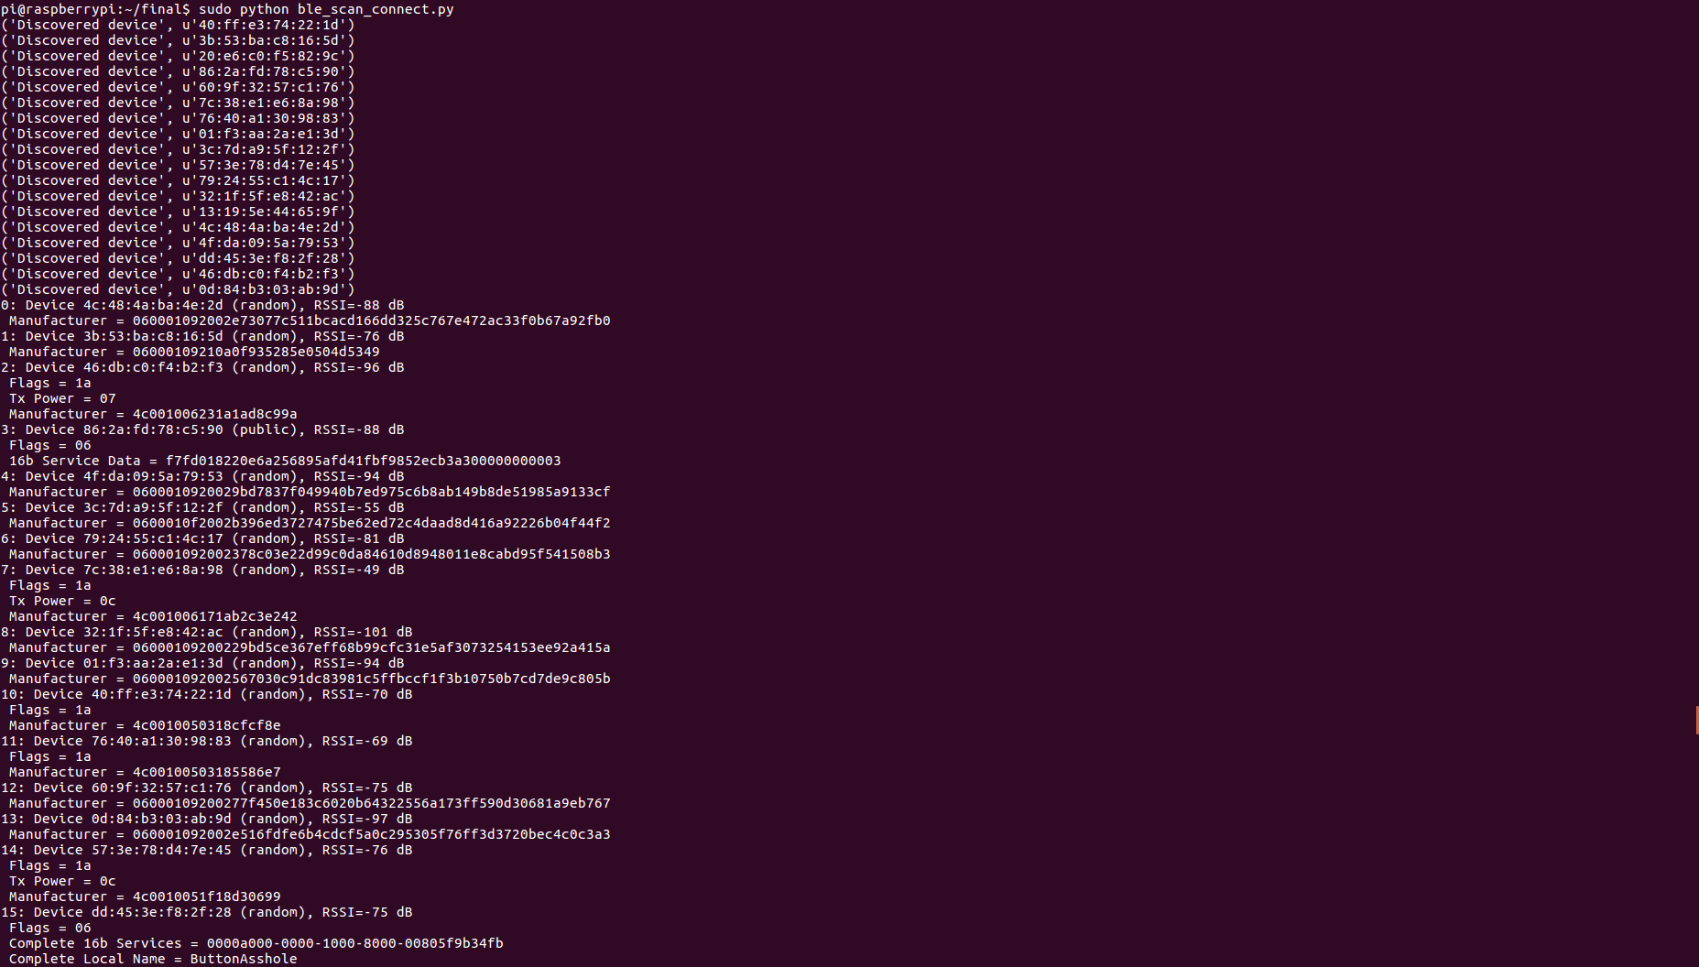
Notes:
Ble

Slide 3
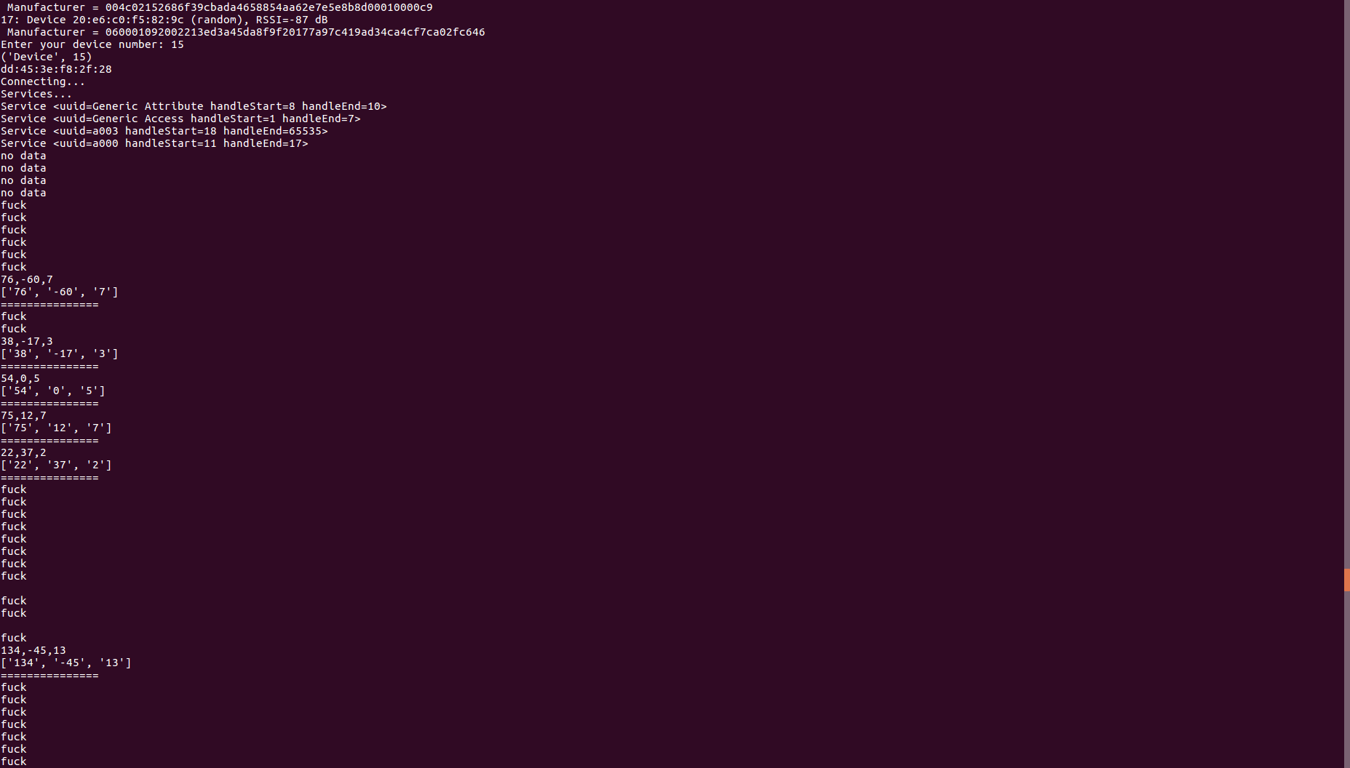
Notes:
用按鈕控制開始偵測

Slide 4
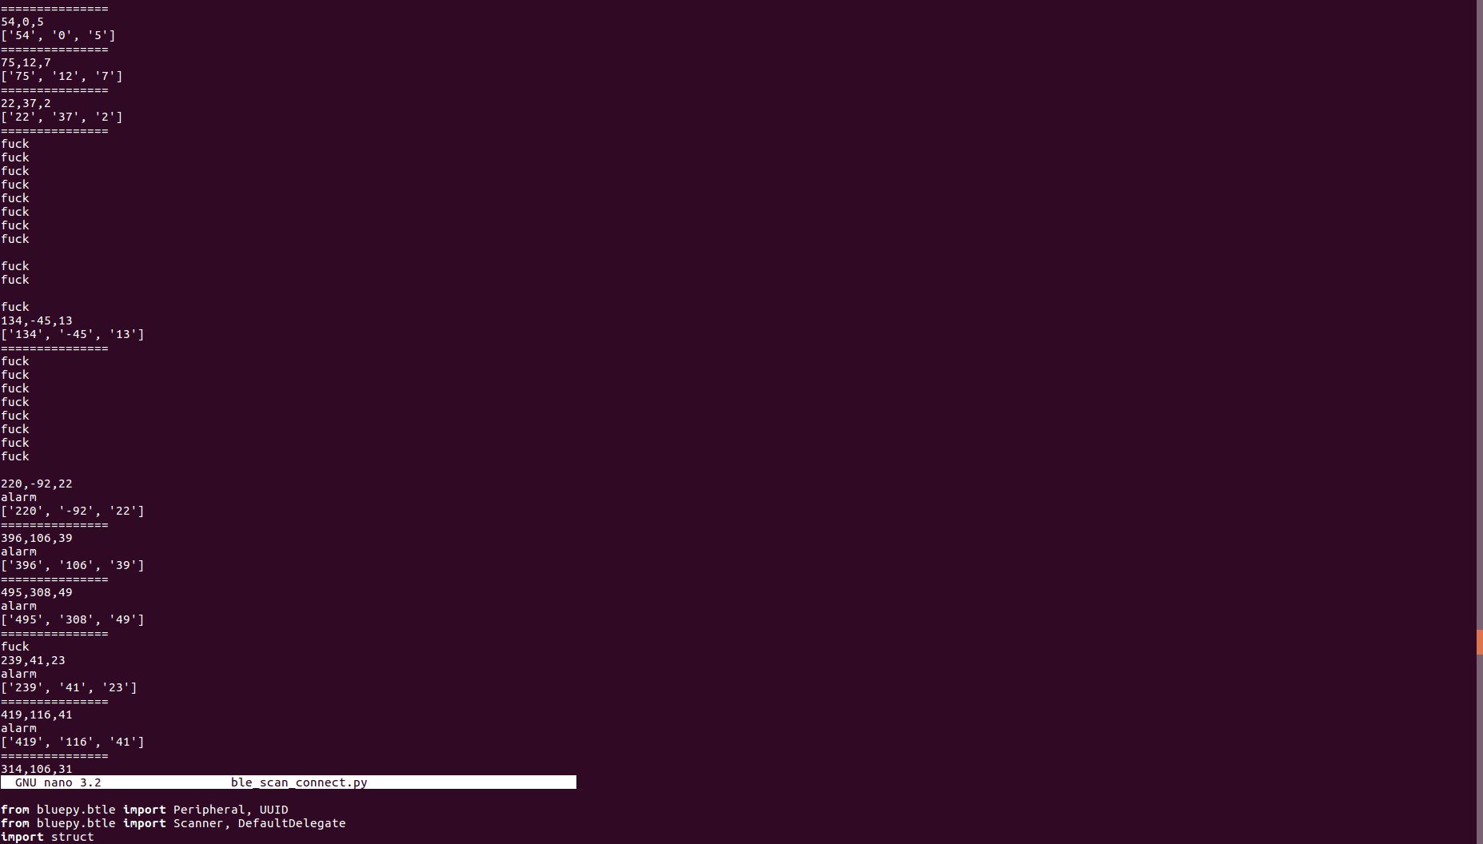
Notes:
alarm加入用stm作為控制data是否釋出

Slide 5
Thanks for your listening

