Slide 1


Slide 2
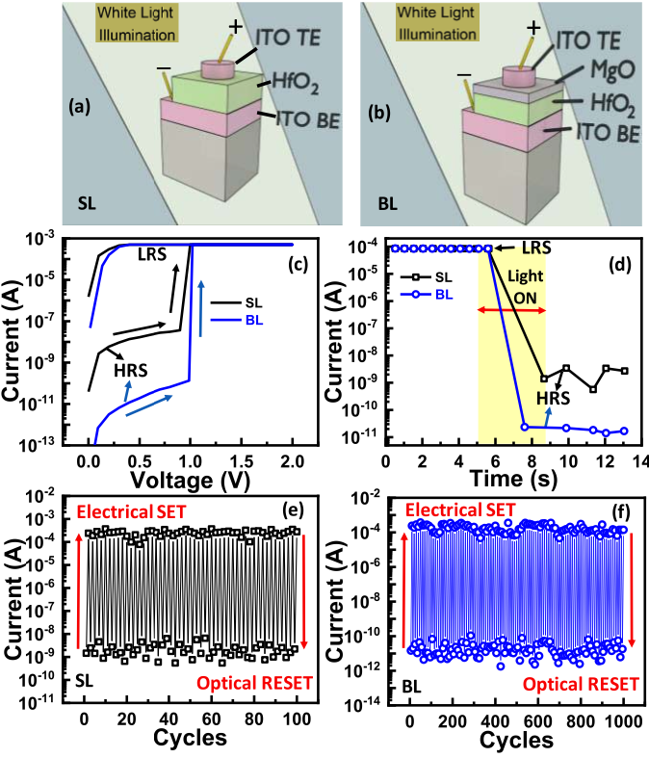
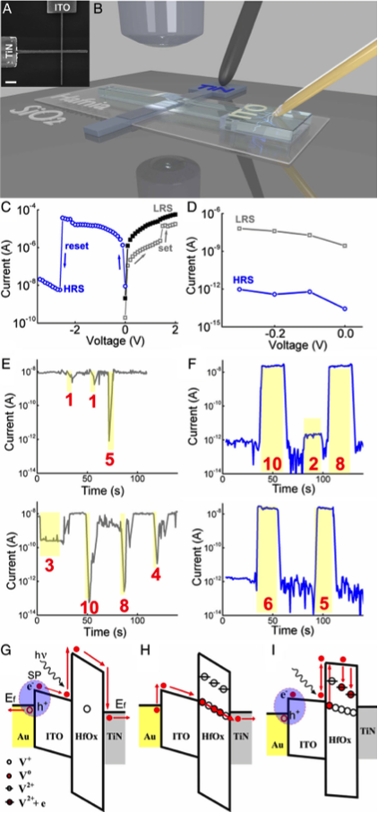
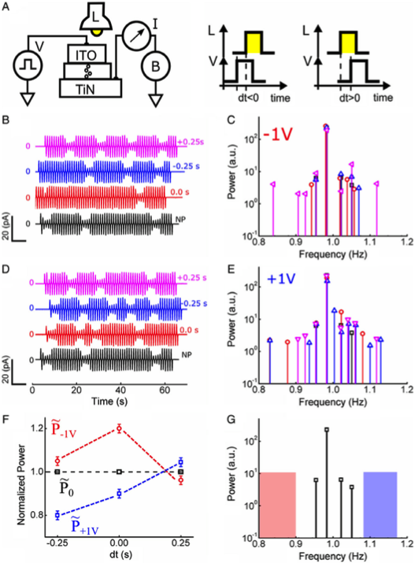
Kumar, D., et al. (2020). "Visible Light Detection and Memory Capabilities in MgO/HfO₂ Bilayer-Based Transparent Structure for Photograph Sensing." IEEE Transactions on Electron Devices 67(10): 4274-4280.
Berco, D., et al. (2020). "An Optoneuronic Device with Realistic Retinal Expressions for Bioinspired Machine Vision." Advanced Intelligent Systems 2(2): 1900115.

