Slide 1
Transformer
報告人：洪鳴憲

Slide 2

Sequence-to-sequence (Seq2seq)
Input a sequence, output a sequence
The output length is determined by model.
Speech
Recognition
你
好
嗎
N
T
機
器
學
習
Machine
Translation
machine
learning
N
N’
machine
learning
機
器
學
習
Speech
Translation

Slide 3
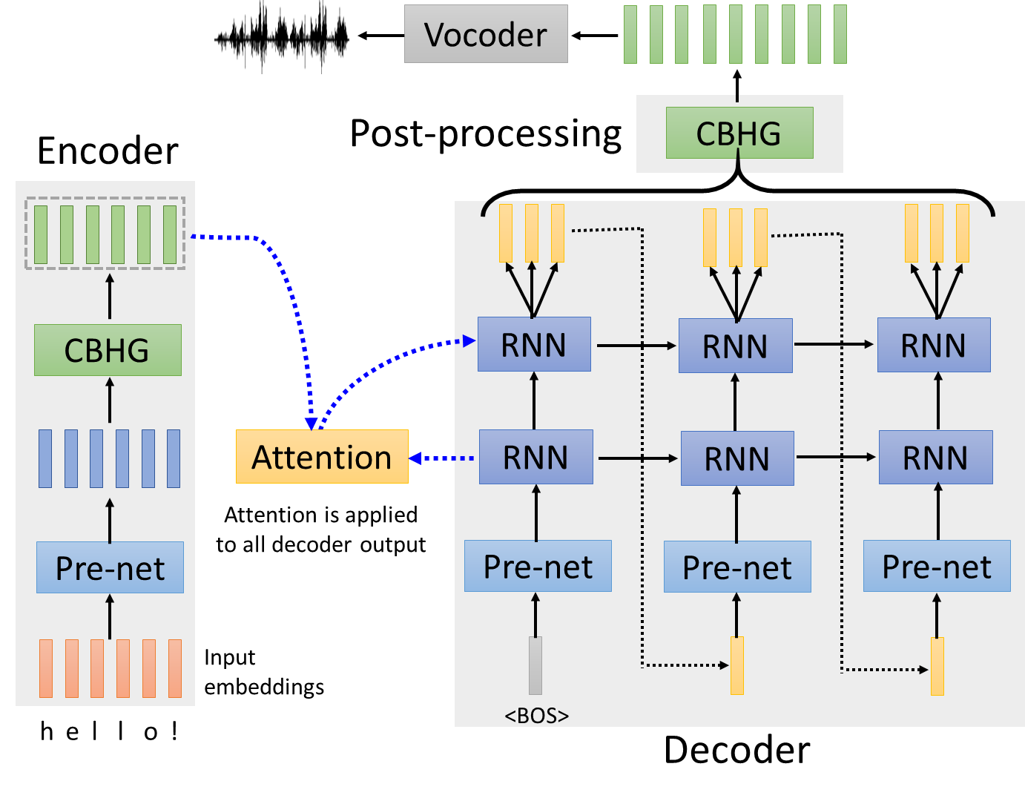
Text-to-Speech (TTS) Synthesis
Taiwanese Speech Synthesis
歡迎來到台大語音處理實驗室
最近肺炎真嚴重，要記得戴口罩、勤洗手，有病就要看醫生
ecotron model

Slide 4
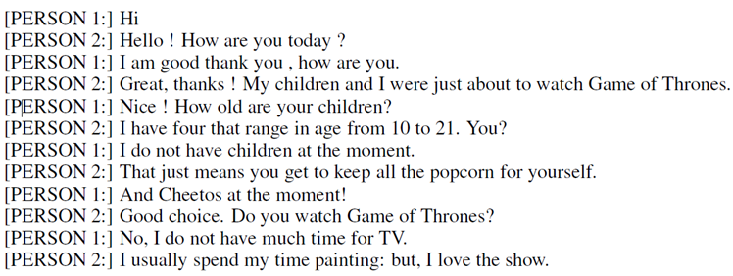
Seq2seq for Chatbot
“Hello! How are you today?”
seq2seq
input
response
“Hi”
Training
data:

Slide 5
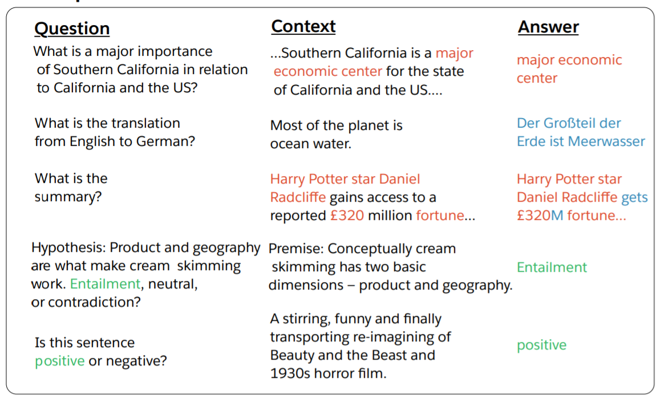
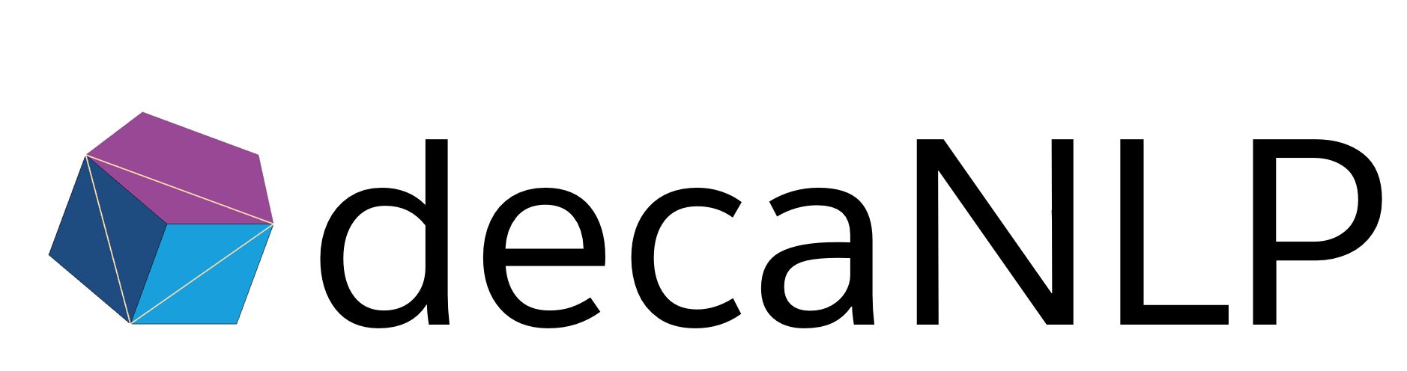
Most Natural Language Processing applications …
Question Answering (QA)
QA can be done by seq2seq
Seq2seq
question, context
answer

Slide 6
Seq2seq for Syntactic Parsing
Is it a sequence?
S
Model
Output
VP
NP
ADJV
Model
Input
deep learning is very powerful

Slide 7
Seq2seq for Syntactic Parsing
(S
(NP
deep
learning
)
(VP
is
(ADJV
very
powerful
)
)
)
Seq2seq!
S
VP
NP
ADJV
deep learning is very powerful

Slide 8

Seq2seq for Multi-label Classification
c.f. Multi-class Classification
An object can belong to multiple classes.
Class 1
Class 1
Class 3
Class 10
Class 3
Class 9
Class 17
Seq2seq
Class 9
Class 7
Class 13

Slide 9
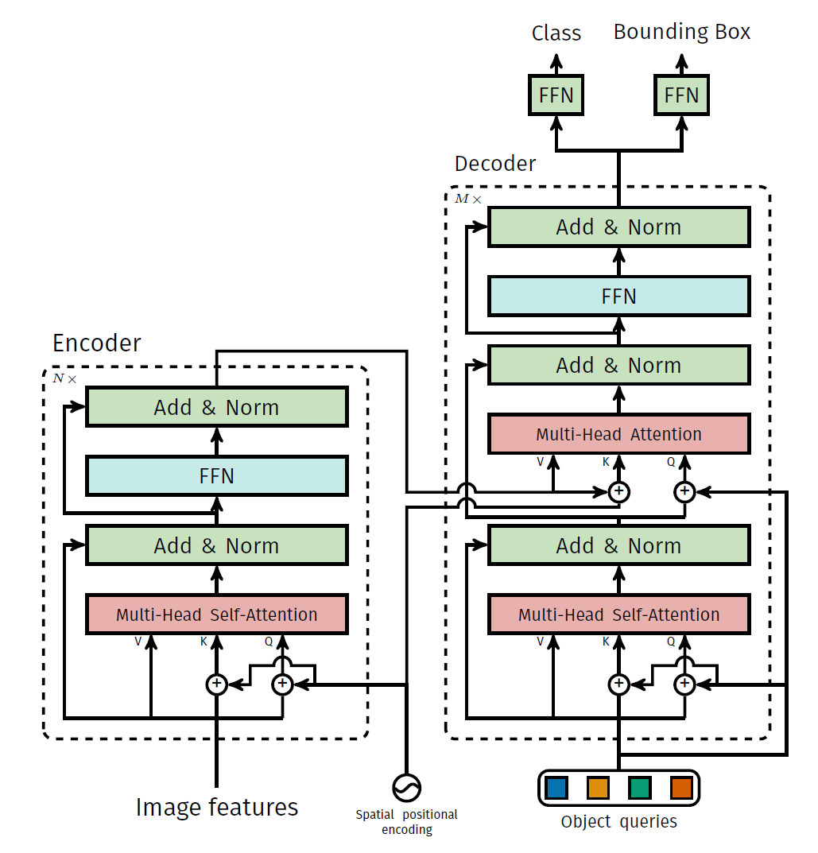
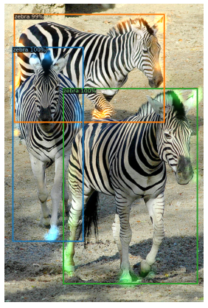
Seq2seq for Object Detection

Slide 10

Seq2Seq
output sequence
Encoder
Decoder
Input sequence

Slide 11
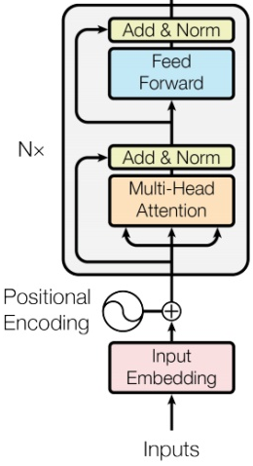








Encoder
Transformer’s Encoder
You can use RNN or CNN.
$$h^{1}$$
$$h^{2}$$
$$h^{3}$$
$$h^{4}$$
Encoder
$$x^{1}$$
$$x^{2}$$
$$x^{3}$$
$$x^{4}$$

Slide 12








$$h^{1}$$
$$h^{2}$$
$$h^{3}$$
$$h^{4}$$
Block
…
…
…
…
FC
FC
FC
FC
Block
Block
Self-attention
$$x^{1}$$
$$x^{2}$$
$$x^{3}$$
$$x^{4}$$

Slide 13

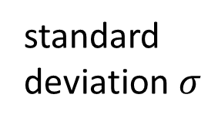

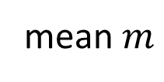





$$\left[\begin{aligned}x_{1}^{′} \\ x_{2}^{′} \\ ⋮ \\ x_{K}^{′}\end{aligned}\right]$$
$$x_{i}^{′}=\frac{x_{i}−m}{σ}$$
norm
residual
Layer Norm
norm
norm
https://arxiv.org/abs/1607.06450
+
residual
$$a+b$$
$$\left[\begin{aligned}x_{1} \\ x_{2} \\ ⋮ \\ x_{K}\end{aligned}\right]$$
mean $m$
FC
standard deviation $σ$
$$b$$
+
$$a$$
Self-attention

Slide 14









BERT
I use the same network architecture as transformer encoder.
$$h^{1}$$
$$h^{2}$$
$$h^{3}$$
$$h^{4}$$
Encoder
Residual
+ Layer norm
$$x^{1}$$
$$x^{2}$$
$$x^{3}$$
$$x^{4}$$

Slide 15
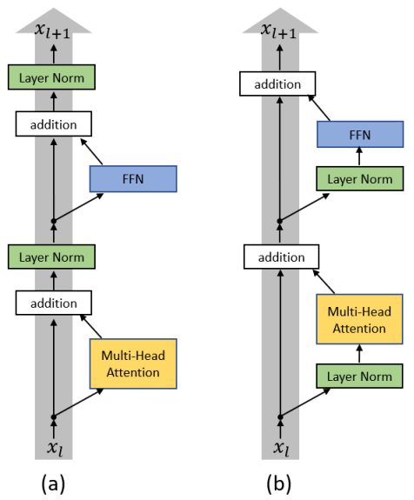

Slide 16
Decoder – Autoregressive (AT)
distribution
學 | 0.0
機 | 0.8
器 | 0.0
習 | 0.1
…… | ……
(Speech Recognition as example)
機
Size V
max
(common characters)
softmax
Encoder
Decoder
( 機器學習 )
(special token)
START

Slide 17
Autoregressive
機
器
學
習
max
max
max
max
Encoder
Decoder
( 機器學習 )
START
機
器
學

Slide 18
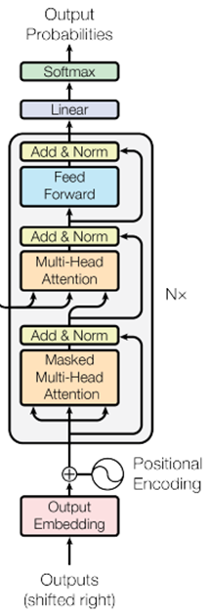
ignore the input from the encoder here ☺
機
器
學
習
max
max
max
Decoder
START
機
器
學

Slide 19
Encoder
Decoder

Slide 20








Self-attention
Masked Self-attention
$$b^{1}$$
$$b^{2}$$
$$b^{3}$$
$$b^{4}$$
$$a^{1}$$
$$a^{2}$$
$$a^{3}$$
$$a^{4}$$
Can be either input or a hidden layer

Slide 21





















Self-attention
Masked Self-attention
$$b^{2}$$
$$α_{2,1}^{′}$$
$$α_{2,2}^{′}$$
$$α_{2,3}^{′}$$
$$α_{2,4}^{′}$$
$$q^{1}$$
$$k^{1}$$
$$v^{1}$$
$$q^{2}$$
$$k^{2}$$
$$v^{2}$$
$$q^{3}$$
$$k^{3}$$
$$v^{3}$$
$$q^{4}$$
$$k^{4}$$
$$v^{4}$$
$$a^{1}$$
$$a^{2}$$
$$a^{3}$$
$$a^{4}$$
Consider how does decoder work
Why masked?

Slide 22
Autoregressive
We do not know the correct output length.
Never stop!
機
器
學
習
慣
……
max
max
max
max
max
Encoder
Decoder
( 機器學習 )
START
機
器
學
習

Slide 23
Adding “Stop Token”
distribution
學 | 0.0
機 | 0.8
器 | 0.0
習 | 0.1
…… | ……
END | 0.0
Size V
(common characters)
softmax
Encoder
Decoder
( 機器學習 )
START

Slide 24
Autoregressive
Stop at here!
機
器
學
習
END
max
max
max
max
max
Encoder
Decoder
( 機器學習 )
START
機
器
學
習

Slide 25

AT v.s. NAT(Non-autoregressive)
w₁
w₃
w₁
END
w₂
END
w₂
w₃
w₄
AT Decoder
NAT Decoder
START
w₁
w₂
w₃
START
START
START
START
How to decide the output length for NAT decoder?
Another predictor for output length
Output a very long sequence, ignore tokens after END
Advantage: parallel, more stable generation (e.g., TTS)
(why? Multi-modality)
NAT is usually worse than AT

Slide 26
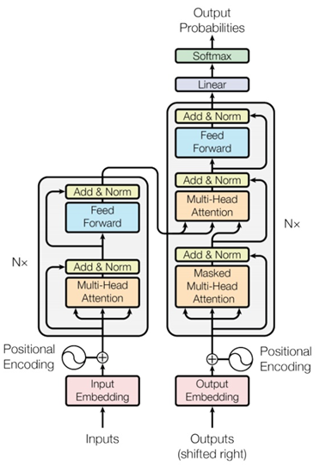
Encoder-Decoder
Cross attention

Slide 27














FC
$$v$$
$$α_{1}^{′}$$
$$α_{2}^{′}$$
$$α_{3}^{′}$$
Cross attention
$$k^{1}$$
$$v^{1}$$
$$k^{2}$$
$$v^{2}$$
$$k^{3}$$
$$v^{3}$$
$$q$$
$$a^{1}$$
$$a^{2}$$
$$a^{3}$$
Encoder
Self-attention (Mask)
START

Slide 28





FC
$$v′$$
$$α_{1}^{′}$$
$$α_{2}^{′}$$
$$α_{3}^{′}$$
$$k^{1}$$
$$v^{1}$$
$$k^{2}$$
$$v^{2}$$
$$k^{3}$$
$$v^{3}$$
$$q′$$
$$a^{1}$$
$$a^{2}$$
$$a^{3}$$
Encoder
Self-attention (Mask)
START
機

Slide 29
Training
學 | 0
機 | 1
器 | 0
鬼 | 0
…… | ……
Ground truth
distribution
機
學 | 0.1
機 | 0.7
器 | 0.1
鬼 | 0.1
…… | ……
Size V
minimize cross entropy
(common characters)
softmax
Encoder
Decoder
Label: 機 器 學 習
<BOS>

Slide 30
Teacher Forcing: using the ground truth as input.
機
器
學
習
<EOS>
minimize cross entropy
Encoder
Decoder
Ground Truth
Label: 機 器 學 習
<BOS>
機
器
學
習

Slide 31
Copy Mechanism
Chat-bot
User: X寶你好，我是庫洛洛
Machine:庫洛洛你好，很高興認識你

Slide 32
























Guided Attention
Monotonic Attention
Location-aware attention
In some tasks, input and output are monotonically aligned. For example, speech recognition, TTS, etc.
Attention weights
$$a^{1}$$
$$a^{2}$$
$$a^{3}$$
$$a^{4}$$
$$a^{1}$$
$$a^{2}$$
$$a^{3}$$
$$a^{4}$$
$$a^{1}$$
$$a^{2}$$
$$a^{3}$$
$$a^{4}$$
generate the 1st output
generate the 2nd output
generate the 3rd output
$$a^{1}$$
$$a^{2}$$
$$a^{3}$$
$$a^{4}$$
$$a^{1}$$
$$a^{2}$$
$$a^{3}$$
$$a^{4}$$
$$a^{1}$$
$$a^{2}$$
$$a^{3}$$
$$a^{4}$$
generate the 1st output
generate the 2nd output
Generate the 3rd output
Something wrong!

Slide 33
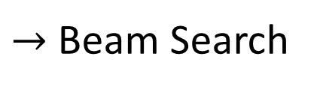
Beam Search
The red path is Greedy Decoding.
The green path is the best one.
Not possible to check all the paths …
$→$ Beam Search
A
B
A
B
A
A
B
B
0.4
0.6
0.9
0.4
A
B
0.6
A
B
0.9
0.6
A
B
0.4
Assume there are only two tokens (V=2).

Slide 34
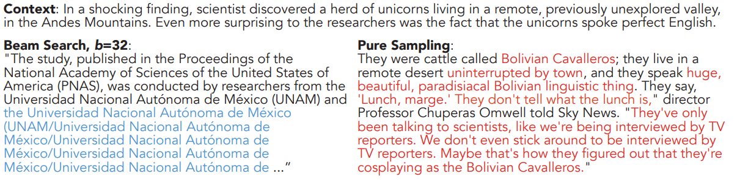
Sampling
The Curious Case of Neural Text Degeneration
https://arxiv.org/abs/1904.09751
Randomness is needed for decoder when generating sequence in some tasks.
Accept that nothing is perfect. True beauty lies in the cracks of imperfection. ☺

Slide 35
Scheduled Sampling
機
器
學
There is a mismatch! ☹
exposure bias
機
氣
學
Decoder
Decoder
<BOS>
器
機
氣
START
機
氣
Ground Truth

Slide 36
Homework

Slide 37
Neural Machine Translation
We will translate from english to traditional chinese
Cats are so cute. -> 貓咪真可愛。
A sentence is usually translated into another language with different length. Naturally, the seq2seq framework is applied on this task.

Slide 38
Requirements
You are encouraged to follow these tips to improve your performance in order to pass the 3 baselines.
Train a simple RNN seq2seq to acheive translation
Switch to transformer to boost performance
Apply back-translation to furthur boost performance

Slide 39
