Slide 1


BACKPACKERs
B10409010 蔡士弦
B10409016 李其翰
B10409028 黃曉珍
CARPE DIEM
B10409031 劉彥妤

Slide 2

SLOGAN
To live is To EAT,
To live is To TRAVEL,
To live is To SEE THE WORLD

Slide 3


MEMBERs
劉彥妤
Born in Malaysia, been travelling to lots of places. Have a dream to become a backpacker and travel around the world. Because of her dream, she came up with an idea of creating a website that will ease and provide an information for backpackers. This course teaches us about how to develop website, not to mention that our group consist 3 different countries, thus she decided to created the website.
李其翰
Originally come from Kaohsiung, but ended up in Taipei for studying in NTUST. His hobby is watching some animations especially One Piece. Curious about how to create a website and a blog, hence he chose this course. Hopefully through this course he'll learn how to create a cutting-edge website. For this project he responsible to collect Hong Kong traveling information, and no one know why he ended up in there.
蔡士弦
Aquarius individual that loves to swim and diving. He said "Diving helps me to ease my stress, it feels like the stress stay at surface". Doesn't really care much about grade and academic things, all that he wants is to pass the subject and graduated in time.
黃曉珍
Indonesian Chinese, that lost in Taiwan for several years. Instead of searching for her way back to her country, she decided to stay and discover more about this country. Once when she was doing some research about Taiwan she came across a webpage called black-buddha. Inspired by the website, she decide to create one too.

Slide 4





FEATUREs
Multiple language
Including Chinese, English, and hopefully we add more in future
Hello affordable hotel !
Say goodbye to pricey hotel, we’ll provide the information about cheap inn
Discover tourist spot
Finding tourist spot never been so easy, you can find hidden gem information in our website
Lost ? Use GPS !
Never afraid of getting lost , we provide gps service for easing the backpackers
Worth a try local food
Satisfy your hunger, by trying the local cuisine. Just click the button and the information will appear

Slide 5
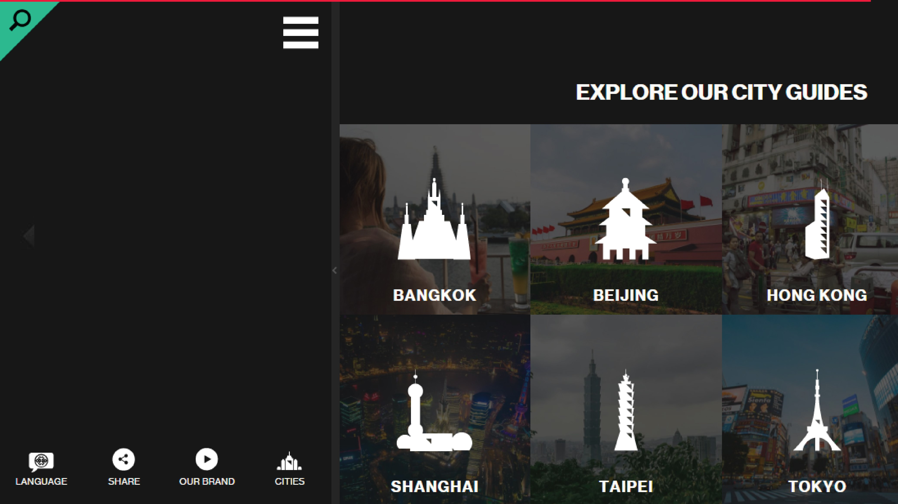
LAYOUT

Slide 6






PROGRESS
Brain
storming
Create theme
Gathered data
Manifest website
Merging front back end
DONE !!

