Slide 1


CPP
C:\NTUST\WebpagesDevelopment\Team05\碼農天堂.exe
☺
☹
☻
Webpages Development [Version 2019.04.19]
(c) 2019 NTUST
C:\Users\student>
▲
_
_
Project-碼農天堂
>>>
>>>
Team05
Members:
組長-郭訓佑
組員-彭鉅展
組員-陳明賢
組員-吳承翰
▼

Slide 2

CPP
C:\NTUST\WebpagesDevelopment\Team05\碼農天堂.exe
☺
☹
☻
Webpages Development [Version 2019.04.19]
(c) 2019 NTUST
C:\Users\student>
▲
_
_
next
>>>
▼

Slide 3
CPP
C:\NTUST\WebpagesDevelopment\Team05\碼農天堂.exe
☺
☹
☻
Webpages Development [Version 2019.04.19]
(c) 2019 NTUST
C:\Users\student>
▲
_
_
Why_do_we_make_it
>>>
『碼農』在現今社會中被當作一個貶義詞，但是在成為一個專業的程式設計師之前誰不是碼農呢？於是我們希望能打造一個讓初學者or有興趣之人方便查詢或是學習的碼農天堂。
>>>
▼

Slide 4

CPP
C:\NTUST\WebpagesDevelopment\Team05\碼農天堂.exe
☺
☹
☻
Webpages Development [Version 2019.04.19]
(c) 2019 NTUST
C:\Users\student>
▲
_
_
next
>>>
▼

Slide 5

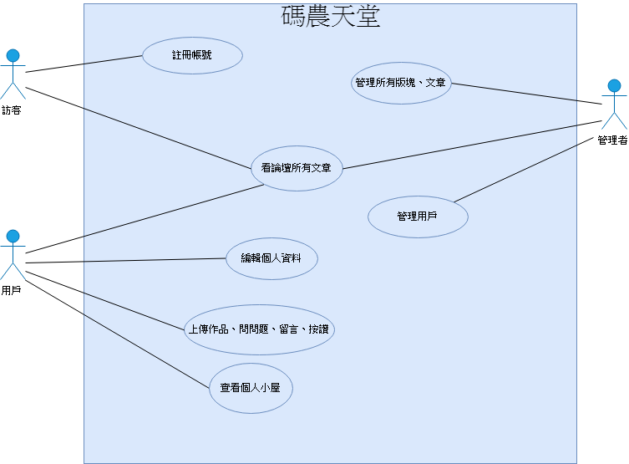
CPP
C:\NTUST\WebpagesDevelopment\Team05\碼農天堂.exe
☺
☹
☻
Webpages Development [Version 2019.04.19]
(c) 2019 NTUST
C:\Users\student>
▲
_
_
C:\NTUST\WebpagesDevelopment\Team05\use_case.jpg
Use_case
>>>
▼

Slide 6
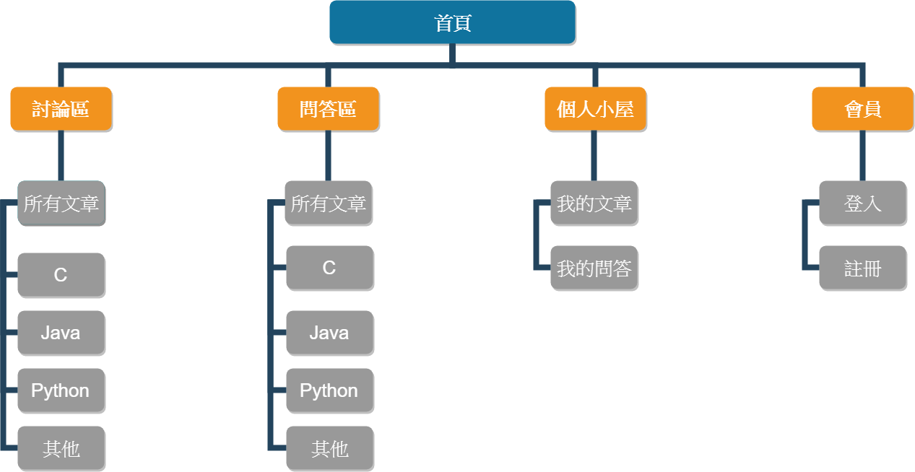
CPP
C:\NTUST\WebpagesDevelopment\Team05\碼農天堂.exe
☺
☹
☻
Webpages Development [Version 2019.04.19]
(c) 2019 NTUST
C:\Users\student>
▲
_
_
Website_architecture
>>>
C:\NTUST\WebpagesDevelopment\Team05\Website_architecture.jpg
▼

Slide 7

CPP
C:\NTUST\WebpagesDevelopment\Team05\碼農天堂.exe
☺
☹
☻
Webpages Development [Version 2019.04.19]
(c) 2019 NTUST
C:\Users\student>
▲
_
_
next
>>>
▼

Slide 8
CPP
C:\NTUST\WebpagesDevelopment\Team05\碼農天堂.exe
☺
☹
☻
Webpages Development [Version 2019.04.19]
(c) 2019 NTUST
C:\Users\student>
▲
_
_
cd..
_
_
C:\Users>
cd desktop
_
_
C:\Users\desktop>
cd website
_
_
C:\Users\desktop\website>
python manage.py runserver
Performing system checks...
System check identified no issues (0 silenced).
June 04, 2019 - 16:19:53
Django version 2.0, using settings 'CoderParadise.settings'
Starting development server at http://127.0.0.1:8000/
Quit the server with CTRL-BREAK.
_
C:\Users\desktop\website>
▼

Slide 9
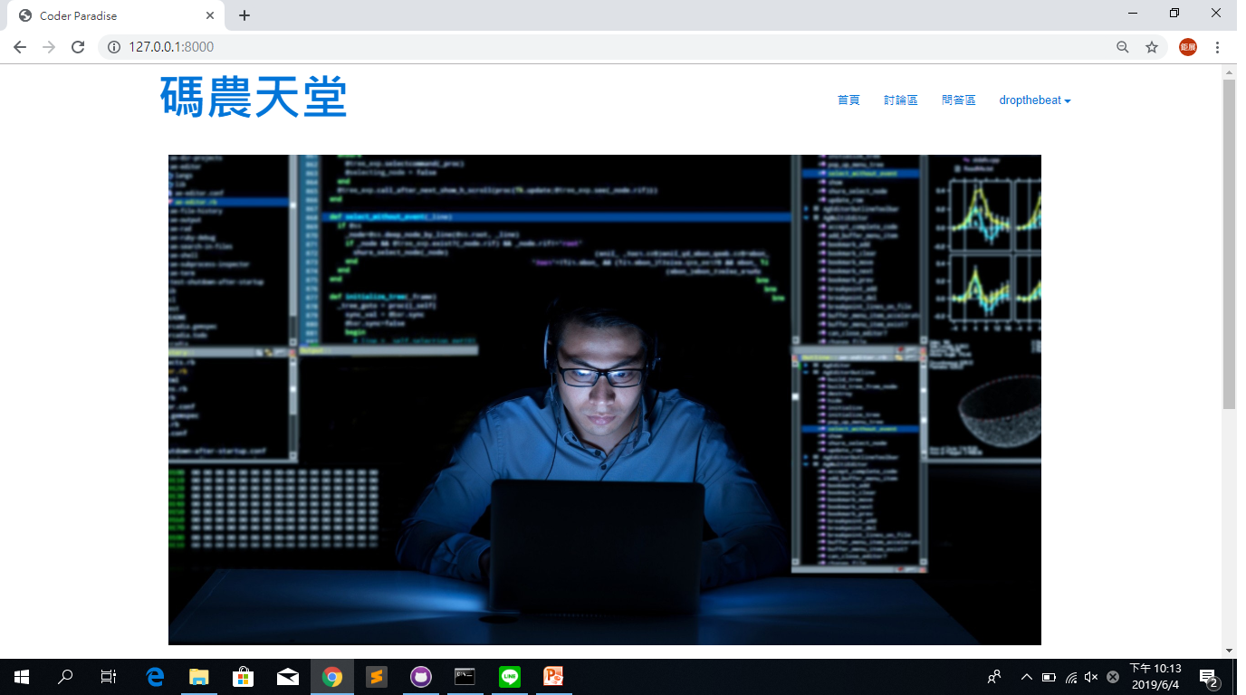
CPP
C:\NTUST\WebpagesDevelopment\Team05\碼農天堂.exe
Webpages Development [Version 2019.04.19]
(c) 2019 NTUST
C:\Users\student>
_
_
Show_the_website_首頁

Slide 10
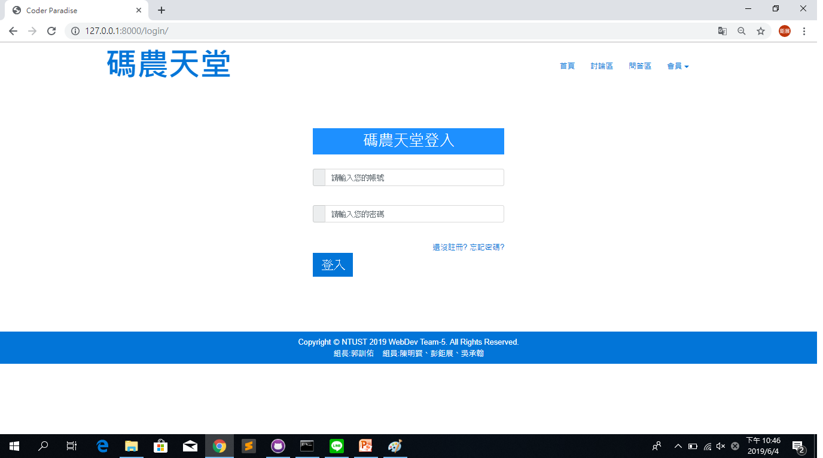
CPP
C:\NTUST\WebpagesDevelopment\Team05\碼農天堂.exe
Webpages Development [Version 2019.04.19]
(c) 2019 NTUST
C:\Users\student>
_
_
Show_the_website_登入

Slide 11
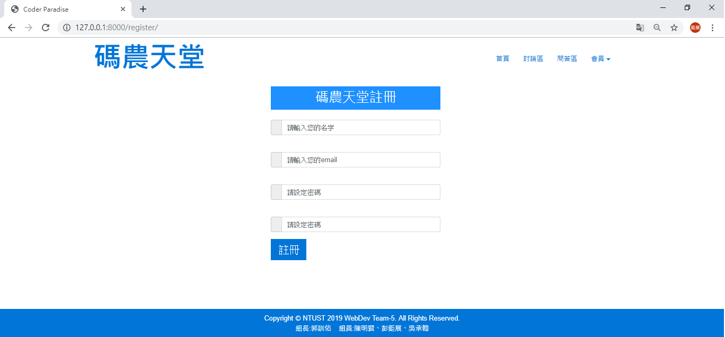
CPP
C:\NTUST\WebpagesDevelopment\Team05\碼農天堂.exe
Webpages Development [Version 2019.04.19]
(c) 2019 NTUST
C:\Users\student>
_
_
Show_the_website_註冊

Slide 12
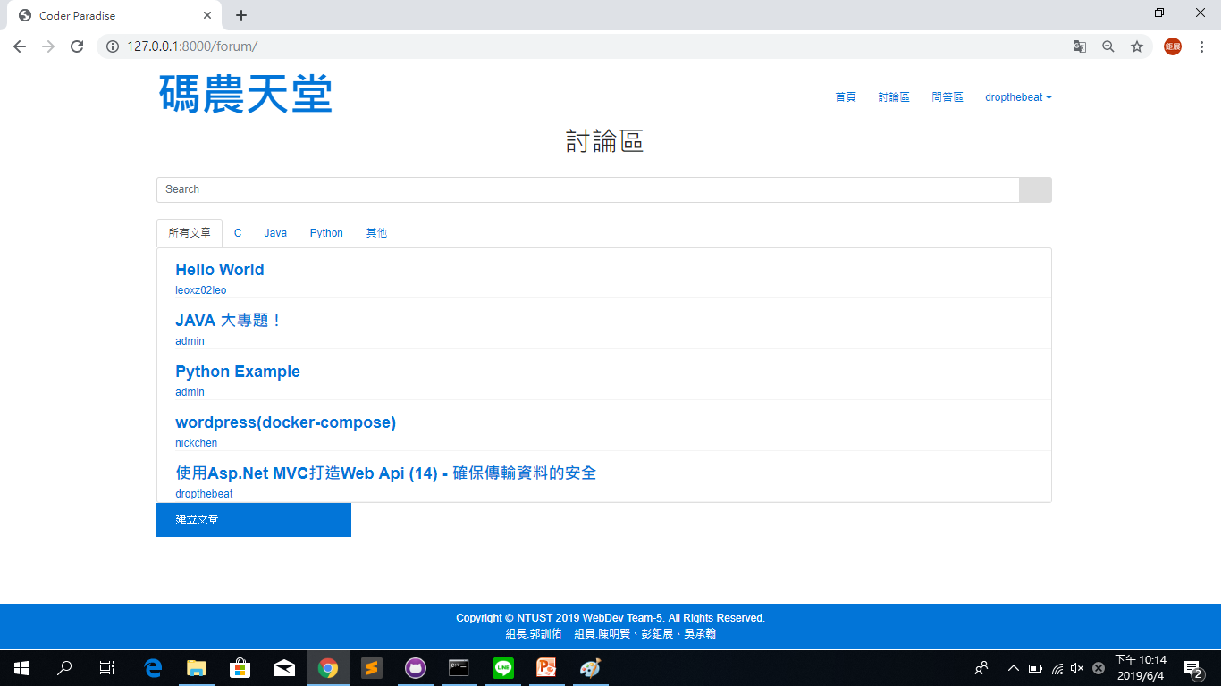
CPP
C:\NTUST\WebpagesDevelopment\Team05\碼農天堂.exe
Webpages Development [Version 2019.04.19]
(c) 2019 NTUST
C:\Users\student>
_
_
Show_the_website_討論區

Slide 13
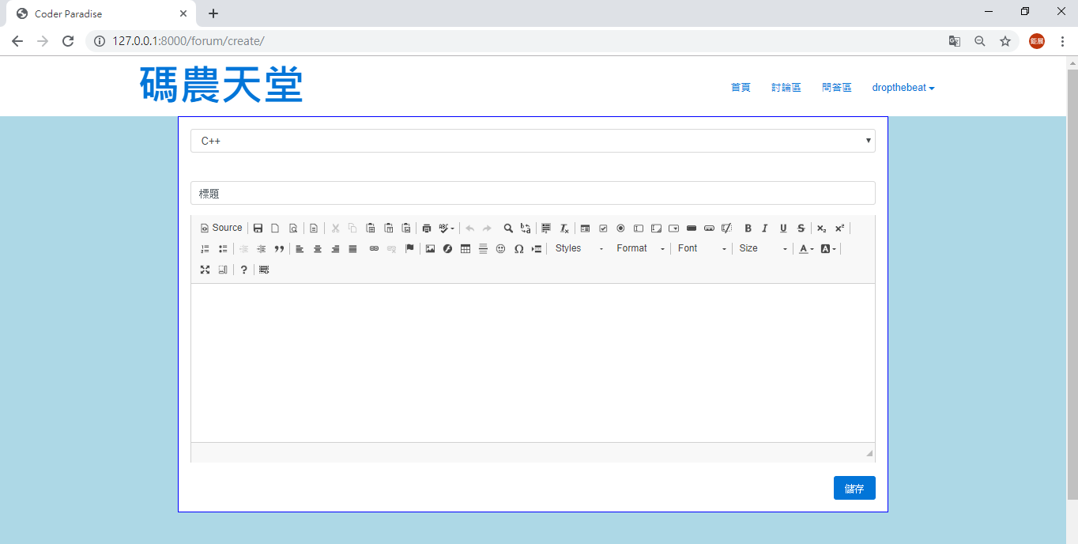
CPP
C:\NTUST\WebpagesDevelopment\Team05\碼農天堂.exe
Webpages Development [Version 2019.04.19]
(c) 2019 NTUST
C:\Users\student>
_
_
Show_the_website_發起討論介面

Slide 14
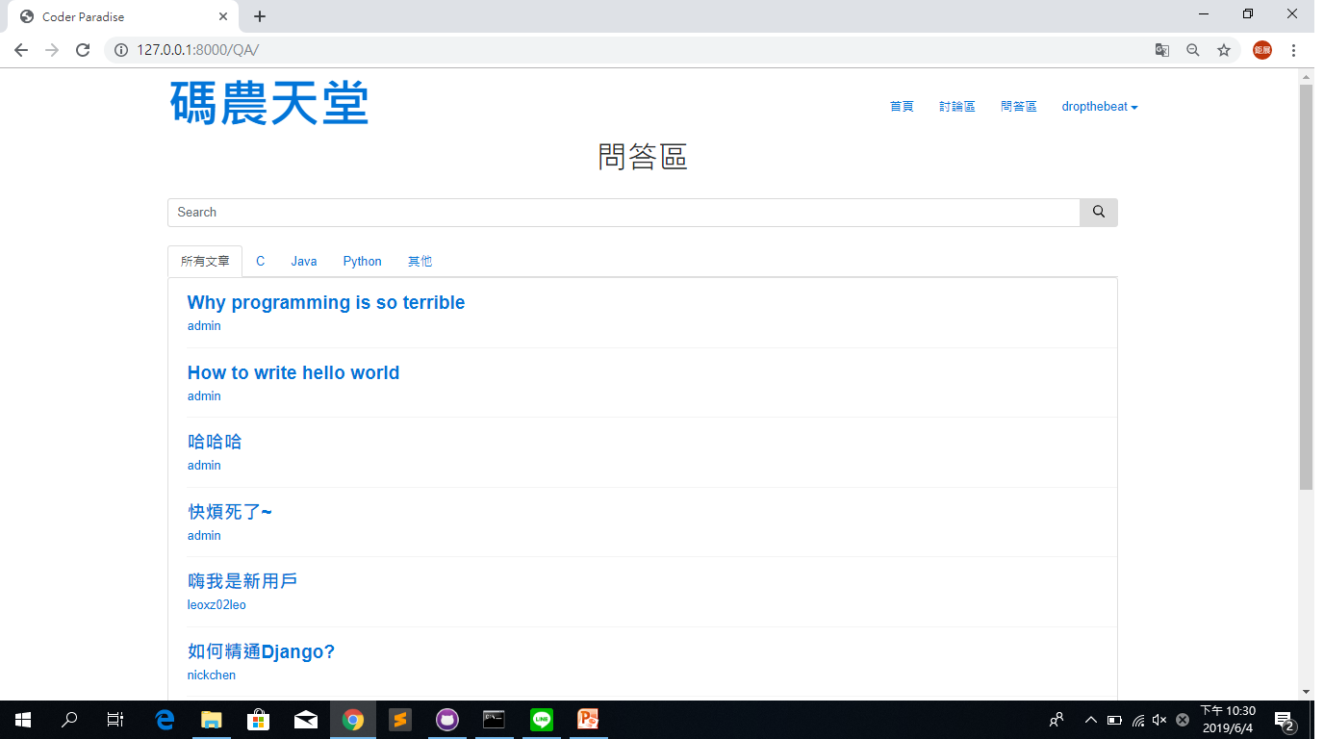
CPP
C:\NTUST\WebpagesDevelopment\Team05\碼農天堂.exe
Webpages Development [Version 2019.04.19]
(c) 2019 NTUST
C:\Users\student>
_
_
Show_the_website_問答區

Slide 15
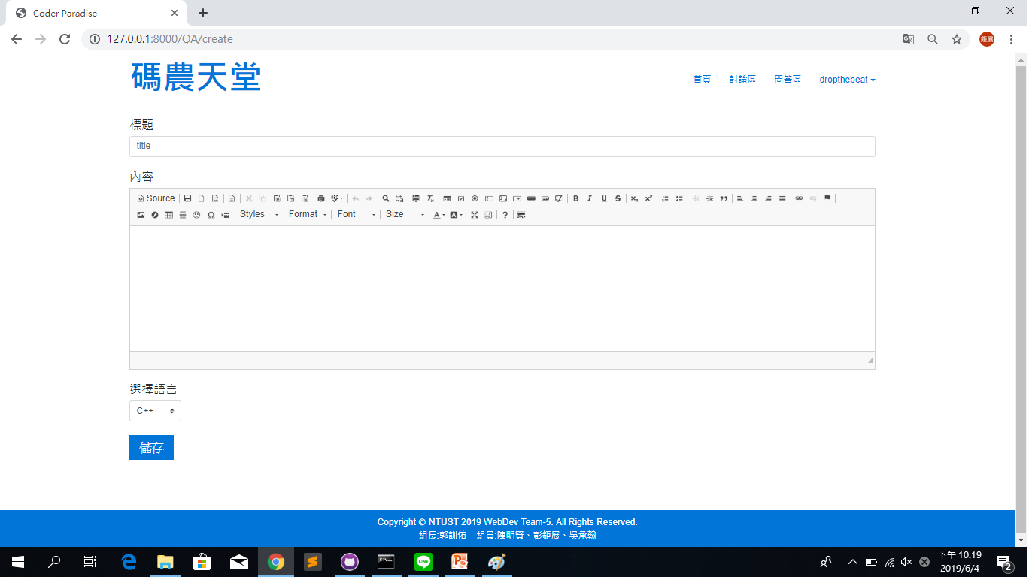
CPP
C:\NTUST\WebpagesDevelopment\Team05\碼農天堂.exe
Webpages Development [Version 2019.04.19]
(c) 2019 NTUST
C:\Users\student>
_
_
Show_the_website_提問介面

Slide 16
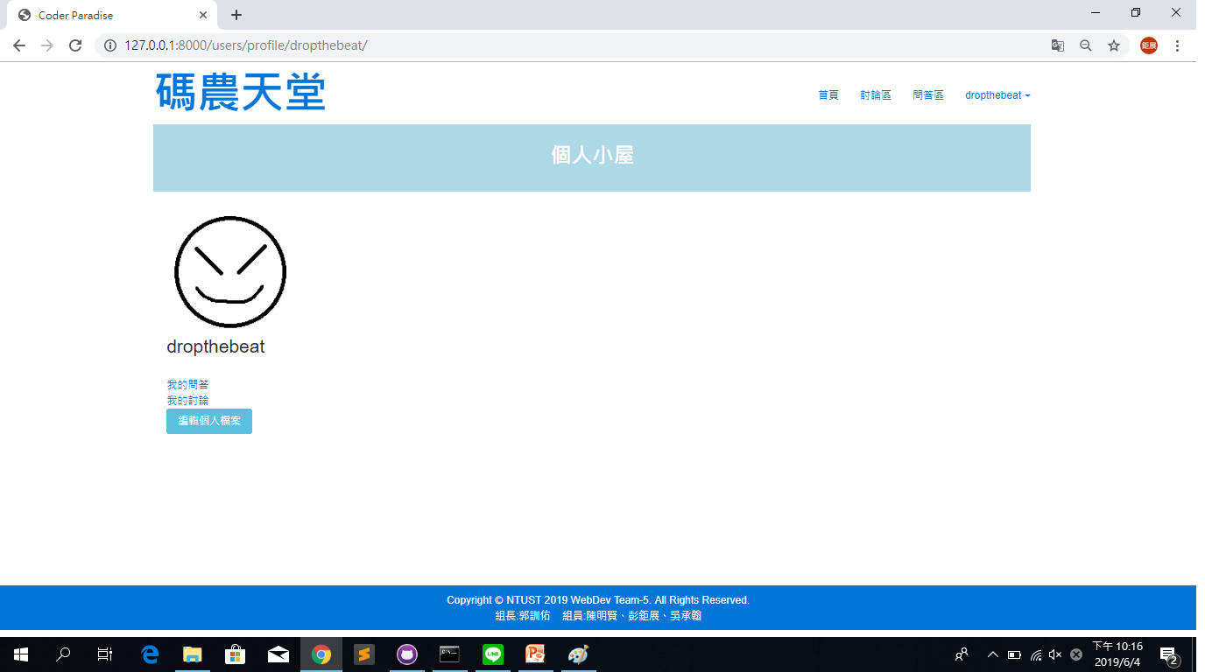
CPP
C:\NTUST\WebpagesDevelopment\Team05\碼農天堂.exe
Webpages Development [Version 2019.04.19]
(c) 2019 NTUST
C:\Users\student>
_
_
Show_the_website_個人小屋

Slide 17
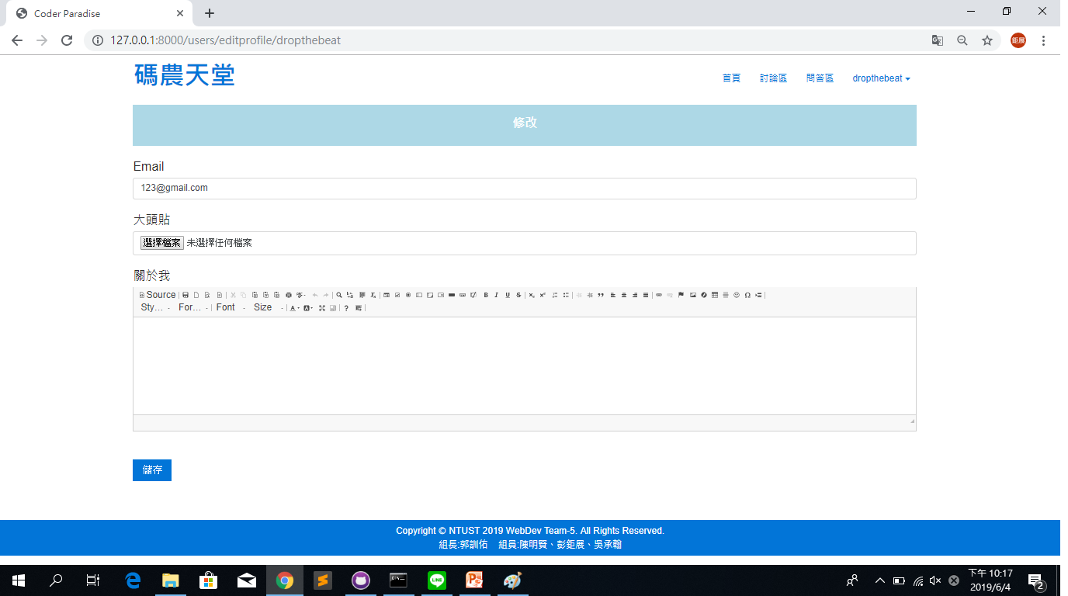
CPP
C:\NTUST\WebpagesDevelopment\Team05\碼農天堂.exe
Webpages Development [Version 2019.04.19]
(c) 2019 NTUST
C:\Users\student>
_
_
Show_the_website_編輯個人檔案

Slide 18

CPP
C:\NTUST\WebpagesDevelopment\Team05\碼農天堂.exe
☺
☹
☻
Webpages Development [Version 2019.04.19]
(c) 2019 NTUST
C:\Users\student>
▲
_
_
next
>>>
▼

Slide 19
CPP
C:\NTUST\WebpagesDevelopment\Team05\碼農天堂.exe
☺
☹
☻
Webpages Development [Version 2019.04.19]
(c) 2019 NTUST
C:\Users\student>
▲
_
_
In_the_Future
>>>
碼農天堂，為了讓吸引夠多程式大神加入這個社群，在未來我們希望它成為一個有獎勵制度的網站，讓大神們在幫助別人的同時也可以透過獎勵還得到額外的權限，例如：VIP.專屬資源分享區…等，另外我們還會新增文章排序功能，使用這可選擇我們預設好的幾種排序方式來找到他想要搜尋的文章和問題或是透過追蹤功能，追蹤大神或是想關注的文章。
如果你是大神，我們期待你的加入，讓更多程式新手遇到問題時可以迎刃而解；相反的，如果你是新手，別害羞，來這邊找答案就對啦!!!
>>>
▼

Slide 20

CPP
C:\NTUST\WebpagesDevelopment\Team05\碼農天堂.exe
☺
☹
☻
Webpages Development [Version 2019.04.19]
(c) 2019 NTUST
C:\Users\student>
▲
_
_
next
>>>
▼

Slide 21
CPP
C:\NTUST\WebpagesDevelopment\Team05\碼農天堂.exe
☺
☹
☻
Webpages Development [Version 2019.04.19]
(c) 2019 NTUST
C:\Users\student>
▲
_
_
Division_of_work
>>>
主題構思 完成首頁 前後端分別開發完成
2019/03/12 2019/04/02 2019/05/31
| | |
| | |
------------------------------------------------------------------>發佈
| | |
| | |
2019/03/19 2019/04/23 2019/06/4
網站的架構及風格 資料庫規劃 整合及調試
▼

Slide 22

CPP
C:\NTUST\WebpagesDevelopment\Team05\碼農天堂.exe
☺
☹
☻
Webpages Development [Version 2019.04.19]
(c) 2019 NTUST
C:\Users\student>
▲
_
_
next
>>>
▼

Slide 23
CPP
C:\NTUST\WebpagesDevelopment\Team05\碼農天堂.exe
☺
☹
☻
Webpages Development [Version 2019.04.19]
(c) 2019 NTUST
C:\Users\student>
▲
_
_
Division_of_work & Score_for_yourselves
>>>
------------------------------------------------------------
| |前端設計 |後端程式 |資料庫設計 |作品自評分 |
|-----------------------------------------------------------
|郭訓佑 |X端設計 |V後端程式|V資料庫設計| |
|-------------------------------------
|彭鉅展 |V端設計 |X後端程式|V資料庫設計| |
|-------------------------------------
|陳明賢 |V端設計 |X後端程式|V資料庫設計| |
|-------------------------------------
|吳承翰 |X端設計 |V後端程式|V資料庫設計| |
|-----------------------------------------------------------
|
滿分100的話
我們給滿分。
|
|
▼

Slide 24
CPP
C:\NTUST\WebpagesDevelopment\Team05\碼農天堂.exe
☺
☹
☻
Webpages Development [Version 2019.04.19]
(c) 2019 NTUST
C:\Users\student>
▲
_
_
The presentation ends.
Thanks
For Watching
▼

