Slide 1


CPP
C:\NTUST\WebpagesDevelopment\Team05\碼農天堂.exe
☺
☹
☻
Webpages Development [Version 2019.04.19]
(c) 2019 NTUST
C:\Users\student>
▲
_
_
Project-碼農天堂
>>>
>>>
Team05
Members:
組長-郭訓佑
組員-彭鉅展
組員-陳明賢
組員-吳承翰
▼

Slide 2

CPP
C:\NTUST\WebpagesDevelopment\Team05\碼農天堂.exe
☺
☹
☻
Webpages Development [Version 2019.04.19]
(c) 2019 NTUST
C:\Users\student>
▲
_
_
next
>>>
▼

Slide 3
CPP
C:\NTUST\WebpagesDevelopment\Team05\碼農天堂.exe
☺
☹
☻
Webpages Development [Version 2019.04.19]
(c) 2019 NTUST
C:\Users\student>
▲
_
_
Why_do_we_make_it
>>>
『碼農』在現今社會中被當作一個貶義詞，但是在成為一個專業的程式設計師之前誰不是碼農呢？於是我們希望能打造一個讓初學者or有興趣之人方便查詢或是學習的碼農天堂。
>>>
碼農天堂，為了吸引程式大神加入這個社群，它將會是一個擁有獎勵制度的一個網站，其他人也可以在這邊製作程式筆記，供大家一起來討論。
▼

Slide 4

CPP
C:\NTUST\WebpagesDevelopment\Team05\碼農天堂.exe
☺
☹
☻
Webpages Development [Version 2019.04.19]
(c) 2019 NTUST
C:\Users\student>
▲
_
_
next
>>>
▼

Slide 5

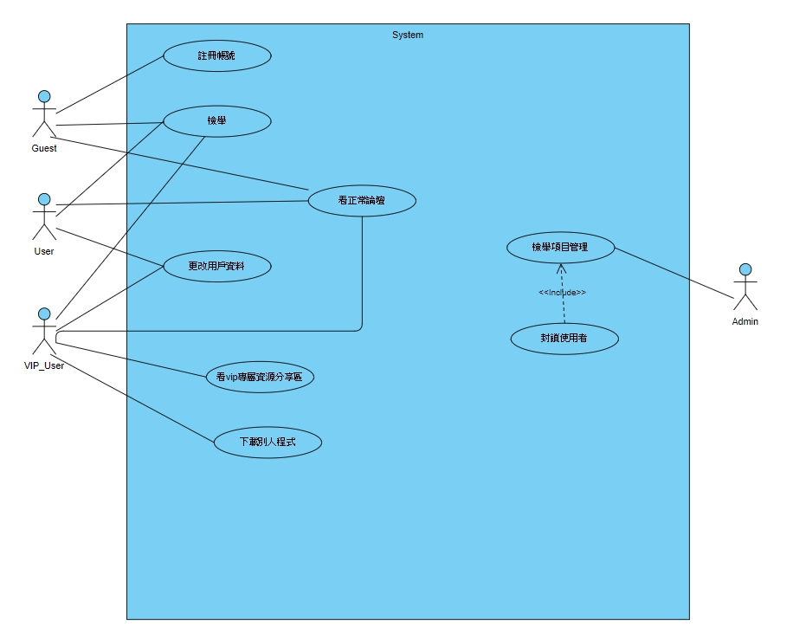
CPP
C:\NTUST\WebpagesDevelopment\Team05\碼農天堂.exe
☺
☹
☻
Webpages Development [Version 2019.04.19]
(c) 2019 NTUST
C:\Users\student>
▲
_
_
C:\NTUST\WebpagesDevelopment\Team05\use_case.jpg
Use_case
>>>
▼

Slide 6
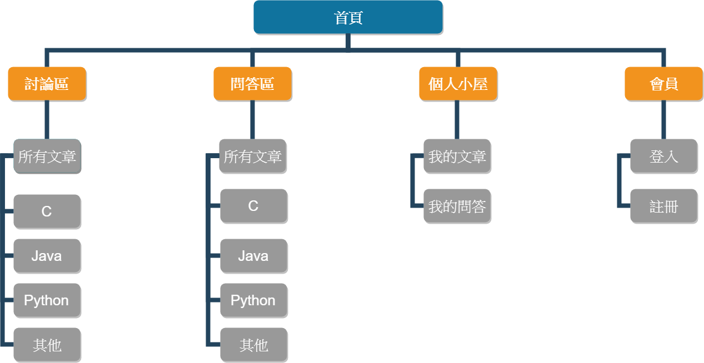
CPP
C:\NTUST\WebpagesDevelopment\Team05\碼農天堂.exe
☺
☹
☻
Webpages Development [Version 2019.04.19]
(c) 2019 NTUST
C:\Users\student>
▲
_
_
Website_architecture
>>>
C:\NTUST\WebpagesDevelopment\Team05\Website_architecture.jpg
▼

Slide 7

CPP
C:\NTUST\WebpagesDevelopment\Team05\碼農天堂.exe
☺
☹
☻
Webpages Development [Version 2019.04.19]
(c) 2019 NTUST
C:\Users\student>
▲
_
_
next
>>>
▼

Slide 8
CPP
C:\NTUST\WebpagesDevelopment\Team05\碼農天堂.exe
☺
☹
☻
Webpages Development [Version 2019.04.19]
(c) 2019 NTUST
C:\Users\student>
▲
_
_
cd..
_
_
C:\Users>
cd desktop
_
_
C:\Users\desktop>
cd website
_
_
C:\Users\desktop\website>
python manage.py runserver
Performing system checks...
System check identified no issues (0 silenced).
June 04, 2019 - 16:19:53
Django version 2.0, using settings 'CoderParadise.settings'
Starting development server at http://127.0.0.1:8000/
Quit the server with CTRL-BREAK.
_
C:\Users\desktop\website>
▼

Slide 9

CPP
C:\NTUST\WebpagesDevelopment\Team05\碼農天堂.exe
☺
☹
☻
Webpages Development [Version 2019.04.19]
(c) 2019 NTUST
C:\Users\student>
▲
_
_
next
>>>
▼

Slide 10
CPP
C:\NTUST\WebpagesDevelopment\Team05\碼農天堂.exe
☺
☹
☻
Webpages Development [Version 2019.04.19]
(c) 2019 NTUST
C:\Users\student>
▲
_
_
Division_of_work
>>>
主題構思 完成首頁 前後端分別開發完成
2019/03/12 2019/04/02 2019/05/21
| | |
| | |
------------------------------------------------------------------>發佈
| | |
| | |
2019/03/19 2019/04/23 2019/06/4
網站的架構及風格 資料庫規劃 整合及調試
▼

Slide 11

CPP
C:\NTUST\WebpagesDevelopment\Team05\碼農天堂.exe
☺
☹
☻
Webpages Development [Version 2019.04.19]
(c) 2019 NTUST
C:\Users\student>
▲
_
_
next
>>>
▼

Slide 12
CPP
C:\NTUST\WebpagesDevelopment\Team05\碼農天堂.exe
☺
☹
☻
Webpages Development [Version 2019.04.19]
(c) 2019 NTUST
C:\Users\student>
▲
_
_
Division_of_work & Score_for_yourselves
>>>
------------------------------------------------------------
| |前端設計 |後端程式 |資料庫設計 |作品自評分 |
|-----------------------------------------------------------
|郭訓佑 |X端設計 |V後端程式|V資料庫設計|我覺得90分再加10分 |
|-----------------------------------------------------------
|彭鉅展 |V端設計 |X後端程式|V資料庫設計|這我給99分 |
|-----------------------------------------------------------
|陳明賢 |V端設計 |X後端程式|V資料庫設計| 70 |
|-----------------------------------------------------------
|吳承翰 |X端設計 |V後端程式|V資料庫設計| |
|-----------------------------------------------------------
▼

Slide 13
CPP
C:\NTUST\WebpagesDevelopment\Team05\碼農天堂.exe
☺
☹
☻
Webpages Development [Version 2019.04.19]
(c) 2019 NTUST
C:\Users\student>
▲
_
_
Thanks_for_watching
▼

