Slide 1
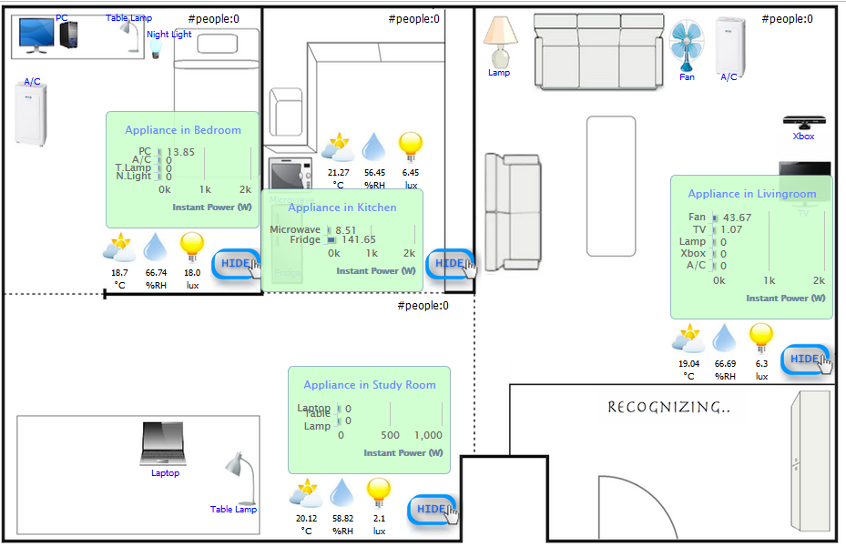









Bedroom
Kitchen
Living room
Studying room
: Light Sensor
: Current Sensor
: Home Server
: Touch Sensor(Reed switch, mercury switch)

