Slide 1
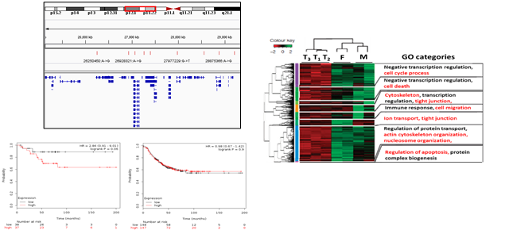
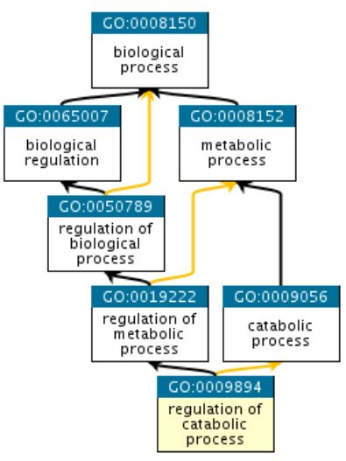
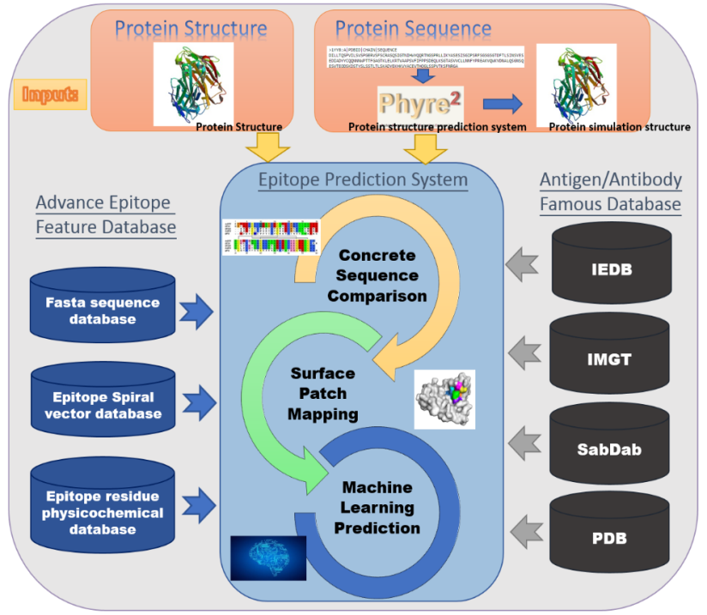
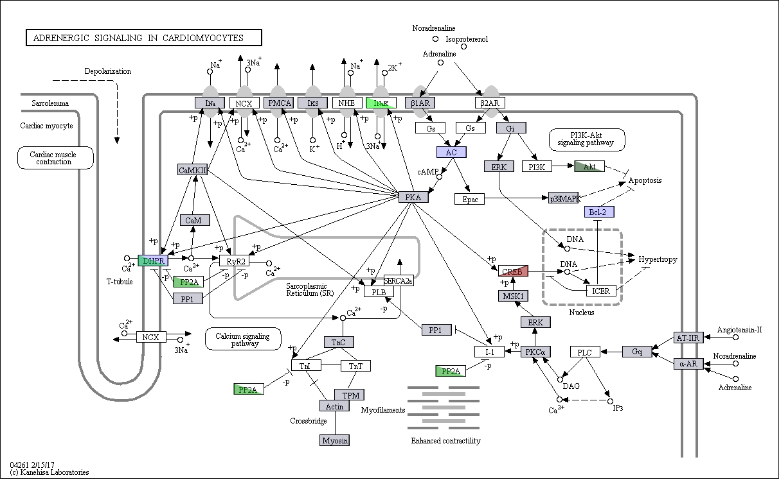
Biomarker Detection / Conformational Epitope Prediction / Linear Epitope Prediction

Slide 2
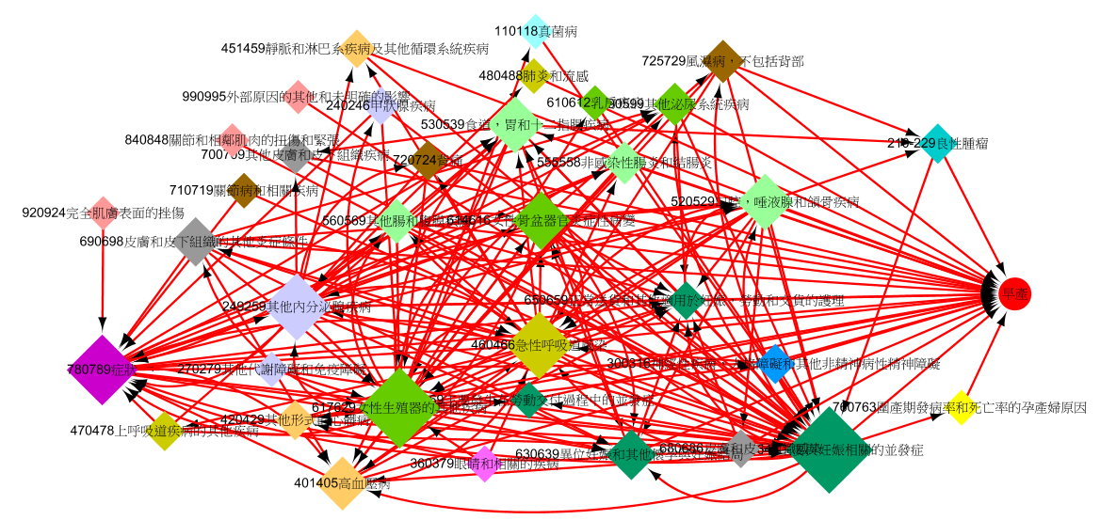
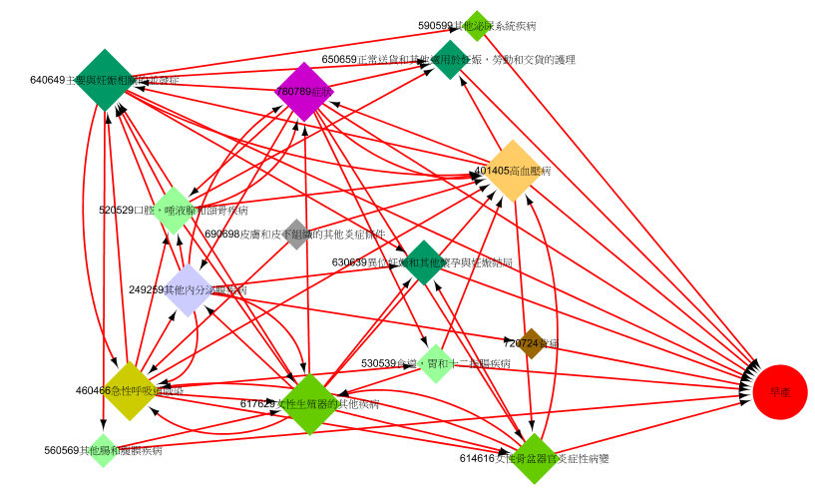
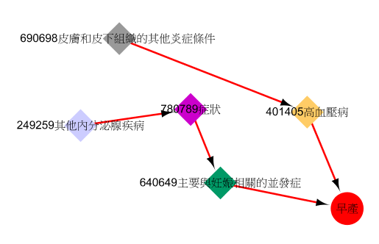
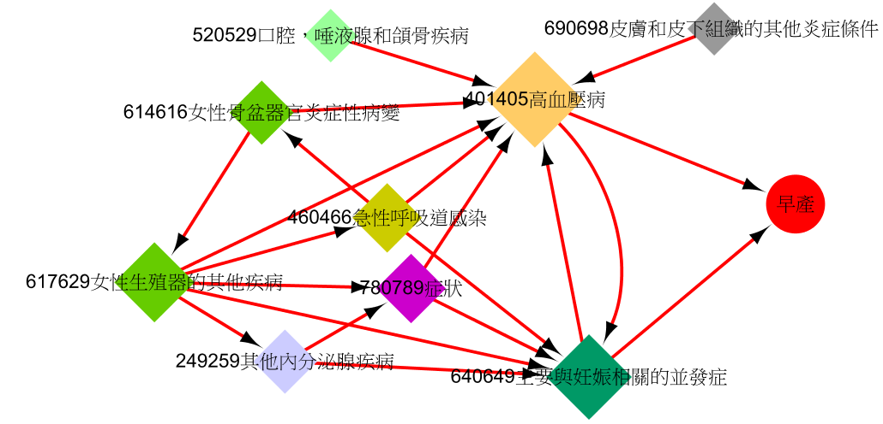
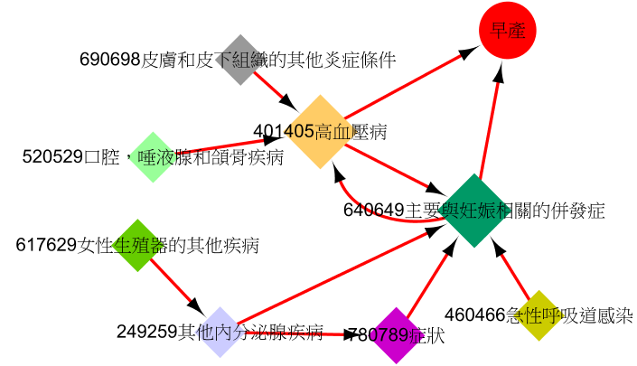
Electronic medical record analytics / Disease trajectory pattern discovery
Odds Ratio>3
Odds Ratio>4
Odds Ratio>5
Odds Ratio>6
Odds Ratio>7
98.42天
71.3天
98.42天
103.92天
82.35天
137.51天
42.35天
76.42天
45.7天
66.71天
59.27天
55.19天
76.58天
39.41天
42.35天
145.92天

Slide 3





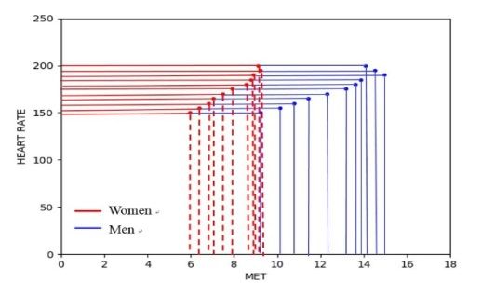



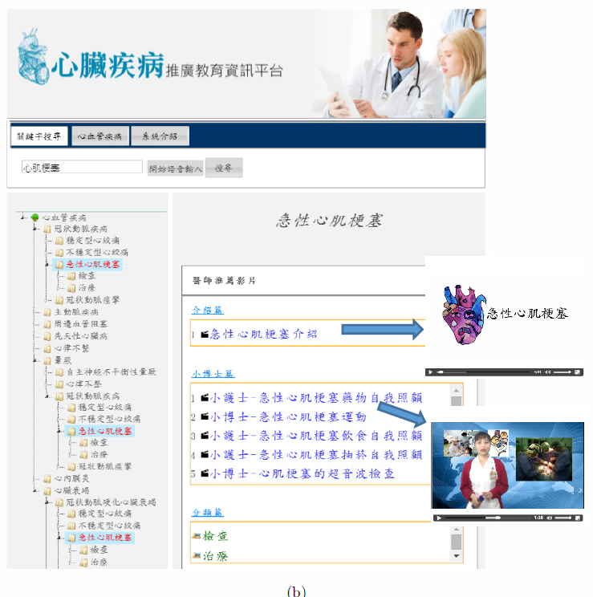
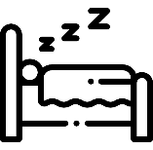

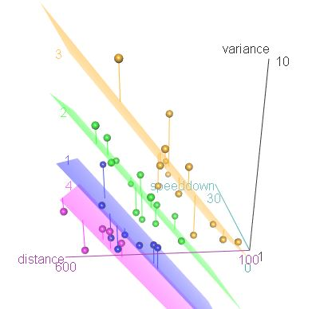
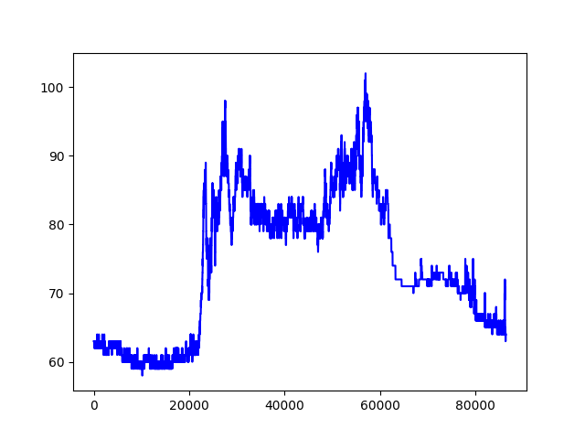
Applications of IoMT devices / Intelligent self care system (PAC-HF)

Slide 4

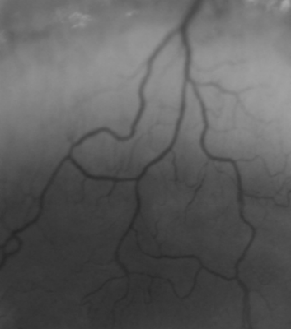
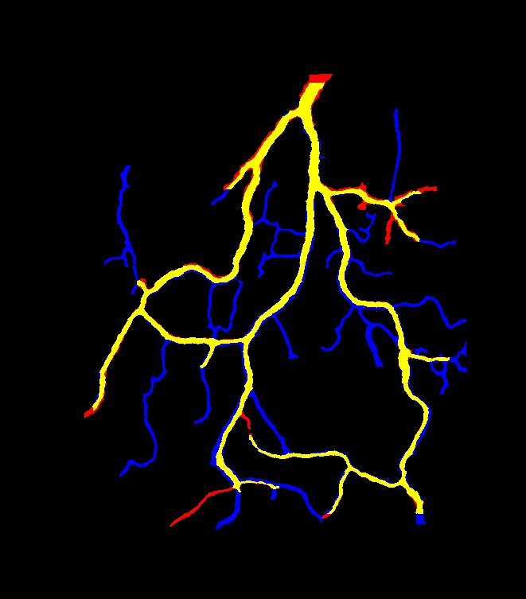

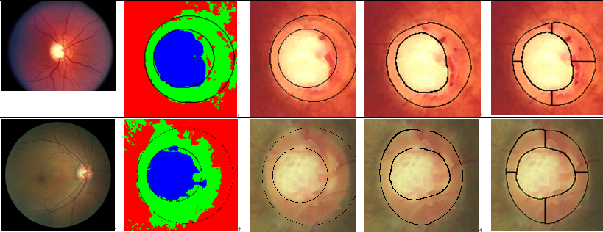
Intelligent Medical Imaging Analysis

