Slide 1
🔐 Secure Login & Authentication System
Personal Project
113598101 康紘郡
Technical Stack: Python 3.11 | Tkinter/CustomTkinter GUI | SQLite | PBKDF2 + TOTP 2FA

Slide 2
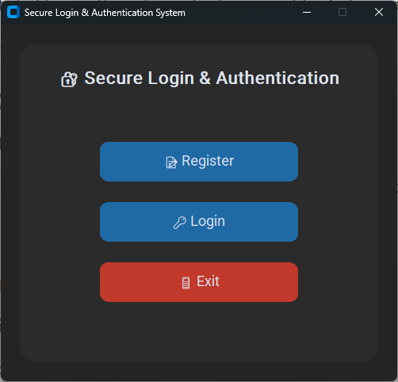
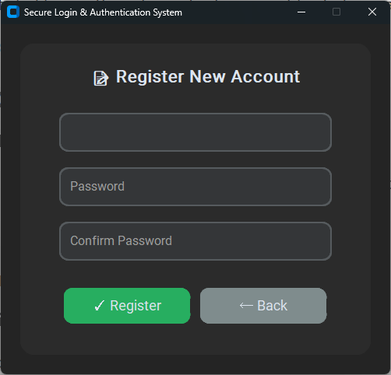
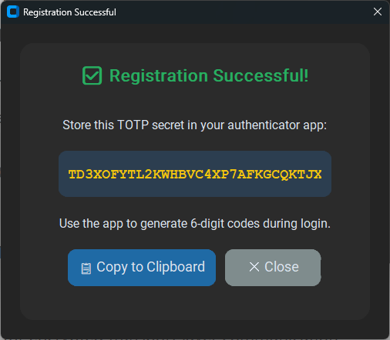
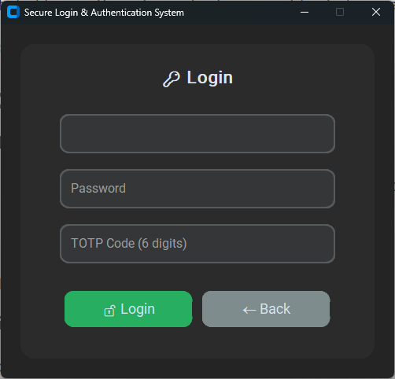
System Interface Demo
Application Screenshots
🏠 Main Menu
Landing page with Register / Login options
📝 Registration Form
User registration with password confirmation
🔑 TOTP Secret Display
Base32 secret for authenticator app setup
🔓 Login Form
Username, password, and TOTP code input

Slide 3
System Architecture & Data Flow
1
User Interface Layer (app.py)
GUI handles registration/login operations with input validation and error handling
2
Cryptography Layer (crypto.py)
PBKDF2-HMAC-SHA256 password hashing, random salt generation, TOTP token generation/verification
3
Database Layer (database.py)
SQLite parameterized queries, secure pragma settings, SQL injection prevention
4
Testing Layer (test.py)
Colored output test framework covering hashing, MFA, SQL injection, and XSS protection
Data Storage Structure
▸ auth.db - SQLite database file
▸ Stored fields: username, hashed credentials, TOTP secret, creation timestamp
▸ All sensitive data encrypted, no plaintext password storage

Slide 4
Security Measures
🔒 Password Hashing
📱 Two-Factor Auth
🛡️ SQL Injection Prevention
PBKDF2-HMAC-SHA256
16-byte random salt
120,000 iterations
Constant-time comparison
RFC 6238 TOTP
6-digit dynamic code
30-second refresh interval
±1 time window tolerance
Parameterized Queries
SQLite URI restricted mode
Full use of prepared statements
Zero string interpolation risk
🚫 XSS Protection
🔑 Secret Management
✅ Input Validation
Input Validation & Encoding
Strict input format checking
Database-level filtering
Script injection prevention
Secure Key Handling
TOTP secret shown once
Passwords not logged
Base32 encoded storage
Multi-layer Checks
Username non-empty validation
Password length ≥ 8 chars
TOTP numeric verification

Slide 5
Testing & Verification
Test Suite Execution
python -m auth_system.test
Test Coverage
✓ Password Hashing Test
PBKDF2 hash generation and verification correctness
✓ MFA Functionality Test
TOTP generation, verification, and time window tolerance
✓ End-to-End Flow Test
Complete registration/login flow with isolated database
✓ SQL Injection Test
Malicious query attempts safely handled
✓ XSS Protection Test
Script injection payloads properly sanitized
✓ Colored Output Report
Visual test results with execution time statistics

Slide 6
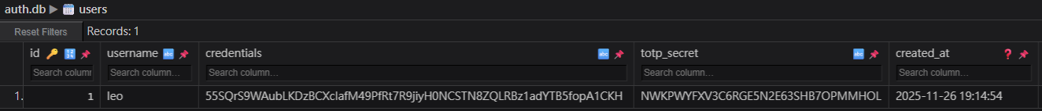
Database Security Verification
Database Structure
🗄️ SQLite Database View
Screenshot showing hashed credentials and encrypted TOTP secrets in database
Manual Verification Checklist
▸ Attempt login with wrong password/OTP - system correctly rejects
▸ Check auth.db - credentials and secrets are hashed, no plaintext storage
▸ Verify log files - no sensitive information leakage
▸ Test TOTP time window tolerance - mechanism works correctly

Slide 7
Security Extension Recommendations
🗄️ Database Upgrade
▸ Migrate to PostgreSQL / MySQL
▸ Implement least-privilege roles
▸ Continue parameterized queries
🔍 Automated Security Testing
▸ Integrate static code analysis tools (Bandit, SonarQube)
▸ Implement dependency scanning for known vulnerabilities (Safety, Snyk)
▸ Build CI/CD pipeline to automatically run security tests
🔐 Enhanced Authentication
▸ Add account lockout mechanism with exponential backoff
▸ Implement failed login attempt counter to prevent brute force attacks
▸ Backup recovery codes
📱 TOTP UX Optimization
▸ Generate QR Code to simplify authenticator app configuration
▸ Provide alternative verification methods (SMS, Email)
🌐 Web Frontend Integration
▸ Implement input/output encoding to prevent XSS attacks
▸ Add CSRF Token protection mechanism
▸ Implement Content Security Policy (CSP) headers
▸ Use HTTPS for encrypted transport layer communication

Slide 8
Project Summary
✨ Implementation Achievements
▸ Complete secure login and registration system with password hashing and 2FA
▸ Multi-layer security protection: SQL injection, XSS, brute force prevention
▸ Comprehensive test framework covering functional and security testing
▸ GUI implementations (Tkinter)
📚 Key Learnings
▸ Secure Coding Practices - Parameterized queries, constant-time comparison, input validation
▸ Cryptography Applications - PBKDF2 hashing, salt generation, TOTP implementation
▸ Attack Prevention - SQL injection, XSS, timing attack protection mechanisms
▸ Test-Driven Development - Unit testing, integration testing, security testing
🚀 Future Development Directions
▸ Expand to web application with RESTful API implementation
▸ Add OAuth 2.0 / OpenID Connect support
▸ Implement Session management and JWT Token mechanism

Slide 9
Thank You !🎉

