Slide 1

Grosser Shopping

Slide 2
Team Member
Darren Dixon – Responsible for create Admin Panel and As admin edit employee, add/delete/update product admin sign in view requests
Rachel Rajen →Worked on Add Item in Cart, Edit , Upadate order, checkout
PruthviRaj Mandala → He is responsible for the Create Employee Panel and Also worked on some user functionalities
Srushti Patel → She worked On Employee Functionality , Update Order status, She can send request to admin for update product, Edit Employee Profile.
Nicholas Tamez→ He implemented User Panel add/delete employee, report generator, user sign in/sign up, admin logout, and helping with all other pieces of code

Slide 3
Over Review Of Functionality
Employee Functionality
Send Request to user
Update Order Status, also if order status is cancle then give refund to user.
Unlock user
Edit Employee Profile
Logout from Employee Panel

Slide 4
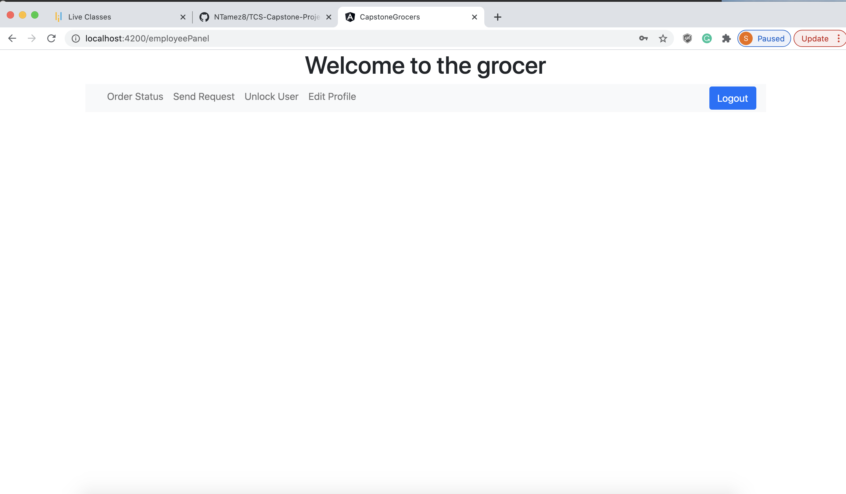
Demo

Slide 5
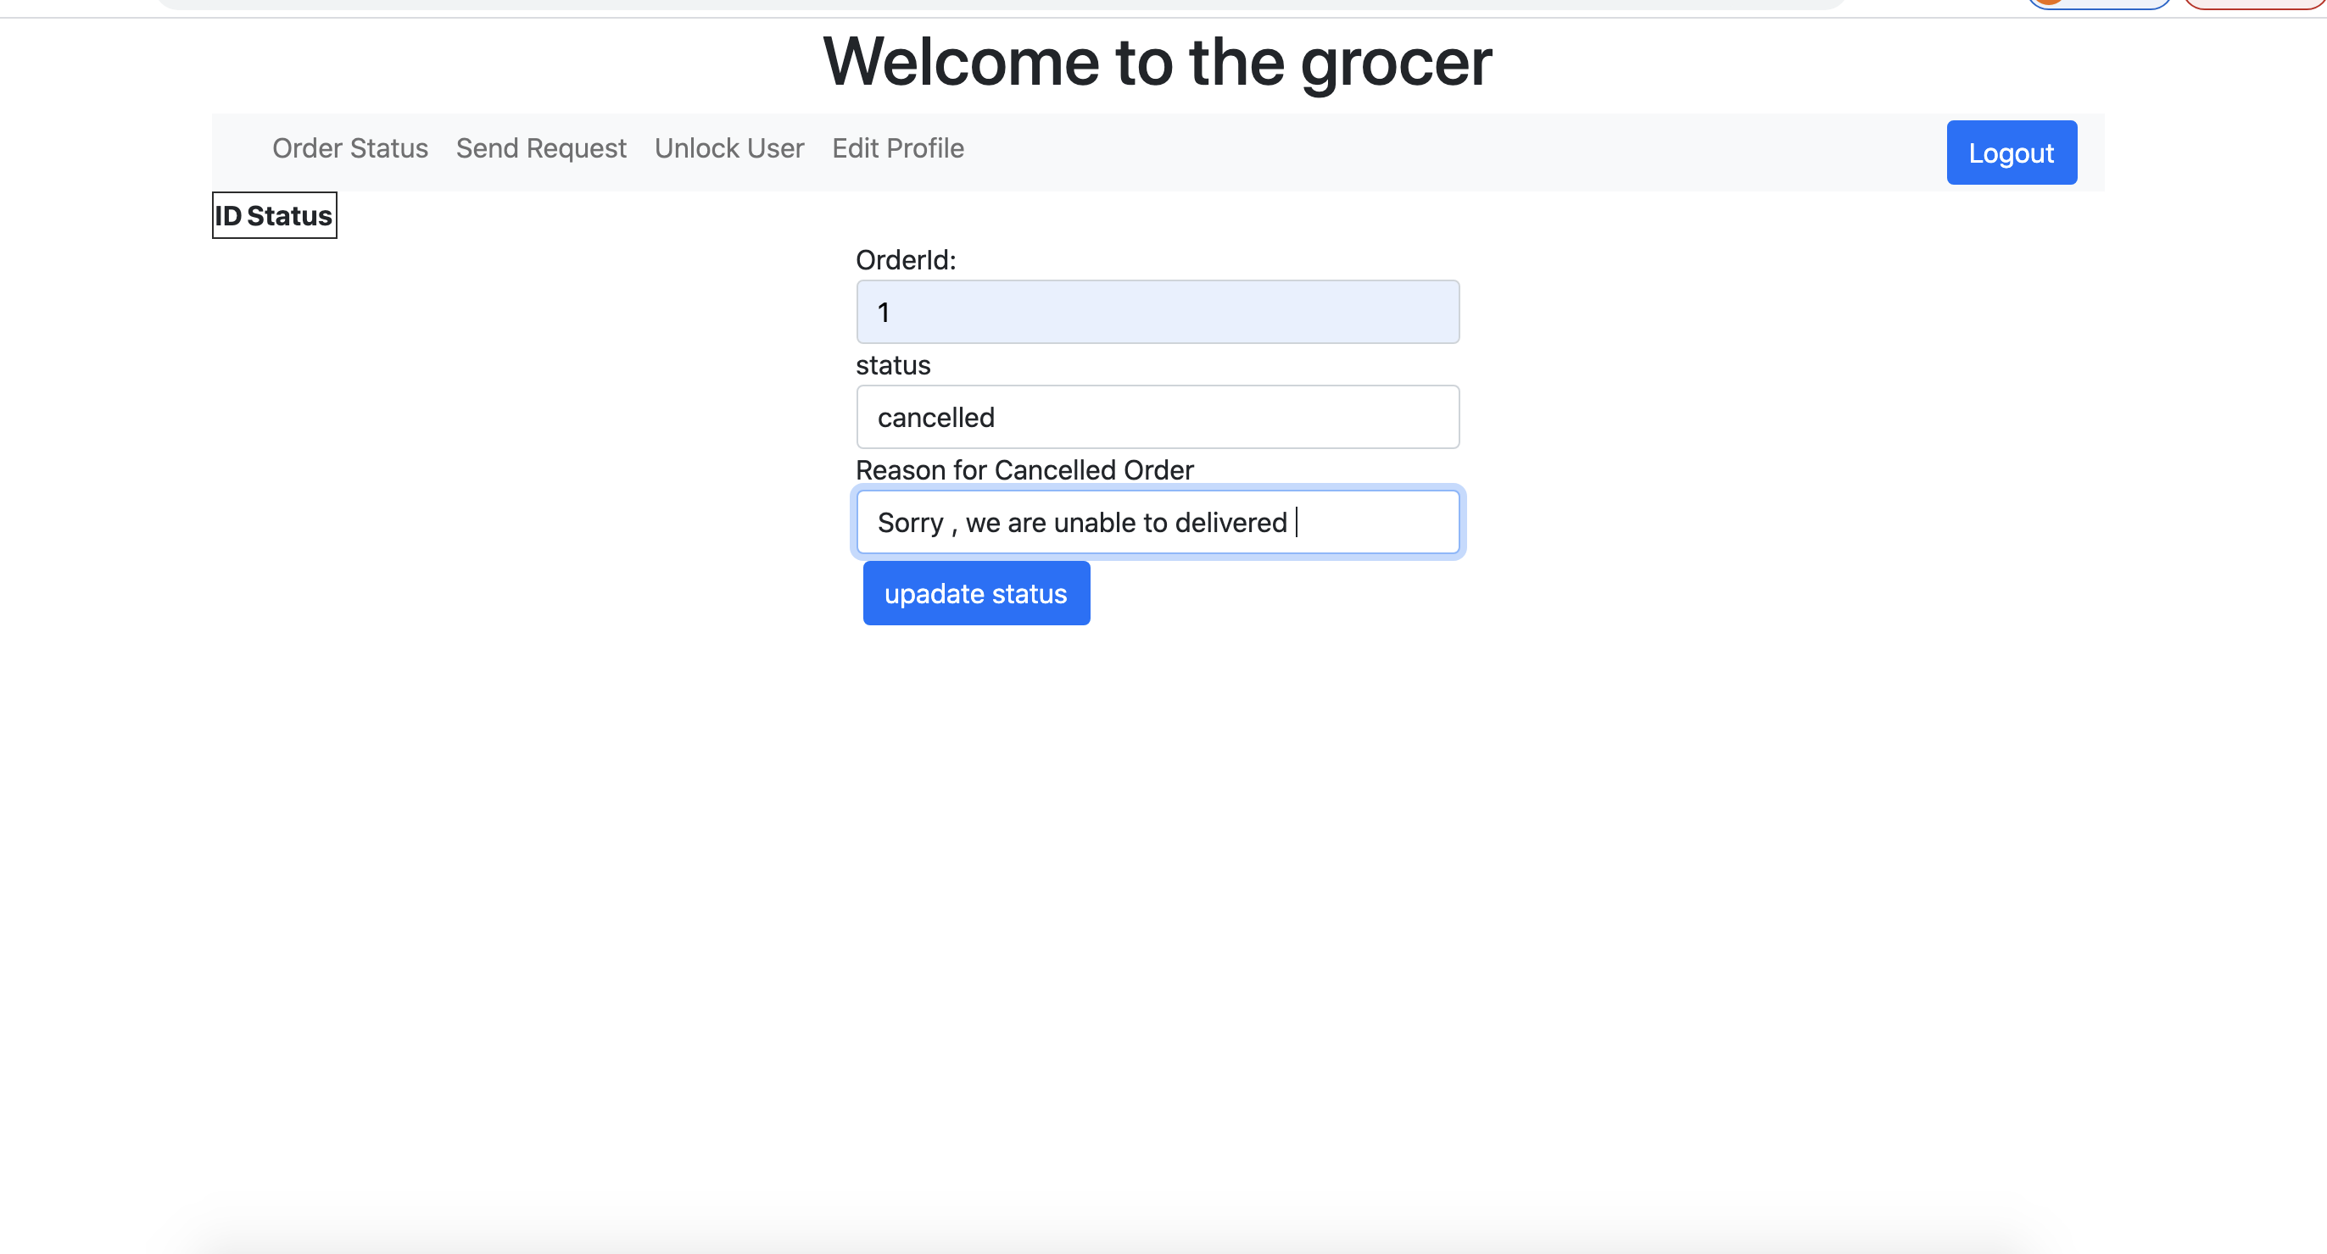

Slide 6
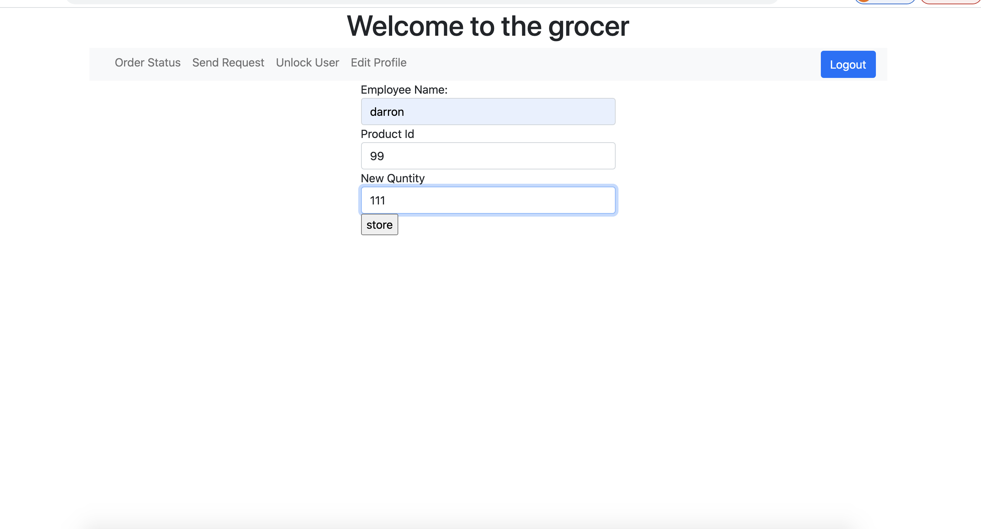

Slide 7
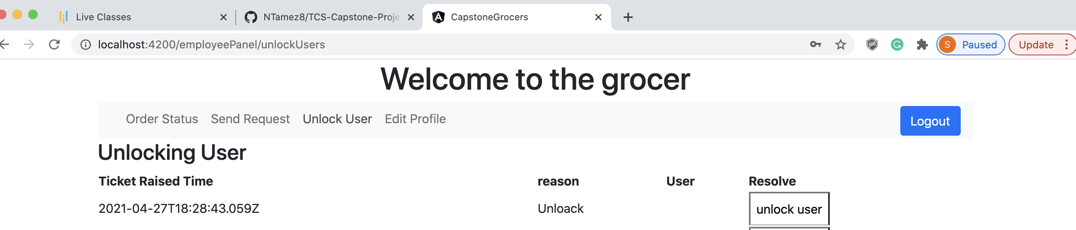

Slide 8
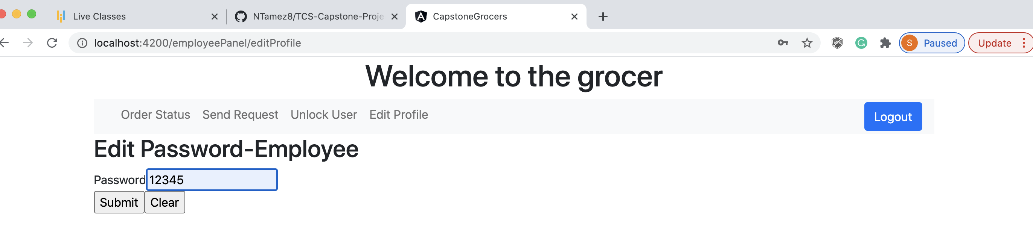

Slide 9
Challenges

Slide 10

Thank You

