Slide 1

Grosser Shopping

Slide 2
Team Member
Darren Dixon – Resposible for create Admin Pannel and As admin he implement to add employee, edit employee, report generator
Nicholas Tamez→ He implemented User Pannel.
Rachel Rajen →Worked on Add Item in Cart, Edit , Upadate order, checkout
PruthviRaj Mandala → He is responsible for the Create Employee Panel and Also worked on some user functionalities
Srushti Patel → She worked On Employee Functionality , Update Order status, She can send request to admin for update product, Edit Employee Profile.

Slide 3
Over Review Of Functionality
Employee Functionality
Send Request to user
Update Order Status, also if order status is cancle then give refund to user.
Unlock user
Edit Employee Profile
Logout from Employee Panel

Slide 4
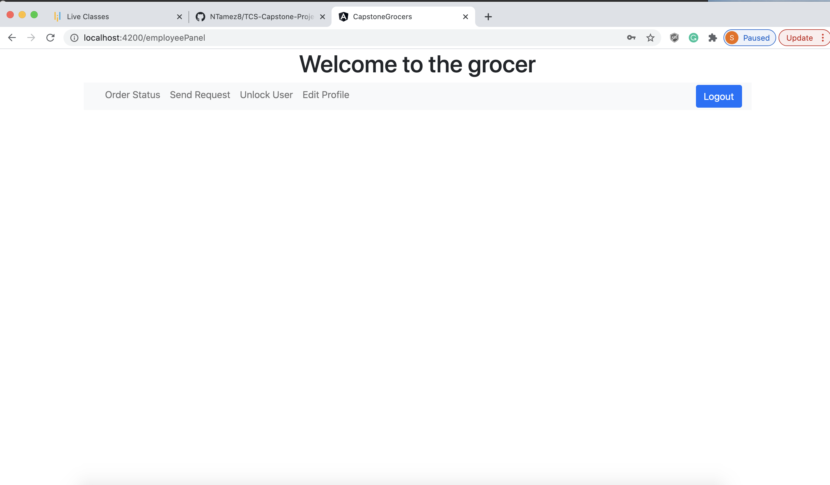
Demo

Slide 5
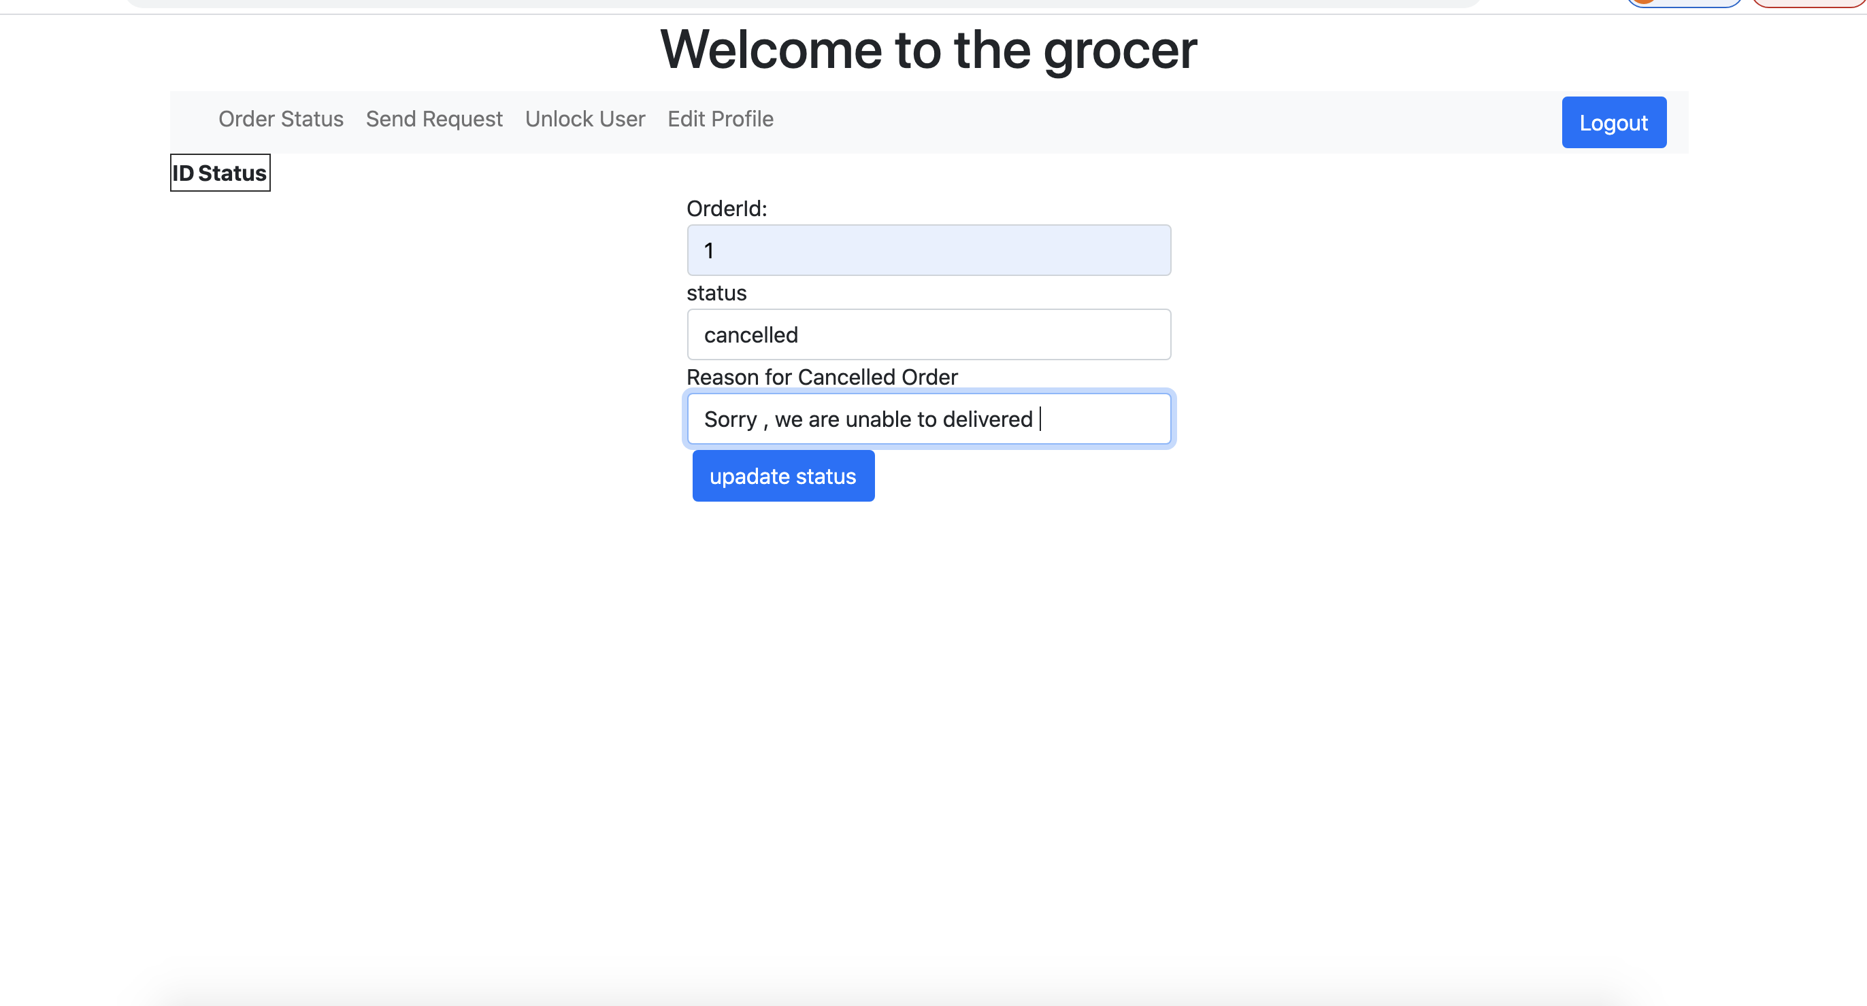

Slide 6
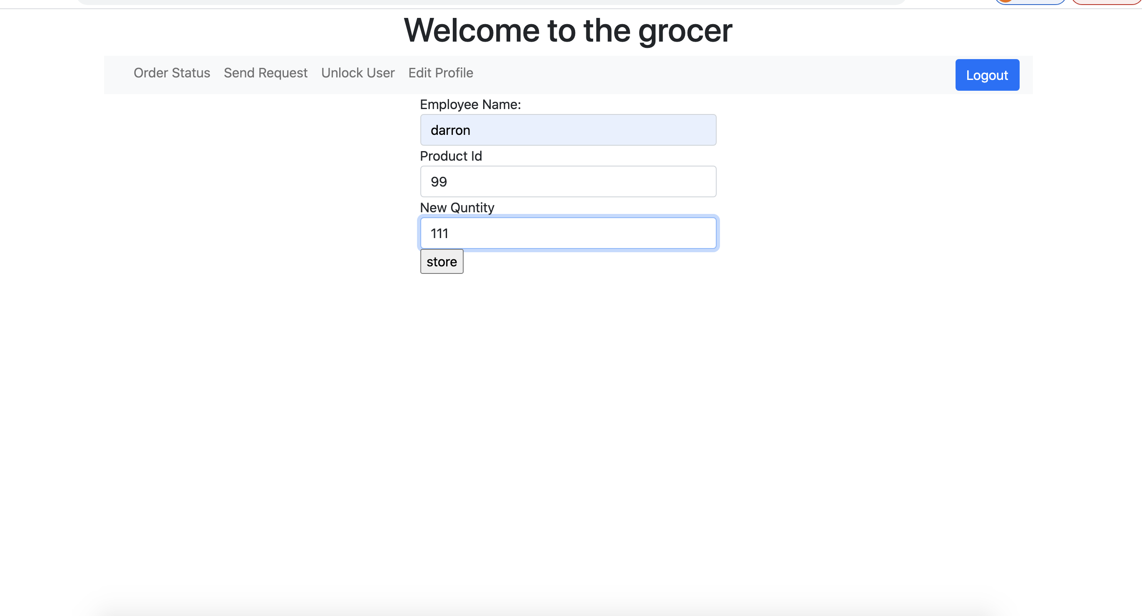

Slide 7
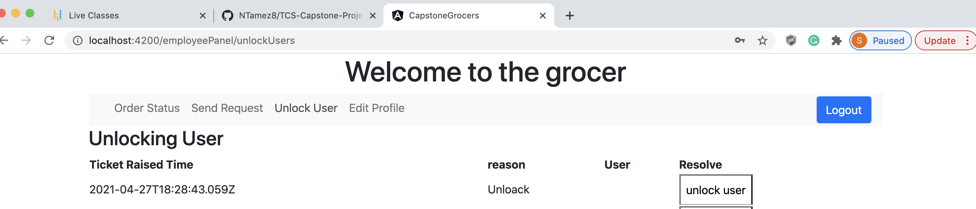

Slide 8
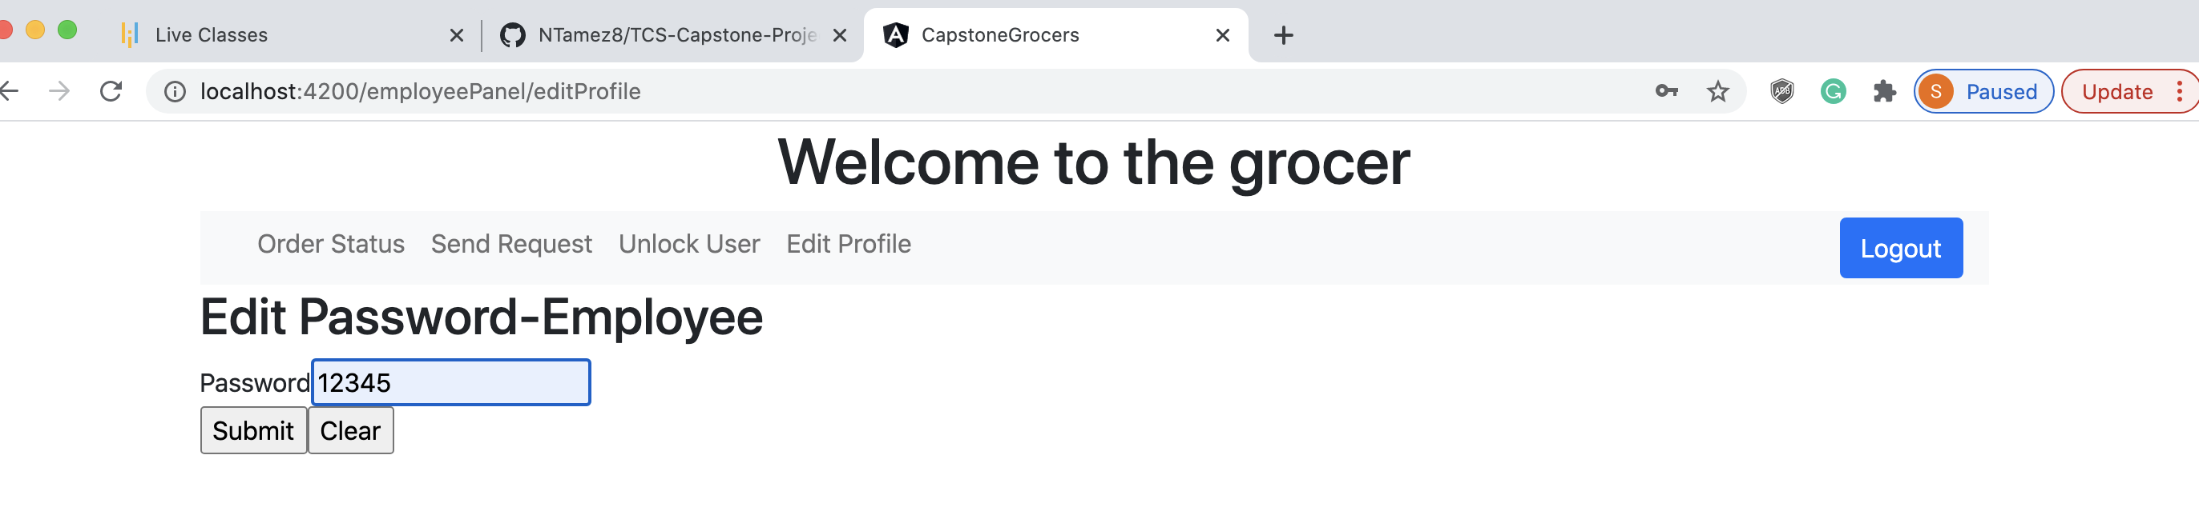

Slide 9

Thank You

