Slide 1

Digital Literacy and AI Training | Roper Gulf Regional Council
Your Orientation Deck
Homework between Session 2 and Session 3
Use this template to build your deck.

Slide 2
THE BRIEF
Your task
Build a short slide deck that introduces your workplace — the kind of thing you could show a new starter on their first day.
Keep it clear and use Roper Gulf Regional Council style guidelines.
Build it in this template, so your deck already carries the council's colours and logo.

Slide 3
STEP 1
Gather your information first
Before you open PowerPoint, jot down the answers to these.
Your place: where the building is, how you get in, and how a new person finds their way around.
Staying safe: the safety protocols that matter, and who to call when something goes wrong.
Who is who: the people in your team, what they do, and who to go to for what.
The bigger picture: where your team sits in the council, and who you report to.
Your role: what you do day to day, and what you are responsible for.

Slide 4
STEP 2
Build the deck
Open PowerPoint and start from this template.
Aim for six to ten slides. One idea per slide.
Give every slide a plain title and no more than three short bullet points.
A photo or a simple map helps in combination with words.

Slide 5
STEP 3
Let Copilot help you start
You do not have to face a blank screen. Ask Copilot to draft an outline, then make it your own.
Try this, and change the words in brackets to fit you:
“You are helping me plan a short orientation presentation for a new starter in [my team] at Roper Gulf Regional Council. Draft an outline of about eight slides that introduces our workplace: the building and getting around, safety and who to call, who is who in the team, where we fit in the council, and my role. Give each slide a title and three short bullet points, in plain language.”

Slide 6
USING COPILOT WELL
Keep it safe
Do not put anyone's personal details, community information, or anything sensitive into Copilot.
Use first names or job titles only.
Copilot writes a first draft, not the final word. Read what it gives you and fix anything that is wrong.

Slide 7
BRING IT TO SESSION 3
What “done” looks like
A short deck, six to ten slides, that you could show a new starter.
Bring it to Session 3 and be ready to talk to it for two minutes.
That is all. If you get stuck, that is a good thing to bring to the session too.

Slide 8



STYLE GUIDE
Your brand colours and logo
Use these colours and the council logo in your deck. This template already has them set up for you.

Slide 9
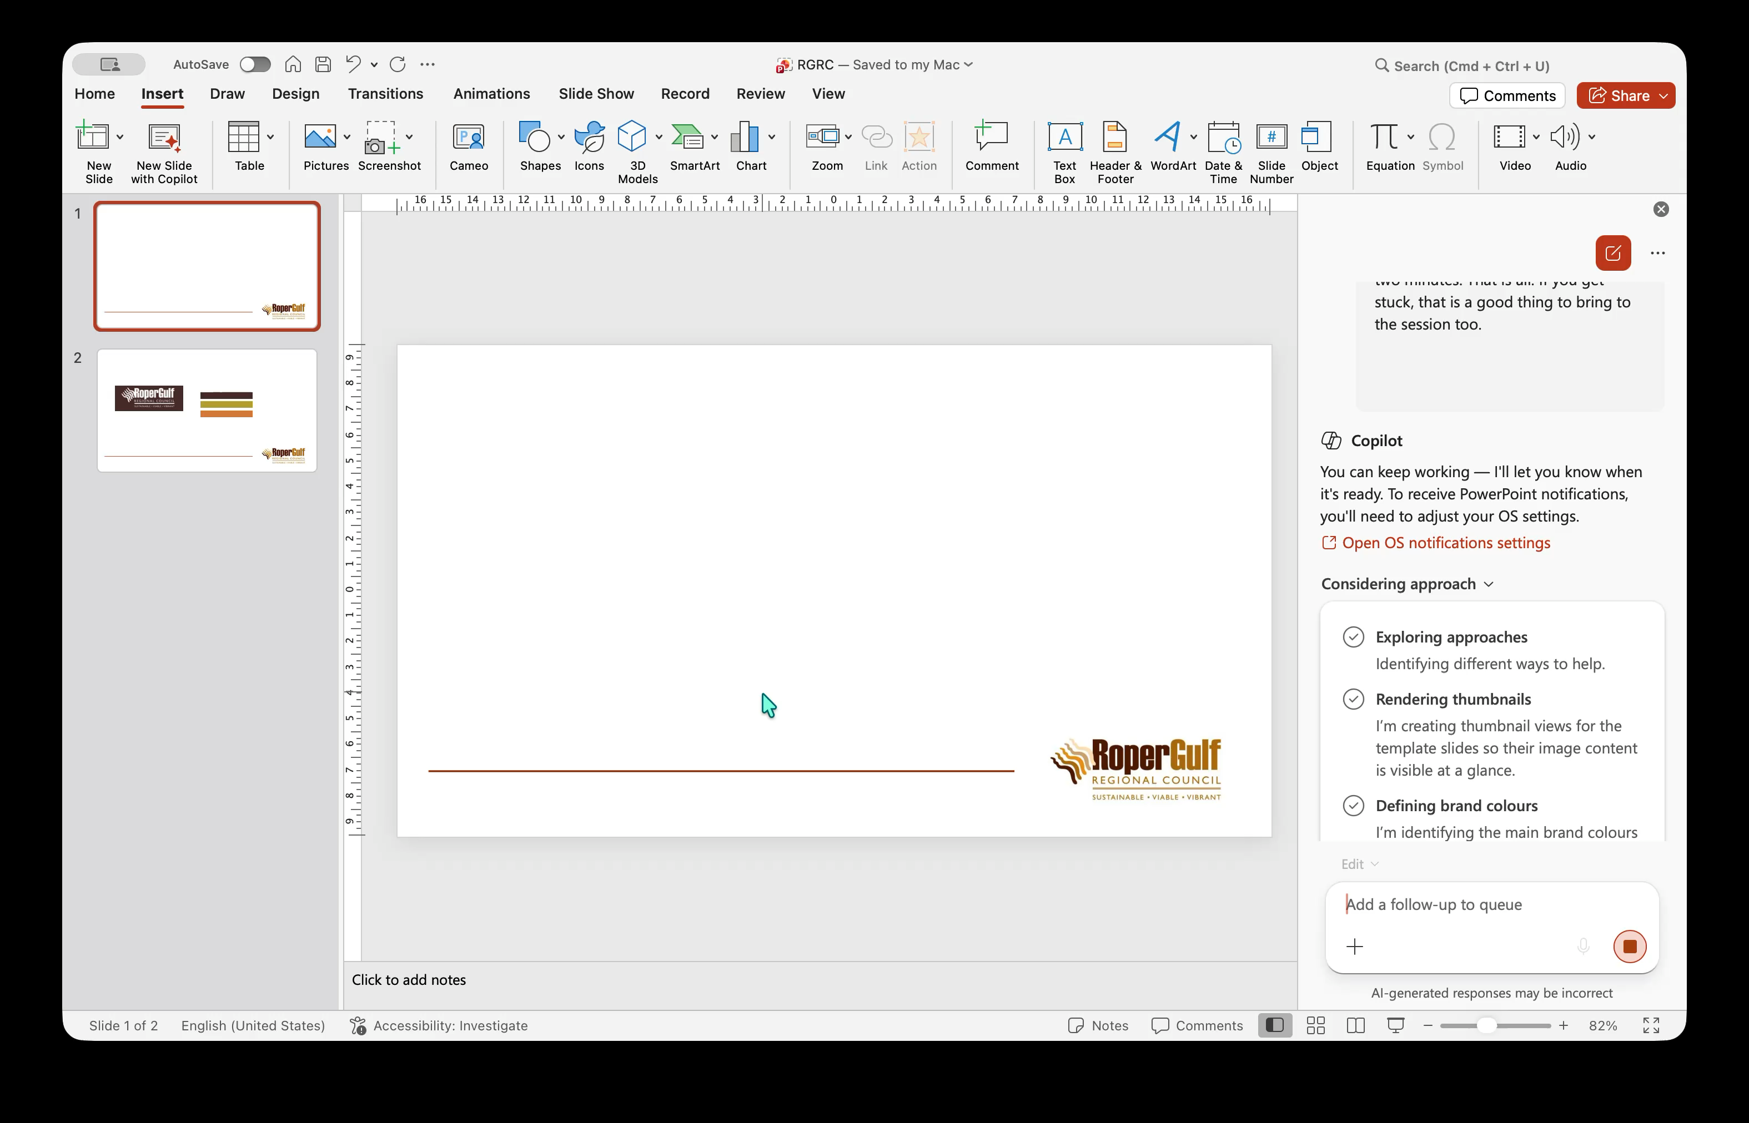
Using Copilot Enterprise to make the last 9 slides….

Slide 10
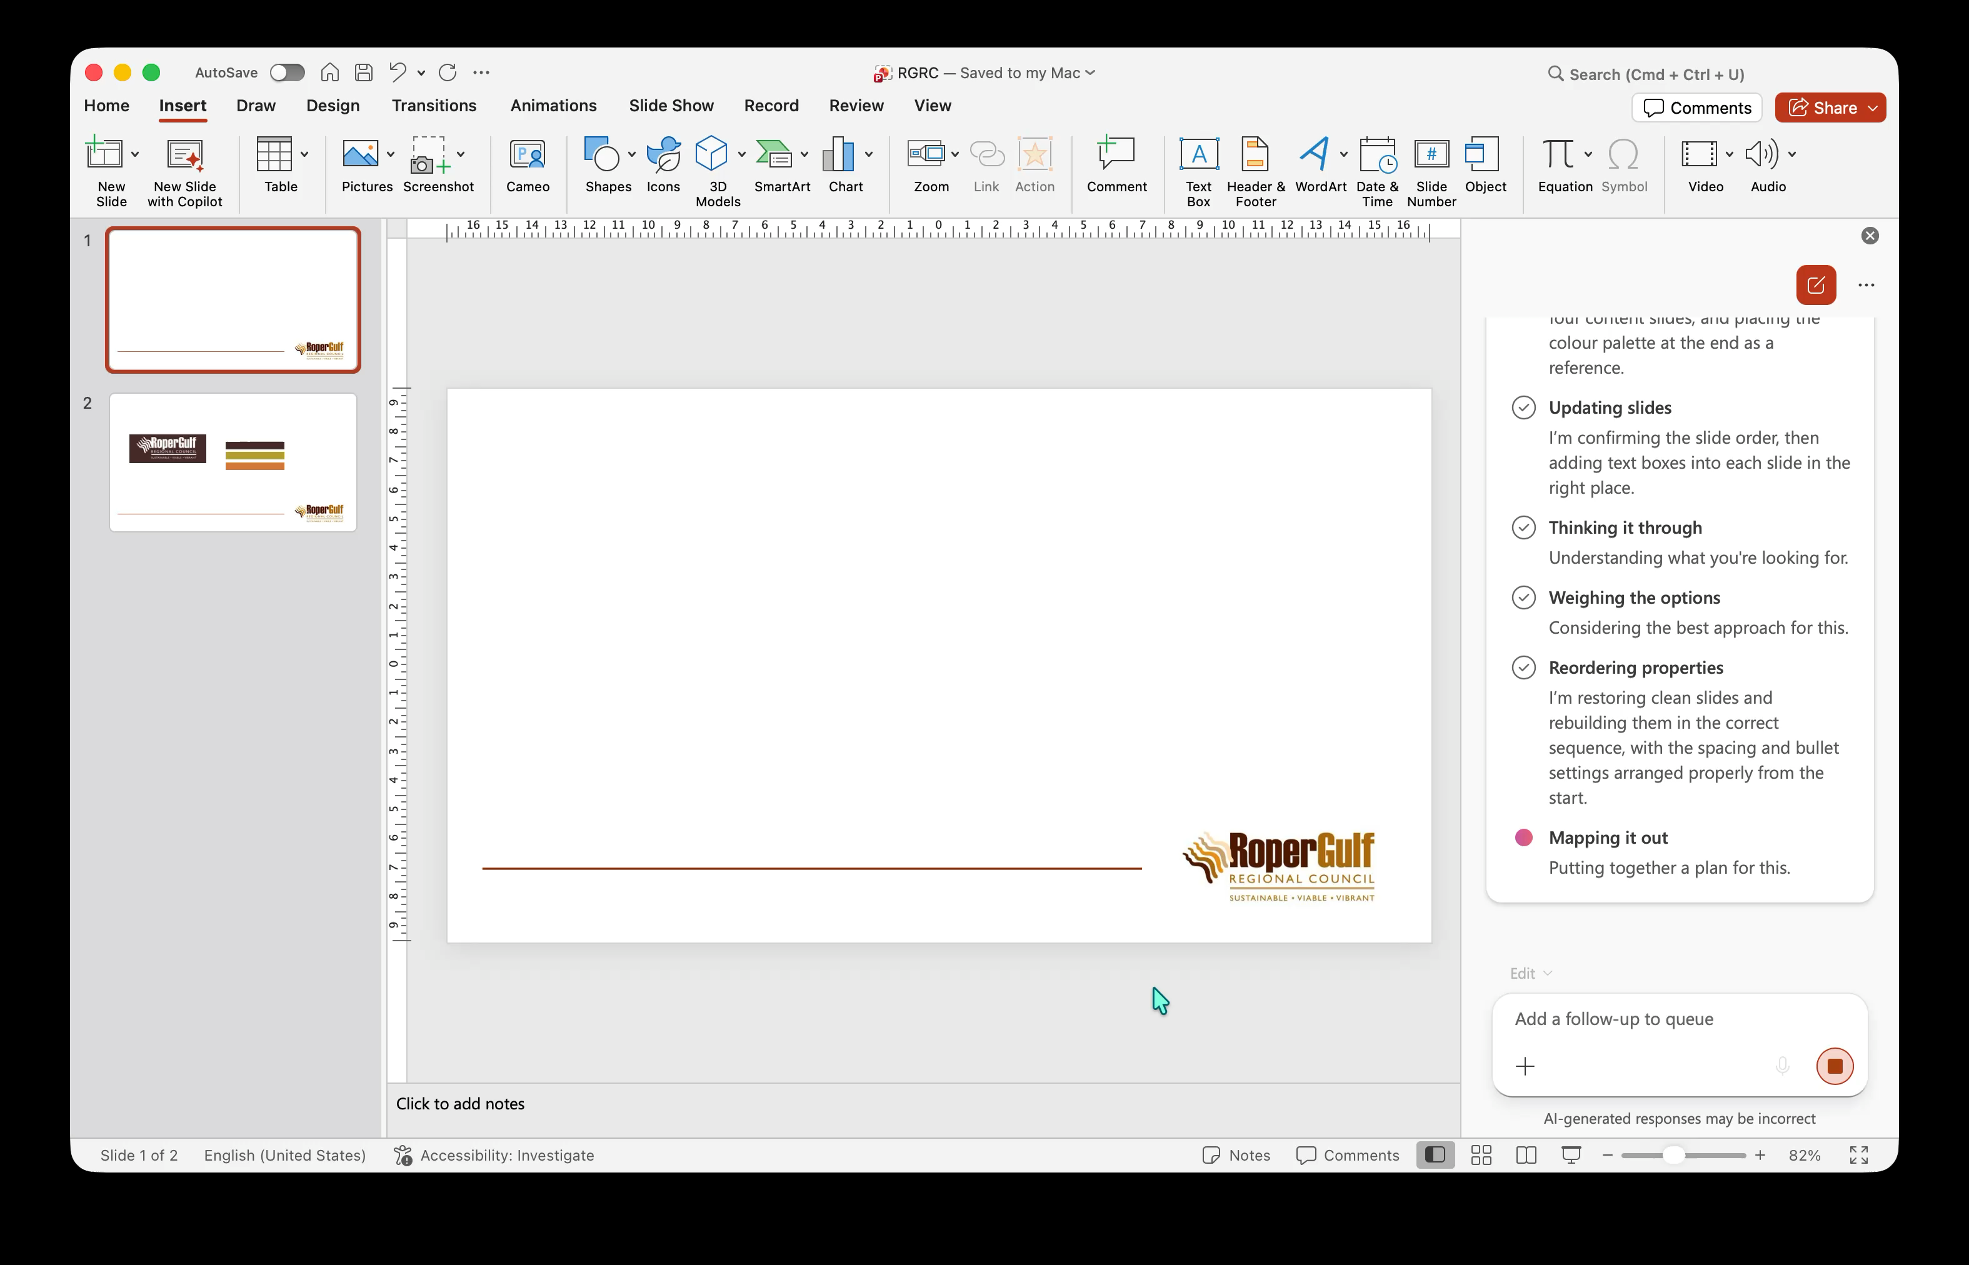
3 minutes later

