Slide 1
Can our values change with time?
Artem Nikitin, MIPT

Slide 2
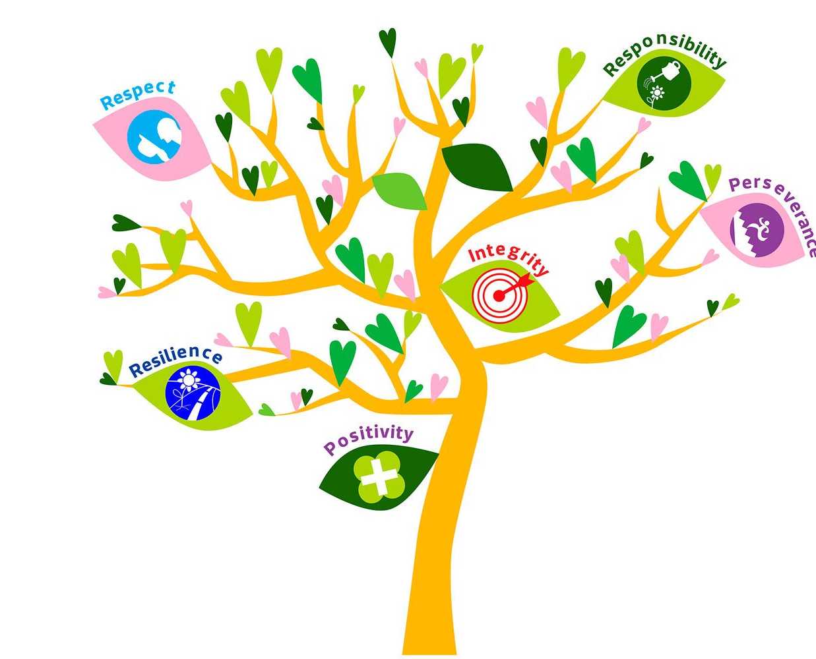
Defining Values
Values - fundamental beliefs guiding behaviour and decisions
Examples: honesty, freedom, equality, respect

Slide 3

Factors Influencing Value Changes
Life experiences
Education and knowledge
Cultural and societal shifts
Personal growth and maturity

Slide 4
Examples of Value Changes
Personal growth (independence vs. family)
Cultural shifts (gender equality, LGBT)
Technological advancements (privacy, connectivity)

Slide 5
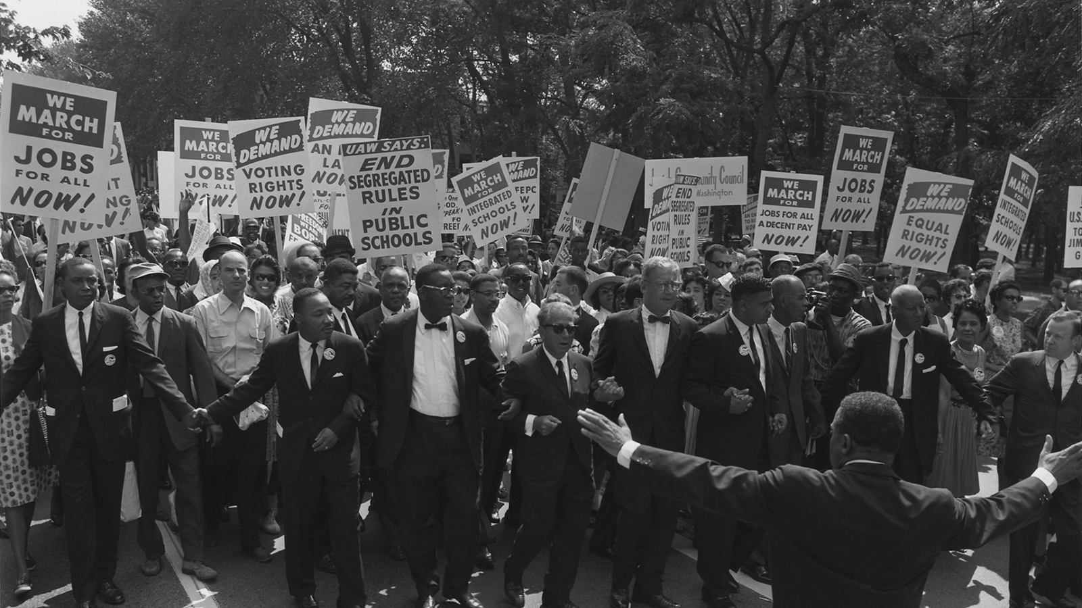
Societal Value Changes
The evolution of societal values regarding race and equality.

Slide 6

The Role of Reflection and Dialogue
Importance of self-reflection
Engaging in open dialogue
Impact on personal growth and societal progress

Slide 7

Theoretical Perspectives
Maslow's Hierarchy of Needs
Social Learning Theory
Cognitive Dissonance Theory

Slide 8
Implications of Changing Values
Personal development
Interpersonal relationships
Policy and leadership

Slide 9
Conclusion
Values are fluid and dynamic
Influences: Personal experiences, societal shifts, quest for knowledge
Embracing change for personal growth and empathy

Slide 10
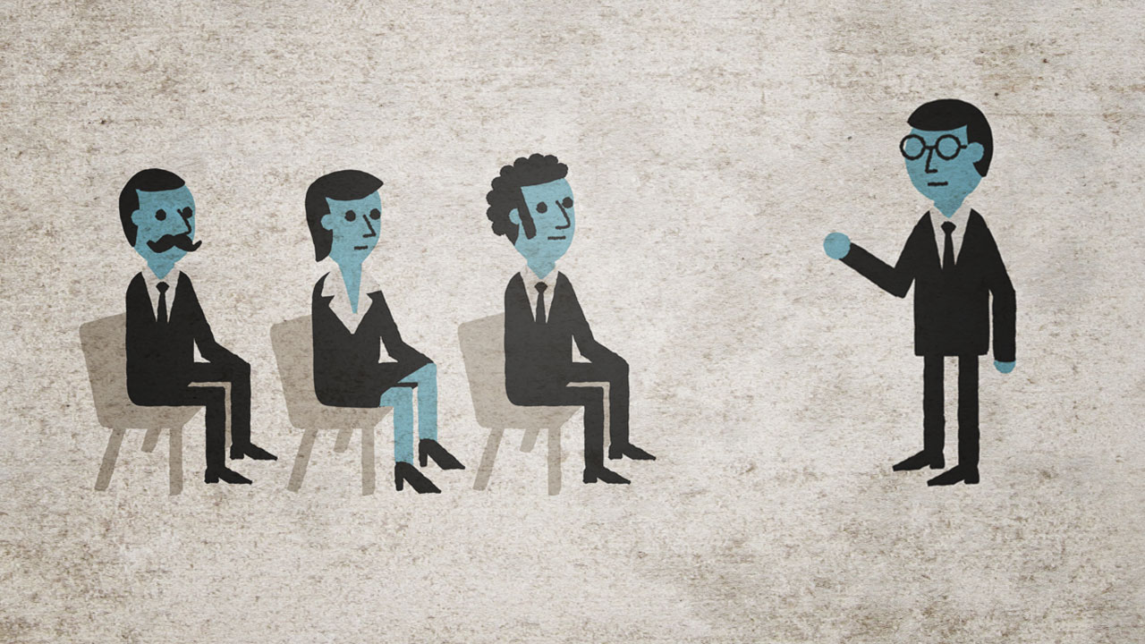
Thanks for your attention!

