Slide 1
Chapter 1: The new mainframe

Slide 2
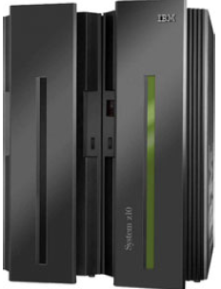
Chapter objectives
Be able to:
List ways in which the mainframe of today challenges the traditional thinking on centralized computing versus distributed computing
Explain how businesses make use of mainframe processing power, the typical uses of mainframes, and how mainframe computing differs from other forms of computing
Outline the major types of workloads for which mainframes are best-suited
Name five jobs or responsibilities related to mainframe computing
List four mainframe operating systems.

Slide 3
Key terms in this chapter
Screenshot 1
application programmer
architecture
balanced system
batch processing
Business Class
compatibility
e-Business
EBCDIC
Enterprise Class
environment friendly
extensibility
high availability
infrastructure
mainframe
MIPS
online processing
platform
production control
punched card
RAS
scalability
server farm
specialty engines
system administrator
system operator
system programmer
total cost of ownership
transaction processing

Slide 4
7th April 1964, Poughkeepsie NY
A new generation of electronic computing equipment was introduced today by International Business Machines Corporation. IBM Board Chairman Thomas J. Watson Jr. called the event the most important product announcement in the company's history.
The new equipment is known as the IBM System/360.
"System/360 represents a sharp departure from concepts of the past in designing and building computers. It is the product of an international effort in IBM's laboratories and plants and is the first time IBM has redesigned the basic internal architecture of its computers in a decade. The result will be more computer productivity at lower cost than ever before. This is the beginning of a new generation - - not only of computers - - but of their application in business, science and government."
Notes:
System/360 offered a choice of five processors and 19 combinations of power, speed and memory. A user could operate the same magnetic tape and disk products as another user with a processor 100 times more powerful.
System/360 also offered dramatic performance gains, thanks to Solid Logic Technology - half-inch ceramic modules containing circuitry far denser, faster and more reliable than earlier transistors.
System/360 monthly rentals will range from $2,700 for a basic configuration to $115,000 for a typical large multisystem configuration.
Comparable purchase prices range from $133,000 to $5,500,000.
Prices as low as $3,000,000 per MIP !
In 1964 a nice house cost about $6,000
Today zSeries pricing is less than $1000 per MIP

Slide 5
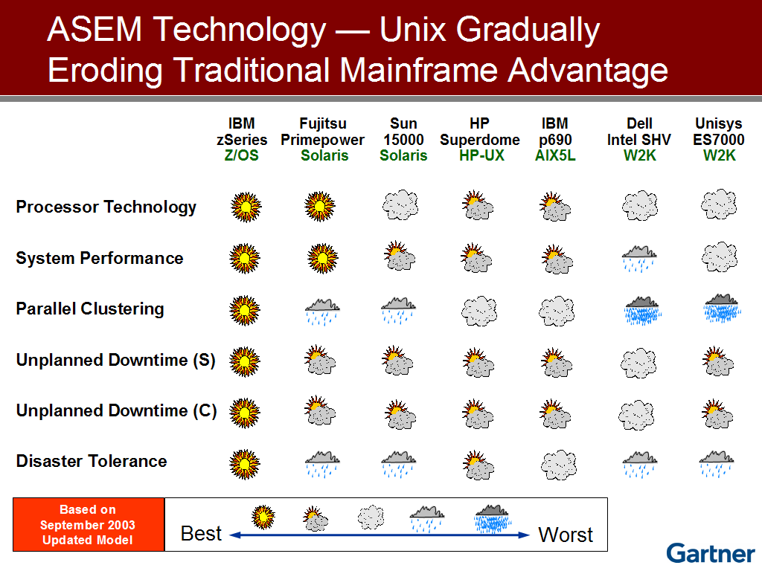
What Would You Title This Chart?

Slide 6




The Mainframe Charter – Providing a Strategic Framework
It is our intention to…
Innovation
Provide leadership in innovation to enhance the use of the IBM mainframe to support increasingly integrated and flexible business processes for the On Demand Business.*
Value
Enhance the value proposition and lower the cost of computing of mainframe solutions in a way that is compelling, clear, and consistent.*
Community
Support programs designed to foster vitality in the IBM mainframe community, helping to promote a strong application portfolio and world-class support services.*
* Excerpted from the Mainframe Charter – August 2003

Slide 7
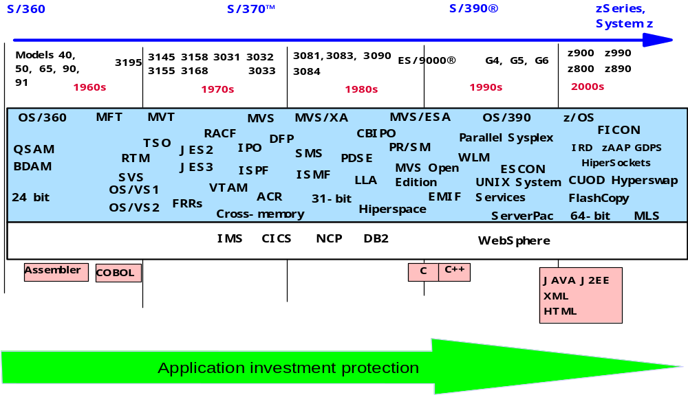
z/OS Innovation –
Redefining the mainframe for 5 decades!
Notes:
System/360 was introduced in 1964. z/OS, its successor, is the result of 40 years of constant innovation and refinement. From the System/360 Model 40 to the zSeries 990, and from the beginnings of OS/360 to z/OS, new capabilities and technologies have been added while protecting your investment in existing applications.

Slide 8
Mainframes in our midst
Mainframes:
Are prevalent, yet hidden from public eye
Not often publicized – stable, reliable, dependable.
Contrast with other forms of computing, such as PCs.
Present opportunities for college graduates in a variety of technical fields.
Notes:
Despite the predominance of mainframes in the business world, these machines are
largely invisible to the general public, the academic community, and indeed many
experienced IT professionals. Instead, other forms of computing attract more attention, at
least in terms of visibility and public awareness. That this is so is perhaps not surprising.
After all, who among us needs direct access to a mainframe? And, if we did, where
would we find one to access? In truth, we are all mainframe users, whether we realize it
or not.

Slide 9
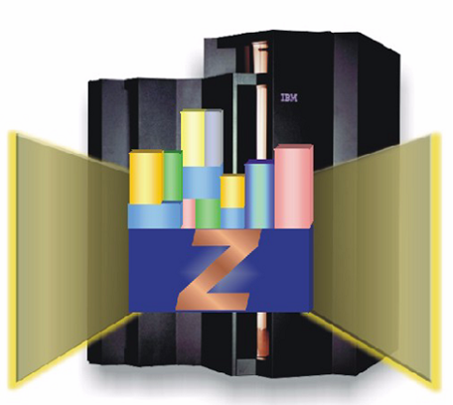
What is a mainframe
A style of operation, applications, and operating system facilities.
Computers that can support thousands of applications and
input/output devices to simultaneously serve thousands of users.
A mainframe is the central data repository, or hub, in a
corporation’s data processing center, linked to users through less
powerful devices such as workstations, terminals or media devices.
Can run multiple, but isolated operating systems concurrently.
What businesses use to host the commercial databases, transaction servers, and
applications that require a greater degree of security and availability than is
commonly found on smaller-scale machines.”.
Centralized control of resources.
Optimized for I/O in all business-related data processing applications supporting high
speed networking and terabytes of disk storage.
Notes:
“ The instructor should supplement these bullets with their own thoughts ! ”

Slide 10
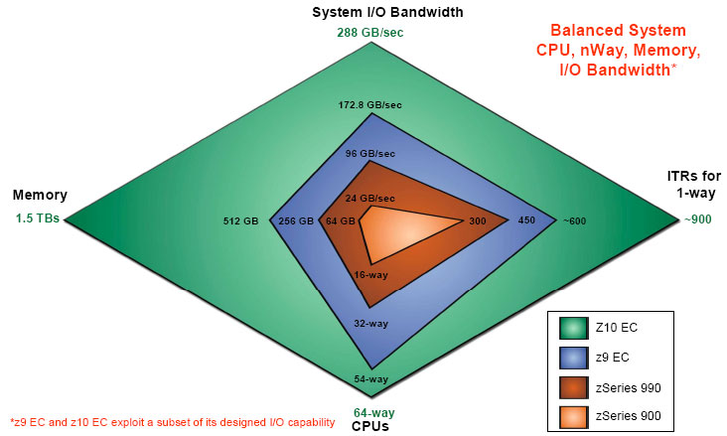
Mainframe is a balanced system design
The ITR is a rate calculated against a base machine, the 701
Internal transaction rate ratio
Notes:
This slide displays the mainframe’s continued growth improvements in all directions. While some of the previous generation of machines have grown more along one graphical axis for a given family, later families focus on the other axes.
The balanced design of today’s mainframe achieves improvement equally along all four axes.
ITR = Internal Throughput Rate (SRM Second or Service Units)

Slide 11
Mainframe facts
Screenshot 1
Who uses mainframes?
  Most Fortune 1000 companies use a mainframe environment
  60% of all data available on the Internet is stored on mainframe computers
Why mainframes?
  Large-scale transaction processing
    Thousands of transactions per second
  Support thousands of users and application programs
  Simultaneously accessing resources
  Terabytes of information in databases
  Large-bandwidth communications
There are more CICS transactions processed daily than Web pages served

Slide 12
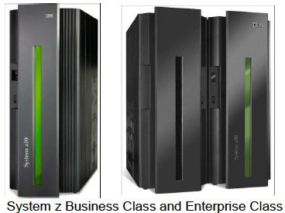
Two mainframe models
BC EC
Notes:
IBM has a mainframe to suit most business organizations, from small to large.
Each model provides for subcapacity processors from very granular processing requirements up to the full range of high-end computing.
The System z Business Class (BC) with a focus on small to midrange enterprise computing, delivers an entry point with very granular scalability and an unprecedented range of capacity settings to grow with the workload. It delivers unparalleled qualities of service to help manage growth and reduce cost and risk.
The BC server further extends System z leadership by enriching its flexibility with enhancements to the just-in-time capacity deployment functions in a single frame housing. The BC provides for a maximum of up to 10 configurable CPs.
The BC shares many of the characteristics and processing traits of its bigger brother the Enterprise Class (EC). This model also delivers granular scalability and capacity settings on a much larger scale targeted to very high end processing needs. It has a larger frame to house the extensive capacity to support greater processing requirements. The EC offers up to 64 configurable
CPs and is considered IBM’s flagship platform.

Slide 13
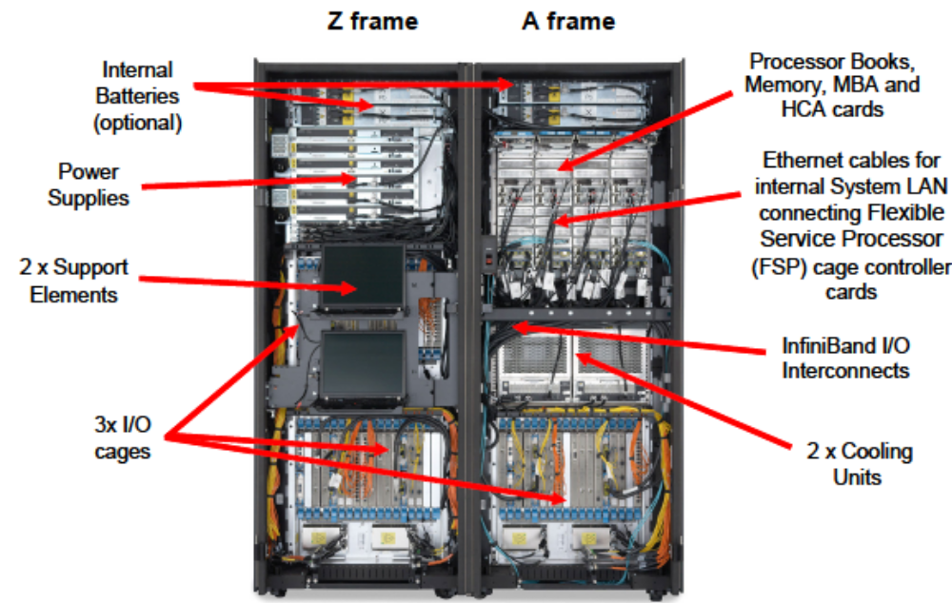
Inside an Enterprise Class (EC) Mainframe

Slide 14
Factors contributing to mainframe use
RAS -- reliability, availability, serviceability
Security
Scalability
Centralized control
Workload management
Partitioning / virtualization
Continuing compatibility
Evolving architecture
Application enablement, complexity, variety
Potential for thousands of users
Extensibility
Total cost of ownership
Environment friendly
Notes:
Instructor should spend time discussing these bullets –
Reliability Involves the use of high-quality hardware and software components,
and extensive self-checking and self-recovery by hardware
components.
Availability The ability of hardware to detect and automatically replace failing
hardware elements, and for system software to detect, isolate, and
recover failing software components.
Serviceability Through well-defined units of replacement, the hardware and software
can often be non-disruptively serviced or upgraded, with little or no
impact to the operational system.
A secure computer system prevents users from accessing or changing any objects on the
system, including user data, except through system-provided interfaces that enforce
authority rules. Mainframe computers can provide a very secure system for processing
large numbers of heterogeneous applications that access critical data.
By scalability we mean the ability of the hardware, software, or a distributed system to
continue to function well as it is changed in size or volume; for example, the ability to
retain performance levels when adding processors, memory, and storage.
The need to support applications of varying ages imposes a strict compatibility demand
on mainframe hardware and software, which have been upgraded many times since the
first System/360 mainframe computer was shipped in 1964. Applications must continue
to work properly. Thus, much of the design work for new hardware and system software
revolves around this compatibility requirement.
Each new generation of mainframes has added improvements in one or more of the following
areas:
More and faster processors
More physical memory and greater memory addressing capability
Dynamic capabilities for upgrading both hardware and software
More sophisticated automated hardware error checking and recovery
Enhanced devices for input/output (I/O) and more and faster paths (channels)
between I/O devices and processors
Sophisticated I/O attachments, such as LAN adapters with extensive inboard
processing
Increased ability to divide the resources of one machine into multiple, logically
independent and isolated systems, each running its own operating system
Enhanced clustering technologies, such as Parallel Sysplex, and the ability to share
data among multiple systems.
In software engineering, extensibility is a system design principle where the implementation takes into consideration future growth. It is a systemic measure of the ability to extend a system and the level of effort required to implement the
extension. Extensions can be through the addition of new functionality or through modification of existing functionality. The mainframe’s central theme is to provide for change while minimizing impact to existing system functions.
Most organizations do not accurately calculate the total costs of their server proliferation, largely because chargeback mechanisms do not exist, because only incremental mainframe investment costs are compared to incremental distributed costs, or because total shadow costs are not weighed in. Many organizations also fail to recognize the path length delays and context switching of running workloads across many servers which typically adds up to a performance penalty non existent on the mainframe.
The mainframe’s virtualization leverages the power of many servers using a small hardware footprint. Today’s mainframe reduces the impact of energy cost to a near-negligible value when calculated on a per logical server basis becausemore applications, several hundred of them, can be deployed on a single machine.

Slide 15
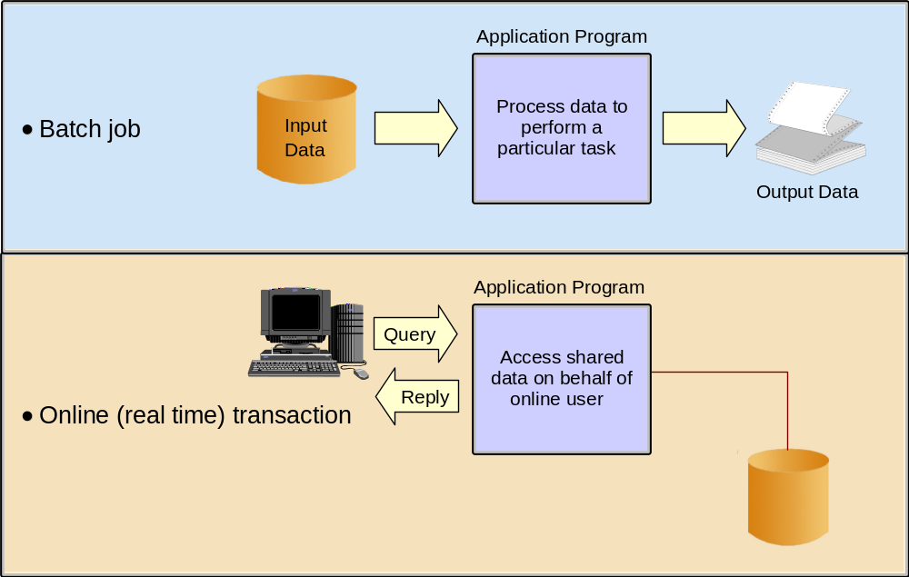
Typical mainframe workloads
Notes:
A batch job is submitted on the computer,
reads and processes data in bulk, and produces output. A batch job can last for hours.
While batch processing is possible on distributed systems, it is not as commonplace as on
mainframes because distributed systems often lack:
Sufficient data storage
Available processor capacity or cycles
Sysplex-wide management of system resources and job scheduling.
Mainframes serve a vast number of online transaction processing (OLTP) systems.
These are often mission-critical applications that businesses depend on for their core
functions. Some industry uses of online systems:
Banks – ATMs, teller systems for customer service
Insurance – Agent systems for policy management and claims processing
Travel and transport – Airline reservation systems
Manufacturing – Inventory control, production scheduling
Government – Tax processing, license issuance and management.

Slide 16
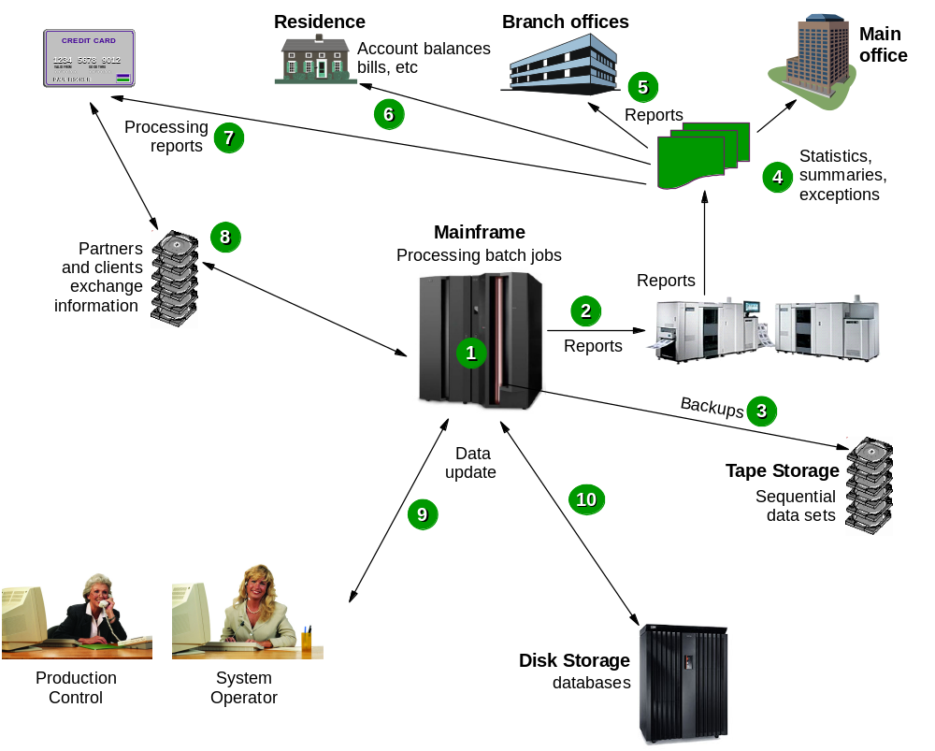
Typical batch use
Notes:
Consider the following elements at work in the scheduled batch process:
1. At night, many batch jobs executing programs and utilities are processed. These jobs
consolidate the results of the online transactions executed during the day.
2. The batch jobs generate reports of business statistics.
3. Backups of critical files and databases are made before and after the batch window.
4. Reports with business statistics are sent to a specific area for analysis during the
following day.
5. Reports with exceptions are sent to the branch offices.
6. Monthly account balance reports are generated and sent to all bank customers.
7. Reports with processing summary are sent to the partner credit card company.
8. A credit card transaction report is received from the partner company.
9. In the production control department, the operations area is monitoring the messages
on the system console and the execution of the jobs.
10. Jobs and transactions are reading or updating the database (the same database used by
online transactions) and many files are written to tape.

Slide 17
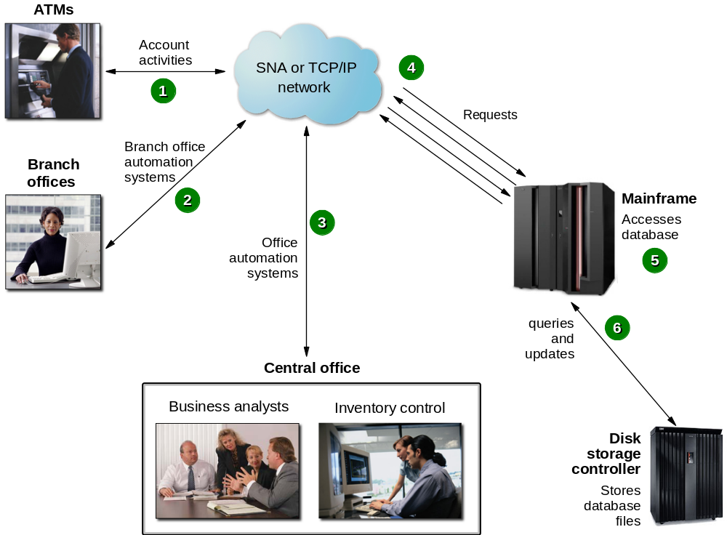
Typical online use
Screenshot 2
Notes:
Common online transactions using a mainframe:
1. A customer uses an ATM, which presents a user-friendly interface for various
functions: Withdrawal, query account balance, deposit, transfer, or cash advance from
a credit card account.
2. Elsewhere in the same private network, a bank employee in a branch office performs
operations such as consulting, fund applications, and money ordering.
3. At the bank’s central office, business analysts tune transactions for improved
performance. Other staff use specialized online systems for office automation to
perform customer relationship management, budget planning, and stock control.
4. All requests directed to the mainframe computer for processing.
5. Programs running on the mainframe computer perform updates and inquires to the
database management system (for example, DB2).
6. Specialized disk storage systems store the database files.

Slide 18
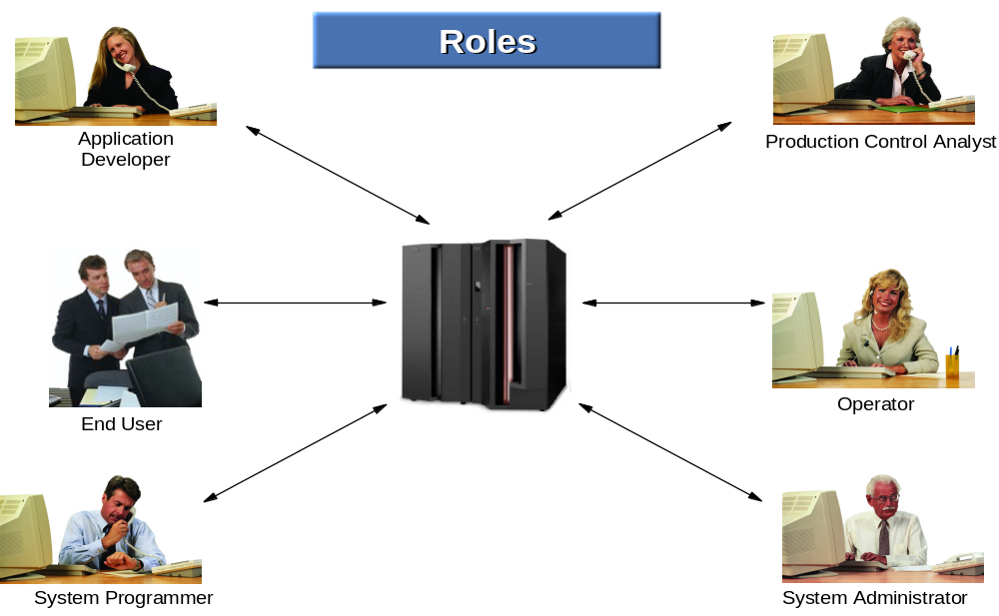
Roles in the mainframe world
Screenshot 2
Notes:
System administrators perform more of the day-to-day tasks
related to maintaining the critical business data that resides on the mainframe, while the
system programmer focuses on maintaining the system itself.
Examples of system administrators include database administrators and
security administrators.
While system programmer expertise lies mainly in the mainframe hardware and software
areas, system administrators are more likely to have experience with the applications.
The application designer and application programmer (or developer) design, build, test,
and deliver mainframe applications for the company’s end users and customers. Based on
requirements gathered from business analysts and end users, the designer creates a design
specification from which the programmer constructs an application. The process includes
many iterations of code changes and compiles, application builds, and unit testing.
The system operator monitors and controls the operation of the mainframe hardware and
software. The operator starts and stops system tasks, monitors the system consoles for
unusual conditions, and works with the system programming and production control staff
to ensure the health and normal operation of the systems.
The production control analyst is responsible for ensuring that batch workloads run to
completion--without error or delay.

Slide 19
Mainframe Operating System Heritage
OS/360 -> OS/VS -> MVS -> MVS/SP -> MVS/XA -> MVS/ESA -> OS/390 -> z/OS
z/OS, IBM’s premier zSeries operating system, is a highly secure, scalable, high-performance enterprise operating system on which to build and deploy traditional and Java-enabled applications, providing a comprehensive and diverse application execution environment.
DOS/360 -> DOS/VS -> VSE/SP -> VSE/ESA -> z/VSE
z/VSE enables proven, robust, and cost-effective solutions. z/VSE provides sturdy batch and industrial strength on-line transaction processing (CICS) capabilities. z/VSE can fit comfortably into a legacy of thrifty, dependable z/VSE solutions.
ACP -> TPF-> z/TPF
TPF is the platform driving the business-critical systems for many of IBM's largest and most sophisticated users of online transaction processing - airlines, railroads, hotels, financial services, government, credit card and banking industries.
CP/67 -> VM/370 -> VM/SP -> VM/XA -> VM/ESA -> z/VM
z/VM provides a highly flexible test and production environment for enterprises deploying the latest e-business solutions. z/VM helps enterprises meet their growing demands for multi-user server solutions with support for a broad range of operating systems.
Notes:
There is one other OS that is not on this chart, Linux. It is life to this platform (application growth, skills issues, MIPS growth). All the problems the MF has had Linux has been a God Send! It’s the survive and thrive. It’s thriving now and there is one reason why – Linux!

Slide 20
Summary
The New Mainframe:
Plays a central role in the daily operations of the world’s largest organizations – and the daily lives of most people.
Is known for its reliability, security, and enormous processing capabilities.
Is designed for processing large scale workloads and serving thousands of users and transactions concurrently.
Is managed by highly skilled technical support staff.
Runs a variety of operating systems.

