Slide 1
Chapter 2A: Hardware systems and LPARs

Slide 2
Objectives
SCREENSHOT 1
In this chapter you will learn:
  About S/360 and zSeries hardware design
  Mainframe terminology
  Hardware componentry
  About processing units and disk hardware
  How mainframes differ from PC systems in data encoding
  About some typical hardware configurations

Slide 3
Introduction
p. 45
Here we look at the hardware in a complete system although the emphasis is on the processor “box”
Terminology is not straightforward
  Ever since “boxes” became multi-engined, the terms system, processor, and CPU have become muddled

Slide 4
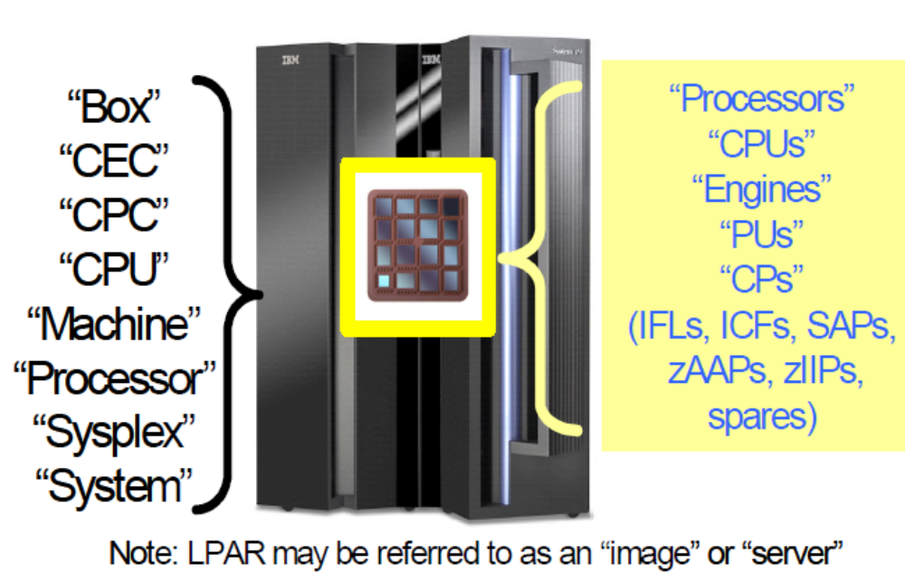
Terminology Overlap
Notes:
In the early S/360 days a system had a single processor, which was also known as the central processing unit (CPU). The terms system, processor, and CPU were used interchangeably. However, these terms became confusing when systems became available with more than one processor. Today the mainframe has a rich heritage of terms as illustrated here.

Slide 5
Early system design
System/360 was designed in the early 1960s
The central processor box contains the processors, memory, control circuits and channel interfaces
  Early systems had up to 16 channels whereas modern systems have 1024 (256 * 4 Logical Channel Subsystems)
Channels connect to control units
Control units connect to devices such as disk drives, tape drives and communication interfaces

Slide 6
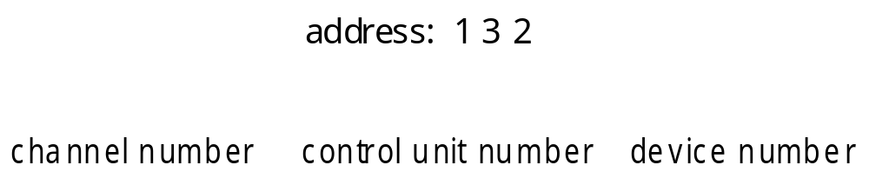
Device address
p. 47
In the early design the device address was physically related to the hardware architecture
Parallel channels had large diameter heavy copper “bus and tag” cables
This addressing scheme is still in use today only vituralized

Slide 7
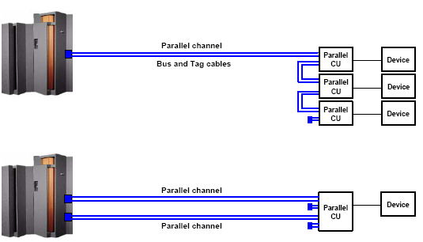
Parallel Channel “Connectivity”
The maximum data rate of the parallel channel is up to 4.5 MB, and the maximum distance that can
be achieved with a parallel channel interface is up to 122 meters (400 ft).
These specifications can be limited by the connected control units and devices.

Slide 8
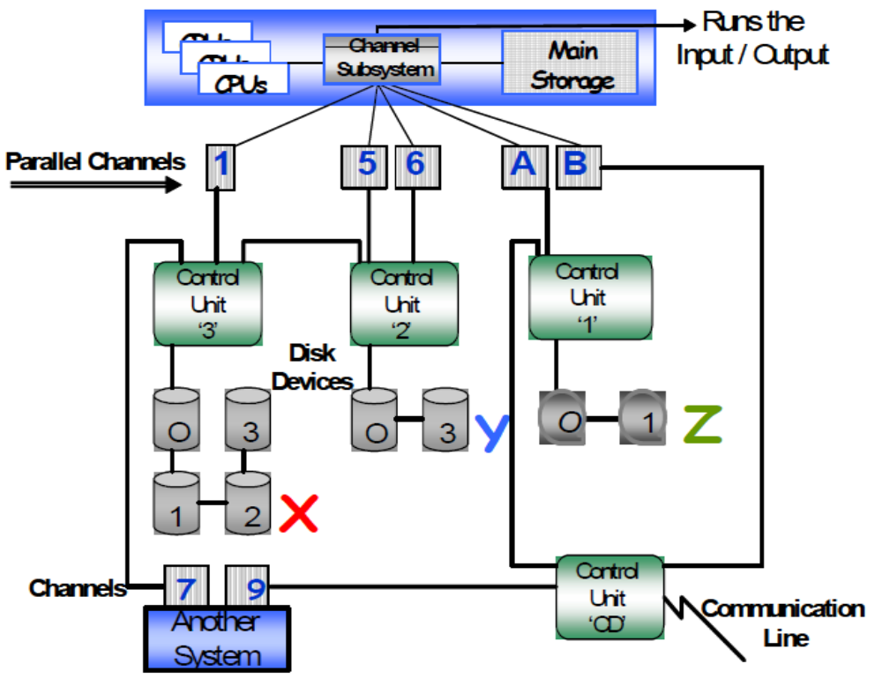
Conceptual S/360
Notes:
The central processor box contains the processors, memory,1 control circuits, and interfaces for channels. A channel provides an independent data and control path between I/O devices and memory. Early systems had up to 16 channels; the largest mainframe machines at the time of this writing can have over 1000 channels. A channel can be considered as a high speed data bus.
Channels connect to control units. A control unit contains logic to work with a particular type of I/O device. A control unit for a printer would have much different internal circuitry and logic than a control unit for a tape drive, for example. Some control units can have multiple channel connections providing multiple paths to the control unit and its devices.
Today’s channel paths are dynamically attached to control units as the workload demands. This provides a form of virtualizing access to devices. More on this later in the chapter.
Control units connect to devices, such as disk drives, tape drives, communication interfaces, and so forth. The division of circuitry and logic between a control unit and its devices is not defined, but it is usually more economical to place most of the circuitry in the control unit.

Slide 9
Current design
Current CEC designs are considerably more complex although modular in their architecture to allow for easy maintenance and upgrades then the early S/360 design
This new design includes:
- CEC modular componentry
- I/O housing
- I/O connectivity
  - I/O operation
  - Partitioning of the system

Slide 10
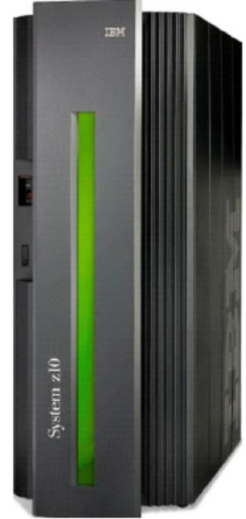
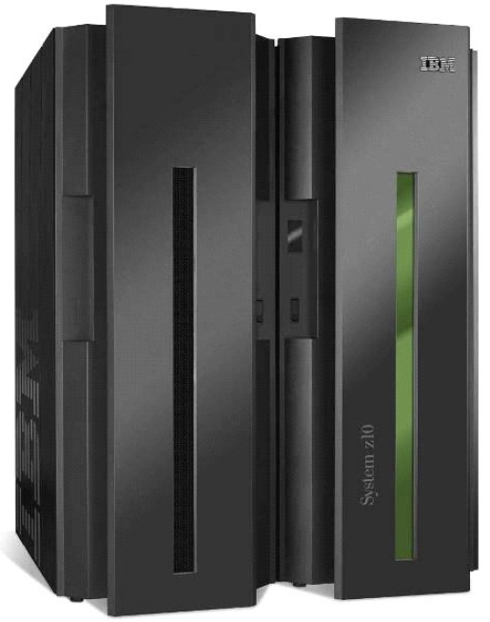
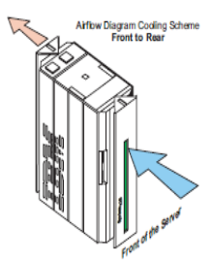
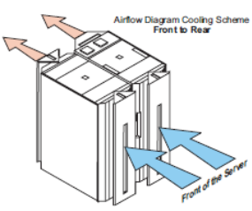
Two Models for System z10 – Physical Dimensions
Business Class (BC) Enterprise Class (EC)
79.3
Air flow
front to rear
Air flow
front to rear
71.1
30.9
61.7
(inches)
(inches)
Model 2098 Model 2097

Slide 11
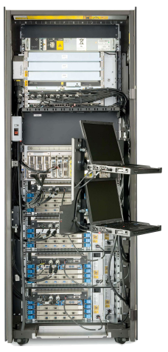
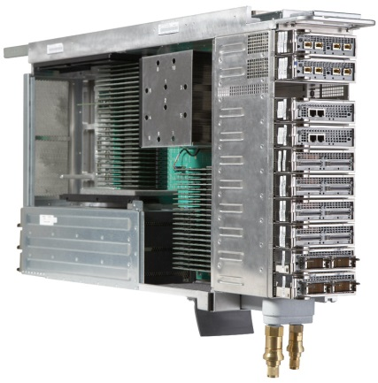
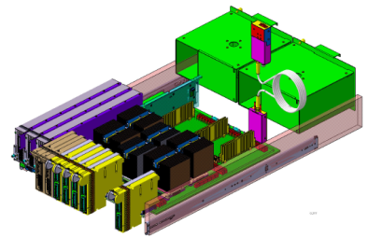
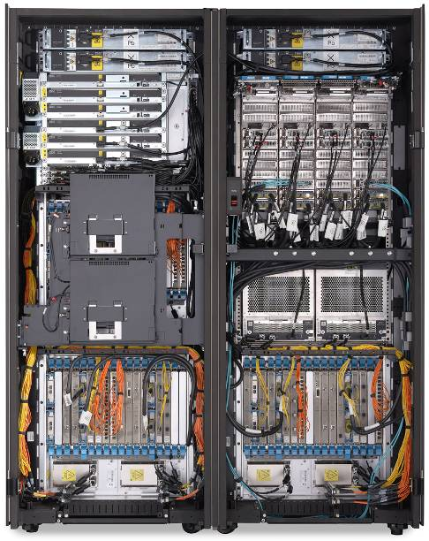
Innovative designs
Business Class design
is based on Drawers
Enterprise Class design
is based on Books
One drawer houses
the Central Processing
Complex (CPC)
One to four drawers
house the I/O features.
Up to four Books house
the Central Processing
Complex
One to three cages
house the I/O features

Slide 12
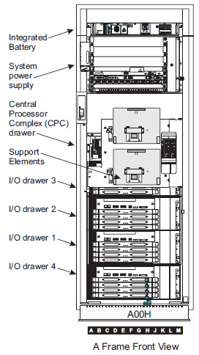
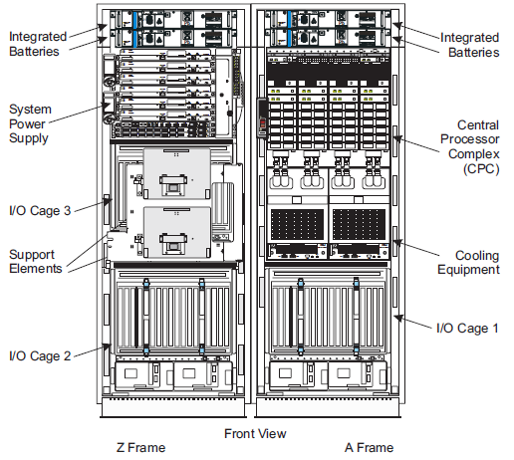
Current Internal Componentry

Slide 13
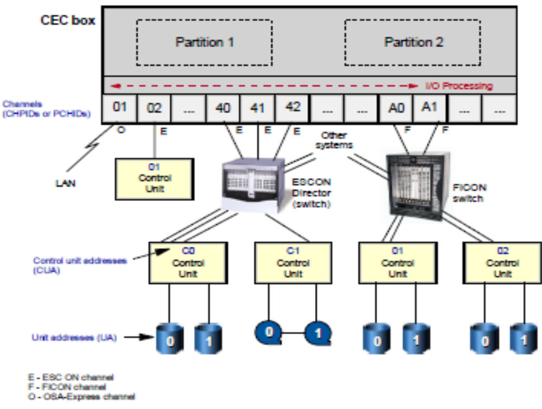
Recent Configurations
Most modern mainframes use switches between the channels and the control units.
The switches are dynamically connected to several systems, sharing the control units
and some or all of its I/O devices across all the systems.
Multiple partitions can sometimes share channel addesses known as spanning.

Slide 14
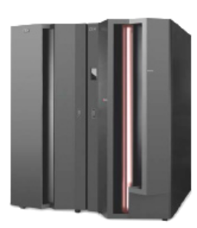

ESCON Connectivity
ESCON (Enterprise Systems Connection) is a data connection created by IBM commonly
used to connect their mainframe computers to peripheral devices.
ESCON replaced the older, slower parallel Bus&Tag channel technology
The ESCON channels use a director to support dynamic switching.
Notes:
ESCON is an optical fiber, half-duplex, serial interface. It originally operated at a rate of 10 Mbyte/s, which was later increased to 17Mbyte/s. The current maximum distance is 43 kilometers.
ESCON was introduced by IBM in September 1990. It replaced the older, slower (4.5 Mbyte/s), copper-based, parallel, Bus & Tag channel technology of 1960-1990 era mainframes. Optical fiber is smaller in diameter and weight, and hence could save installation costs. Space and labor could also be reduced when fewer physical links were required - due to ESCON's switching features. ESCON allows the establishment and reconfiguration of channel connections dynamically, without having to take equipment off-line and manually move the cables. ESCON supports channel connections using serial transmission over a pair of fibers. The ESCON Director supports dynamic switching (which could be achieved prior to ESCON, but not with IBM-only products). It also allows the distance between units to be extended up to 60km over a dedicated fiber. “Permanent virtual circuits” are supported through the switch.
ESCON switching has advantages over a collection of point-to-point links. A peripheral previously capable of accessing a single mainframe can now be connected simultaneously to up to eight mainframes, providing peripheral sharing.

Slide 15
ESCON Director
ESCD
ESCD
Notes:
ESCON Director is an I/O switch capable of providing dynamic, nonblocking, any-to-any connectivity for up to 60 fiber optic links operating at 200 Mb/s.

Slide 16
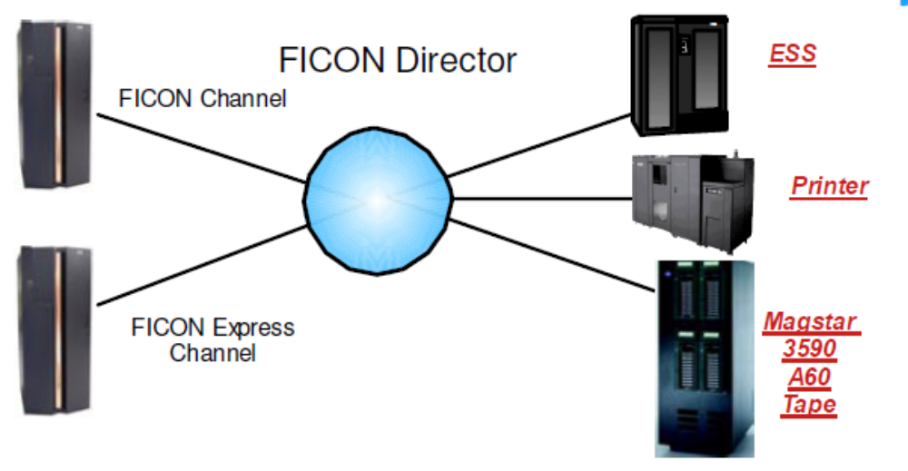
Fiber Connectivity (FICON)
FICON (for Fiber Connectivity) was the next generation high-speed input/output (I/O) interface
used by for mainframe computer connections to storage devices.
FICON channels increase I/O capacity through the combination of a new architecture and
faster physical link rates to make them up to eight times as efficient as ESCON
(Enterprise System Connection),

Slide 17
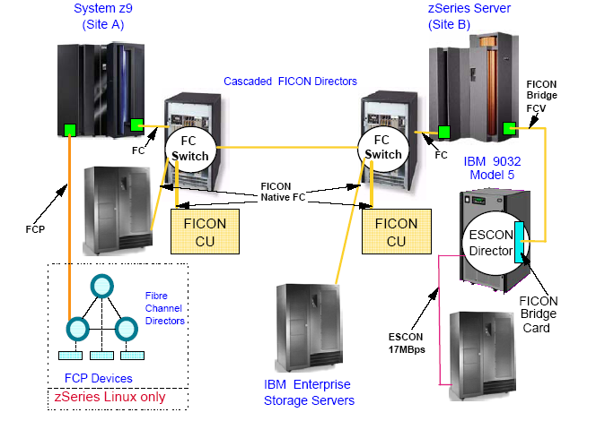
FICON Connectivity

Slide 18
ESCON vs FICON
ESCON
- 20 Mbytes / Second
- Lots of “dead time”. One active request at a time.
- One target control unit
FICON
- up to 25GB/ Second
- Uses FCP standard
- Fiber Optic cable (less space under floor)
- Currently, up to 64 simultaneous “I/O packets” at a time with
up to 64 different control units
- Supports Cascading switches

Slide 19
System z I/O Connectivity
ESCON and FICON channels
Switches to connect peripheral devices to more than one CEC
CHPID addresses are two hex digits (FF / 256)
Multiple partitions can share CHPIDs (MIF- multiple image facility: LPARS can share channels)
I/O subsystem layer exists between the operating system and the CHPIDs

Slide 20
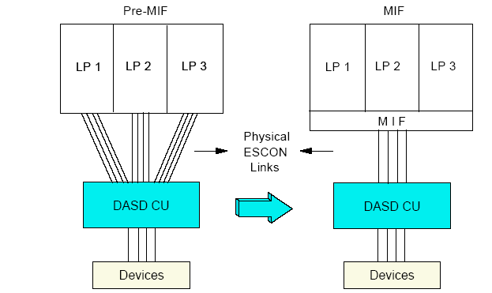
MIF Channel Consolidation - example
statically dynamically
assigned assigned

Slide 21
I/O Connectivity Addressing and Definitions
I/O control layer uses a control file IOCDS that translates physical I/O addresses into devices numbers that are used by z/OS
Device numbers are assigned by the system programmer when creating the IODF and IOCDS and are arbitrary (but not random!)
On modern machines they are three or four hex digits
example - FFFF = 64K devices can be defined
The ability to have dynamic addressing theoretically 7,848,900 maximum number of devices can be attached.
Notes:
Today’s mainframe - up to 64,512 subchannels per LCSS maximum. With 15 LPARs per LCSS = 967,680 subchannels per LCSS maximum. That said, we can't multiply that by 4 LCSSes because the z990 is limited to 30 LPARs. No matter how the 30 LPARs are placed in 2, 3 or 4 LCSSes, the maximum number of subchannels is 1,935,360. (Decide for yourself whether you want to consider 1 K to be 1,000 or 1,024 for this discussion. When we publish 63K, the definition is 1,024.
System z EC - Up to 65,280 subchannels in Set 0 (768 larger than z990) plus 65,535 in Set 1 per LCSS = 130,815 subchannels per LCSS maximum. With 15 LPARs per LCSS = 1,962,225 subchannels per LCSS maximum. We CAN multiply this by 4 LCSSes because z9 EC supports 60 LPARs. So, the maximum number of subchannels is 7,848,900, more that 4 times as many as z990. The corresponding number for the z9 BC is half the number for the z9 EC because the BC supports only 30 LPARs.
Note that these numbers are theoretical maximums. How many a given system will actually use, even if all 60 LPARs are defined, is determined by the HCD/IOCP definition. This complex topic is discussed in the "IOCP User's Guide" for each machine. And, the subchannels in Set 1 on z9 do NOT represent more devices because they are used only for parallel access (PAVs) for disk devices defined in Set 0. So, more I/O access, not more devices. This may allow larger disk volumes to be defined, so it is fair to say that more subchannels enable access to more data.

Slide 22
Channel Subsystem Relationship to Channels, Control Units and I/O Devices
Z10
Channel Subsystem
Controls queuing, de-queuing, priority management and
I/O identification of all I/O operations performed by LPARs
Supports the running of an OS and allows CPs, memory
and Subchannels access to channels
This represents an I/O device to the hardware and is used
by the OS to pass an I/O request to the channel subsystem
The communication path from the channel subsystem to the
I/O network and connected Control Units/devices
Partitions
Subchannels
Channels
Control Units
Devices
(disk, tape, printers)
CU
CU
CU
@
@
@
=
@
=
=
=
Notes:
The role of the Channel Subsystem is to control communication of internal and external channels to control units and devices. The configuration definitions of the CSS define the operating environment for the correct execution of all system Input/Output (I/O) operations.
The CSS provides the server communications to external devices via channel connections.
The channels permit transfer of data between main storage and I/O devices or other servers under the control of a channel program. The CSS allows channel I/O operations to continue independently of other operations within the central processors.
The building blocks that make up a Channel Subsystem are listed here. The structure provides up to four Channel Subsystems. Each CSS has from one to 256 CHPIDs, and may be configured with up to 15 logical partitions that relate to that particular Channel Subsystem. CSSs are numbered from 0 to 3, and are sometimes referred to as the CSS Image ID (CSSID 0, 1, 2, and 3).
Note: The z9 and z10 EC provides for up to four Channel Subsystems, 1024 CHPIDs, and up to 60 logical partitions for the total system.

Slide 23
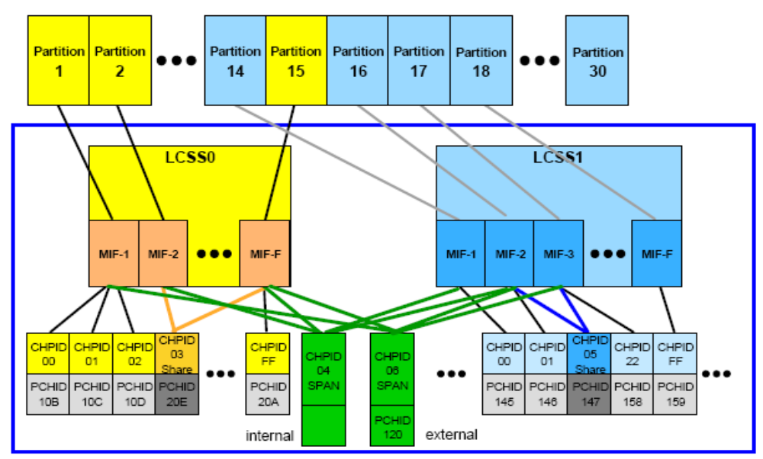
Channel Spanning
Notes:
Channel spanning
Channel spanning extends the MIF (muliple Image facility) concept of sharing channels across logical partitions to sharing channels across Logical Channel Subsystems and logical partitions.
Spanning is the ability for the channel to be configured to multiple Logical Channel Subsystems. When defined that way, the channels can be transparently shared by any or all of the configured logical partitions, regardless of the Logical Channel Subsystem to which the logical partition is configured.
A channel is considered a spanned channel if the same CHPID number in different LCSSs is assigned to the same PCHID in IOCP, or is defined as “spanned” in HCD.
In the case of internal channels (for example, IC links and HiperSockets), the same applies,
but there is no PCHID association. They are defined with the same CHPID number in multiple
LCSSs.
CHPIDs that span LCSSs reduce the total number of channels available on the z9 EC, z9 BC,
z990, or the z890. The total is reduced, since no LCSS can have more than 256 CHPIDs. For
a z890 that supports two LCSSs, a total of 512 CHPIDs are supported. If all CHPIDs are spanned across the two LCSSs, then only 256 channels can be supported. For a z9 EC or a z990 with four LCSSs, a total of 1024 CHPIDs are supported. If all CHPIDs are spanned across the four LCSSs, then only 256 channels can be supported.

Slide 24
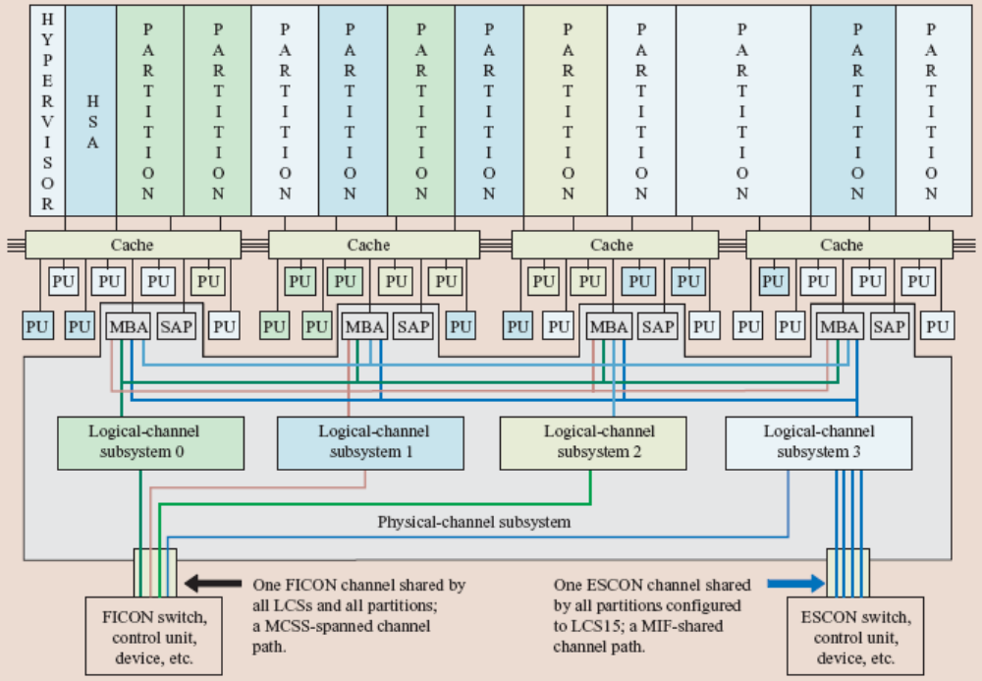
The Mainframe I/O Logical Channel Subsystem Schematic
Memory bus adapter
H
I
P
E
R
V
I
S
O
R
H
S
A
Cache
Cache
Cache
Cache
MBA
SAP
MBA
SAP
MBA
SAP
MBA
SAP
Logical-channel
Subsystem 0
Logical-channel
Subsystem 1
Logical-channel
Subsystem 2
Logical-channel
Subsystem 3
Physical-Channel Subsystem
-One FICON channel shared
by all LCSs and all partitions
-A MCSS-Spanned Channel Path
- One ESCON channel shared
by all partitions configured
to LCS15
- A MIF-shared channel path
FICON Switch,
Control Unit,
Devices, etc.
ESCON Switch,
Control Unit,
Devices, etc.
Notes:
The mainframe’s CSS comprises all of the hardware and firmware required to implement the System z’s CSS architecture, including all of the different types of channel paths provided by system z. The firmware in the system assist processors (SAPs) and I/O channel paths performs the bulk of the I/O instructions and I/O interrupt processing. There is also firmware in the CPs that initiates the I/O instructions and participates in the handling of I/O interruptions. The CSS directs the flow of information between I/O devices and main storage. The CSS uses one or more channel paths as the communication links in managing the flow of this information. As part of I/O processing, the CSS also performs channel-path selection and channel-path management functions, such as testing for channel-path availability, selecting an available channel path, and initiating execution of I/O operations over the selected channel path with the attached I/O devices. When I/O operations are completed, the CSS analyzes the resulting status and transmits it back to the program by use of I/O interruptions and I/O status information.
To provide communication among the various elements in the CSS and to maintain information about the I/O
configuration, a set of control blocks are allocated in the hardware system area (HSA)—storage that is accessible only to the embedded software (firmware).

Slide 25
System z – I/O Configuration Support
Each Logical Channel Subsystem has a set of Subchannels
System z Processor
Logical Channel Subsystem
Logical Channel Subsystem
Partitions
Partitions
Subchannels
Subchannels
63K
63K
Channels
Channels

Slide 26
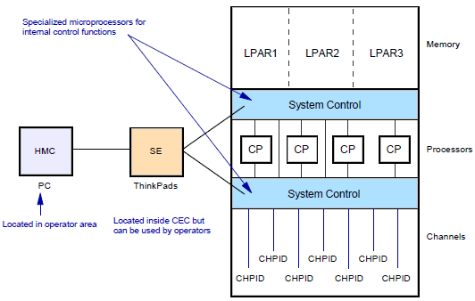
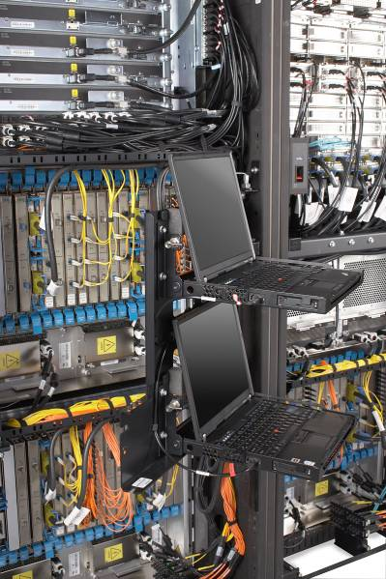
System Control and Partitioning
Support Elements (SEs)
Either can be use to
configure the IOCDS
Notes:
There are many ways to illustrate a mainframe’s internal structure, depending on what we wish to emphasize. Here shows several of the functions of the internal system controls on current mainframes. The IBM mainframe can be partitioned into separate logical computing systems.
System resources (memory, processors, I/O channels) can be divided or shared among many such independent logical partitions (LPARs) under the control of the LPAR hypervisor, which comes with the standard Processor Resource/ Systems Manager (PR/SM) feature on all mainframes. The hypervisor is a software layer to manage multiple operating systems running in a single central processing complex. The mainframe uses a type 1 hypervisor. Each LPAR supports an independent operating system (OS) loaded by a separate initial program load (IPL) operation.
For many years there was a limit of 15 LPARs in a mainframe; today’s machines can be configured with up to 60 Logical Partitions. Practical limitations of memory size, I/O availability, and available processing power usually limit the number of LPARs to less than these maximums. Each LPAR is considered an isolated and distinct server that supports an instance of an operating system (OS). The operating system can be any version or release supported by the hardware. In essence, a single mainframe can support the operation of several different OS environments

Slide 27
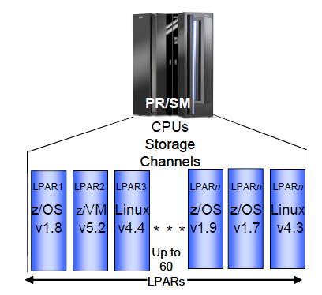
Logical Partitions (LPARs) or Servers
A system programmer can assign different operating environments to each partition with isolation
An LPAR can be assigned a number of dedicated or shared processors.
Each LPAR can have different storage (CSTOR) assigned depending on workload requirements.
The I/O channels (CHPIDs) are assigned either statically or dynamically as needed by server workload.
Provides an opportunity to consolidate distributed environments to a centralized location
Notes:
For many years there was a limit of 15 LPARs in a mainframe; today’s machines can be configured with up to 60 Logical Partitions or servers within a single CEC. Practical limitations of memory size, I/O availability, and available processing power usually limit the number of LPARs to less than these maximums. Each LPAR is considered an isolated and distinct server that supports an instance of an operating system (OS). The operating system can be any version or release supported by the hardware. In essence, a single mainframe can support the operation of several different OS environments. System administrators assign portions of memory to each LPAR; memory also
known as central storage (CSTOR) cannot be shared among LPARs. CSTOR in past literature may also be referred to as main storage, provides the system with directly addressable, fast-access electronic storage of data. Both data and
programs must be loaded into central storage (from input devices) before they can be processed by the CPU.

Slide 28
Characteristics of LPARs
LPARs are the equivalent of a separate mainframe for most practical purposes
Each LPAR runs its own operating system
Devices can be shared across several LPARs
Processors can be dedicated or shared
When shared each LPAR is assigned a number of logical processors (up to the maximum number of physical processors)
Each LPAR is independent

Slide 29
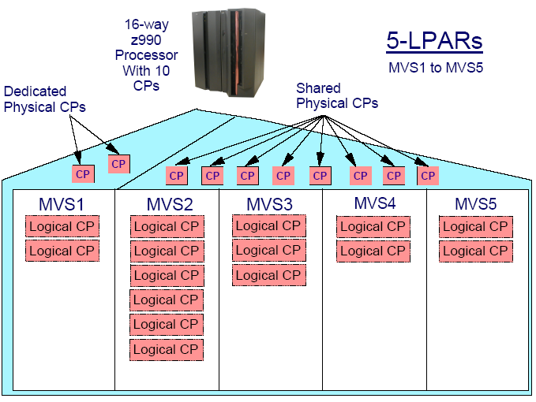
Shared CPs example

Slide 30
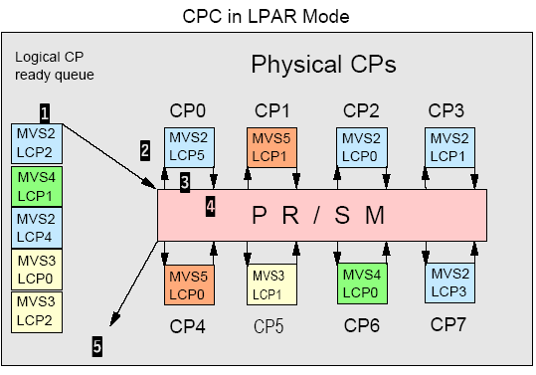
LPAR Logical Dispatching
(Hypervisor)
1 - The next logical CP to be dispatched is chosen from the logical
CP ready queue based on the logical CP weight.
2 - LPAR LIC dispatches the selected logical CP
(LCP5 of MVS LP) on a physical CP in the CPC
(CP0, in the visual).
3 - The z/OS dispatchable unit running on that logical processor
(MVS2 logical CP5) begins to execute on physical CP0.
It executes until its time slice (generally between 12.5 and 25
milliseconds) expires, or it enters a wait, or it is intercepted
for some reason.
4 - In the visual, the logical CP keeps running until it uses all its
ime slice. At this point the logical CP5 environment is saved
and control is passed back to LPAR LIC, which starts executing
on physical CP0 again.
5 - LPAR LIC determines why the logical CP ended execution and
requeues the logical CP accordingly. If it is ready with work,
t is requeued on the logical CP ready queue and step 1
begins again.

Slide 31
LPAR Summary
System administrators assign:
  Memory
  Processors
  CHPIDs either dedicated or shared
This is done partly in the IOCDS and partly in a system profile on the Support Element (SE) in the CEC. This is normally updated through the HMC.
Changing the system profile and IOCDS will usually require a power-on reset (POR) but some changes are dynamic

Slide 32
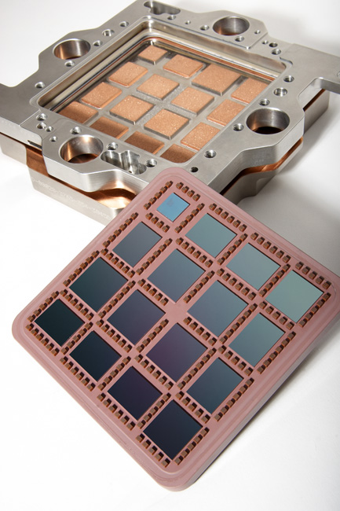
Processor units or engines
Today’s mainframe can characterize workloads using different license engine types
General Central Processor (CP)
- Used to run standard application and system workloads
System Assist Processor (SAP)
- Used to schedule I/O operations
Integrated Facility for Linux (IFL)
- A processor used exclusively by a Linux LPAR under z/VM.
z/OS Application Assist Processor (zAAP)
- Provides for Java and XML workload offload
z/OS Integrated Information Processor (zIIP)
- Used to optimize certain database workload functions and
XML processing
Integrated Coupling Facility (ICF)
- Used exclusively by the Coupling Facility Control Code (CFCC)
providing resource and data sharing
Spares
- Used to take over processing functions in the event of an engine failure
Multi Chip Module (MCM)
Note: Channels are RISC micro processors and are assigned depending on I/O configuration requirements.

Slide 33
Capacity on Demand
Various forms of Capacity on Demand exist
Additional processing power to meet unexpected growth or sudden demand peaks
CBU – Capacity Back Up
CUoD – On/Off Capacity Upgrade on Demand
SubCapacity Licensing Charges
LPAR CPU Management (IRD)

Slide 34
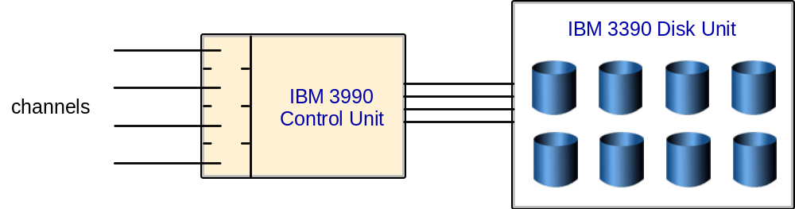
Disk Devices
Current mainframes use 3390 disk devices
The original configuration was simple with a controller connected to the processor and strings of devices attached to the back end

Slide 35
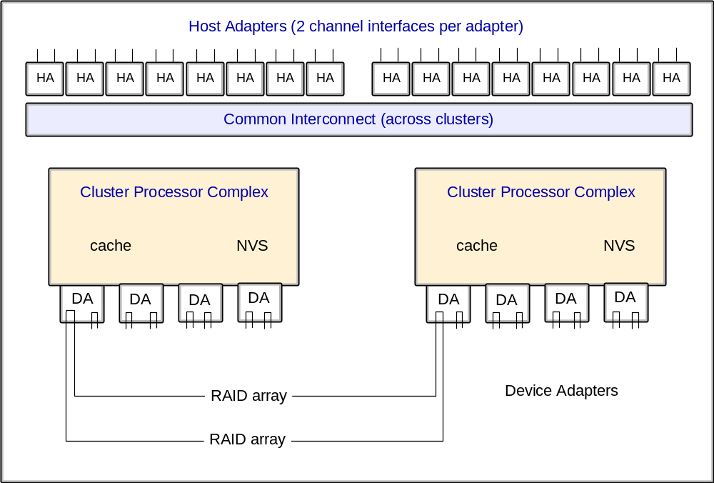
Current 3390 Implementation

Slide 36
Modern 3390 Devices
The physical disks are commodity SCSI- type units
Many configurations are possible but usually it is RAID-5 arrays with hot spares
Almost every part has a fallback or spare and the control units are emulated by 4 RISC processors in two complexes.

Slide 37
Modern 3390 Devices
The 2105 offers FlashCopy, Extended Remote Copy, Concurrent Copy, Parallel Access Volumes, Multiple Allegiance
This is a huge extension of the original 3390 architecture and offers a massive performance boost.
To the z/OS operating system these disks just appear as traditional 3390 devices so maintaining backward compatibility

Slide 38
EBCDIC
The IBM S/360 through to the latest zSeries machines use the Extended Binary Coded Decimal Interchange character set for most purposes
This was developed before ASCII and is also an 8 bit character set
z/OS Web Server stores ASCII data as most browsers run on PCs which expect ASCII data
UNICODE is used for JAVA on the latest machines

Slide 39
Clustering
Screenshot 2
Clustering has been done for many years in several forms
  Basic shared DASD
  CTC/GRS rings
  Basic and Parallel sysplex
Image is used to describe a single z/OS system, which might be standalone or an LPAR on a large box

Slide 40
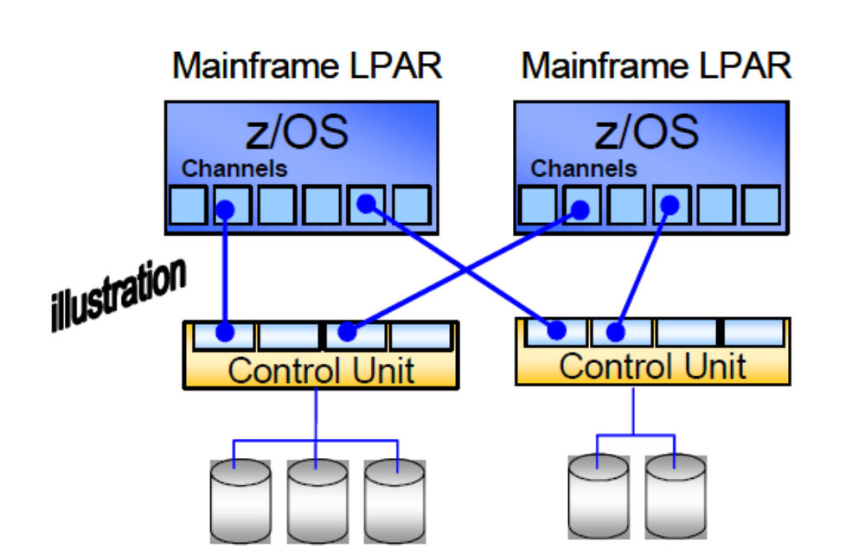
Basic shared DASD
Limited capability
Reserve and release against a whole disk
Limits access to that disk for the duration of the update
Notes:
The capabilities of a basic shared DASD system are limited. The operating systems automatically issue RESERVE and RELEASE commands to a DASD before updating the volume table of contents (VTOC), or catalog. The VTOC and catalog < discussed later > are structures that contain metadata for the DASD, indicating where various data sets reside.) The RESERVE command limits access to the entire DASD to the system issuing the command, and this lasts until a RELEASE command is issued. These commands work well for limited periods (such as updating
metadata). Applications can also issue RESERVE/RELEASE commands to protect their data sets for the duration of the application. This is not automatically done in this environment and is seldom done in practice because it would lock out other systems’ access to the DASD for too long.
A basic shared DASD system is typically used where the Operations staff controls which jobs go to which system and ensures that there is no conflict such as both systems trying to update the same data at the same time. Despite this limitation, a basic shared DASD environment is very useful for testing, recovery, and careful load balancing.

Slide 41
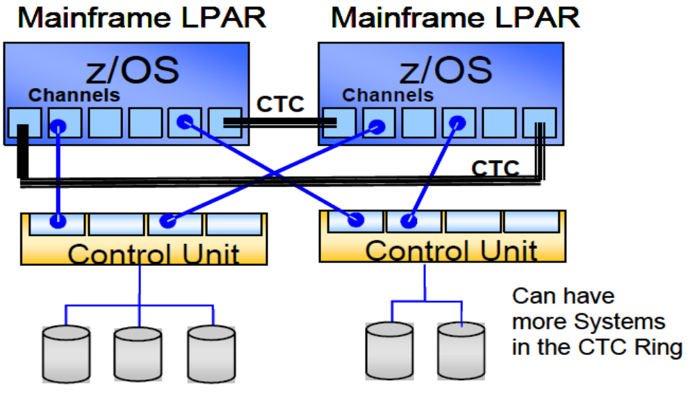
Basic Sysplex
Global Resource Sharing (GRS) used to pass information between systems via the Channel-To-Channel ring
Request ENQueue on a dataset, update, the DEQueue
Loosely coupled system
Notes:
A Systems Complex, commonly called a sysplex, is one or more (up to 32) systems joined into a cooperative single unit using specialized hardware and software. It uses unique messaging services to exchange status information and can share special file structures contained within coupling facility (CF) data sets. A sysplex is an instance of a computer system running on one or more physical partitions where each ‘can’ run a different release of a z/OS operating system.
Sysplexes are often isolated to a single system, but Parallel Sysplex technology allows multiple mainframes to act as one. It is a clustering technology that can
provide near-continuous availability.

Slide 42
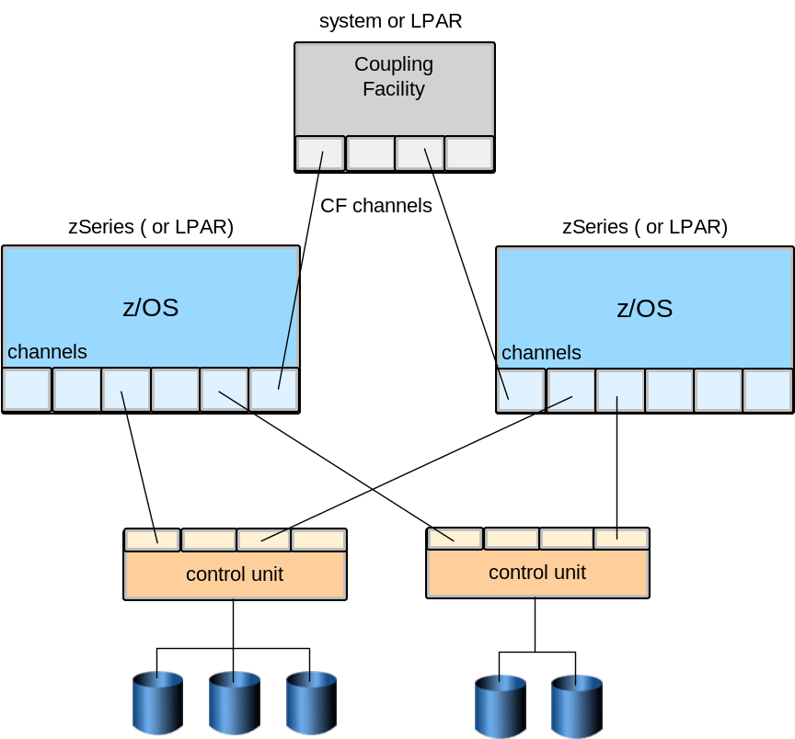
Parallel Sysplex
This extension of the CTC ring uses a dedicated Coupling Facility to store ENQ data for GRS
This is much faster
The CF can also be used to share application data such as DB2 tables
Can appear as a single system
Notes:
Sysplexes are often isolated to a single system, but Parallel Sysplex technology allows multiple mainframes to act as one. It is a clustering technology that can provide near-continuous availability. A Parallel Sysplex is a symmetric sysplex using multisystem data-sharing technology. This is the mainframe’s clustering technology. It allows direct, concurrent read/write access to shared data from all processing servers in the configuration without impacting performance or data integrity. Each LPAR can concurrently cache shared data in the CF processor memory through hardware-assisted cluster-wide serialization and coherency controls.

Slide 43
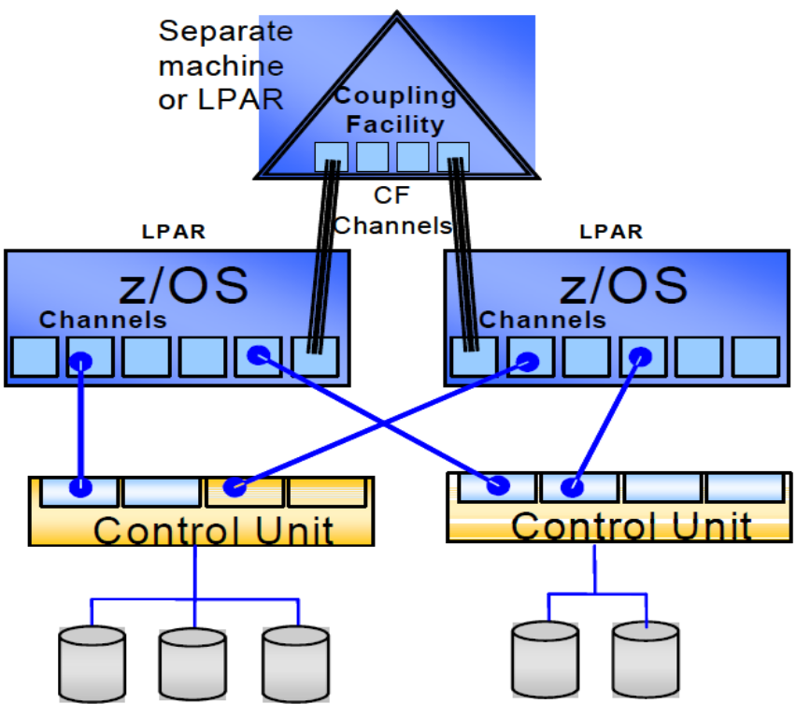
Parallel Sysplex Attributes
Dynamically balances workload across systems with high performance
Improve availability for both planned and unplanned outages
Provide for system or application rolling-maintenance
Offer scalable workload growth both vertically and horizontally
View multiple-system environments as a single logical resource
Use special server time protocol (STP) to sequence events between servers

Slide 44
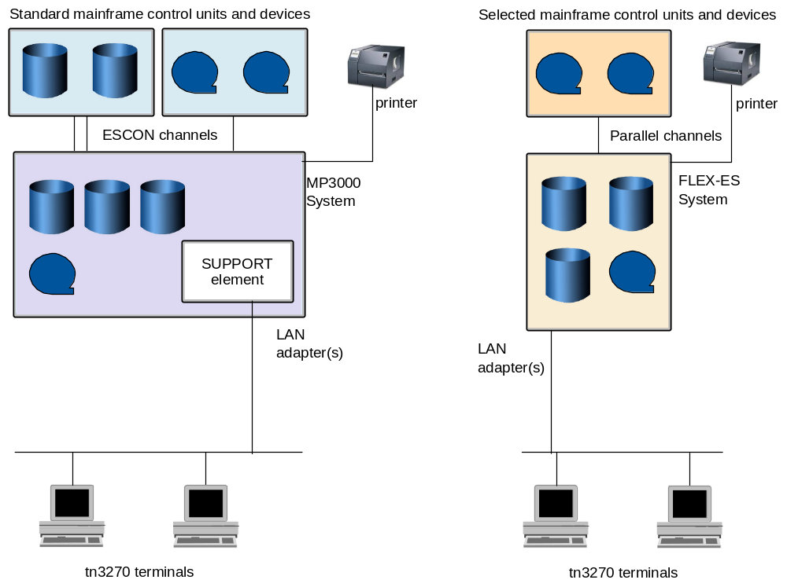
Typical Systems
This shows two very small systems
  On the left is a Multiprise 3000, which was designed for small installations with internal disk drives
  On the right is a FLEX-ES emulation system, which runs on a PC running Linux or UNIX

Slide 45
Summary
Terminology is important
The classic S/360 design is important as all later designs have enhanced it. The concepts are still relevant
New processor types are now available to reduce software costs
EBCDIC character set
Clustering techniques and parallel sysplex

Slide 46
Extra Slides on Hardware Management and LPAR Creation

Slide 47
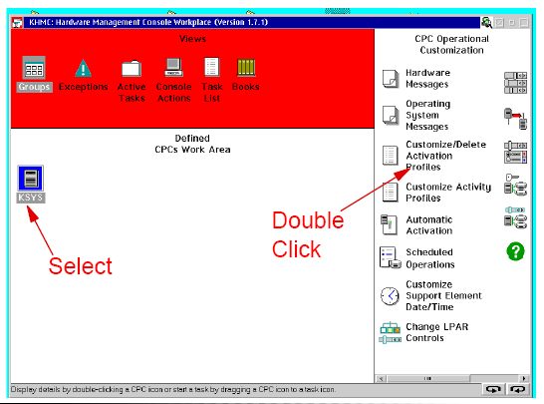
Hardware Management Console (HMC)

Slide 48
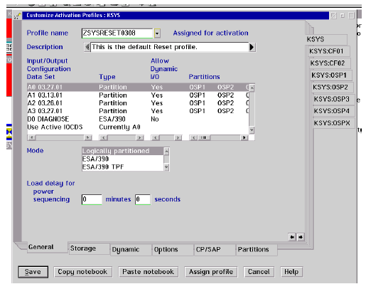
OS
Storage
assignment
i.e assign a profile
to a Linux partition
Allocate PUs

Slide 49
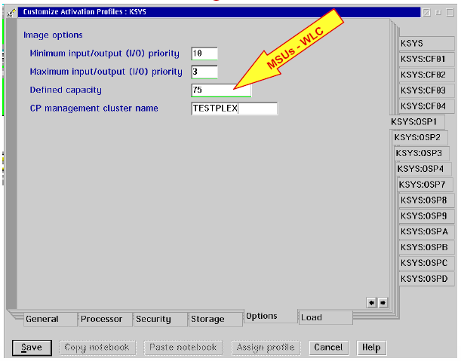

Slide 50
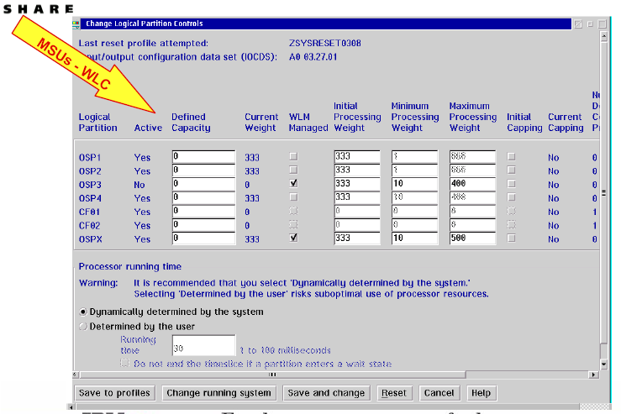

Slide 51
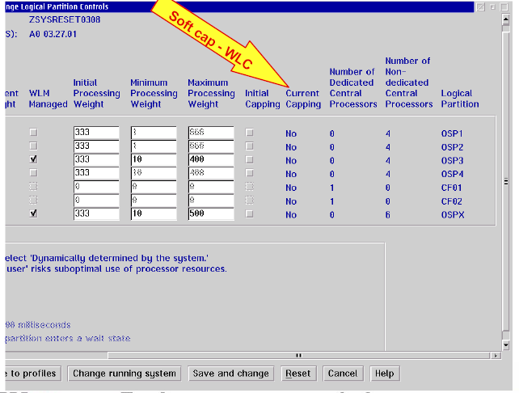

Slide 52
