Slide 1
Chapter 3: z/OS Overview

Slide 2
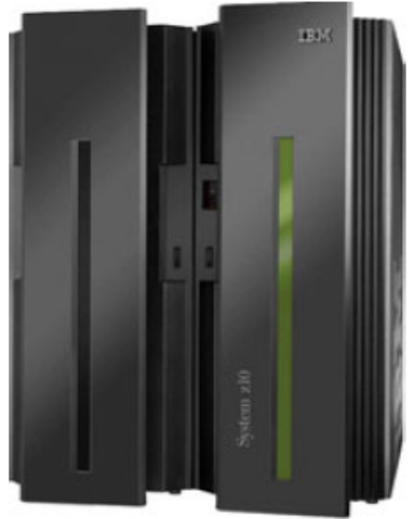
Chapter objectives
Be able to:
Give examples of how z/OS differs from a single-user operating system.
List the major types of storage used by z/OS.
Explain the concept of virtual storage and its use in z/OS.
State the relationship between pages, frames, and slots.
List several defining characteristics of the z/OS operating system.
List several software products used with z/OS to provide a complete system.
Describe several differences and similarities between the z/OS and UNIX operating systems.

Slide 3
Key terms in this chapter
address space
addressability
auxiliary storage
dynamic address translation (DAT)
frame
input/output (I/O)
middleware
Multiprocessing
multiprogramming
page
page data set
paging
program product
real storage
slot
swap data set
UNIX
virtual storage
z/OS

Slide 4
What is z/OS?
SCREENSHOT 1
The most widely used mainframe operating system
  64-bit operating system
Ideally suited for processing large workloads for many concurrent users
Designed for:
  Serving 1000s of users concurrently
  I/O and numeric intensive computing
  Processing very large heterogeneous workloads
  Running mission critical applications securely
Notes:
The operating system we discuss in this course is z/OS, the most widely used of all
mainframe operating systems. z/OS is designed to offer a stable, secure, and
continuously available environment for applications running on the mainframe.
To understand how and why z/OS functions as it does, it is important to understand the
environment in which it functions. The special features that make z/OS unique reflect the
computer environments that z/OS manages.
z/OS gets work done by dividing it into pieces and giving portions of the job to various system
components and subsystems that function interdependently. At any point in time, one
component or another gets control of the processor, makes its contribution, and then
passes control along to a user program or another component.

Slide 5
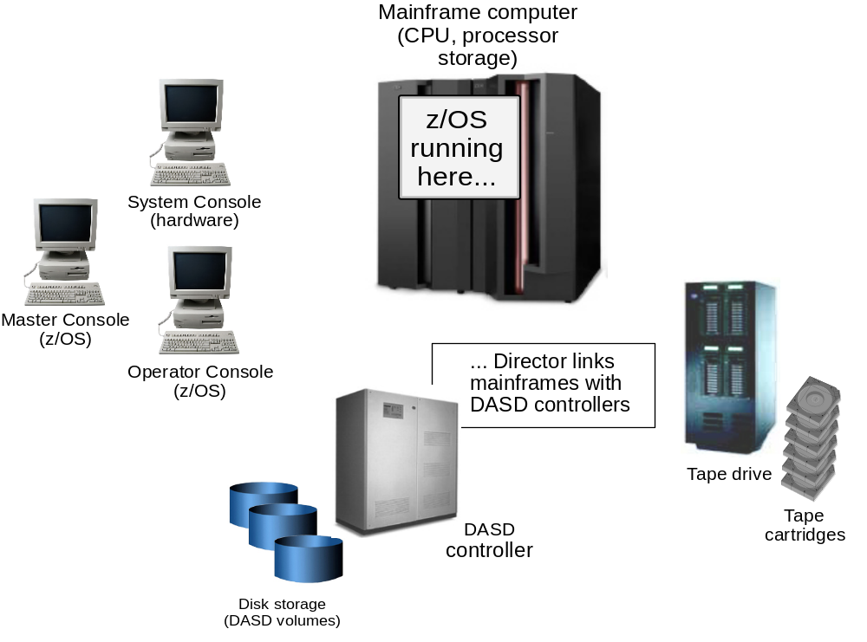
Hardware resources managed by z/OS
z/OS runs
here
Notes:
Mainframe hardware consists of processors and a multitude of peripheral devices such as disk drives (called direct access storage devices or DASD), magnetic tape drives, and various types of user consoles. Tape and DASD are used for system functions and by user programs executed by z/OS.
Today’s z/OS provides a new disk device geometry called Extended Address Volume (EAV) that enables support for over 223 Gigabytes (262,668 cylinders)
per disk volume in its initial offering. This helps many larger customer’s having the 4-digit device number limitation to begin consolidation of disk farms.
The mainframe offers several types of I/O adapter cards that include open standards, allowing flexibility for configuring high bandwidth for any device type.
All hardware components offer built-in redundancy, ensuring reliability and availability, from memory sparing to cooling units. Today’s mainframe also has
capacity provisoning capability to monitor z/OS utilization of system workloads. This feature allows CPUs to be turned on and off dynamically.
Not shown here, for example, are the hardware control units, such as the director, which connect the mainframe to the other tape drives, DASD devices, and consoles.

Slide 6
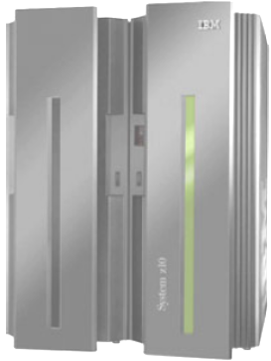
Multiprogramming and Multiprocessing
Multiprogramming is the capability of executing many programs concurrently
Multiprocessing is the simultaneous operation of
two or more processors that share the various
hardware resources, such as memory and external
disk storage devices.
- This is also known as Symmetric Multi Processing
(SMP)
Notes:
The earliest operating systems were used to control single-user computer systems. In those days, the operating system would read in one job, find the data and devices the job needed, let the job run to completion, and then read in another job. In contrast, the computer systems that z/OS manages are capable of multiprogramming, or executing many programs concurrently. With multiprogramming, when a job cannot use the processor, the system can suspend, or interrupt, the job, freeing the processor to work on another job.
z/OS makes multiprogramming possible by capturing and saving all the relevant information about the interrupted program before allowing another program to execute. When the interrupted program is ready to begin executing again, it can
resume execution just where it left off. Multiprogramming allows z/OS to run thousands of programs simultaneously for users who might be working on different projects at different physical locations around the world.
z/OS can also perform multiprocessing, which is the simultaneous operation of two or more processors that share the various hardware resources, such as memory and external disk storage devices. The techniques of multiprogramming and multiprocessing make z/OS ideally suited for processing workloads that require many input/output (I/O) operations. Typical mainframe workloads include
long-running applications that write updates to millions of records in a database, and online applications for thousands of interactive users at any given time. By way of contrast, consider the operating system that might be used for a single-user computer system. Such an operating system would need to execute programs on behalf of one user only. In the case of a personal computer (PC), for example, the entire resources of the machine are often at the disposal of one user.

Slide 7
Brief history of z/OS addressability
: System/370 defined storage addresses as 24 bits in length,
providing addressability for up to 16MB of virtual storage.
: System/370-XA extended the addressability of the architecture to
31 bits, for up to 2GB of virtual storage.
2000: z/Architecture extended the addressability to 64 bits, for up to
16EB of virtual storage.

Slide 8
Overview of z/OS internals
Comprises modules, system programs (macros), system components
Uses a program status word (PSW)
Techniques of multiprogramming and multiprocessing
Information about the system, resources, and tasks is contained in control blocks
Manages three different kinds storage:
  Real storage or Central Storage (CSTOR)
  Auxiliary storage
  Virtual storage
Notes:
A group of related instructions is called a routine or module. A set of related modules that make a particular possible is called a system component.
Sequences of instructions that perform frequently used system functions can be invoked with executable macro instructions, or macros. z/OS macros exist for functions such as opening and closing data files, loading and deleting programs, and sending messages to the computer operator.
The program status word (PSW) is a 64-bit data area in the processor that, along with control registers, timing registers, and prefix registers, provides details crucial to both the hardware and the software. The current PSW includes the address of the next program
instruction and control information about the program that is running. Each processor has only one current PSW. Thus, only one task can execute on a processor at a time.
z/OS is capable of multiprogramming, or executing many programs concurrently, on behalf of many users at once. In multiprogramming, when a job cannot use the processor, the system can suspend, or interrupt, the job, freeing the processor to work on another job. z/OS can also perform multiprocessing, which is the simultaneous operation of two or more processors that share the various hardware resources, such as memory and external disk storage devices.
As instructions execute the work of a computer system, they keep track of this work in storage areas known as control blocks. Generally speaking, there are three types of z/OS control blocks:
System-related control blocks
Resource-related control blocks
Task-related control blocks
Each system-related control block represents one z/OS system and contains system-wide
information, such as how many processors are in use. Each resource-related control block
represents one resource, such as a processor or storage device. Each task-related control
block represents one unit of work.
Conceptually, mainframes and all other computers have two types of physical storage.
The physical storage located with the mainframe processor itself. This is called
processor storage or real storage; think of it as memory for the mainframe.
The physical storage external to the mainframe, including storage on direct access
devices, such as disk drives and tape drives. This storage is called auxiliary storage.

Slide 9
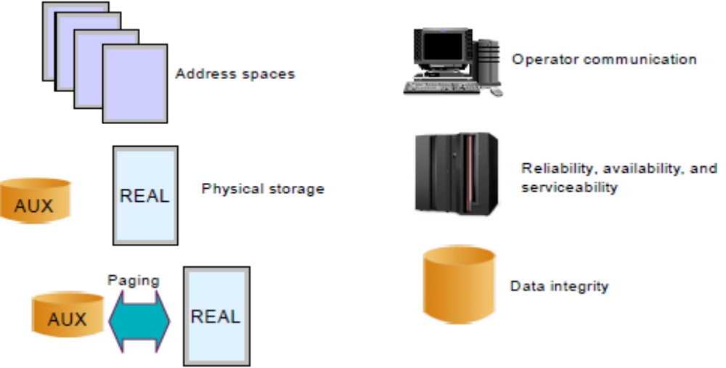
Virtual storage concepts
Virtual storage is an “illusion” created through z/OS management of real storage and auxiliary storage through tables.
The running portions of a program are kept in real storage; the rest is kept in auxiliary storage
Range of addressable virtual storage available to a user or program or the operating system is an address space
Each user or separately running program is represented by an address space (each user gets a limited amount of private storage)
Notes:
Virtual storage means that each running program can assume it has access to all of the real storage defined by the architecture’s addressing scheme. The only limit is the number of bits in a storage address.
To allow each user to act as though this much storage really exists in the computer system, z/OS keeps only the active portions of each program in real storage. z/OS keeps the rest of the code and data in special files on auxiliary storage, which usually consists
of a number of high-speed direct access storage devices (DASDs).
An address space is the area of contiguous virtual addresses available for executing instructions and storing data. The range of virtual
addresses in an address space starts at zero and can extend to the highest address permitted by the operating system architecture.
z/OS provides each user with a unique address space and maintains the distinction between the programs and data belonging to each address space. Each address space is isolated from one another. If a failure occurs in one address space it doesn’t affect other address spaces.

Slide 10
Addressing value of a byte
Bits 0 0 0 0 0 0 0 0
Bit count 1 2 3 4 5 6 7 8
Bit value 128 64 32 16 8 4 2 1 (binary, power of 2)
In summary:
One byte can address 256 locations
Three bytes can address 16 million locations

Slide 11
What’s in an address space?
z/OS provides each user with a unique address space and maintains the distinction between the programs and data belonging to each address space.
Because it maps all of the available addresses, however, an address space includes system code and data as well as user code and data. Thus, not all of the mapped addresses are available for user code and data.

Slide 12
z/OS address spaces
z/OS and its related subsystems require address spaces of their own to provide a functioning operating system:
  System address spaces are started after initialization of the master scheduler. These address spaces perform functions for all the other types of address spaces that start in z/OS.
  Subsystem address spaces for major system functions and middleware products such as DB2, CICS, and IMS.
  TSO/E address spaces are created for every user who logs on to z/OS
  Address spaces for every batch job that runs on z/OS.

Slide 13
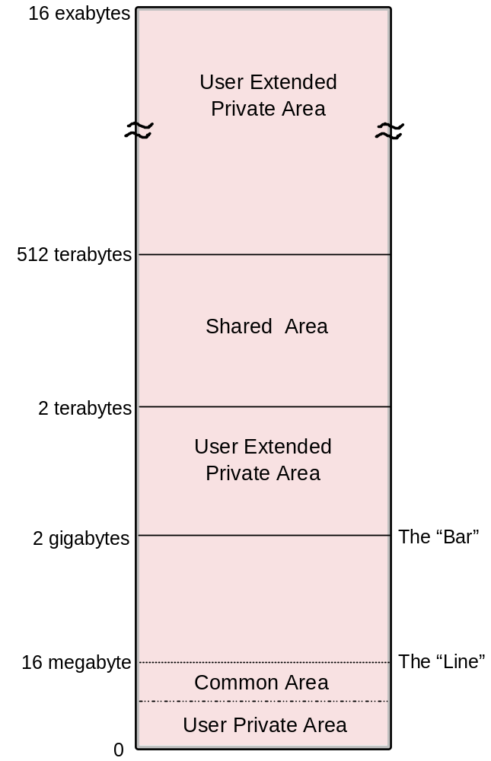
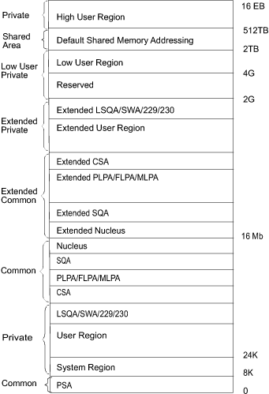
64-bit address space map
The “BAR”
These are
storage subpools
used to classify
different uses
The “LINE”
Notes:
0 to 2³¹ The layout is the same.
2³¹ - 2³² From 2 GB to 4 GB is considered the bar. Below the bar can be
addressed with a 31-bit address. Above the bar requires a 64-bit
address.
2³² - 2⁴¹ The low non-shared area (user private area) starts at 4 GB and
extends to 2⁴¹.
2⁴¹ - 2⁵⁰ Shared area (for storage sharing) starts at 2⁴¹ and extends to
2⁵⁰ or higher, if requested.
2⁵⁰ - 2⁶⁴ High non-shared area (user private area) starts at 2⁵⁰ or
wherever the shared area ends and goes to 2⁶⁴.
With the release of zSeries mainframes in 2000, IBM extended the addressability
of the architecture to 64 bits. With 64-bit addressing, the potential size of a z/OS address
space expands to a size so vast that we need new terms to describe it. Each address space,
called a 64-bit address space, is 16 exabytes (EB) in size; an exabyte is slightly more than
one billion gigabytes. The new address space has logically 264 addresses. It is 8 billion
times the size of the former 2 GB address space. The number is 16 with 18 zeros after it:
16,000,000,000,000,000,000 bytes, or 16 EB (see the slide).
We say that the potential size is 16 exabytes because z/OS, by default, continues to create
address spaces with a size of 2 GB. The address space exceeds this limit only if a
program running in it allocates virtual storage above the 2 GB address. If so, the z/OS
operating system increases the storage available to the user from 2 GB to 16 EB.
The 16 MB address became the dividing point between the two previous architectures (the 24-bit addressability
introduced with MVS/370 and the 31-bit addressing introduced in the operating system MVS Extended
Architecture or MVS/XA), and is commonly called the line. The area that separates the virtual storage area below the 2 GB address from the user private area is called the bar.

Slide 14
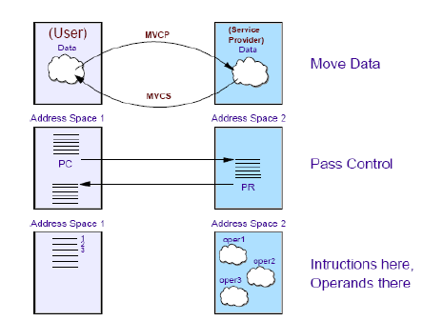
Synchronous Cross Memory (comm across address spaces)
Cross memory is an evolution of virtual storage and has 3 objectives:
Move data synchronously between virtual addresses located in distinct
address spaces.
2. Pass control synchronously between instructions located in distinct address
spaces.
3. Execute one instruction located in one AS and its operands are located in
other address space.
Notes:
Address space communication
In a multiple virtual address space environment, applications need ways to communicate between address spaces. z/OS provides two methods of inter-address space communication:
Scheduling a service request block (SRB), an asynchronous process Using cross-memory services and access registers, a synchronous process A program uses an SRB to initiate a process in another address space or in the same address space. The SRB is asynchronous in nature and runs independently of the program that issues it, thereby improving the availability of
resources in a multiprocessing environment. We discuss SRBs further in “What is an SRB (Service Request Block)?” on page 134 in the textbook.
A program uses cross-memory services to access another user’s address spaces directly. You might compare z/OS cross-memory services to the UNIX Shared Memory functions, which can be used on UNIX without special authority.
Unlike UNIX, however, z/OS cross-memory (XM) services require the issuing program to have special authority, controlled by the authorized program facility (APF). This method allows efficient and secure access to data owned by others, data owned by the user but stored in another address space for convenience, and for rapid and secure communication with services like transaction managers
and database managers. Cross-memory is also implemented by many z/OS subsystems13 and products.
Cross memory can also be synchronous enabling one program to provide services coordinated to other programs. In the example, synchronous cross memory communication takes place between address space 2, which gets control from address space 1 when the program call (PC) is issued. Address space 1 had previously established the necessary environment, before the PC
instruction transfers control to an address space 2 called a PC routine. The PC routine provides the requested service and returns control to address space 1.

Slide 15
How virtual storage works
Virtual storage is divided into 1-megabyte segments composed of 4-kilobyte pages
Transfer of pages between auxiliary storage and real storage is called paging
When a requested page is not in real storage, an interruption (called a page fault) is signaled and the system brings it into real storage
z/OS uses segment, page and region tables to keep track of storage
Addresses are translated dynamically, a process called Dynamic Address Translation (DAT)
Frames and slots are repositories for a page of information
  A frame is a 4K piece of real storage
  A slot is a 4K record in a page data set
Notes:
For the processor to execute a program instruction, both the instruction and the data it references must be in real storage. The convention of early operating systems was to have the entire program reside in real storage when its instructions were executing.
However, the entire program does not really need to be in real storage when an instruction executes. Instead, by bringing pieces of the program into real storage only when the processor is ready to execute them—moving them out to auxiliary storage when
it doesn’t need them, an operating system can execute more and larger programs concurrently.
The operating system can divide a program into pieces assign each piece a unique address.
This arrangement allows the operating system to keep track of these pieces. In z/OS, the program pieces are called pages.
z/OS uses tables to determine whether a page is in real or auxiliary storage, and where.
To find a page of a program, z/OS checks the table for the virtual address of the page, rather than searching through all of physical storage for it. z/OS then transfers the page into real storage or out to auxiliary storage as needed. This movement of pages between
auxiliary storage slots and real storage frames is called paging. Paging is key to understanding the use of virtual storage in z/OS.
Dynamic address translation, or DAT, is the process of translating a virtual address during
a storage reference into the corresponding real address.
Physical storage is divided into areas, each the same size and accessible by a unique
address. In real storage, these areas are called frames; in auxiliary storage, they are called
slots.

Slide 16
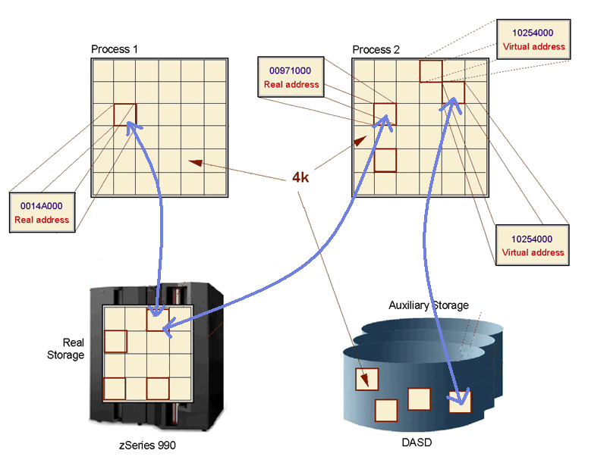
How virtual storage works (continued…)
Notes:
An address is an identifier of a required piece of information, but not a description of
where in real storage that piece of information is. This allows the size of an address
space (that is, all addresses available to a program) to exceed the amount of real
storage available.
All real storage references are made in terms of virtual storage addresses.
A hardware mechanism is used to map the virtual storage address to a physical
location in real storage. As shown on the slide, the virtual address 10254000 can
exist more than once, because each virtual address maps to a different address in real
storage.
When a requested address is not in real storage, a hardware interruption is signaled to
z/OS and the operating system brings the required instructions and data into real
storage.

Slide 17
Pages, Frames, and Slots
The pieces of a program executing in virtual storage must be moved between real and auxiliary storage:
  A block of real storage is a frame.
  A block of virtual storage is a page.
  A block of auxiliary storage is a slot.
A page, a frame, and a slot are all the same size: 4096 bytes (4 kilobytes).
To the programmer, the entire program appears to occupy contiguous spaces in real storage at all times.

Slide 18
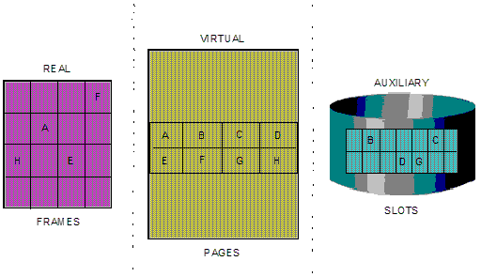
Pages, Frames, and Slots (continued)
Notes:
The slide shows z/OS performing paging for a program running in virtual storage. The
lettered boxes represent parts of the program. In this simplified view, program parts A, E,
F, and H are active and running in real storage frames, while parts B, C, D, and G are
inactive and have been moved to auxiliary storage slots. All of the program parts,
however, reside in virtual storage and have virtual storage addresses.

Slide 19
Page Stealing
z/OS tries to keep an adequate supply of available real storage frames on hand.
When this supply becomes low, z/OS uses page stealing to replenish it.
Pages that have not been accessed for a relatively long time are good candidates for page stealing.
z/OS also uses various storage managers to keep track of all pages, frames, and slots in the system:
  Auxiliary Storage Manager (ASM)
  Real Storage Manager (RSM)
  Virtual Storage Manager (VSM)

Slide 20
Swapping
Swapping is one of several methods that z/OS uses to balance the system workload and ensure that an adequate supply of available real storage frames is maintained.
Swapping has the effect of moving an entire address space into, or out of, real storage:
  A swapped-in address space is active, having pages in real storage frames and pages in auxiliary storage slots.
  A swapped-out address space is inactive; the address space resides on auxiliary storage and cannot execute until it is swapped in.
  A logically-swapped out address space is inactive; its pages are ready to be swapped out but have not yet been swapped out.
Notes:
“Working set” is the number of active pages in an application. The inactive pages have been paged out, leaving the active pages in memory. The number of applications that can fit comfortably in a system concurrently is a function of the working set of each.
When an entire application is moved to auxiliary storage, it is “swapped out”. This means that all of the pages (including the working set) are moved to a separate swap data set. When resources are freed up, the application is brought back into memory.

Slide 21
What is storage protection?
z/OS uses the following techniques to preserve the integrity of each user’s work:
A private address space for each user
Page protection
Low-address protection
Multiple storage protect keys
Notes:
Up to now, we’ve discussed virtual storage mostly in the context of a single user or program. In reality, of course, many programs and users are competing for the use of the system.

Slide 22
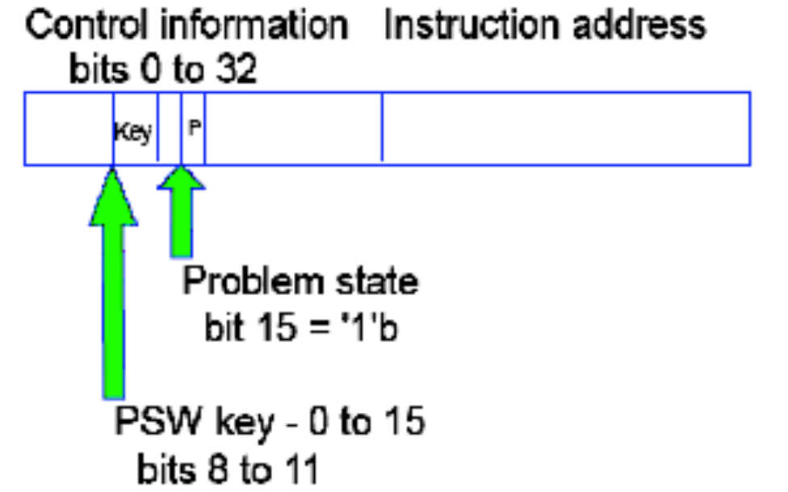
Storage Protection Keys
z/OS uses 16 storage protect keys.
A specific key is assigned according to the type of work being performed.
- The key is stored in bits 8 through 11 of the program
status word (PSW).
- A PSW is assigned to each job in the system.
Notes:
Storage protect keys 0 through 7 are used by the z/OS base control program (BCP) and various subsystems and middleware products. Storage protect key 0 is the master key. Its use is restricted to those parts of the BCP that require almost unlimited store and fetch capabilities. In almost any situation, a storage protect key of 0 associated with a request to access or modify the contents of a central storage location means that the request will be satisfied.
Storage protect keys 8 through 15 are assigned to users. Because all users are isolated in private address spaces, most users—those whose programs run in a virtual region—can use the same storage protect key. These users are called V=V (virtual = virtual) users and are assigned a key of 8. Some users, however, must run in a central storage region. These users are known as V=R (virtual =
real) users and require individual storage protect keys because their addresses are not protected by the DAT process that keeps each address space distinct.
Without separate keys, V=R users might reference each other’s code and data.
These keys are in the range of 9 through 15.

Slide 23
Role of storage managers
Real storage manager
-The real storage manager or RSM™ keeps track of the contents of central
storage.
Auxiliary storage manager
- The auxiliary storage manager or ASM uses the system’s page data sets,
to keep track of auxiliary storage slots.
Virtual storage manager
- The virtual storage manager or VSM™ responds to requests to obtain and
frees virtual storage.
Notes:
Real storage manager
The real storage manager or RSM™ keeps track of the contents of central
storage. It manages the paging activities described earlier, such as page-in,
page-out, and page stealing, and helps with swapping an address space in or
out. RSM also performs page fixing (marking pages as unavailable for stealing).
Auxiliary storage manager
The auxiliary storage manager or ASM uses the system’s page data sets, to
keep track of auxiliary storage slots. Specifically:
Slots for virtual storage pages that are not in central storage frames
Slots for pages that do not occupy frames, but, because the frame’s contents
have not been changed, the slots are still valid.
When a page-in or page-out is required, ASM works with RSM to locate the
proper central storage frames and auxiliary storage slots.
Virtual storage manager
The virtual storage manager or VSM™ responds to requests to obtain and free
virtual storage. VSM also manages storage allocation for any program that must
run in real, rather than virtual storage. Real storage is allocated to code and data
when they are loaded in virtual storage. As they run, programs can request more
storage by means of a system service, such as the GETMAIN macro. Programs
can release storage with the FREEMAIN macro.
VSM keeps track of the map of virtual storage for each address space. In so
doing, it sees an address space as a collection of 256 subpools, which are
logically related areas of virtual storage identified by the numbers 0 to 255. Being
logically related means the storage areas within a subpool share characteristics
such as:
Storage protect key
Whether they are fetch protected, pageable, or swappable
Where they must reside in virtual storage (above or below 16 megabytes)
Whether they can be shared by more than one task
Some subpools (numbers 128 to 255) are predefined by use by system
programs. Subpool 252, for example, is for programs from authorized libraries.
Others (numbered 0 to 127) are defined by user programs.

Slide 24
How is peripheral storage managed?
Management of peripheral storage devices involves file allocation, placement, monitoring, migration, backup, recall, recovery, and deletion.
A typical z/OS production system includes both manual and automated processes for managing storage.
A user or program can directly control many aspects of z/OS storage use.
The primary means of managing Aux storage in z/OS is through Data Facility System Managed Storage (DFSMS).
Notes:
In an operating system, storage management involves file allocation, placement,
monitoring, migration, backup, recall, recovery, and deletion. These activities can be
done either manually or through the use of automated processes. When storage
management is automated, the system determines object placement, and automatically
manages object backup, movement, space, and security. A typical z/OS production
system includes both manual and automated processes for managing storage.
Depending on how a z/OS system and its storage devices are configured, a user or
program can directly control many aspects of storage use, and in the early days of the
operating system, users were required to do so. Increasingly, however, z/OS installations
rely on installation-specific settings for data and resource management, and add-on
storage management products to automate the use of storage. The primary means of
managing storage in z/OS is through the DFSMS component, which is discussed in Chapter 4,
“Working with data sets”.

Slide 25
What is Workload Management and its objectives?
WLM manages the processing of workloads in the system according to
the business goals
WLM manages the use of system resources, such as processors and
storage to accomplish these goals.
WLM has three objectives:
1. To achieve the business goals that are defined by the installation, by
automatically assigning sysplex resources to workloads based on their
importance and goals.
This objective is known as goal achievement.
2. To achieve optimal use of the system resources from the system point of view.
This objective is known as throughput.
3. To achieve optimal use of system resources from the point of view of the
individual address space.
This objective is known as response and turnaround time.
Notes:
Goal achievement is the first and most important task of WLM. Optimizing throughput and minimizing turnaround times of address spaces come after that.
Often, these latter two objectives are contradictory. Optimizing throughput means keeping resources busy. Optimizing response and turnaround time, however, requires resources to be available when they are needed. Achieving the goal of an important address space might result in worsening the turnaround time of a less important address space. Thus, WLM must make decisions that represent trade-offs between conflicting objectives.

Slide 26
WLM Balances Throughput and Turnaround
To balance throughput with response and turnaround time, WLM
does the following:
Monitors the use of resources by the various address spaces.
Monitors the system-wide use of resources to determine whether they are fully utilized.
Determines which address spaces to swap out (and when).
Inhibits the creation of new address spaces or steals pages when certain shortages of central storage exist.
Changes the dispatching priority of address spaces, which controls the rate at which the address spaces are allowed to consume system resources.
Selects the devices to be allocated, if a choice of devices exists, in order to balance the use of I/O devices.

Slide 27
When is WLM Notified To Do Work
Other z/OS components, transaction managers, and database
managers can communicate to WLM a change in status for a particular address space (or for the system as a whole), or to invoke WLM’s decision-making power.
For example, WLM is notified when:
Central storage is configured into or out of the system.
An address space is to be created.
An address space is deleted.
A swap-out starts or completes.
Allocation routines need to choose the devices to be allocated to a
request.
A priority workload is missing its goal

Slide 28
What is interrupt processing?
An interrupt is an event that alters the sequence in which the processor executes
instructions. An interrupt might be planned (specifically requested by the currently
running program) or unplanned (caused by an event that might or might not be related
to the currently running program).
Supervisor calls or SVC interrupts
I/O interrupts
External interrupts
Restart interrupts
Program interrupts
Machine check interrupts
Works pretty much like it works in the PC world.
Notes:
There are 6 types of interrupts:
Supervisor calls or SVC interrupts
These occur when the program issues an SVC to request a particular system
service. An SVC interrupts the program being executed and passes control to
the supervisor so that it can perform the service. Programs request these
services through macros such as OPEN (open a file), GETMAIN (obtain
storage), or WTO (write a message to the system operator).
I/O interrupts
These occur when the channel subsystem signals a change of status, such
as an I/O operation completing, an error occurring, or an I/O device such as a
printer has become ready for work.
External interrupts
These can indicate any of several events, such as a time interval expiring, the
operator pressing the interrupt key on the console, or the processor receiving
a signal from another processor.
Restart interrupts
These occur when the operator selects the restart function at the console or
when a restart SIGP (signal processor) instruction is received from another
processor.
Program interrupts
These are caused by program errors (for example, the program attempts to
perform an invalid operation), page faults (the program references a page that
is not in central storage), or requests to monitor an event.
Machine check interrupts
These are caused by machine malfunctions.

Slide 29
How is the program status word (PSW) used?
The PSW controls the order in which instructions are fed to the processor, and indicates the status of the system in relation to the currently running program.
Although each processor has only one PSW, it is useful to think of three types of PSWs to understand interrupt processing:
- Current PSW
- New PSW
- Old PSW

Slide 30
Creating dispatchable units of work
Dispatchable units of work are represented by two kinds of control blocks:
Task control blocks (TCBs)
These represent tasks executing within an address space, such as user
programs and system programs that support the user programs.
Service request blocks (SRBs)
These represent requests to execute a system service routine. SRBs are
typically created when one address space detects an event that affects a
different address space; they provide one mechanism for communication
between address spaces.
Notes:
What is a TCB (Task Control Block)?
A TCB is a control block that represents a task, such as your program, as it runs
in an address space. A TCB contains information about the running task, such as
the address of any storage areas it has created. Do not confuse the z/OS term
TCB with the UNIX data structure called a process control block or PCB.
TCBs are created in response to an ATTACH macro. By issuing the ATTACH
macro, a user program or system routine begins the execution of the program
specified on the ATTACH macro, as a subtask of the attacher’s task. As a
subtask, the specified program can compete for processor time and can use
certain resources already allocated to the attacher’s task.
The region control task (RCT), which is responsible for preparing an address
space for swap-in and swap-out, is the highest priority task in an address space.
All tasks within an address space are subtasks of the RCT.
What is an SRB (Service Request Block)?
An SRB is a control block that represents a routine that performs a particular
function or service in a specified address space. Typically, an SRB is created
when one address space is executing and an event occurs that affects another
address space.
The routine that performs the function or service is called the SRB routine;
initiating the process is called scheduling an SRB; the SRB routine runs in the
operating mode known as SRB mode.
An SRB is similar to a TCB in that it identifies a unit of work to the system. Unlike
a TCB, an SRB cannot “own” storage areas. SRB routines can obtain, reference,
use, and free storage areas, but the areas must be owned by a TCB. In a
multi-processor environment, the SRB routine, after being scheduled, can be
dispatched on another processor and can run concurrently with the scheduling
program. The scheduling program can continue to do other processing in parallel
with the SRB routine. As mentioned earlier, an SRB provides a means of
asynchronous inter-address space communication for programs running on
z/OS.
Only programs running in a mode of higher authority called supervisor state can
create an SRB. These authorized programs obtain storage and initialize the
control block with things such as the identity of the target address space and
pointers to the code that will process the request. The program creating the SRB
then issues the SCHEDULE macro and indicates whether the SRB has global
(system-wide) or local (address space-wide) priority. The system places the SRB
on the appropriate dispatching queue where it will remain until it becomes the
highest priority work on the queue.

Slide 31
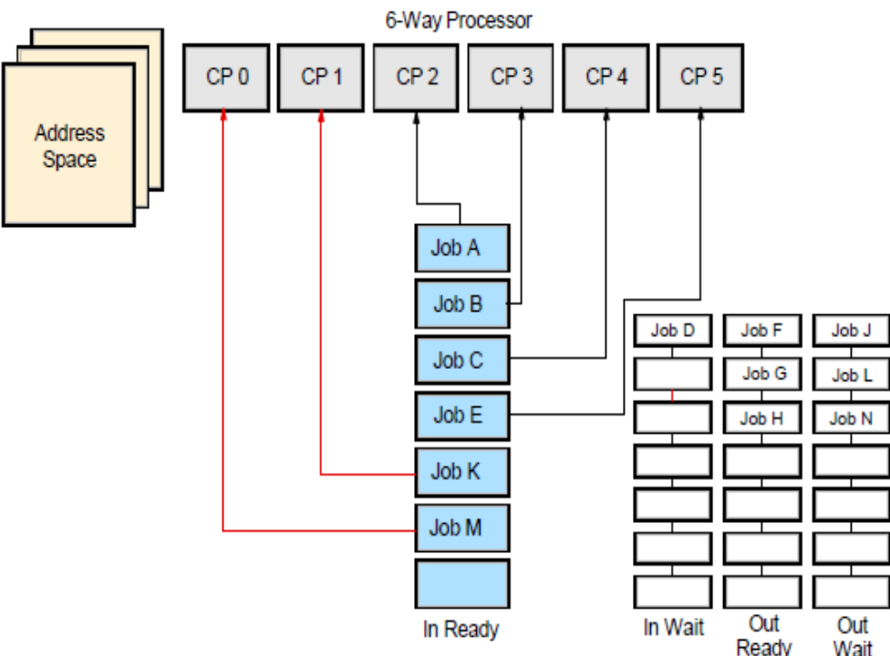
What does the dispatcher do?
In z/OS, the dispatcher component is responsible for routing control to the highest priority unit of work that is ready to execute.
The dispatcher processes work in the following order:
1. Special exits
2. SRBs that have a global priority
3. Ready address spaces in order of priority.
An address space can be in any
one of four queues:
- IN-READY
- IN-WAIT
- OUT-READY
- OUT-WAIT
Note: Only IN-READY work can be selected for dispatching.
Notes:
New work is selected, for example, when a task is interrupted or becomes non-dispatchable, or after an SRB completes or is suspended (that is, an SRB is delayed because a required resource is not available). These are exits to routines that have a high priority because of specific
conditions in the system. For example, if one processor in a multi-processing
system fails, alternate CPU recovery is invoked by means of a special exit to
recover work that was being executed on the failing processor.
2. SRBs that have a global priority
3. Ready address spaces in order of priority
An address space is ready to execute if it is swapped in and not waiting for
some event to complete. An address spaces’s priority is determined by the
dispatching priority specified by the user or the installation.
After selecting the highest priority address space, z/OS (through the
dispatcher) first dispatches SRBs with a local priority that are scheduled for
that address space and then TCBs in that address space.
If there is no ready work in the system, z/OS assumes a state called an enabled wait until fresh work enters the system.

Slide 32
Serializing the use of resources
Global Resource Serialization (GRS)
- Global resource serialization serializes access to resources to protect their
integrity.
- This is used mostly when resources are shared across systems
Enqueuing
- Enqueuing is the means by which a program running on z/OS
requests control of a serially reusable resource.
- Enqueuing is accomplished by means of the ENQ (enqueue) and
DEQ (dequeue) macros, which are available to all programs running
on the system.
Locking
- The system serializes the use of system resources by authorized routines
and in a Parallel Sysplex, by processors.
- A lock is simply a named field in storage that indicates whether a resource
is being used and who is using it.
Notes:
In a multitasking, multiprocessing environment, resource serialization is the technique used to coordinate access to resources that are used by more than one application. Programs that change data need exclusive access to the data.
Otherwise, if several programs were to update the same data at the same time, the data could be corrupted (also referred to as a loss of data integrity). On the other hand, programs that need only to read data can safely share access to the same data at the same time.
The most common techniques for serializing the use of resources are enqueuing and locking. These techniques allow for orderly access to system resources needed by more than one user in a multiprogramming or multiprocessing environment. In z/OS, enqueuing is managed by the global resource serialization component and locking is managed by various lock manager programs in the
supervisor component.

Slide 33
Summary of z/OS facilities
Address spaces and virtual storage for users and programs.
Virtual storage is backed by real and auxiliary storage.
Movement of programs and data between real storage and auxiliary storage through paging.
Dispatching work for execution, based on priority and ability to execute.
An extensive set of facilities for managing files stored on disk or tape. Operators use consoles to start and stop z/OS, enter commands, and manage the operating system.
Notes:
An address space describes the virtual storage addressing range available to an online
user or a running program.
Two types of physical storage are available: real storage and auxiliary storage (AUX).
Real storage is also referred to as real memory or central storage.
z/OS moves programs and data between real storage and auxiliary storage through a
process called paging.
z/OS dispatches work for execution. That is, it selects programs to be run based on
priority and ability to execute and then loads the program and data into real storage.
All program instructions and data must be in real storage when executing.
An extensive set of facilities manages files stored on direct access storage device
(DASD) or tape cartridges.
Operators use consoles to start and stop z/OS, enter commands, and manage the
operating system.
z/OS provides operational facilities such as security, recovery, data integrity and
workload management.

Slide 34
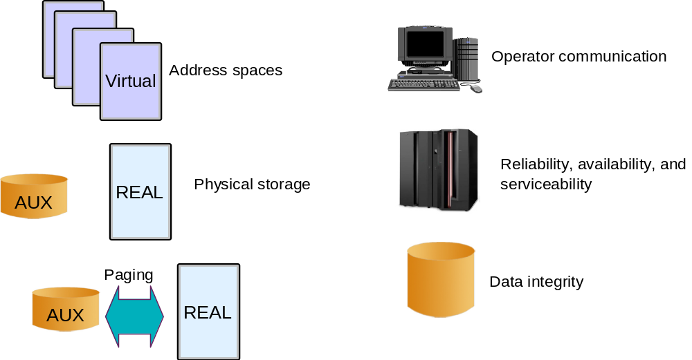
Summary of z/OS facilities (continued…)

Slide 35
Defining characteristics of z/OS
Uses address spaces to ensure isolation of private areas
Designed to ensure data integrity, regardless of how large the user population might be.
Can process a large number of concurrent batch jobs, with automatic workload balancing
Allows security to be incorporated into applications, resources, and user profiles.
Allows multiple communications subsystems at the same time.
Provides extensive recovery facilities, making unplanned system restarts very rare.
Can manage mixed workloads.
Can manage large I/O configurations of 1000s of disk drives, automated tape libraries, large printers, networks of terminals, etc.
Can be controlled from one or more operator terminals, or from application programming interfaces (APIs) that allow automation of routine operator functions.
Notes:
The use of address spaces in z/OS holds many advantages: Isolation of private areas
in different address spaces provides for system security, yet each address space also
provides a common area that is accessible to every address space.
The system is designed to preserve data integrity, regardless of how large the user
population might be. z/OS prevents users from accessing or changing any objects on
the system, including user data, except by the system-provided interfaces that enforce
authority rules.
The system is designed to manage a large number of concurrent batch jobs, with no
need for the customer to externally manage workload balancing or integrity problems
that might otherwise occur due to simultaneous and conflicting use of a given set of
data.
The security design extends to system functions as well as simple files. Security can
be incorporated into applications, resources, and user profiles.
The system allows multiple communications subsystems at the same time, permitting
unusual flexibility in running disparate communications-oriented applications (with
mixtures of test, production, and fall-back versions of each) at the same time. For
example, multiple TCP/IP stacks can be operational at the same time, each with
different IP addresses and serving different applications.
The system provides extensive software recovery levels, making unplanned system
restarts very rare in a production environment. System interfaces allow application
programs to provide their own layers of recovery. These interfaces are seldom used
by simple applications—they are normally used by more sophisticated applications.
The system is designed to routinely manage very disparate workloads, with automatic
balancing of resources to meet production requirements established by the system
administrator.
The system is designed to routinely manage large I/O configurations that might
extend to thousands of disk drives, multiple automated tape libraries, many large
printers, large networks of terminals, and so forth.
The system is controlled from one or more operator terminals, or from application
programming interfaces (APIs) that allow automation of routine operator functions.
The operator interface is a critical function of z/OS. It provides status information,
messages for exception situations, control of job flow, hardware device control, and
allows the operator to manage unusual recovery situations.

Slide 36
Other programs for z/OS
A z/OS system usually contains additional licensed programs (priced software) needed to create a practical working system:
  security manager
  database manager
  compilers
  utility programs
  vendor products
Notes:
We won’t attempt to list all of the z/OS program products in this course (hundreds exist);
some common choices include:
A security system
z/OS provides a framework for customers to add security through the addition of a
security management product (IBM’s program product is Resource Access Control
Facility or RACF®). Non-IBM security system program products are also available.
Compilers
z/OS includes an assembler and a C compiler. Other compilers, such as the COBOL
compiler, are offered as separate products.
A relational database, such as DB2
Other types of database products, such as hierarchical databases, are also available.
Transaction processing facilities
IBM offers several, including:
– Customer Information Control System (CICS)
– Information Management System (IMS)
– WebSphere
A sort program
Fast, efficient sorting of large amounts of data is highly desirable in batch processing.
IBM and other vendors offer sophisticated sorting products.
A large variety of utility programs
For example, the System Display and Search Facility (SDSF) program that we use
extensively in this course to view output from batch jobs is a program product. Not
every installation purchases SDSF; alternative products available.
A large number of other products are available from various independent software
vendors (commonly called ISVs in the industry).

Slide 37
Middleware for z/OS
Middleware is typically something between the operating system and an end user or end-user applications.
Middleware supplies major functions not provided by the operating system.
Typical z/OS middleware includes:
  Database systems
  Web servers
  Message queuing and routing functions
  Transaction managers
  Java virtual machines
  XML processing functions
Notes:
As commonly used, the term usually applies to major software products such as database
managers, transaction monitors, Web servers, and so forth.
Typical z/OS middleware includes:
Database systems
Web servers
Message queuing and routing functions
Transaction managers
Java virtual machines
XML processing functions
A middleware product often includes an application programming interface (API). In
some cases, applications are written completely to this middleware API, while in other
cases it is used only for unique purposes. Some examples of mainframe middleware APIs
include:
The WebSphere suite of products, which provides a complete API that is portable
across multiple operating systems. Among these, WebSphere MQ provides
cross-platform APIs and inter-platform messaging.
The DB2 database management product, which provides an API (expressed in the
SQL language) that is used with many different languages and applications.

Slide 38
A brief comparison of z/OS and UNIX…
SCREENSHOT 2
Quite a few concepts are common to both:
  Boot the system versus IPL the system
  Files versus data sets
  Editors → vi, ed, sed, and emacs (UNIX) versus ISPF (z/OS)
  telnet or rlogin (UNIX) versus TSO logon (z/OS)
Notes:
As a new user of z/OS, many of the z/OS terms
will sound unfamiliar to you. As you work through this course, however, the z/OS
meanings will be explained and you will find that many elements of UNIX have analogies
in z/OS.

Slide 39
UNIX System Services : Processes
Address Space ( zOS Task)
Address Space ( USS Process)
TCB
Process
TCB
TCB
Process
Process
TCB
TCB
Each Process has an ID (PID) number
Each Process is either a Parent or Child

Slide 40
Managing UNIX System Services
IPL…
Trace
data
z/OS
including
UNIX Services
SMF & RMF
records
RMF
Reports

Slide 41
Extra Slides

Slide 42
Workload Manager – Consistent Service Levels
OnLine Processing
Data Base
Processing
S
Y
S
P
L
E
X
Service levels
are maintained
Batch File
Updating
Batch Reporting
Data
Mining
illustration
Transaction type:
  Web "buy" vs "browse"
  B2B
  Batch payroll
  Test
User/user type:
  Top 100 clients
  Typical clients
  Executive
  Design team
Time periods:
  1AM - 4AM
  Mon - Fri
  Weekends
  End of quarter
Policy
Based
Policy
Based
Notes:
Use Slide show this has animation – note to the audience as new workload is introduced it does not impact existing workload – policy based management attempts to ensure service levels.

Slide 43

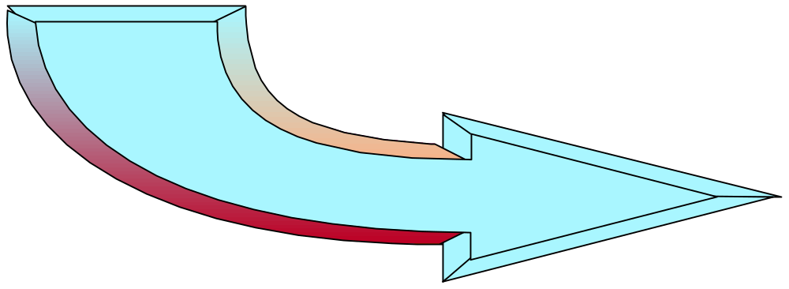

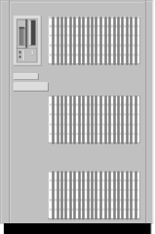
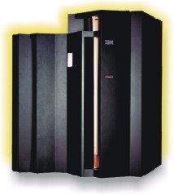
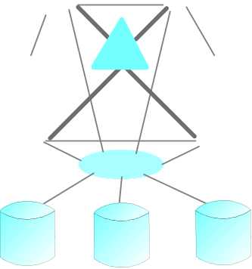
Providing Scalability
Solution:
+ Multiply!
Firewalls
+ Multiply!
+ Multiply!
Parallel
Sysplex
Routers and
Edge Servers
Web Servers
Application
Servers
How quickly can more capacity be added?
Notes:
And that brings new problems to the environment.

Slide 44
Managing Multiple Workloads
There is some workload management in distributed OS environments but customers still tend not to mix workloads within a single OS instance instead they dedicate servers to a specific workload or partition a server so the workloads do not interfere with one another
Routing definitions and bigger/more servers are used for higher priority work
  Causes white space problems
Serves Web content (text and graphics)
Web interface for customers who do transactions
Routers + Edge Servers
Application Servers
Data/Trans
Server
Web Servers
Notes:
White Space, no sharing of resources, scale each up individually, 5 to 1 peak to average, sometimes as high as 9 to 1. Wasted resources. So what about Sun and HP? Sharing, but resources must be allocated in block of processors and not shared. Scale up and Scale out using IBM zSeries Infrastructure Simplification.

Slide 45
Summary
z/OS, the most widely used mainframe operating system, is ideally suited for processing large workloads for many concurrent users.
Virtual storage is an illusion created by the architecture, in that the system seems to have more storage than it really has.
Each user of z/OS gets an address space containing the same range of storage addresses.
z/OS is structured around address spaces, which are ranges of addresses in virtual storage.
Production systems usually include add-on products for middleware and other functions.
Notes:
An operating system is a collection of programs that manage the internal workings of a
computer system. The operating system taught in this course is z/OS, the most widely
used mainframe operating system.
The z/OS operating system’s use of multiprogramming and multiprocessing, and its
ability to access and manage enormous amounts of storage and I/O operations, makes it
ideally suited for running mainframe workloads.
The concept of virtual storage is central to z/OS. Virtual storage is an illusion created by
the architecture, in that the system seems to have more storage than it really has. Virtual
storage is created through the use of tables to map virtual storage pages to pages in real
storage or slots in auxiliary storage. Only those portions of a program that are needed are
actually loaded into real storage. z/OS keeps the inactive pieces of address spaces in
auxiliary storage.
z/OS is structured around address spaces, which are ranges of addresses in virtual
storage. Each user of z/OS gets an address space containing the same range of storage
addresses. The use of address spaces in z/OS allows for isolation of private areas in
different address spaces for system security, yet also allows for inter-address space
sharing of programs and data through a common area accessible to every address space.
Programs running on z/OS and zSeries mainframes can run with 24-, 31-, or 64-bit
addressing (and can switch among these if needed). Programs can use a mixture of
instructions with 24-bit, 64-bit, or 32-bit operands, and can switch among these if
needed.
Mainframe operating systems seldom provide complete operational environments. They
depend on program products for middleware and other functions. Many vendors,
including IBM, provide middleware and various utility products.
Middleware is a relatively recent term that can embody several concepts at the same
time. A common characteristic of middleware is that it provides a programming
interface, and applications are written (or partially written) to this interface.

