Slide 1

Rainfall Prediction Using LSTM Deep Learning Model
OR 610 Project
By Tuan Nguyen
May 2nd, 2023

Slide 2

CONTENT
Introduction
Dataset
Model
Experimental Results
Discussion

Slide 3


1. INTRODUCTION

Slide 4
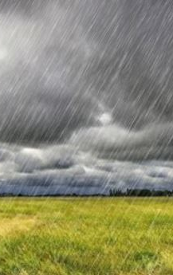
Rainfall
Rainfall (or Precipitation)
Condensed atmospheric water vapor pulled by gravity
Affects numerous human activities
Can cause hazardous weather conditions
Knowing when it will rain in advance can lead better mitigation plan/take advantage of these events

Slide 5
CURRENT METHODS
Physical Based – Simulation Models
NOAA’s Global Forecast System (GFS)
ECMWF’s Integrated Forecasting System (IFS)
Problem: Costly To Operate
CHALLENGES – LONG TERM PREDICTION:
Many influencing factors
“Butterfly Effect”
Non-deterministic
Amplified error per time step
POSSIBLE SOLUTIONS:
Predict only Monthly/Weekly average
Lose temporal information
Statistical Based – Statistic/ML/DL Models
ARIMA, SVM, MLP, ANFIS, RNN/LSTM (Historical Records)
CNN, ConvLSTM (Radar Echo, Satellite Images)
Problem: Slower To Adapt To New Data

Slide 6
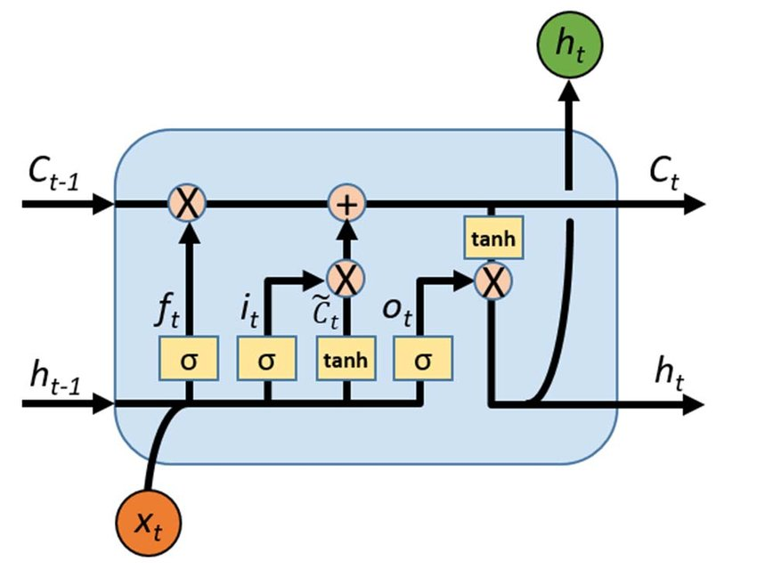
Solution Proposal
LSTM Model Architecture
Predict Daily Rainfall In Millimeters (Mm)
Input: 30 – 90 Days Prior Weather Data
Output:
Daily Iterative Model: 1-day Prediction
Single Prediction Model: 30-days Prediction

Slide 7
2. DATASET

Slide 8
Original dataset
“Rain in Australia” dataset
Kaggle dataset, 145,460 observations of 23 columns
Daily measurements from 49 Stations:
Temperature (Max, Min)
Temperature (9am, 3pm)
Rainfall
Evaporation
Sunshine hours
Wind gust direction (9am, 3pm)
Wind gust speed (9am, 3pm)
Humidity (9am, 3pm)
Pressure (9am, 3pm)
Cloud (9am, 3pm)
Reference: https://www.kaggle.com/datasets/jsphyg/weather-dataset-rattle-package

Slide 9
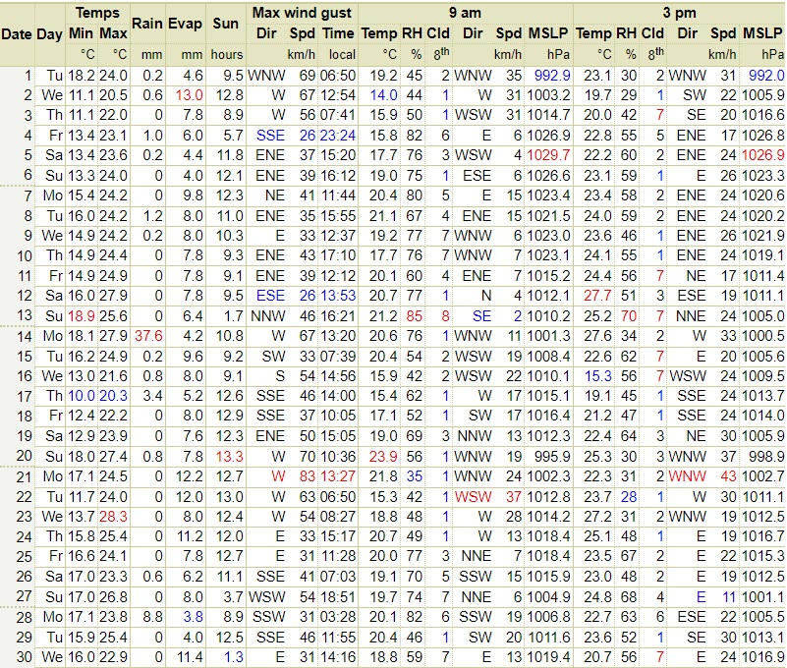
Reference: http://www.bom.gov.au/climate/dwo/IDCJDW2124.latest.shtml

Slide 10
Missing values
Overall Missing Value in each column:
Date: 0.00 %
Location: 0.00 %
MinTemp: 1.02 %
MaxTemp: 0.86 %
Rainfall: 2.24 %
Evaporation: 43.16%
Sunshine: 48.01%
WindGustDir: 7.09 %
WindGustSpeed: 7.05 %
WindDir9am: 7.26 %
WindDir3pm: 2.90 %
WindSpeed9am: 1.21 %
WindSpeed3pm: 2.105%
Humidity9am: 1.82 %
Humidity3pm: 3.098%
Pressure9am: 10.35%
Pressure3pm: 10.33%
Cloud9am: 38.42%
Cloud3pm: 40.81%
Temp9am: 1.21 %
Temp3pm: 2.48 %
RainToday: 2.24 %
RainTomorrow: 2.24 %

Slide 11
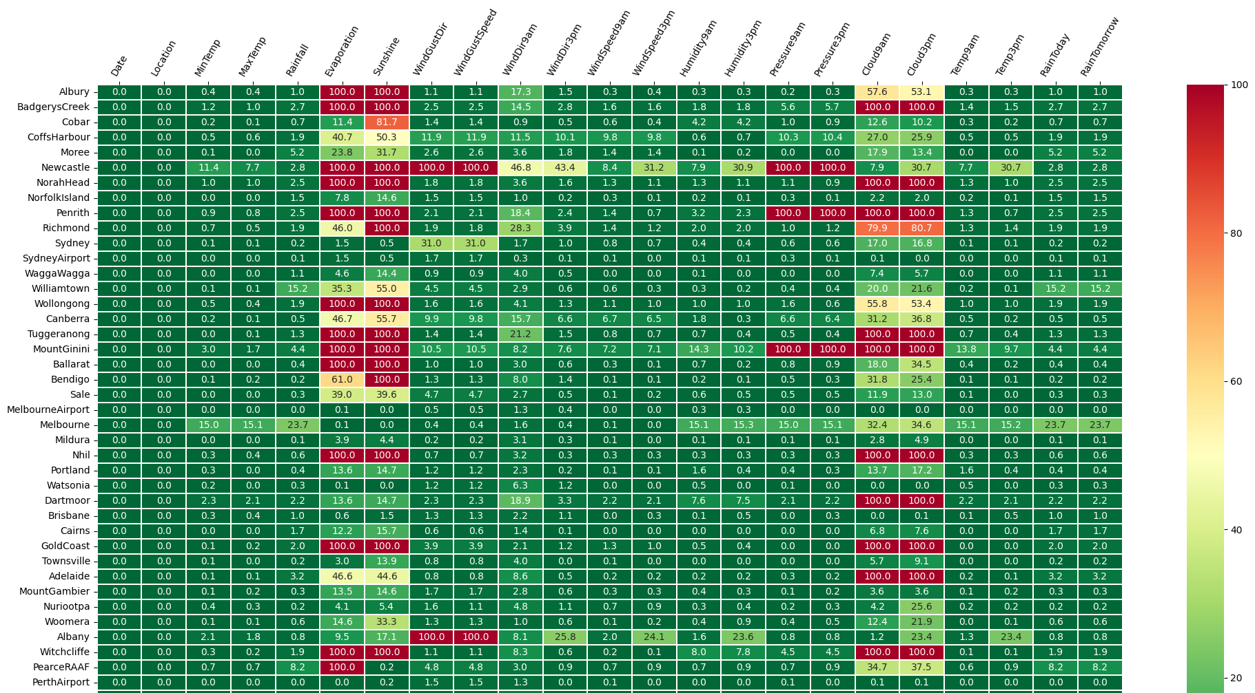

Slide 12
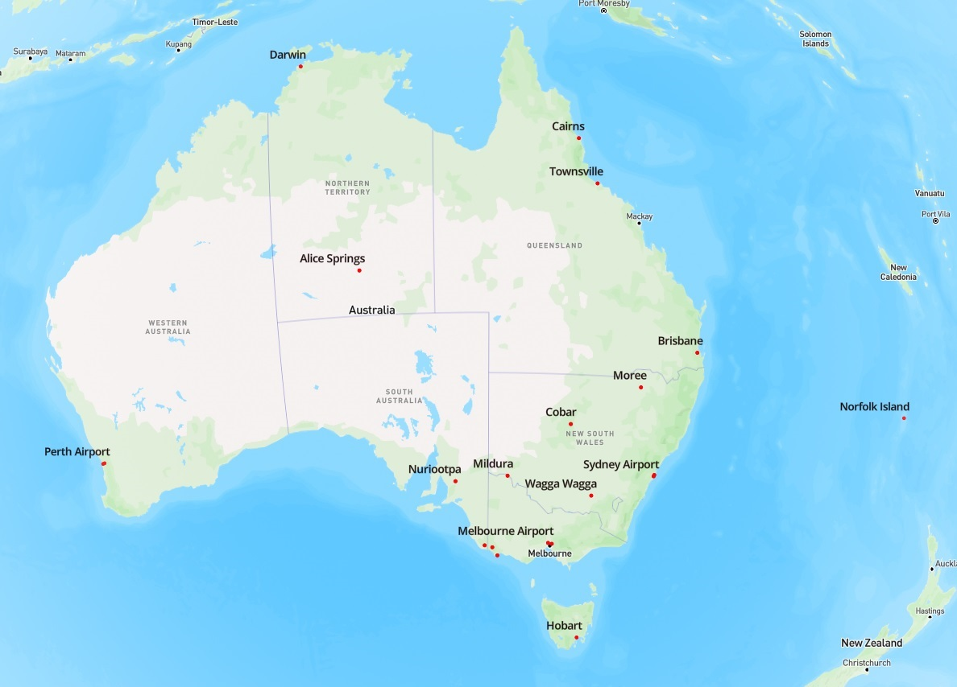
Selected stations
21 Stations selected (< 30% N/A per column)
Sydney Airport
Sydney
Wagga Wagga
Moree
Cobar
Melbourne Airport (major)
Mildura
Portland
Watsonia
Dartmoor
Brisbane
Cairns
Townsville
Nuriootpa
Perth Airport
Perth
Alice Springs
Darwin
Norfolk Island
Mount Gambier
Hobart
64,353 Observations of 23 Columns

Slide 13
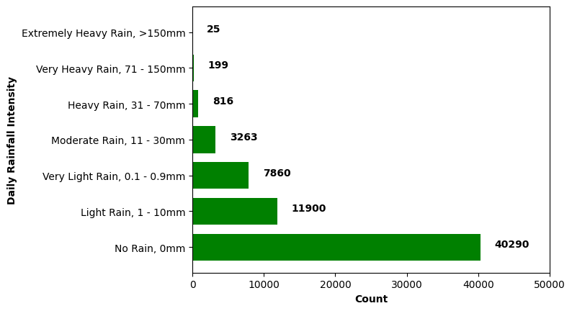
Rainfall data

Slide 14
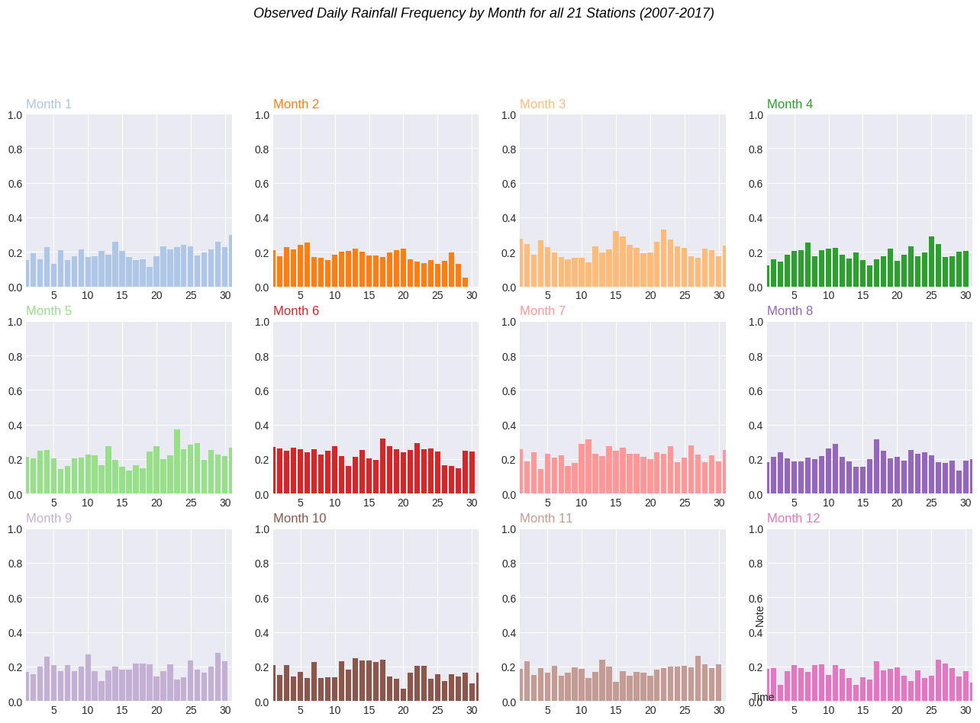

Slide 15
Preprocess
Missing Values:
Create separate data frame for each station
Fill N/A using Mean & Mode at each station
Recombine all frames
Rescale data (sklearn):
MinMaxScaler(): Rainfall
StandardScaler(): Temperature, Evaporation, Wind speed, Pressure, Cloud
Convert from % to ratio: Humidity

Slide 16
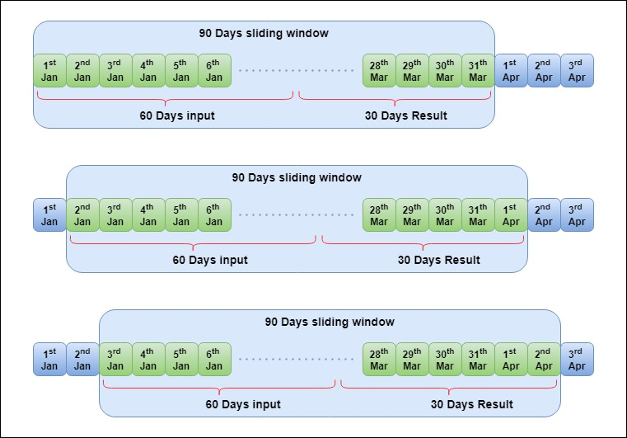
TRAin / val / test split
Create sequence with Sliding window
Split ratio:
0.8 Train
0.15 Val
0.05 Test
Ingest using Torch Data Loader
Only enabled shuffled in Train Data Loader

Slide 17
3. Model

Slide 18
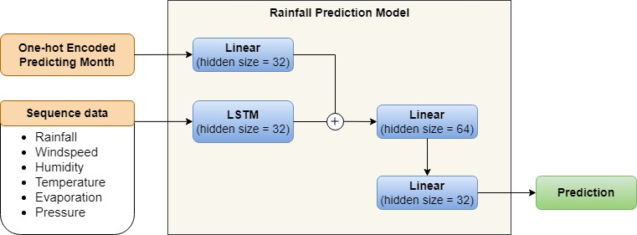
Model architecture
Daily Iterative: Last linear output size = 1
Single Prediction: Last linear output size = 30

Slide 19
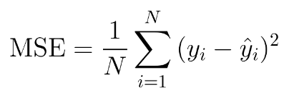
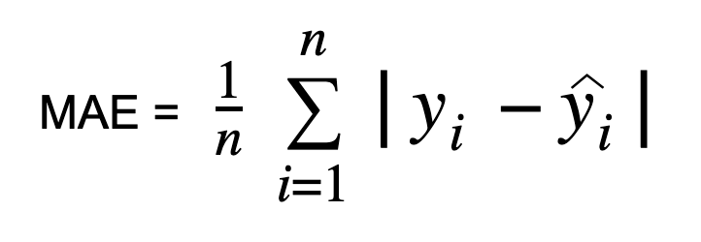
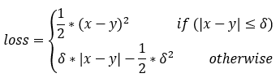
Loss function
Mean Square Error (MSE):
Sensitive to outlier
Predicts closer to mean
Mean Absolute Error (MAE):
Equal weights to outliers
Predicts closer to median
Huber Loss:
Combine advantages of MSE & MAE
Use MSE if loss below delta
Use MAE if loss above delta

Slide 20
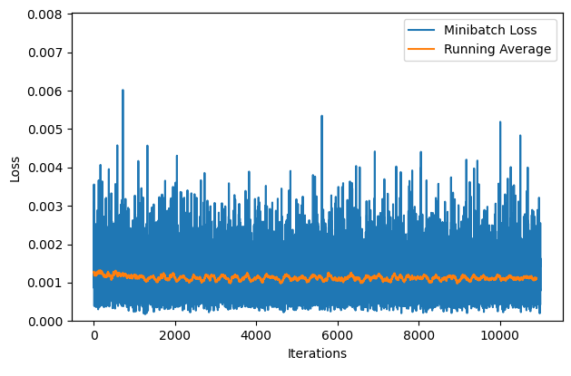
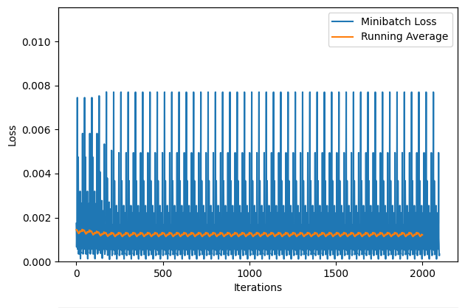
Model Training
Training Loss (Daily Iterative)
50 epochs with Adam Optimizer (lr = 0.001)
Different input sequence length used (30, 60, 90)
Various batch size used (32,64,128,256)
Best weight set (lowest Val loss) was recorded for each epoch
Data Loader shuffle seed also affect performance
Validation Loss (Daily Iterative)

Slide 21
4. Experimental Results

Slide 22
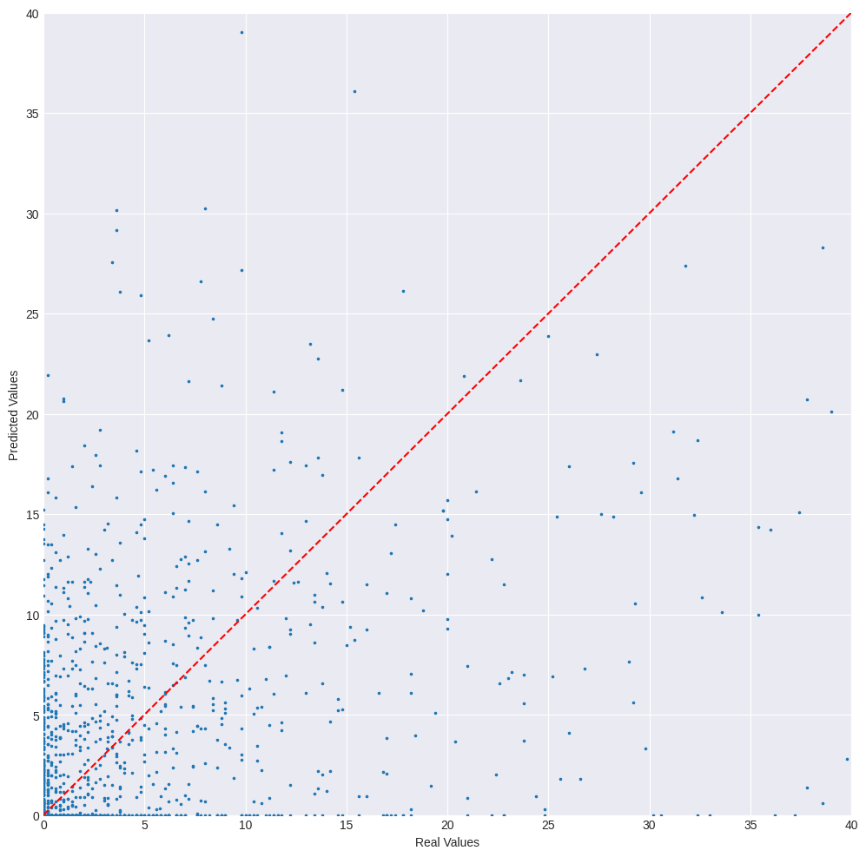
Daily iterative model
Pred (y-axis) versus Real (x-axis)
Batch Size | Metric | Input Sequence Length
 |  | 30 days | 60 days | 90 days
32 | MSE | 52.81804 | 56.30755 | 48.95148
 | RMSE | 7.26760 | 7.50383 | 6.99653
 | MAE | 2.26170 | 2.28474 | 2.00663
64 | MSE | 61.54731 | 61.32821 | 45.00431
 | RMSE | 7.84520 | 7.83123 | 6.70852
 | MAE | 2.20892 | 2.25611 | 2.2923
128 | MSE | 51.45301 | 57.52034 | 46.68670
 | RMSE | 7.17307 | 7.58421 | 6.83276
 | MAE | 2.30552 | 2.64371 | 2.04567
256 | MSE | 54.02511 | 57.29244 | 45.78643
 | RMSE | 7.35017 | 7.56917 | 6.76656
 | MAE | 2.49377 | 2.59183 | 2.20926

Slide 23
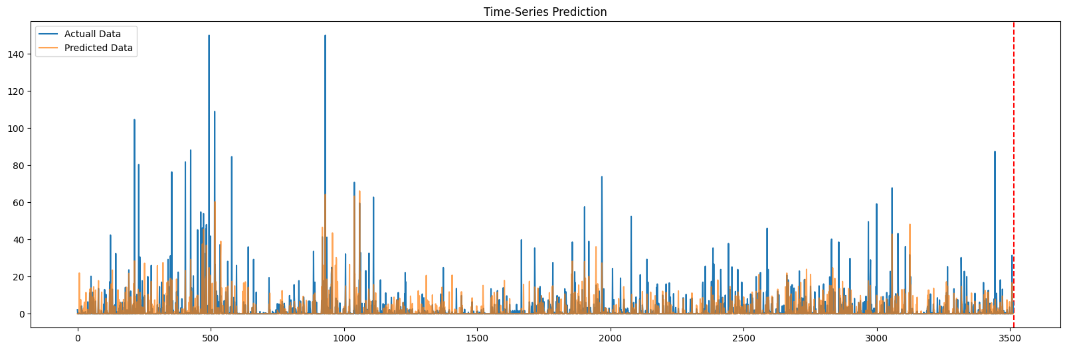
Daily iterative model

Slide 24
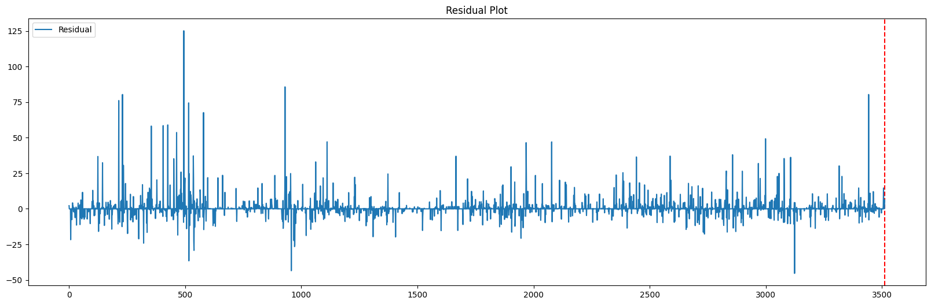
Daily iterative model

Slide 25
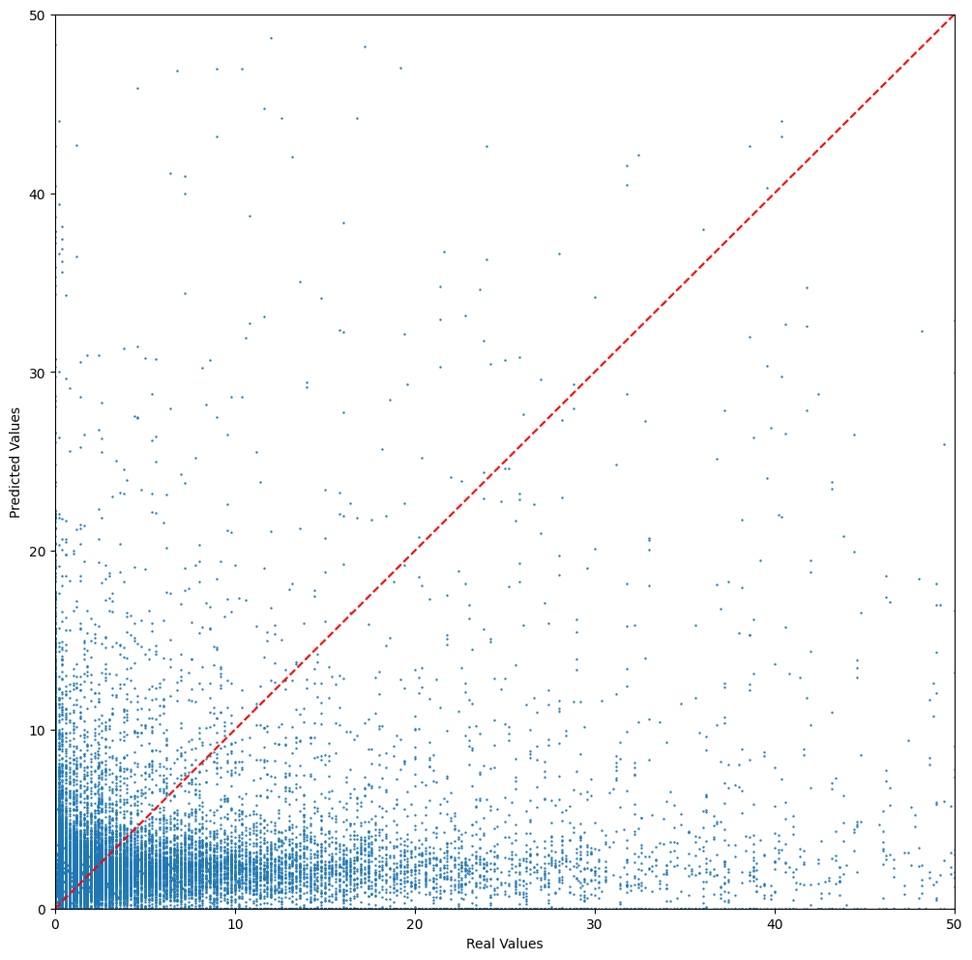
Single prediction model
Pred (y-axis) versus Real (x-axis)
Fixed input length of 60 days
Output length of 30 days
Batch size set to 128
Model performance:
MSE = 69.4754
RMSE = 8.33519
MAE = 2.9877

Slide 26
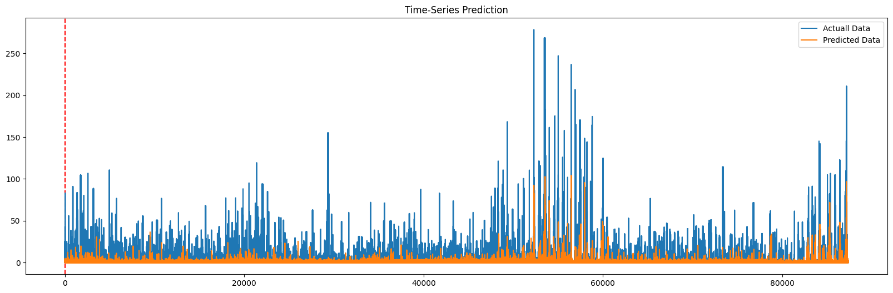
Single prediction model

Slide 27
Result comparison
Model (best) | Metric | Model Type
 |  | Daily Iterative | Single Prediction
Trained Model | MSE | 45.78643 | 69.4754
 | RMSE | 6.76656 | 8.33519
 | MAE | 2.20926 | 2.9877
All zeroes | MSE | 75.32471 | 78.96564
 | RMSE | 8.67898 | 8.88626
 | MAE | 2.37367 | 2.30722
Randomized | MSE | 137.27216 | 392.0345
 | RMSE | 11.71632 | 19.79986
 | MAE | 9.8348 | 11.92328

Slide 28
5. Discussion

Slide 29
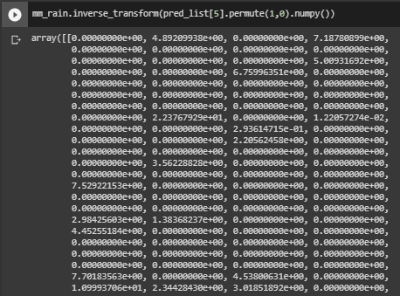
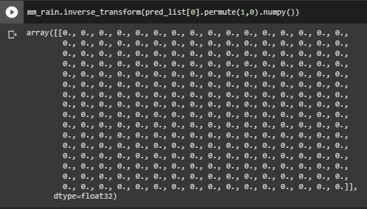
Effect of Loss FN
MSE Loss (nn.MSELoss):
Encourage model to make Non-zero predictions
MAE Loss (nn.L1Loss):
Encourage model to make all-zero predictions
Behavior caused by zero-inflated data

Slide 30
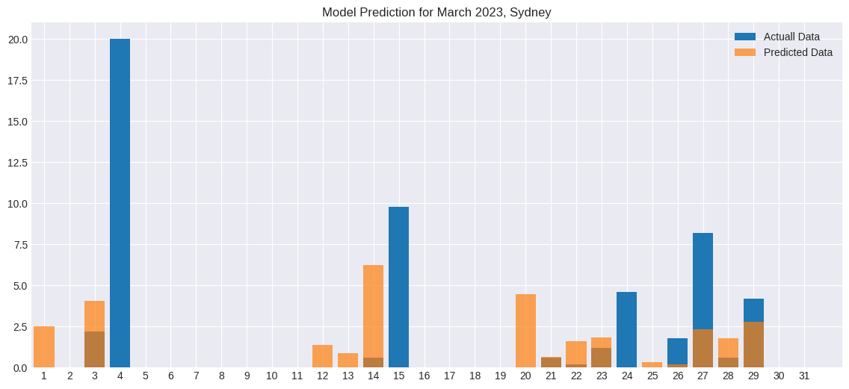
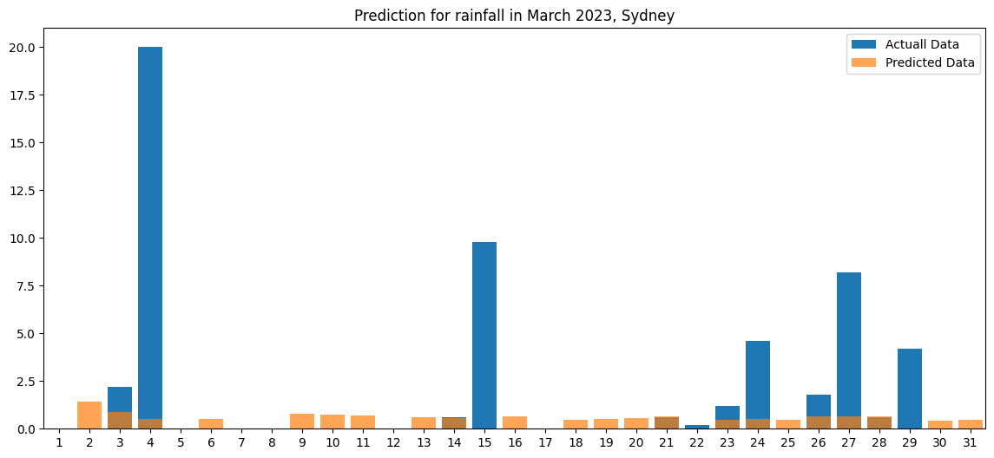
Models Behavior
Daily Iterative Model
Over-predict Amount
Under-predict Rainfall Event occurrences
Single Prediction Model:
Under-predict Amount
Over-predict Rainfall Event occurrences

Slide 31
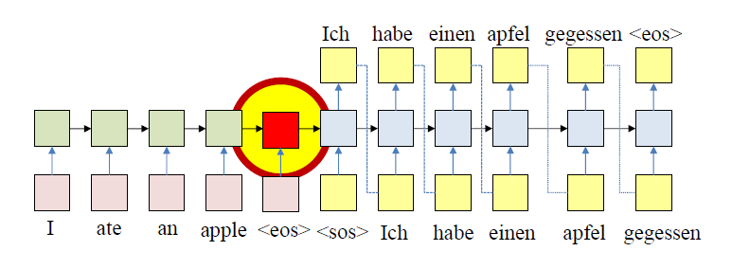
Limitation
Model prediction only relies on last hidden stage
Information in all previous hidden stages not utilized
Information might not be retained through sequence length
Reference: Feng, Tianshu. “RNN2 - Sequence to Sequence Prediction” , OR610 – Deep Learning, GMU College of Engineering and Computing, March 21st, 2023.

Slide 32
Future work
Model prediction only relies on last hidden stage
Modified LSTM
Incorporate attention
Multiply zero-inflated input with input gate sigmoid unit
Information in all previous hidden stages not utilized
Attention Mechanism
Information might not be retained through sequence length
Transformer

Slide 33
Thank you Q&A

