Slide 1


DeepRacer
Collaborative Leaderboard Development
Powered by AWS
Steve Depp Dan Kuratko Jessica Price Jacob Turpin

Slide 2



DeepRacer
CLI Driven Leaderboard
Concept
Build, train and test an AWS DeepRacer virtual race car
Submit design and performance data to the cloud
View a leaderboard composed of many DeepRacer submissions
01
02
03
AWS DeepRacer Model
Submit
Model
Data
View a DeepRacer Leaderboard
BUILD A RACECAR
Players create an AWS DeepRacer model, tune their car by modifying hyperparameters, and train their models on the practice track
SUBMIT YOUR CAR
Players submit their model specs and performance into a DynamoDB table through a CLI that pulls from DeepRacer log files
COMPARE RACERS
Players access a collaborative leaderboard to see how their model stacks up against the competition

Slide 3
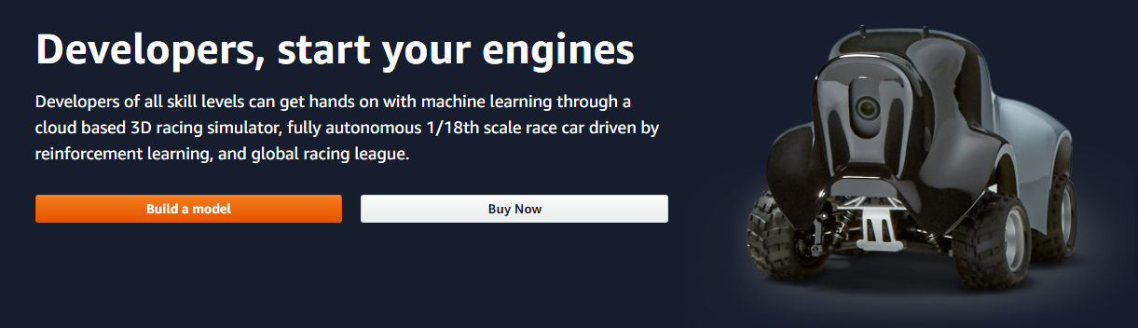
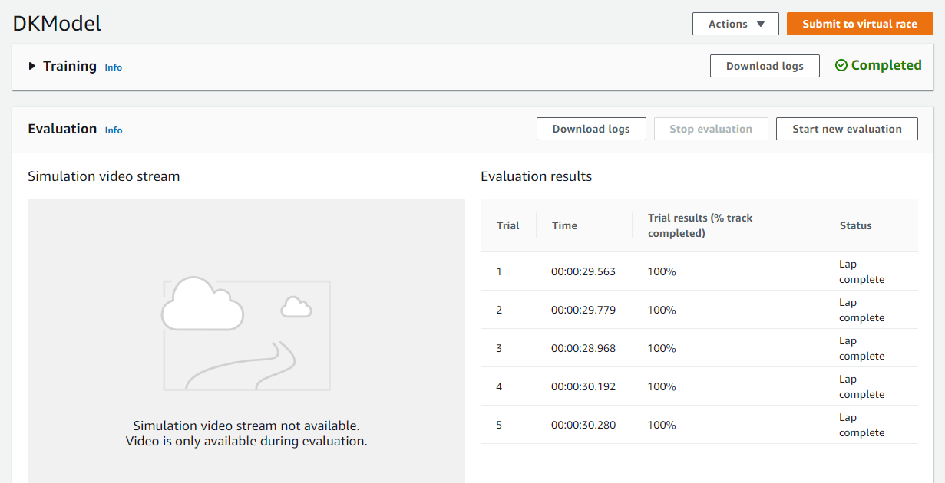
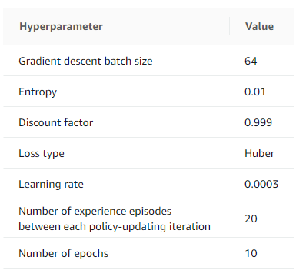
Constructing a (Virtual) Race Car
AWS DeepRacer

Slide 4
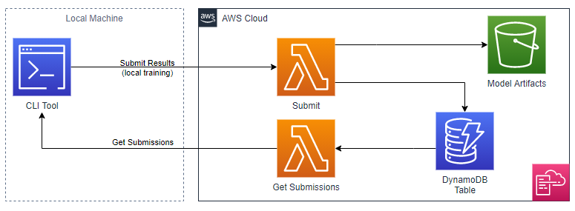
Architecture
AWS Cloud Formation

Slide 5



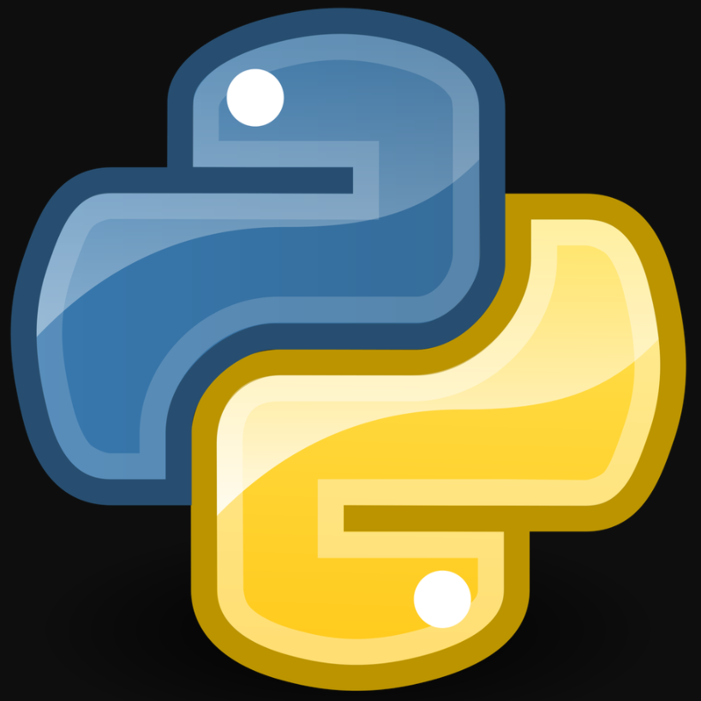

Infrastructure
AWS Cloud Formation
CLI Tool
Lambda Functions
DynamoDB Table
Racers submit their data and gain access to the leaderboard through a CLT
CLI initiates “put” and “pull” lambda functions to move the data
Racer data captured in one central table
Assembler
S3 Bucket
Racer log files collected from user machines
DynamoDB table stored in the cloud

Slide 6
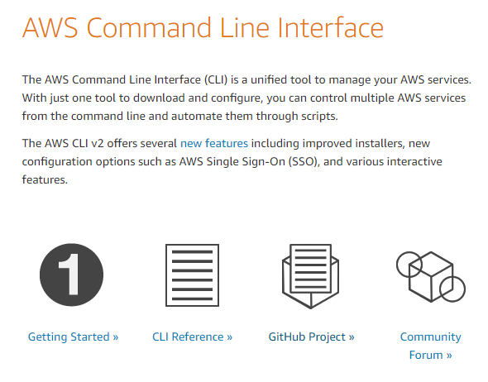
Command Line Interface
Screen Shot of CLI

Slide 7


Assembler
&
DynamoDB
ASSSEMBLER
LEADERBOARDTABLE
Assembler: Collects data from downloaded SpeedRacer files
LeaderboardTable: Stores data from new assembler.py file into DynamoDB table
Sort and query functionality
Source for get_submissions Lambda function
Assembles data from 5 files
Model_data.json
Hyperparameters.json
Training_params.yaml
Training.json
Evaluation.json
Two key variables defined
Track
Person
All other variables are called through the Lambda function

Slide 8



Lambda Functions
Push & Pull
Pull Function
Basic Setup
Queries DynamoDB table
Develops a table for user to view and/or save to local device
Author From Scratch
Fill in Basic Information
Set Permissions
Push Function
Pulls specific data from .json and .yaml files
Sends data into DynamoDB table

Slide 9

Lambda Code
Push Lambda
Pull Lambda
LAMBDA CODE
LAMBDA CODE

Slide 10








RESULTS
Extracted data placed in DynamoDB
A leaderboard table is presented to end user
Built Infrastructure
Step #2
Step #4
Step #1
Step #3
Step #5
Lambda function extracts specified data
Lambda function creates a leaderboard

Slide 11
ADD OUTPUT EXAMPLE
Output
Example

Slide 12





Discussion
List successes
List successes
List successes
List successes
SUSCESSES
LIMITATIONS
List limitations
List limitations
List limitations
List limitations
Educational tool
List Use Cases
List Use Cases
List Use Cases
List Future Development
List Future Development
List Future Development
List Future Development
USE CASES
FUTURE DEVELOPMENT

