Slide 1


Analysis of Cohort Default Rates (CDR) in Post-Secondary Education in the United States
Prince Gyamfi
Marketne Noel
Dillon Orr
MS Data Science
Analytical Capstone Project I
National University
Advisor Committee
John Vivian, PhD
Ebrahim Tarshizi, PhD
Notes:
Good Evening Professor & classmates. My name Is Marketne Noel, to my left is Dillon Or and to my right is Prince Gyamfi. We are graduate students at National university perusing a degree in Data science.
I would like to introduce you to our Thesis project (An analysis of cohort default rate, CDR for short, in post-secondary education in the United states.) Post secondary are thinks like University, Colleges and trade school, Typically anything after higher education after high school.
Industry Advisor
John Vivian: Bioinformatics Scientist at Atreca, Inc.
And Faculty Advisor the wonderful Ebrahim Tarshizi
Analysis of Cohort Default Rates (CDR) in Post-Secondary Education in the United States

Slide 2



The CDR is the percentage of US graduate students who default on their student loans.
$$CDR= \frac{(Stafford + Subsidized + Unsubsidized) Loan + Enter Repayment In 3cy + Defaulted In 3cy}{(Stafford + Subsidized + Unsubsidized) Loan + Enter Repayment In 3cy }$$
Public Institute
Private Institute
Student Loan
Cohort
Proprietary Institute
Notes:
So what is CDR.
Well cohort, in educational terms is defined as a group of students who are educated at the same time, usually in the program.
The cohort default rate is a percentage value give to a post secondary-school based on the number of students who have default on their students loans and are considered in debt.
It started in 1980 to draw attention to predatory institutions who prayed on low income students who might have trouble repaying their loans . Effecftively prevents these institutes from accepting acdamically under qualify students who have a higher likely hood of going in debt. Orginally students who defaulted on their loan for 180 days were calculated into the CDR, but since 1998, the number of days has movd up to 270. finally in 2005 schools where given the right to chanllenge the Educatins department CDR with their records to ensure they were correct.

Slide 3


CDR is the criteria that determine whether an educational institute partakes in negligent actives.
Negligent Institution
40% CDR.
Penalized
30% CDR.
30% CDR.
30% CDR.
Penalized
Year 1
Year 2
Year 3
Notes:
The US department of education enforces the CDR by punish post secondary institutes in the following manner. They would deny them the right to partake in federal assistance for their student, which will eventually reduce the number of incoming students. The program work like this.
If an instates maintains a CDR of 30% for more than three years, they will be blacklisted.
If an institute maintains a CDR of 40% for 1 year, they will be blacklisted.

Slide 4
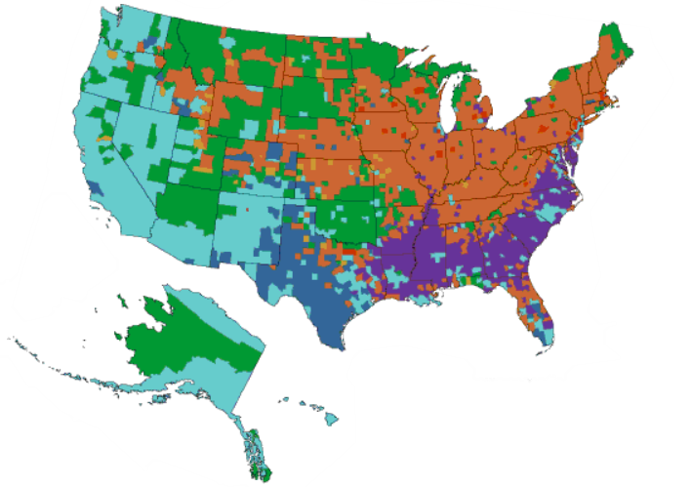
We propose that Post-Secondary Institutes with high CDRs are located most frequently in US cities with a larger minority population.
 | Asian
 | Black
 | Hispanic
 | Native American
 | Pacific Islander
 | White
 | Multiethnic
Negligent Institute
H0: Institutes with high CDR are not frequently located in US cities with a high minority population.
H1: Institutes with high CDR are frequently located in US cities with a high minority population.
Source: (CensusScope, 2020)
Notes:
We are here today to determine weather predatory post secondary institutes are more prevalent in minority (non-white) neighborhood then majorities (white). We believe that there is economical and educational value in knowing such information which may enable institutes to take preventative actions as necessary and create an early warning sign for institutes and students.

Slide 5
The US Department of Education and US Census Department provide information that can help us pinpoint the location and effect of negligent institutions.
CDR FY 2014 - 2016
Institution's Name
State
City
Degree type
School Type
Cohort Year
Borrowers in Default
Borrowers in Repay
Census 2010
State
City
Sex
Age
Race
Federal Student Aid (CDR)
United States Census Bureau
Data Summary
# of Columns | 29
# of Rows | 4811
Data Summary
# of Columns | 10
# of Rows | 1260772
LEFT JOIN ON CITY
Notes:
To determine weather a post secondary institute is predatory or have predatory characteristic we will use the following data source.
United states census bureau, which provides us information on the race by county.
Federal Student Aid webs site, which contain dataset of CDR
IPEDS which stands for Integrated Post Secondary Educational Data System.
Now I would like to introduce Prince Gymafi who will give more detail on CDR and brief over of information which can be pull from out data sources.

Slide 6
Postsecondary Students Enrollment for Fall 2016, without Distance Education, is 19.84 million.
Source: (The Condition of Education, 2019)

Slide 7
High CDR is a result of students who take out student loans and do not complete their schooling.
Source: (U.S Department of Education, 2019)
Notes:
To determine weather a post secondary institute is predatory or have predatory characteristic we will use the following data source.
United states census bureau, which provides us information on the race by county.
Federal Student Aid webs site, which contain dataset of CDR
IPEDS which stands for Integrated Post Secondary Educational Data System.
Now I would like to introduce Prince Gymafi who will give more detail on CDR and brief over of information which can be pull from out data sources.

Slide 8
Based on the previous study done by the U.S. Department of Education from FY 2009 to FY 2016, Black-Americans have a higher CDR than their White counterparts across all types of Institutions.
Source: (U.S Department of Education, 2019)
Notes:
To determine weather a post secondary institute is predatory or have predatory characteristic we will use the following data source.
United states census bureau, which provides us information on the race by county.
Federal Student Aid webs site, which contain dataset of CDR
IPEDS which stands for Integrated Post Secondary Educational Data System.
Now I would like to introduce Prince Gymafi who will give more detail on CDR and brief over of information which can be pull from out data sources.

Slide 9
From FY 2015 to FY 2016, the CDR showed a decrease trend from 10.8% to 10.1%.
Source: (Fuller, 2019)
Notes:
To determine weather a post secondary institute is predatory or have predatory characteristic we will use the following data source.
United states census bureau, which provides us information on the race by county.
Federal Student Aid webs site, which contain dataset of CDR
IPEDS which stands for Integrated Post Secondary Educational Data System.
Now I would like to introduce Prince Gymafi who will give more detail on CDR and brief over of information which can be pull from out data sources.

Slide 10
Implementation of a Flow-Chart for our Analysis Methods creates procedures and increases accountability within our group.
Does data need cleaning?
Data Collection
Exploratory
Data Analysis
Yes
Clean data & add features if needed
Start
No
Is difference significant?
Redefine H1
Fail to reject H0
No
Significance Testing
Yes
Select Machine Learning models
Model Validation
Create predictive classifier
Create thesis document & edit for publishing
Explore areas for future research
Create visualizations and dashboard
Do we have confidence in model?
Submit
Yes
No

Slide 11
Exploratory Data Analysis (EDA) reveals key variables for our project.
RACE
DRATE
SEX
SCHOOL TYPE
CITY
DATA
OPEID
DATA
Exploratory Analysis
High-level Analysis
In-depth Analysis
Conclusion

Slide 12
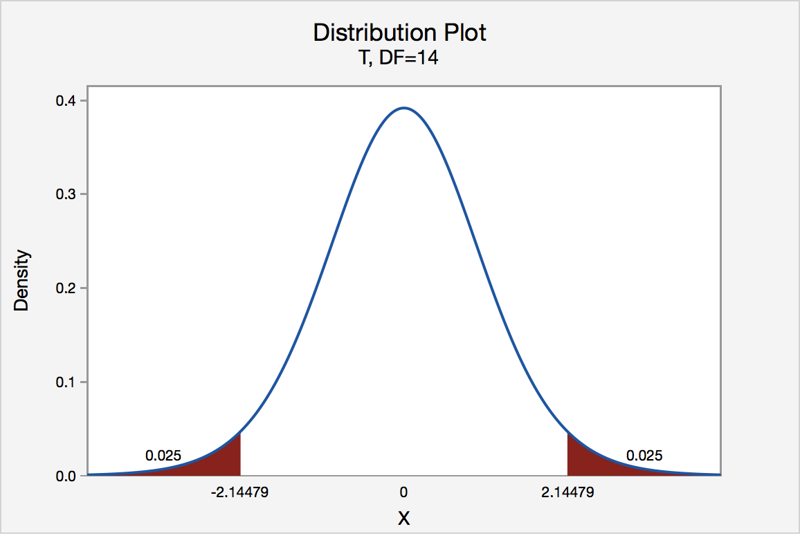
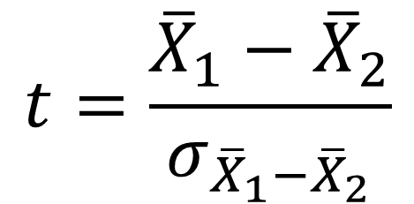
A two-tailed t-test can help us determine significance between average CDR.
$$t=\frac{{\overline{X}}_{1}−{\overline{X}}_{2}}{σ_{{\overline{X}}_{1}−{\overline{X}}_{2}}}$$
Source: (Penn State, 2020)
Exploratory Analysis
High-level Analysis
In-depth Analysis
Conclusion

Slide 13



Machine Learning methods allow for a more in-depth analysis of our data that can be viewed in an easy-to-access dashboard.
Unsupervised Learning
Supervised Learning
Business Intelligence Dashboard
Exploratory Analysis
High-level Analysis
In-depth Analysis
Conclusion

Slide 14


Since CDR Data is released yearly, and Census Data is only released every 10 years, we cannot update our dashboard in real time.

Slide 15


Our research will help prospective students understand the relationship between college type and default rate.
College
Private
Public
Non-Profit
For-Profit
Exploratory Analysis
High-level Analysis
In-depth Analysis
Conclusion

Slide 16
References
Black Voice News (2019). Survey: Doubts About 2020 Census Higher with Minorities. Black Voice News. https://blackvoicenews.com/2019/10/22/survey-doubts-about-2020-census-higher-with-minorities/
Minitab (2016) Understanding t-Tests: t-values and t-distributions. The Minitab Blog. Retrieved from https://blog.minitab.com/blog/adventures-in-statistics-2/understanding-t-tests-t-values-and-t-distributions
Official Cohort Default Rates for Schools. (n.d.). Retrieved from https://www2.ed.gov/offices/OSFAP/defaultmanagement/cdr.html
Penn State (2020). Distribution Plot. STAT Online | Department of Statistics. https://online.stat.psu.edu/statprogram/reviews/statistical-concepts/hypothesis-testing/critical-value-approach
Scikit-Learn (2020). Logistic Function. Scikit-Learn. Retrieved from
https://scikit-learn.org/stable/auto_examples/linear_model/plot_logistic.html
US Census Bureau. (2016). Modified Race Data 2010. Retrieved from https://www.census.gov/data/datasets/2010/demo/popest/modified-race-data-2010.html
Use the Data. (n.d.). Retrieved from https://nces.ed.gov/ipeds/use-the-data

