Slide 1

Analysis of Cohort Default Rates (CDR) in Post-Secondary Education in the United States.
Prince Gyamfi
Marketne Noel
Dillon Orr
MS Data Science
Analytical Capstone Project I
National University
Advisor Committee
John Vivian, PhD.
Ebrahim Tarshizi, PhD.
Notes:
Good Evening Professor & class mates. My name Is Marketne Noel, to my left is Dillon Or and to my right is Prince Gyamfi. We are graduate students at National university perusing a degree in Data science.
I would like to introduce you to our Thesis project (An analysis of cohort default rate, CDR for short, in post-secondary education in the United states.) Post secondary are thinks like University, Colleges and trade school, Typically anything after higher education after high school.
Industry Advisor
John Vivian: Bioinformatics Scientist at Atreca, Inc.
And Faculty Advisor the wonderful Ebrahim Tarshizi

Slide 2

The CDR is the percentage of US graduate students who default on their student loans.
Student Loan
Notes:
So what is CDR.
Well cohort, in educational terms is defined as a group of students who are educated at the same time, usually in the program.
The cohort default rate is a percentage value give to a post secondary-school based on the number of students who have default on their students loans and are considered in debt.
It started in 1980 to draw attention to predatory institutions who prayed on low income students who might have trouble repaying their loans . Effecftively prevents these institutes from accepting acdamically under qualify students who have a higher likely hood of going in debt. Orginally students who defaulted on their loan for 180 days were calculated into the CDR, but since 1998, the number of days has movd up to 270. finally in 2005 schools where given the right to chanllenge the Educatins department CDR with their records to ensure they were correct.

Slide 3
The CDR is the criteria that determine whether an educational institute partakes in fraudulent actives.
> 30 % for 3 years
> 40 % for 1 years
Notes:
The US department of education enforces the CDR by punish post secondary institutes in the following manner. They would deny them the right to partake in federal assistance for their student, which will eventually reduce the number of incoming students. The program work like this.
If an instates maintains a CDR of 30% for more than three years, they will be blacklisted.
If an institute maintains a CDR of 40% for 1 year, they will be blacklisted.

Slide 4
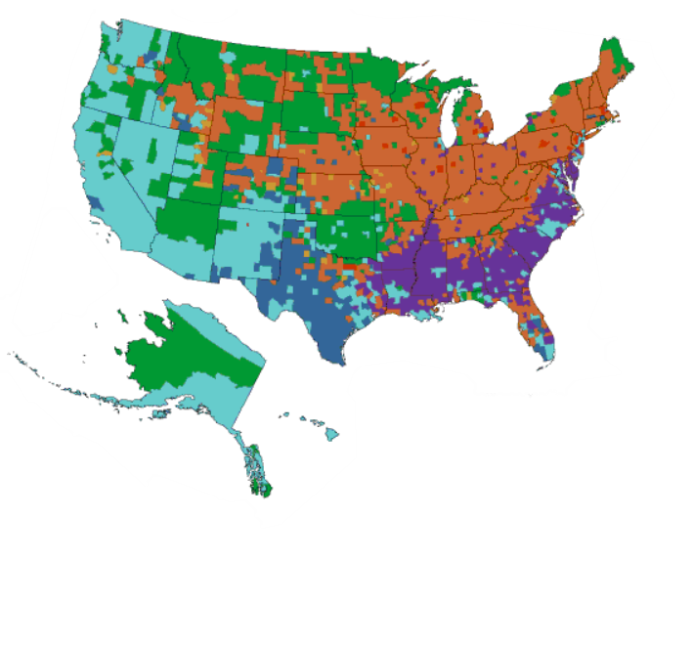
We propose that predatory colleges are located more frequently in US counties that have higher minority (non-white) populations.
 | Asian
 | Black
 | Hispanic
 | Native American
 | Pacific Islander
 | White
 | Multiethnic
Source: (CensusScope, 2020)
Notes:
We are here today to determine weather predatory post secondary institutes are more prevalent in minority (non-white) neighborhood then majorities (white). We believe that there is economical and educational value in knowing such information which may enable institutes to take preventative actions as necessary and create an early warning sign for institutes and students.

Slide 5
The US Education Department and US Census provide identifiable information to determine whether an educational institute partakes in predatory practices.
Federal Student Aid
United States Census Bureau
Predatory Educational Institute
IPEDS
Notes:
To determine weather a post secondary institute is predatory or have predatory characteristic we will use the following data source.
United states census bureau, which provides us information on the race by county.
Federal Student Aid webs site, which contain dataset of CDR
IPEDS which stands for Integrated Post Secondary Educational Data System.
Now I would like to introduce Prince Gymafi who will give more detail on CDR and brief over of information which can be pull from out data sources.

Slide 6
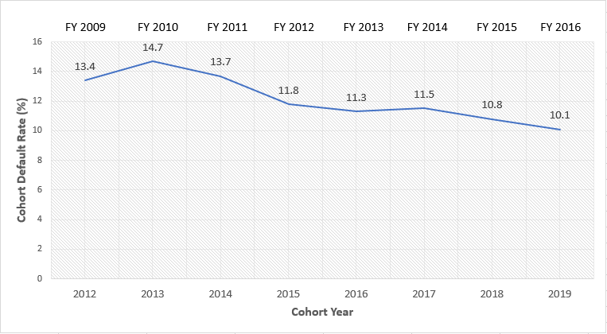
National student loan cohort rates show a decreasing trend.
Source: (U.S Department of Education, 2020)
Notes:
In the United States today, based on the 3-year result that was released by the Department of Education for the FY 2016, the Federal student loan cohort default rate (CDR) stands at 10.1% which represented a decrease from 10.8% in the previous years (Fuller, 2019).

Slide 7
We know that on average, proprietary schools have the highest default rate.
Source: (U.S Department of Education, 2020)
Notes:
Based on the FY 2016 data released in 2019, clearly shows that Private, Non-profit schools are lower in Cohort Default rate as compared to Public and Proprietary schools with 11.9 and 12.4 respectfully.

Slide 8
Major problem with CDR is as result of large number of students who took student loan never completed their schooling.
Source: (U.S Department of Education, 2020)

Slide 9
Overall, Black-Americans has a higher cohort default rate than their White counterparts in a study from FY 2009 to FY 2016.
Source: (U.S Department of Education, 2020)

Slide 10

Colleges and Universities that partner with student connections experienced a decrease in their CDR.
75%
51%
Notes:
A study in 2014, cohort, 75 percent of colleges and universities that partner with student connections experienced a decrease in their CDR from the average of the prior three CDR periods, compared to only 51 percent of overall institutions.

Slide 11
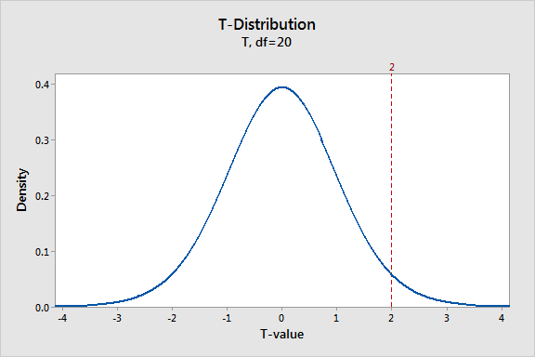
Using a Difference of Means Test (t-test), we can conclude that Proprietary Colleges have significantly higher default rates.
Source: (Minitab, 2016)

Slide 12
Association Rules can determine whether a proprietary institution is likely to exist in an area with a high minority population.
A
B
C
High Default Rate
Presence of Proprietary Institution
High Minority Population
A+B
A+C
B+C
A+B+C

Slide 13
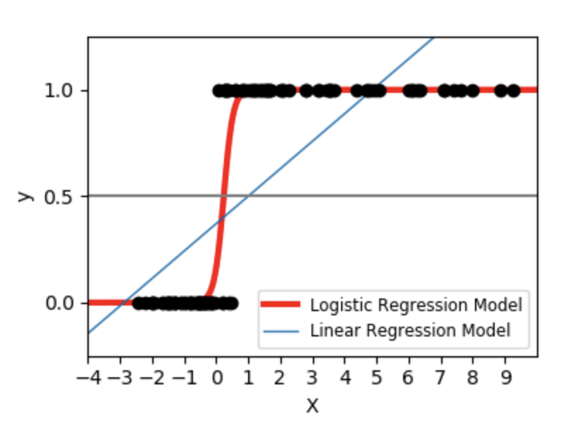
Logistic Regression allows us to see the impact of School Type on default rate.
Source: (Scikit-Learn, 2020)

Slide 14
We can use feature engineering to create an at-risk threshold based on default percentage.
0-5%
LOW
6-10%
MEDIUM
11-25%
HIGH
26+%
EXTREME

Slide 15
We aim to predict if a school is going to be subject to sanctions by using a Random Forest Classifier.
Vote 1
Vote 2
Vote 3

Slide 16
References
Minitab (2016) Understanding t-Tests: t-values and t-distributions. The Minitab Blog. Retrieved from https://blog.minitab.com/blog/adventures-in-statistics-2/understanding-t-tests-t-values-and-t-distributions
Official Cohort Default Rates for Schools. (n.d.). Retrieved from https://www2.ed.gov/offices/OSFAP/defaultmanagement/cdr.html
Scikit-Learn (2020). Logistic Function. Scikit-Learn. Retrieved from
https://scikit-learn.org/stable/auto_examples/linear_model/plot_logistic.html
US Census Bureau. (2016). Modified Race Data 2010. Retrieved from https://www.census.gov/data/datasets/2010/demo/popest/modified-race-data-2010.html
Use the Data. (n.d.). Retrieved from https://nces.ed.gov/ipeds/use-the-data

