Slide 1
HIV+/HCC-
HIV+/HCC+
HIV-/HCC+
Enrollment
HIV Diagnosis
HCC Diagnosis
Visit
Visit - HCC
Enrollment
HIV Diagnosis
HCC Diagnosis
Visit
Visit - HCC
Enrollment
HIV Diagnosis
HCC Diagnosis
Visit
Visit - HCC
Baseline
AIM 1, AIM 2
6 Month
Visit
Visit - HCC
AIM 2
1 Year
Visit
Visit – HCC
Outcome

Slide 2
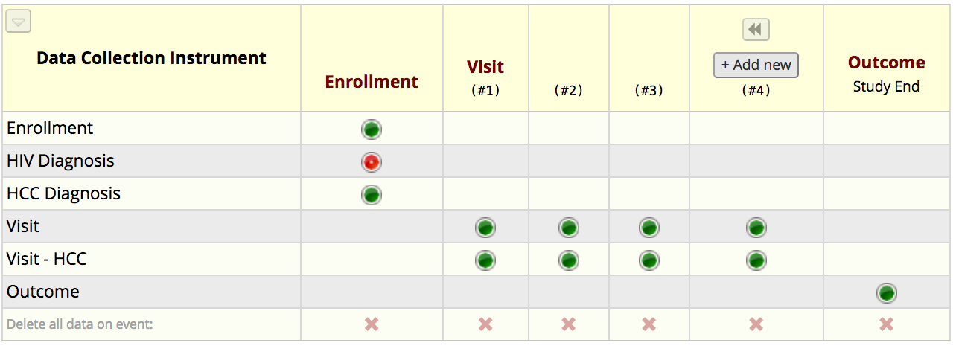
Example of patient who is HIV+/HCC+ on P1
On Follow-Up Visits
On last day of visit when the study ended
On Enrollment Visit

Slide 3
HIV+ve individuals with moderate/advanced Fibrosis or Cirrhosis
Baseline
Enrollment
HIV Diagnosis
Visit
Visit HIV
Visit
Visit - HIV
AIM 3
Every Visit
If the individuals get HCC at any point
HCC Diagnosis (?)
Visit – HCC (?)
End of Study
Outcome

Slide 4
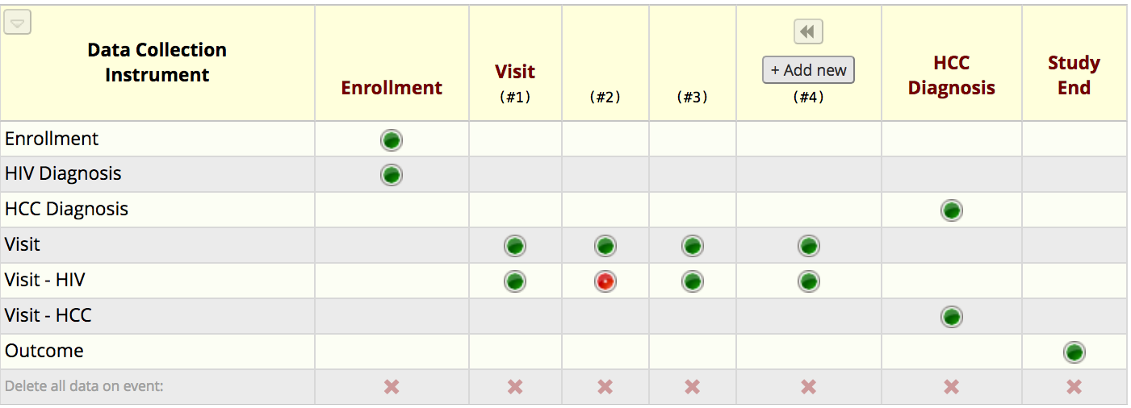
Example of patient who in Aim 3 in P1
On Y3 Follow-Up
Patient develops HCC
On Y2 Follow-Up
On Enrollment Visit
On last day of visit when the study ended

