Slide 1
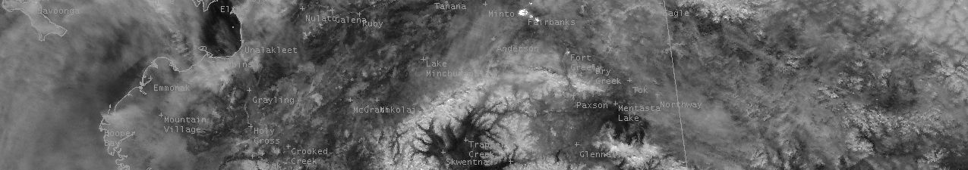



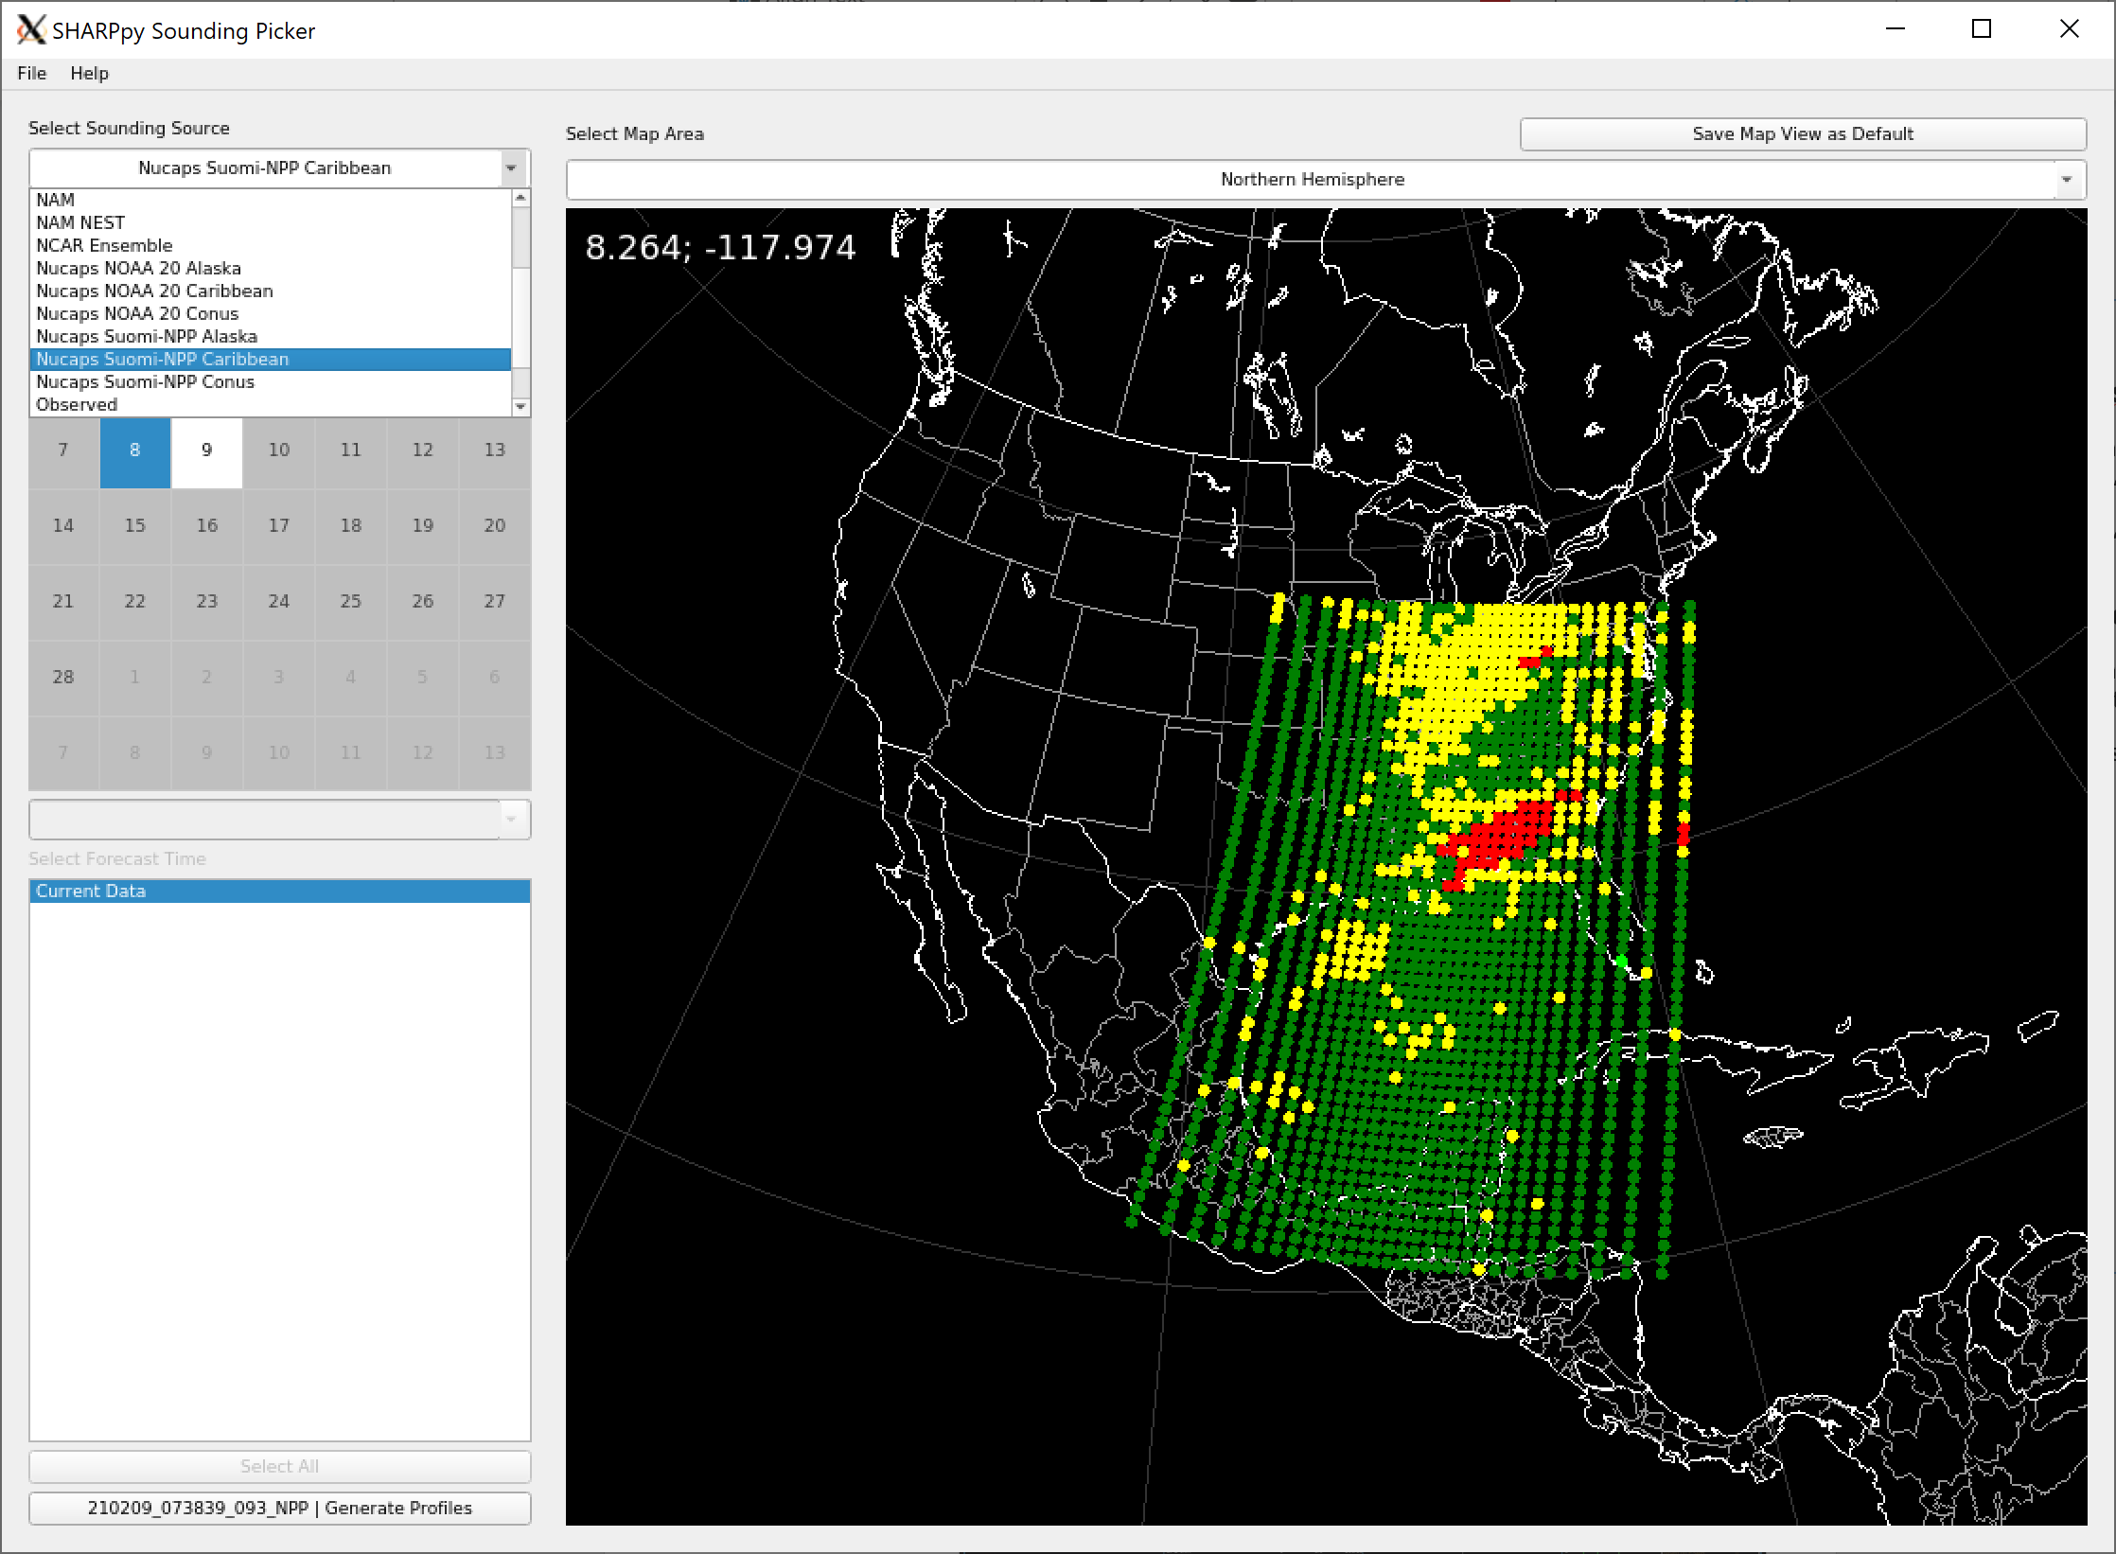
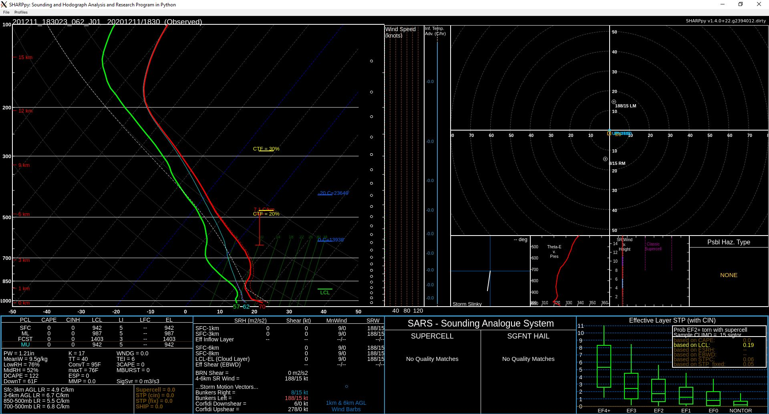
Displaying NUCAPS in SHARPpy
Quick Guide
1. Run SHARPpy (https://sharppy.github.io/SHARPpy/index.html).
Note: Quick guide available for SHARPpy installation.
2. From Select Sounding Source select a NUCAPS data source (e.g. NUCAPS NOAA-20 Alaska).
3. NUCAPS soundings will appear on the map with color coded quality flags. These are the latest, real-time soundings collected from the Direct Broadcast system at the University of Wisconsin-Madison. Click on any dot to view the NUCAPS sounding. The selected dot will be light green.
NOTE: NUCAPS does not retrieve wind data.
4. From Select Forecast Time click Generate Profiles in the bottom left corner of GUI.
5. The skew-T for the selected NUCAPS sounding should now pop up.

Slide 2
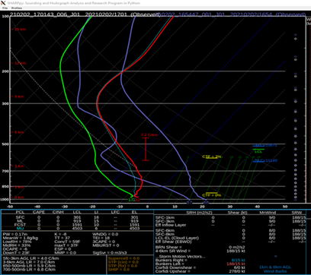
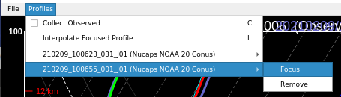
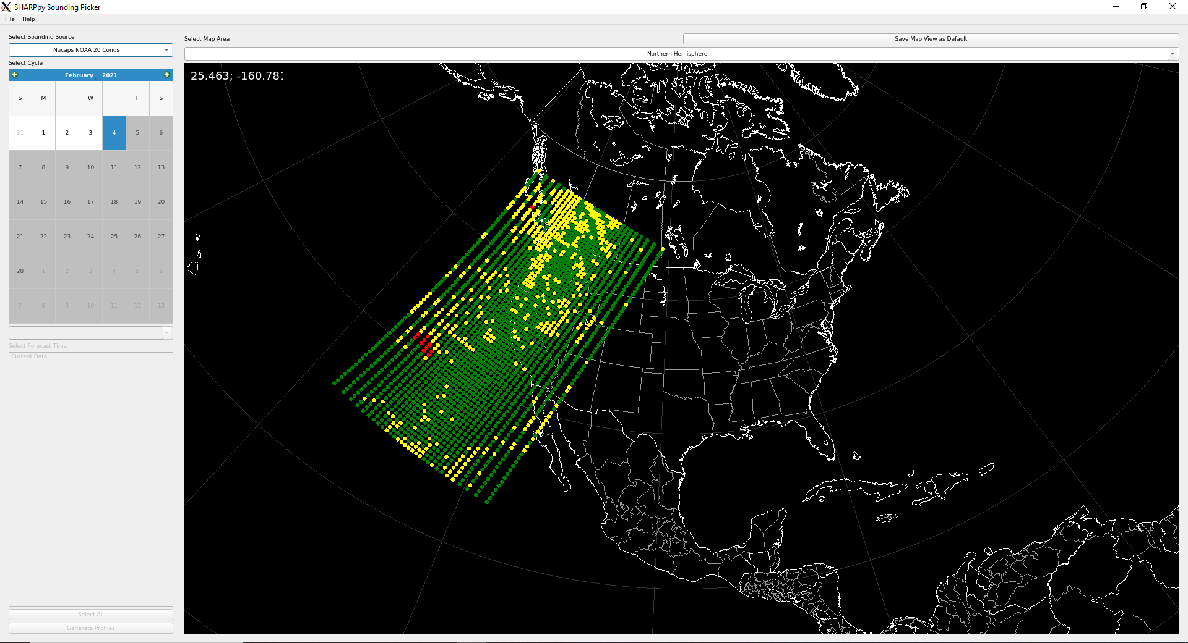
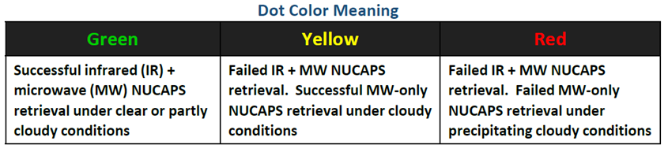
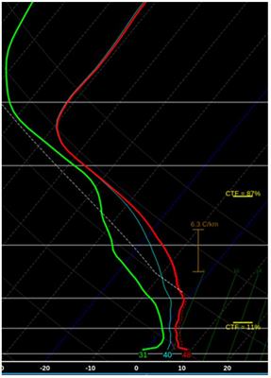


Displaying NUCAPS in SHARPpy
Quick Guide
Loading Multiple Profiles
Select a dot on the map, click Generate Profiles to launch the skew-T window.
Keep the skew-T window open. In the map display, select another point, and click Generate Profiles.
In the skew-T window, click the Profiles → Collect Observed
Changing Focus Profile
The focus profile will have green (moisture) and red (temperature) lines.
The CAPE in the tables are for the focus profile.
Select Profiles → <profile name> → Focus to change the focus profile
Interpreting Quality Flags
Color coded quality flag helps forecaster to quickly interpret retrieval robustness before interrogating the sounding profile.
Green dots can be used without reservation. Yellow, red dots may be useful alongside cloud top fraction.
Interpreting Cloud Top Fraction
NUCAPS produces a model-independent cloud top pressure (CTP) and fraction retrieval for two cloud layers. CTF can be compared with model output.
CTF is also useful because profiles above the cloud tops may be representative of the atmosphere, even for failed retrievals.
Clouds can introduce uncertainty and cause IR+MW retrievals to fail, but cloud fraction alone does not determine the quality flag. Note: Quick Guide available for Quality Control
Contributor: Jeff Szkodzinski STC https://weather.msfc.nasa.gov/sport/

