Slide 1
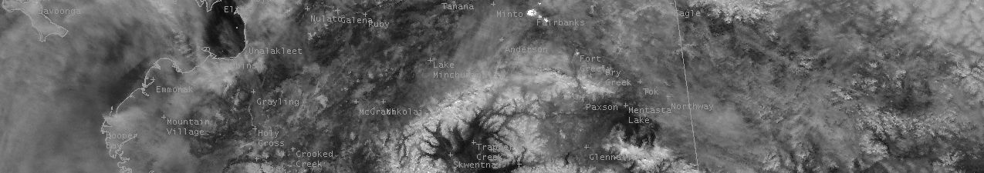
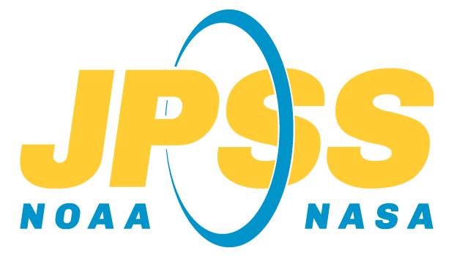




Installing NUCAPS in SHARPpy
Quick Guide
Install Pre-requisites
You will need Python 3 to run SHARPpy. For instructions, visit the following websites:
https://www.anaconda.com/products/individual for instructions on how to set-up Python.
You will need run a few simple commands in a command line program:
Linux/MacOS: Open the Terminal application.
Windows: Open the Anaconda Prompt applications.
Install the NUCAPS test branch in SHARPpy
You can now install the beta version of SHARPpy which contains NUCAPS satellite soundings. Open the command line for your operating system (see above) to perform these steps.
> git clone https://github.com/Jeff-Szkodzinski/SHARPpy.git
Change your directory to where you have downloaded SHARPpy (e.g. /home/<user>/SHARPpy).
> cd /home/<user>/SHARPpy
Next, we to create an isolated Anaconda environment just for running SHARPpy with all the necessary libraries (using conda env create <options>; it may take several minutes to install the libraries). If you are interested, you can open the environment.yml file to see which libraries are used.
> conda env create -f environment.yml
After creating the environment, we need to switch to this new environment (via conda activate <env_name>) which we have named devel.
> conda activate devel
Run setup.py to apply our NUCAPS updates to SHARPpy.
> python setup.py install
Once the installation is complete, keep the terminal open and follow the steps in the next section to launch SHARPpy.
Running SHARPpy from the Command Line
In the command line, type the command sharppy to launch the program.
> sharppy
If successful, a window will open which will give you access to soundings from NUCAPS, RAOBS, and select models. For instructions on using SHARPpy, see the “Display NUCAPS in SHARPpy” quick guide.
Contributor: Jeff Szkodzinski (STC) https://weather.msfc.nasa.gov/sport/

