Slide 1
Introduction
E-Store Management System
PRESENTER: CODE - TRIAD

Slide 2
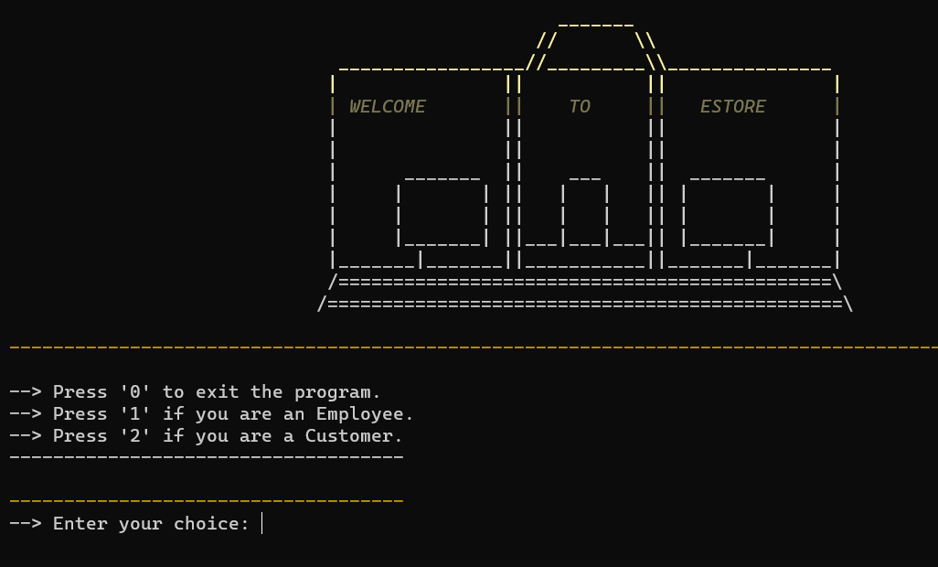
Overview
• Revolutionizing Online Shopping
• Seamless E-Store Management
• Enhanced User Experience

Slide 3
Customer Interface
• User-Friendly Shopping Experience
• Secure Payment Options
• Order Tracking and History

Slide 4
Employee Interface
• Efficient Inventory Management
• Order Processing and Fulfillment
• Sales Analytics

Slide 5
Benefits for Customers
• Convenient Shopping Anytime, Anywhere
• Wide Product Selection
• Personalized Recommendations

Slide 6
Benefits for Employees
• Streamlined Inventory Control
• Automation of Repetitive Tasks
• Real-time Sales Insights

Slide 7
Security Measures
• Encrypted Transactions
• Secure User Authentication
• Data Privacy Compliance

