Slide 1

CADEC

Slide 2
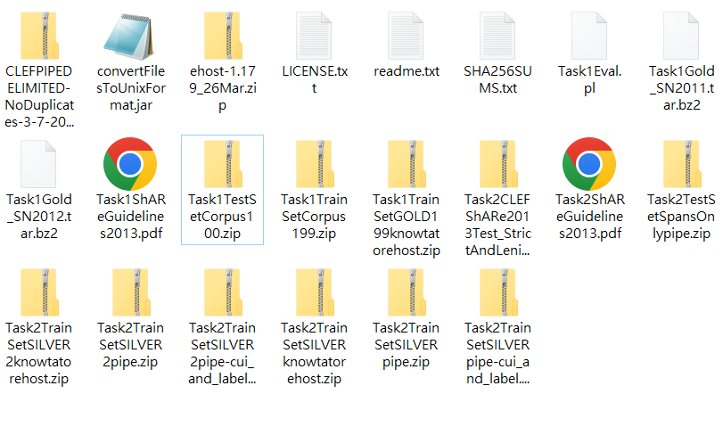
Share13

Slide 3
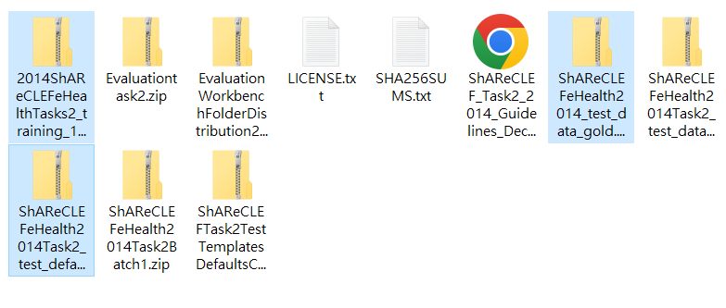
Share14

