Slide 1
Best mobile emulator I could find
www.springbox.com/mobilizer/
Requires installation, including installation of Adobe Air.
You can accomplish pretty much the same thing by looking at the site on an iPhone and an Android phone.

Slide 2
Network analysis in reporting and storytelling
Rich Gordon
Medill School of Journalism
Northwestern Media Management Center
@richgor

Slide 3
What role could network analysis play in a reporter's toolbox?

Slide 4
Reporting and storytelling: how can network analysis be useful?
Analyze relationships
Visualize connections
Understand who’s “powerful” in a network of people
Using centrality measures

Slide 5
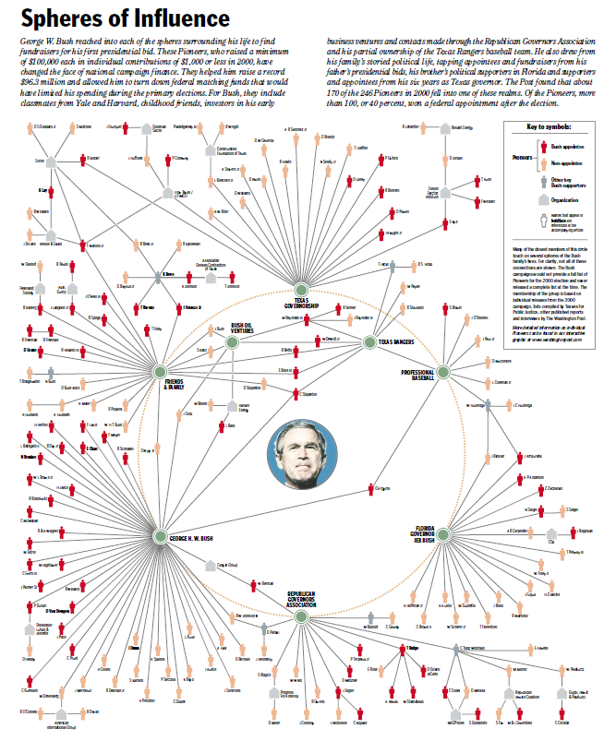
Washington Post: Bush Pioneers
Article
Interactive graphic

Slide 6
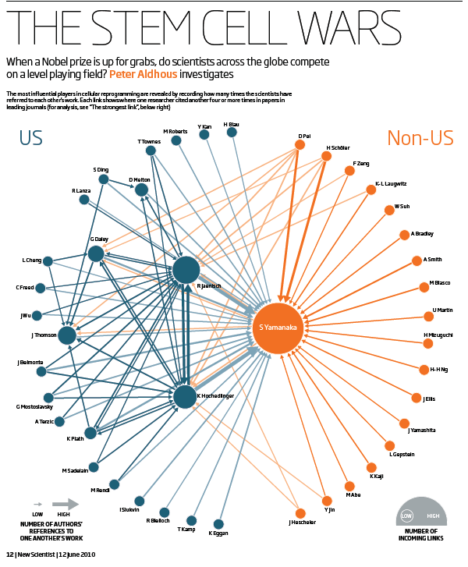
New Scientist: Stem cell wars

Slide 7
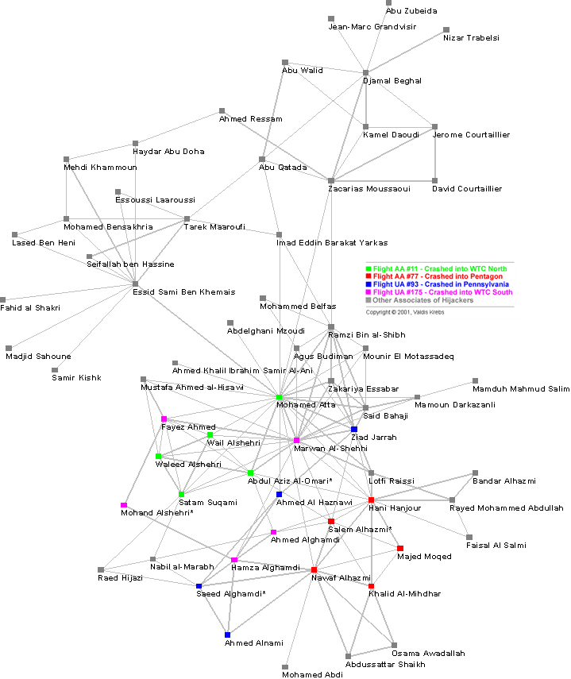
Valdis Krebs: 9/11 terrorists

Slide 8
Network analysis in journalism: Politics

Slide 9
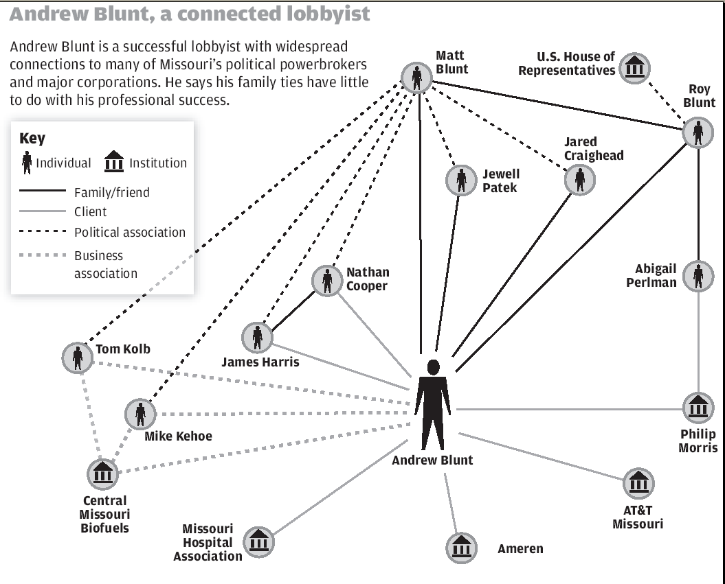
St. Louis Post-Dispatch: Lobbyist connections

Slide 10
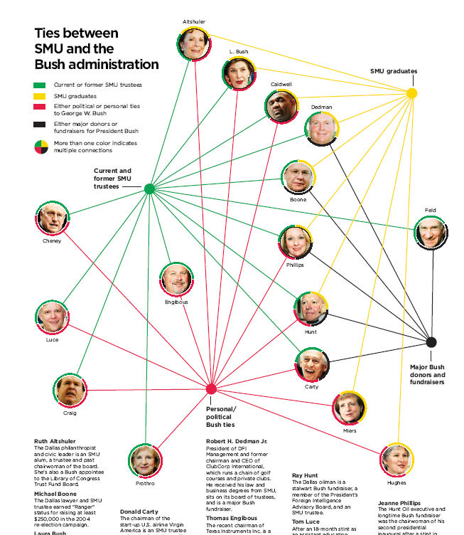
Dallas Morning News: SMU / Bush administration connections

Slide 11
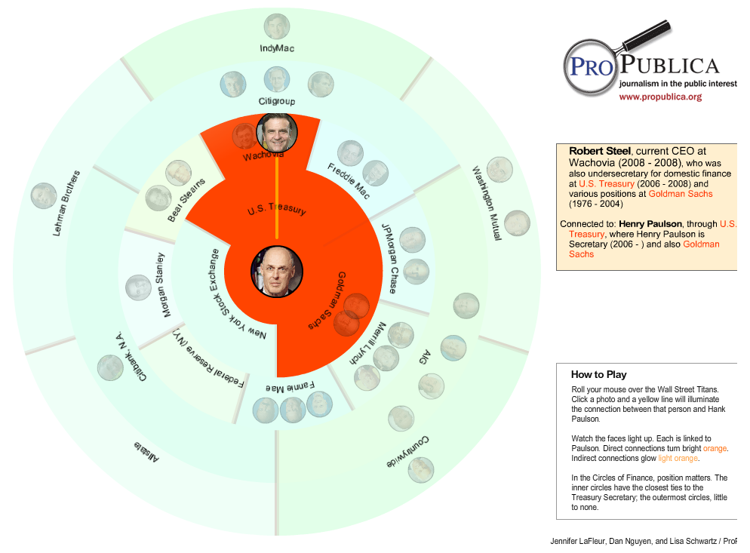
Pro Publica: Degrees of Hank Paulson
http://www.propublica.org/special/degrees-of-hank-paulson

Slide 12
Network analysis in journalism: Community power and influence

Slide 13
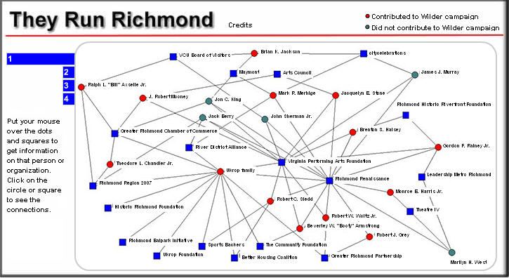
Richmond Times-Dispatch: They run Richmond
http://media.gatewayva.com/rtd/multimedia/TheyRunRichmond/

Slide 14
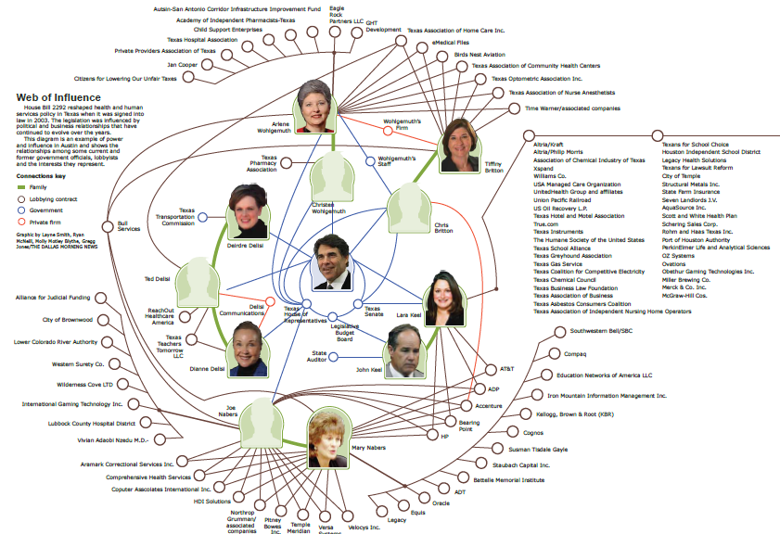
Dallas Morning News: Influence in Austin
http://www.dallasnews.com/sharedcontent/dws/graphics/0109/influence/

Slide 15
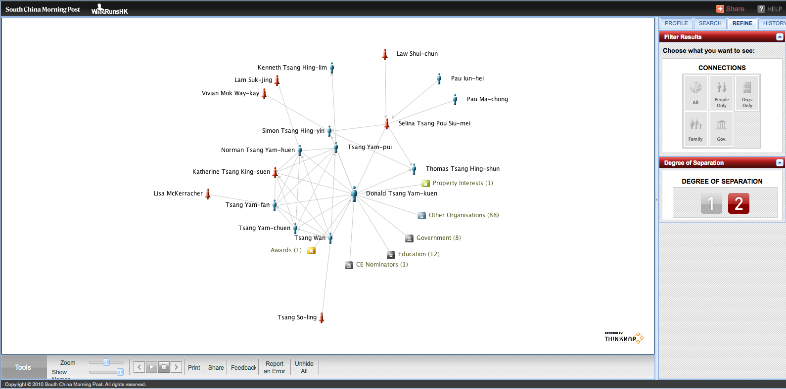
South China Morning Post: Who runs Hong Kong
http://www.youtube.com/watch?feature=player_embedded&v=xrB_OslXv3A#!

Slide 16
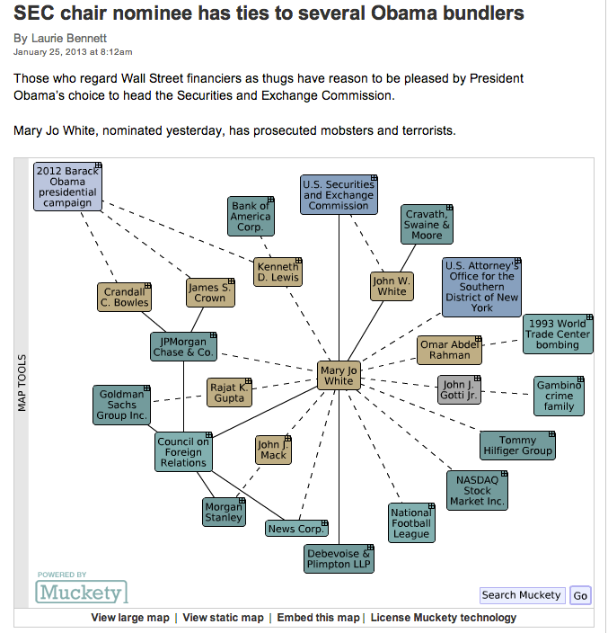
Sites allowing exploration of networks of people
Theyrule.net
Muckety.com
NNDB.com (Notable Names Database)

Slide 17
Network analysis in journalism: Business

Slide 18
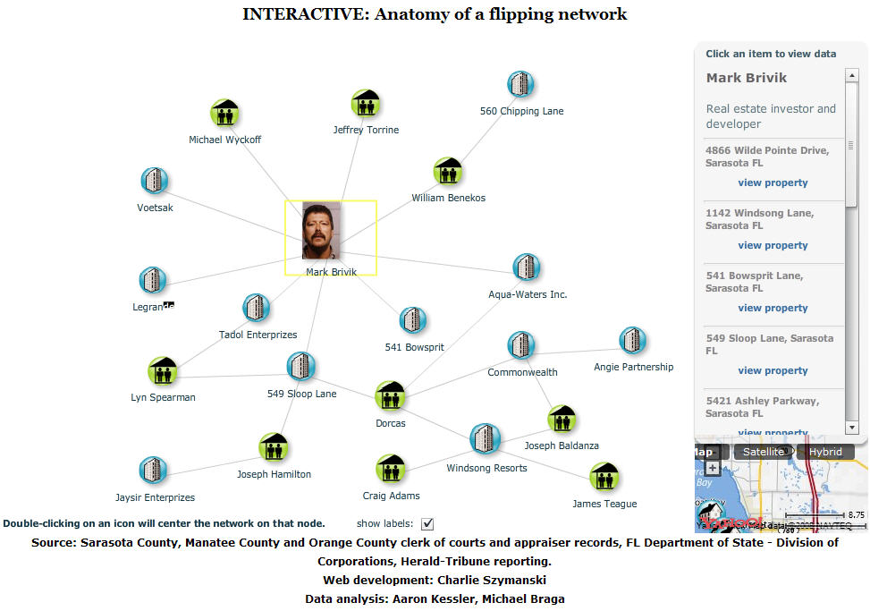
Sarasota Herald-Tribune: Real estate “flipping”

Slide 19
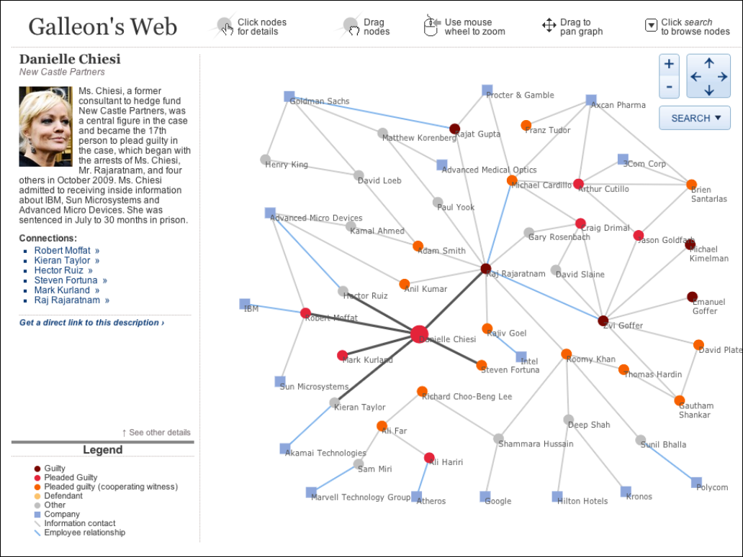
Wall Street Journal: Galleon’s Web (insider trading)
http://online.wsj.com/article/SB10001424052748703386704576186592268116056.html

Slide 20
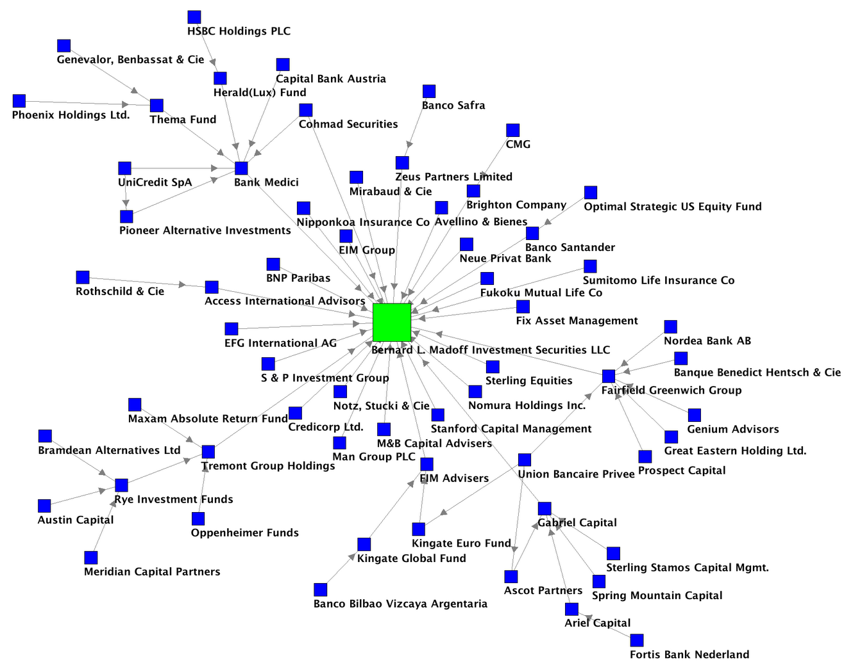
Valdis Krebs: Bernie Madoff investor network

Slide 21
Your assignment
You and your partner will get 15 minutes or so in class to discuss these recommendations -- and ask you to choose one to present to the class. For this session, DO NOT use improving SEO strategy as the recommendation you present.
Your short (3 minutes) presentation should include:
Language of your recommendation
Evidence from analytics
Something you can show us on the site that supports the need for this recommendation.

