Slide 1
Super-Resolution GAN
JingTian Zhang
Advisor: Professor Beilun Wang
August 11th, 2019
Notes:
超分辨率

Slide 2
Off-topic :
L1 & L2 regularization
Why L1 regularization can realize sparse? and what is L2 regularization’s meaning?

Slide 3

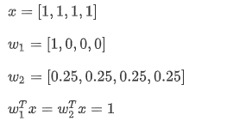

Off-topic :

Slide 4
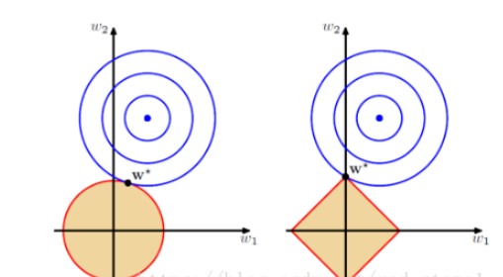
Off-topic :

Slide 5
let’s start super resolution task.

Slide 6
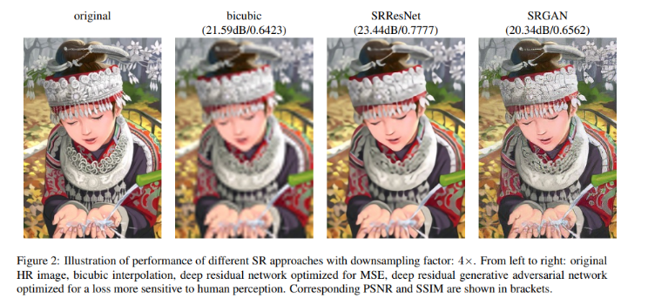
Introduction
Notes:
bicubic

Slide 7
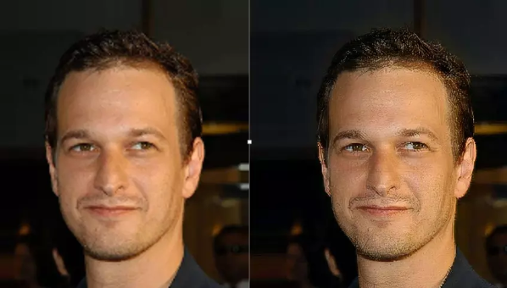
Introduction

Slide 8
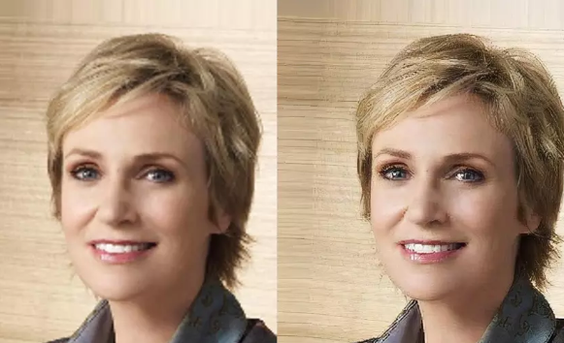
Introduction

Slide 9
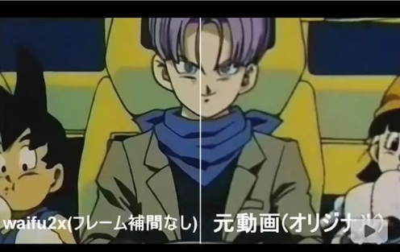
Introduction
increase size while preventing the quality from deteriorating
satellite, space image analysis, medical image processing, compressed image, video enhancement, and other application
Notes:
单图像超分辨率技术涉及到增加小图像的大小，同时尽可能地防止其质量下降。这一技术有着广泛用途，包括卫星和航天图像分析、医疗图像处理、压缩图像／视频增强及其他应用。

Slide 10
Background
pixel
PSNR estimation
interpolation
SRCNN and SRResNet

Slide 11

Background 0: pixel
Goal: use low-resolution image to produce a corresponding high-resolution image evaluation.
HR: high resolution
LR: low resolution
MSE: train to minimize MSE to predict the image
Notes:
even

Slide 12
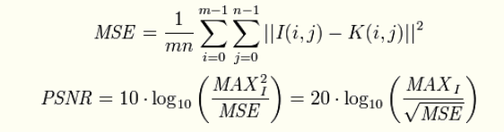
Background 1: PSNR estimation
Peak Signal to Noise Ratio
image after compression compared with the original image
The higher the PSNR, the smaller the distortion after compression
MAX means Gray scale, usually equals 255
Notes:
PSNR is the most common and widely used objective measurement method for evaluating picture quality.
压缩后图像一定会比原图像质量差的，所以就用这样一个评价指标来规定标准了。

Slide 13

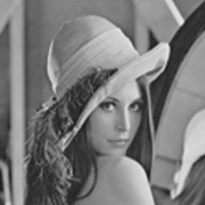
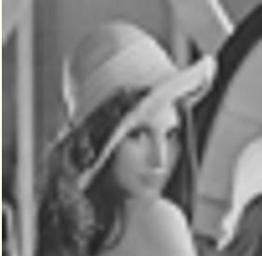
Background 1: PSNR
Original
PSNR=30.2dB
PSNR=24.5dB
Notes:
CV goddess

Slide 14
Background 1: PSNR
However !
PSNR is not completely equal to human’s vision.
human’s eyes are more sensitive to contrast differences with low spatial frequency.
Notes:
PSNR 是最普遍，最广泛使用的评鉴画质的客观量测法，不过许多实验结果都显示，PSNR 的分数无法和人眼看到的视觉品质完全一致，有可能 PSNR 较高者看起来反而比 PSNR 较低者差。这是因为人眼的视觉对于误差的敏感度并不是绝对的，其感知结果会受到许多因素的影响而产生变化（例如：人眼对空间频率较低的对比差异敏感度较高，人眼对亮度对比差异的敏感度较色度高，人眼对一个区域的感知结果会受到其周围邻近区域的影响）。

Slide 15
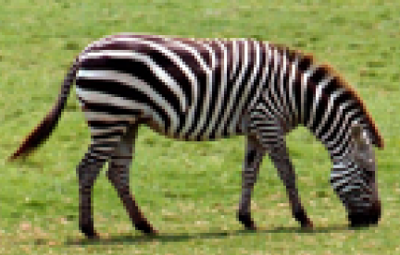
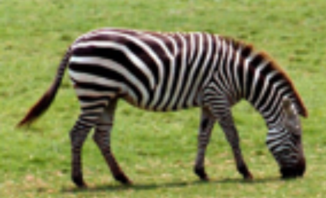
Background 2: interpolation
nearest neighbor interpolation
double linear interpolation
Notes:
interpolation is a common but easy way to increase resolution
many interpolation methods like nearest neighbor\ double linear\bicubic

Slide 16

Background 3: SRCNN and SRResNet
The first deep learning solution is SRCNN
weakness:
difficult to train
sensitive to the change of hyperparameters
bicubic interpolation
SRCNN
Notes:
SRCNN 是超越传统方法的首个深度学习方法。它是一个卷积神经网络

Slide 17
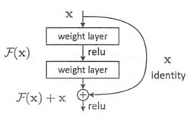
Background 3: SRCNN and SRResNet
ResNet
In other networks, it is a series structure from top to bottom
Input + after convolution Output
-> output
residual learning model
Notes:
其他的网络中，都是从上到下的串联的结构 ，而resnet网络则是跳连结构，它的意思是将输入特征直接传输到输出层，和经过卷积之后的特征相加，共同组成输出层的一部分。
深层次的特征，浅层次的特征

Slide 18


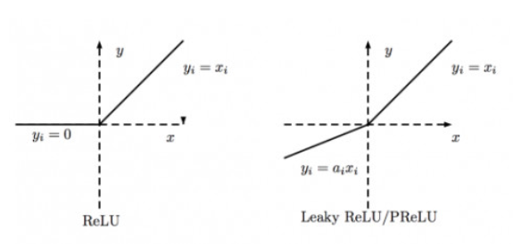
Background 3: SRCNN and SRResNet
SRResNet
1.Use parametric ReLU (PReLU), which is converted from LeakyReLU
LeakyReLU: fix the alpha
PReLU: learn the alpha
PReLU introduces a learning parameter to help it learn part of the negative coefficients adaptively.

Slide 19
Background 3: SRCNN and SRResNet
SRResNet
2.Sub-pixel Convolution
upscale image method:
interpolation
deconvolution (in this task, it may lead in more work)
sub-pixel-convolution
Notes:
子像素卷积

Slide 20
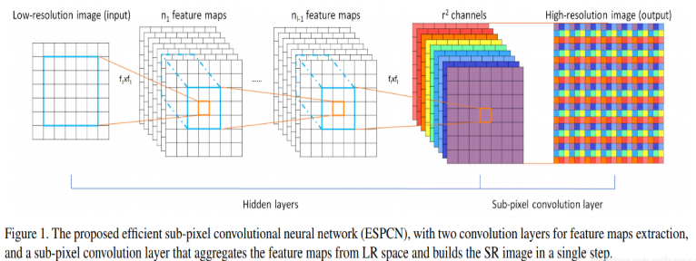
Background 3: SRCNN and SRResNet
sub-pixel-convolution
Notes:
上图很直观得表达了sub-pixel convolution的做法，前面就是一个普通的CNN网络，到后面彩色部分就是sub-pixel conv的操作了。首先，如果我想对原图放大3倍，那么我需要生成出3^2=9个same size的特征图。将九个same size的特征图拼成(piece together)一个X3的大图，这就是sub-pixel convolution的操作了。

Slide 21


Background 3: SRCNN and SRResNet
SRCNN
SRResNet

Slide 22
Super-Resolution Generative Adversarial Networks
Let’s go to the point of view ----
SRGAN(Super-Resolution Generative Adversarial Networks)

Slide 23
SRGANs: contribution
add a discriminator network and two losses
Notes:
SRGAN is a discriminator based on SRResnet. The function of GAN is to add an additional discriminator network and two losses (g_loss and d_loss) to train the two networks in an alternate training mode.

Slide 24
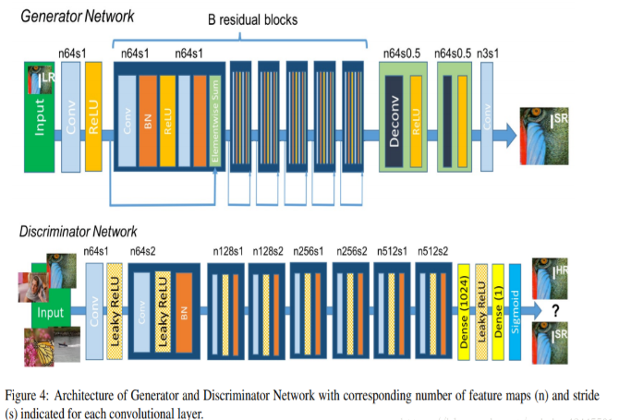
Networks structure:
Notes:
Generative network is SRResNet
Discriminator is likely VGG network.

Slide 25
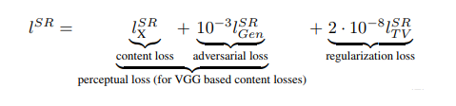
SRGANs: Loss
1.Generator loss
perceptual loss
Notes:
感知损失是利用卷积神经网络提取出的特征，通过比较生成图片经过卷积神经网络后的特征和目标图片经过卷积神经网络后的特征的差别，使生成图片和目标图片在语义（semantics）和风格上更相似。
感知损失[13,14]被提出来优化超分辨率模型在特征空间而不是在像素空间

Slide 26
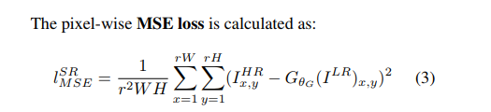
SRGANs: Loss
1.1 Content Loss 1：MSE
smoothly

Slide 27
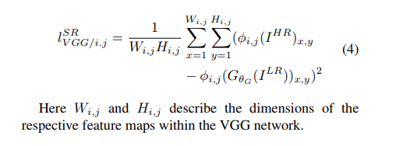
SRGANs: Loss
1.1 Content Loss2 : VGG Loss
Notes:
在已经训练好的vgg上提出某一层的feature map，将生成的图像的这一个feature map和真实图像这一个map比较。

Slide 28
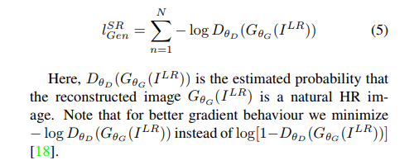
SRGANs: Loss
1.2 Adversarial Loss

Slide 29
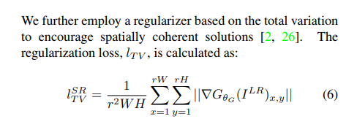
SRGANs: Loss
1.3 Regularization Loss

Slide 30
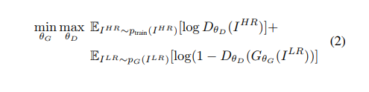
SRGANs: Loss
2. Discriminator Loss

Slide 31
Thank you!

