Slide 1
Visualizing Data
Alexis yohros
Intro to comparative politics

Slide 2
Making sense of data
Why is data visualization important?
One Hundred Million 311 Calls
https://www.wired.com/2010/11/ff_311_new_york/
Visualizing Policy
Opiod Crisis in MA
https://chapter55.digital.mass.gov/
Comparisons Across Countries
Income and Life Expectancy
https://www.gapminder.org/answers/how-does-income-relate-to-life-expectancy/

Slide 3
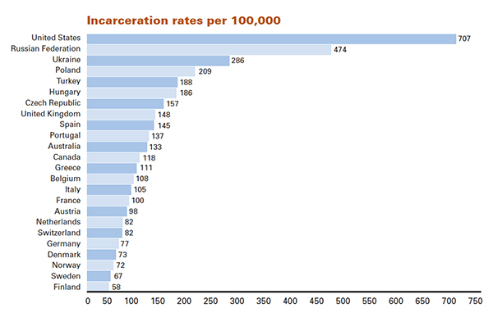
Descriptive statistics
Tools like Excel, Stata, R, and Python

Slide 4
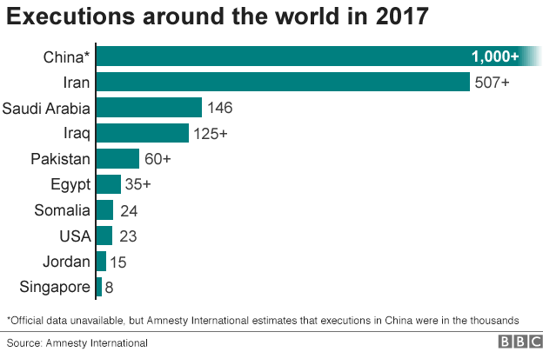

Slide 5
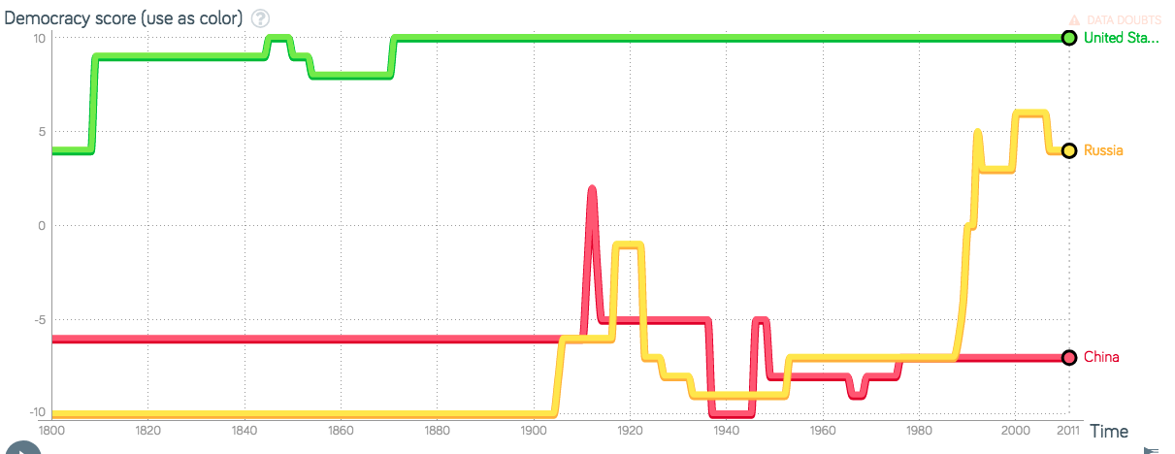
Comparative Trends over time
Democracy Score: from Polity IV dataset (autocracy score-democracy score)

Slide 6
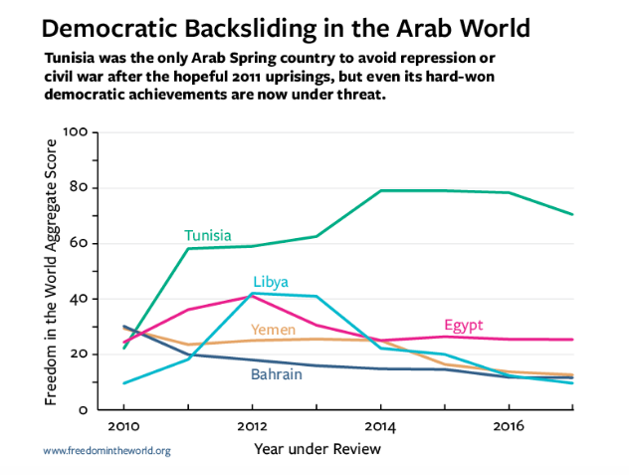

Slide 7
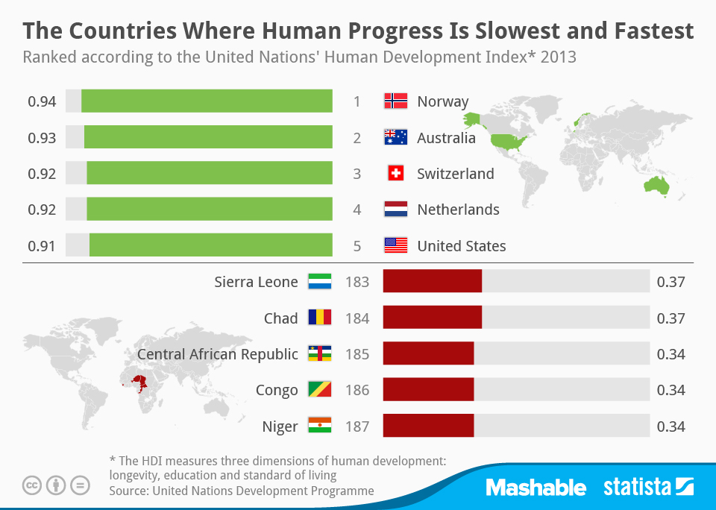

Slide 8
Applying it to your projects
Plotting trends using GDPPC data
Plotting metrics from the Human Development Index for a country over time
Comparing the same metric (GDP) across countries
Other measures of economic well-being

Slide 9
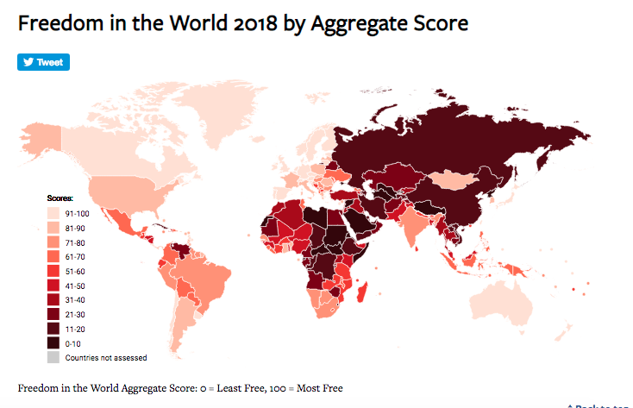
Mapping
Using R or ArcGIS
https://freedomhouse.org/report/freedom-world/freedom-world-2018

Slide 10
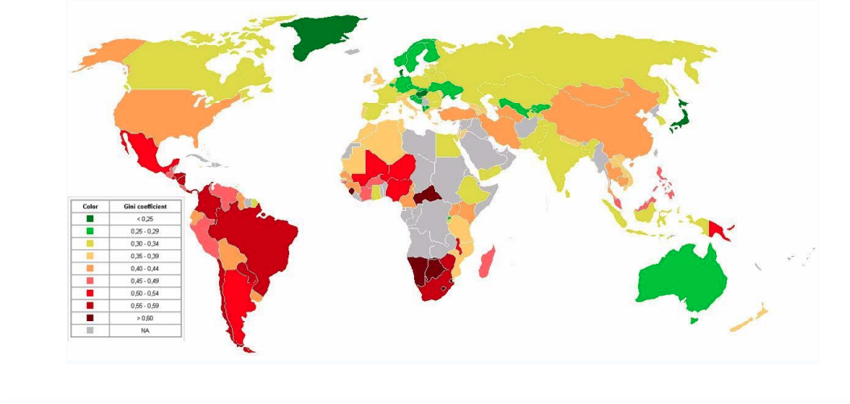
Gini Coefficient Across Countries

Slide 11
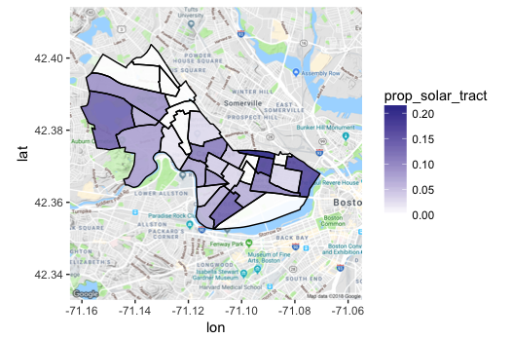
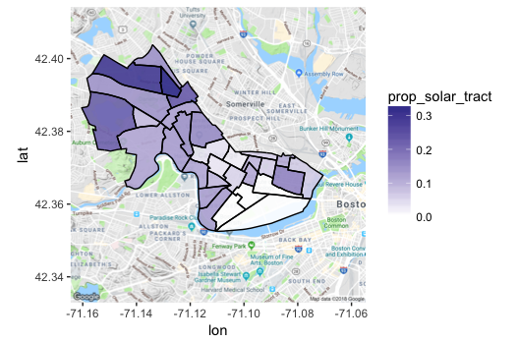
Creating maps in R
Investment in Solar Power 2014
Investment in Solar Power 2017

Slide 12
Applying it to your projects
Mapping metrics across countries
Seeing changes over time across one country
GDP, democratic score, other measures of economic well-being
Ethnic diversity in different regions of a country

Slide 13
More advanced: Visualizing text
Text analysis tools like Python
Most common words, changes in language over time
School Shooting and the Media Example (section of module)
https://bit.ly/2IRzCof

Slide 14
Collecting data
Quantitative data
Qualitative data
String versus numeric
Creating datasets
Excel
Country | Population | GDP | Article
USA
Russia

Slide 15
From csv files to excel
Comma separated values:
Walk through: Political Regimes
https://ourworldindata.org/democracy

Slide 16
Visualizing in excel
Follow along

Slide 17
Where to find data
Follow along
https://www.icpsr.umich.edu/icpsrweb/
Exploring Gapminder: https://www.gapminder.org/tools/

Slide 18
Resources
Alexis Yohros
Yohros.a@husky.neu.edu
Cara Messina
Messina.c@husky.neu.edu
NULab for Texts, Maps and Networks
Workshops
GIS Specialist at NEU Library:
Bahare Sanaie-Movahed
B.sanaiemovahed@northeastern.edu

Slide 19
Text analysis tools : Resources
Links:
https://www.jasondavies.com/wordtree/
https://databasic.io/en/samediff/
https://storybench.shinyapps.io/textanalysis/

