Slide 1
Using Stata
Applied Econometrics

Slide 2
What is Stata?
It is a multi-purpose statistical package to help you explore, summarize and analyze datasets.
A dataset is a collection of several pieces of information called variables (usually arranged by columns). A variable can have one or several values (information for one or several cases).
ID | Age | Year | Course
Person 1 | 18 | Freshman | Econ
Person 2 | 21 | Senior | English
Person 3 | 22 | Senior | Econ

Slide 3
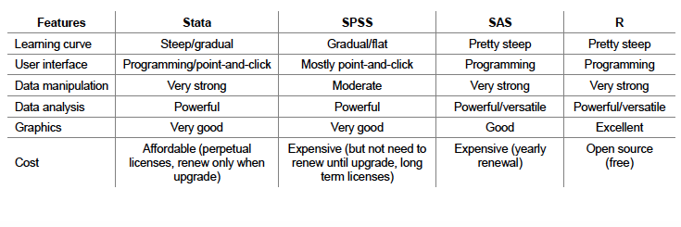
Other Programs
Stata is most used statistical software on college campuses
Other programs are available that are useful for specific functions

Slide 4
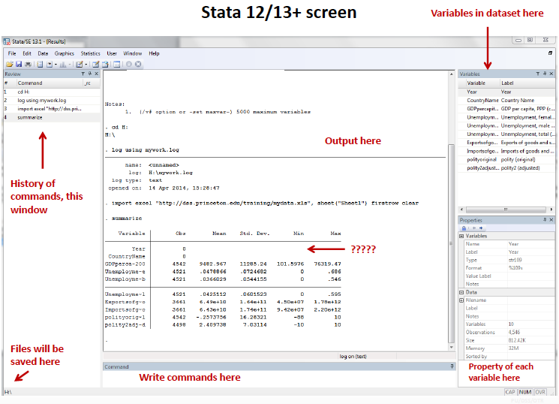
What does Stata look like?

Slide 5
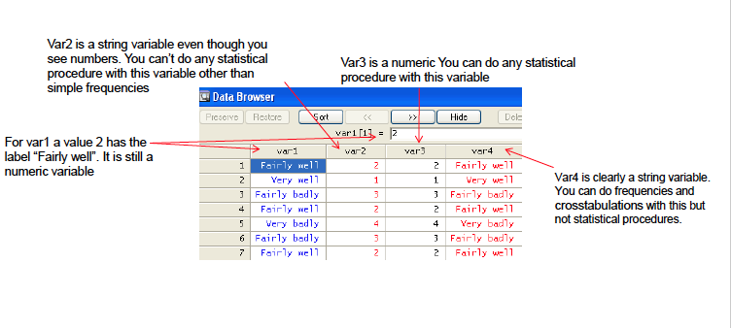
Types of Variables
String versus numeric

Slide 6
Coding on Stata
Drop down menus versus do-files
What do we mean by coding?
Telling our computer what to do
Stata as an Interpreter:
reads the source code of the program as written by programmer (us)
parses the source code
Interprets instructions on the fly
Sequence of statements that have been crafted to do something

Slide 7
Tutorial Follow Along
Using do-files
Uploading a file: different formats, using drop-down and using code
Getting to know your dataset: number of variables, number of cases, format of variables, browser/editor
Looking at specific variables: descriptive statistics
Commands: understanding if, and, or, not, etc.
Cross-tabs – two categorical variables at once
Renaming variables and labels
Generate new variables
Cleaning your data: Sorting, deleting, keeping variables
Simple visualizations: histograms and bar graphs
Keeping a log

