Slide 1
Introduction to Recording and Editing Audio with Audacity
Taught By: Avery Blankenship and Johan Arango-Quiroga
JRNL3610: Digital Storytelling
Prof. Bhargava
Fall 2024
Feel free to ask questions at any point during the presentation!

Slide 2
Objectives
Understand podcast anatomy
Learn best practices for audio recording
Learn about and explore Audacity as a podcast editing tool
Learn how to:
Record audio
Clip audio
Add/move/delete tracks
Add sound effects and/or background music
Save and export projects
Slides and handouts available at:

Slide 3
Podcast Anatomy

Slide 4
Podcasts
Podcasts typically begin with an opening segment of 10–30 seconds of music and audio wherein the creator identifies the podcast title, host, and episode topic—this creates a trademark/signature and indicates to the listener that the podcast is about to begin. Be as creative as you want!
Notes:
*Consider the emotions and perceptions sounds evoke in listeners when choosing music and sound effects for your intro (spooky violins, dramatic horns, happy guitars, etc.)

Slide 5
Podcast Anatomy: Intro/Opening Segment
Intros/Opening segments are listeners’ first impressions of a podcast. From the opening segment alone, listeners make assumptions about the podcast’s Audience, Genre, Style, and overall Structure.
This means that within a short span of time, the podcast’s opening segment must accomplish several goals like:
Grabbing attention: several successful podcasts set the tone using Media (e.g., theme song music, sound effects, archival audio clips)
Identifying an audience: Acknowledging/naming people who might be interested
Establishing listener expectations: Explaining the goal and theme of the podcast

Slide 6
Podcast Anatomy: The Body
Your podcast should have an argument or perspective, not just a recitation of facts. Try to keep your tone persuasive and conversational. Like any good piece of reporting, your podcast should be organized and rehearsed ahead of time. Do your research and have your script written before you start recording; know how your show is laid out and how much time you have.
Write out large numbers and/or complicated words/names out phonetically (twenty-two thousand and thirty-four vs. 22,034)
Mark out spaces in the script for pauses, sound clips/effects, transitions between topics, etc.

Slide 7
Podcast Anatomy: The Outro
Podcasts typically end with a closing segment of 10–30 seconds of music and audio acknowledging the creator names the creator(s), institutional affiliation, and audio/production credits, and acknowledgments including people whose work or advice has significantly influenced or contributed to the episode.
An outro script for your class might sound something like “This podcast was made by [student name]...opening music created by [artist name], sound effects taken from [repository name]... with special thanks to [name] for their contribution.” It may also include outro music.
As in your opening segment, you can use music and sound effects to make your closing segment dynamic and interesting.

Slide 8
Example Podcasts
(DITI Student) Sage Shumate, Criminal Justice and Psychology, “Six By Nine: Safety or Suffering Podcast.”
First Up from NPR
Critical Role
What’s Her Name
Stuff You Missed in History Class

Slide 9
Best Practices for Podcasting

Slide 10
General Best Practices
Test your mic and technology before you start.
Record some test audio and play it back before you begin.
Have a plan for the conversation and transitions.
Give yourself a script. As you record, mark out spaces for transitions in the recording (topic-to-topic, parts of the episode).
Prepare phonetic pronunciations for names or jargon and write out long numbers in full (e.g., "twelve thousand, four hundred and two" vs "12,402")
Include transcripts for accessibility (use software like Otter AI).
Use open access media/music (BBC Sound Effects, Incompetech, YouTube).

Slide 11
Environmental Considerations
Ideally, find a room with good sound absorption to prevent the “echo effect”
Yes: carpet, cushions, bookshelves, clothes (bedrooms, closets)
No: larger spaces with hard, smooth surfaces (kitchens, bathrooms)
Consider: Does the room have an echo? Hard floors/countertops/stainless steel surfaces?
Put some distance between yourself and the microphone (depending on your equipment).
Being too close can make the audio too loud or garble sound as you speak. If you are positioned too far away the audio will be too quiet or too muffled to salvage.
Stay hydrated!
Keep a drink nearby (water, juice, etc.) to soothe your throat and keep it relaxed.
Notes:
Carpets, Curtains, Bedding, and Wooden furniture (like full bookshelves) are great for sound absorption.
Typically, you can save some audio that’s too loud. It’s more difficult to save audio that’s too quiet. But the best practice is to find a position that feels comfortable for you! Practice recording a phrase at different distances and play it back to help find the right position.

Slide 12
Recording Considerations for Interviews
Remote Recording (via Skype, Zoom).
If you record via Zoom, save your recording to your computer not the cloud.
Ease in to recording with low-stakes conversation
Interviews are like playing catch. Start with questions that allow everyone to get comfortable. Be yourself!
Don’t rush, and know you can start over
You don’t need to get everything in a single take, and you won’t use all the audio that you record. So don’t be afraid to pause frequently and remember you can start over (or cut something altogether!)

Slide 13
Recording From a Phone
Smartphones have become a very common way to record interview audio. Even professional journalists now primarily use their smartphones.
Depending on the phone you have, the app you use will be different—any app that can record audio will work. These free apps are a good starting place:
Recorder (Google LLC) for Pixel phones
Voice Memos (Apple) for iPhones
Samsung Voice Recorder (Samsung) for Galaxy

Slide 14
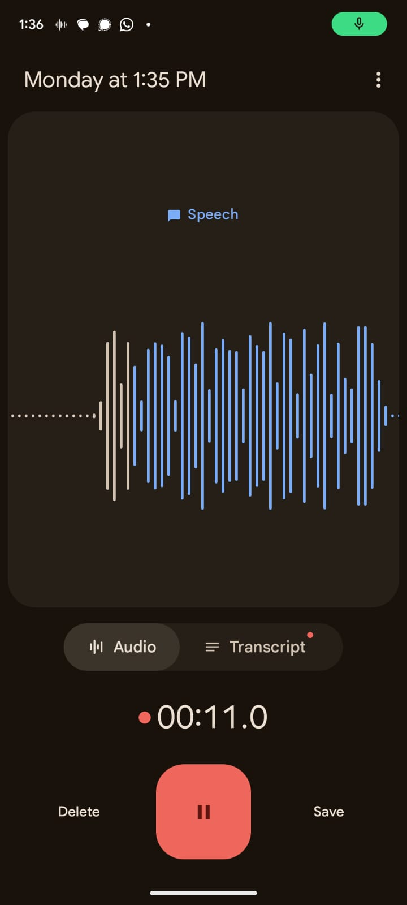
Using Audio Recording Apps
These apps universally use a big, red button to start recording. This slide shows Google’s Recorder app, but all of these buttons will be very similar regardless of the app you are using.
If you want to take a short break in your recording you can hit pause (highlighted in green). This will stop the recording until you hit record again, but it won’t end the recording as a whole.
To get to the pause button in Apple Voice Memos, swipe up on the recording while it’s running.
Finally, when you’re done recording remember to hit save or stop (often represented by a square) depending on your app. This will end the recording altogether and let you send it to your computer.
Be mindful of how your data and the recorded audio is stored on different recording apps.

Slide 15
Monitoring Your Recording
While you are recording, the app will show a waveform (highlighted in red), which shows the current audio input
Make sure to check your waveform intermittently as you record (especially at the beginning)
If you aren’t seeing any waveform or it is very small, the phone is likely not picking up your audio
The peaks and troughs of the wave show when it is picking up more and less audio. This should generally match the louder and quieter parts of your interview recording, though don’t worry if it doesn’t seem to be completely precise.

Slide 16
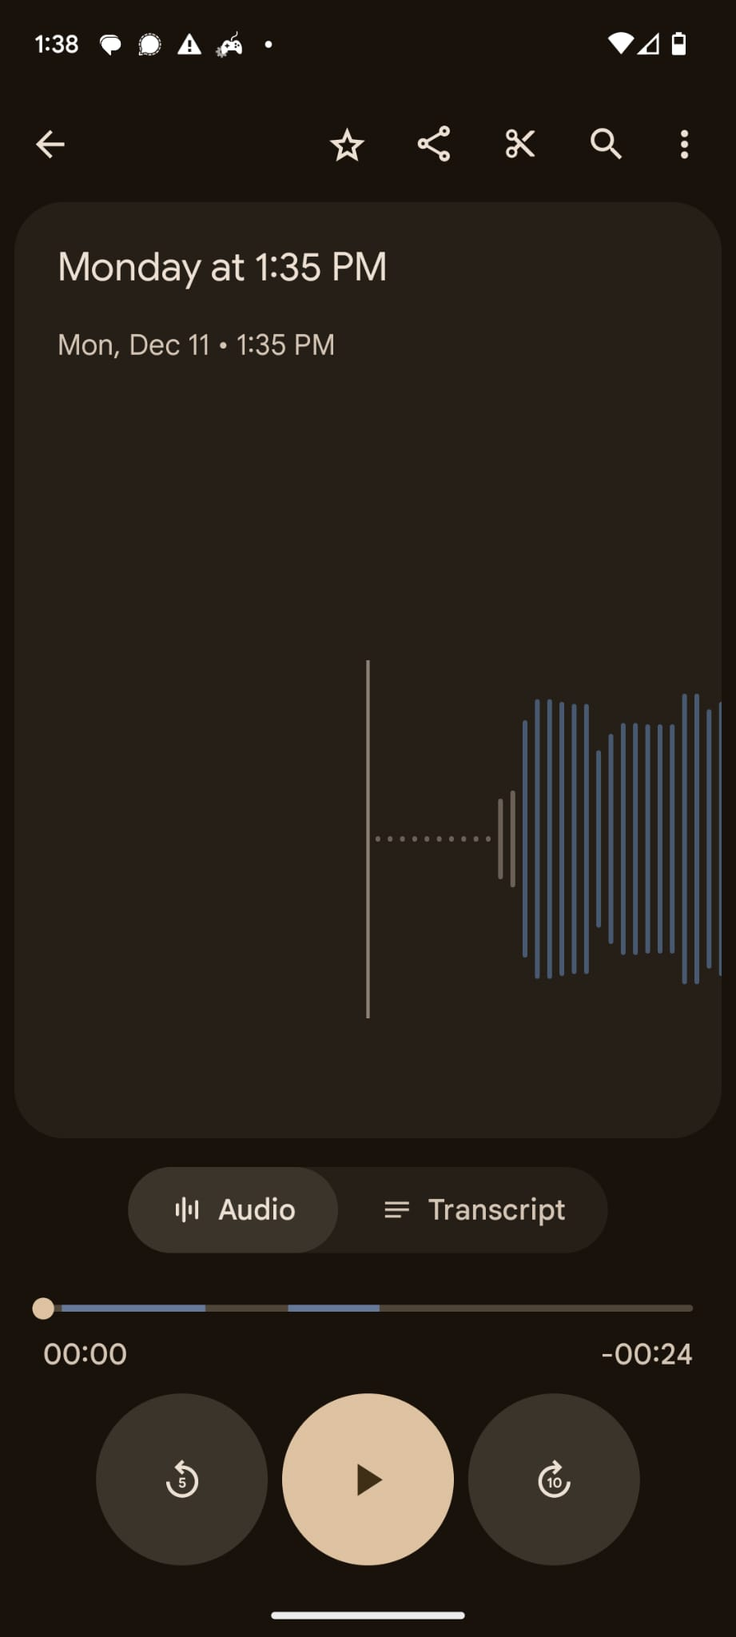
Getting the Audio From Your Android
The easiest way to get the file from your phone to your computer will be to use the share function. Look for a symbol like the one highlighted on the right.
From the share menu, you will be able to send the file to yourself in various forms, such as email.
Sometimes the file size may exceed the limit for email, which is where Google Drive can work better
As soon as you have files on your computer, you can move on to audio editing!

Slide 17
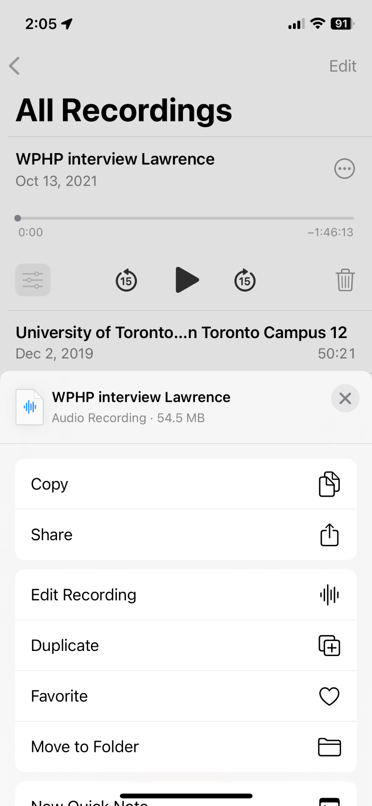
Getting Audio From Your iPhone
To get audio out of Voice Memos, click the three dots (highlighted in red) and select “share” (highlighted in green).
You’ll need to pick a method that works for you:
Airdrop and iCloud work.
If you download the app for Drive or Dropbox (or similar), you can send the file to those.
It will probably be too big a file to email to yourself.

Slide 18
Making Podcasts: Audacity

Slide 19
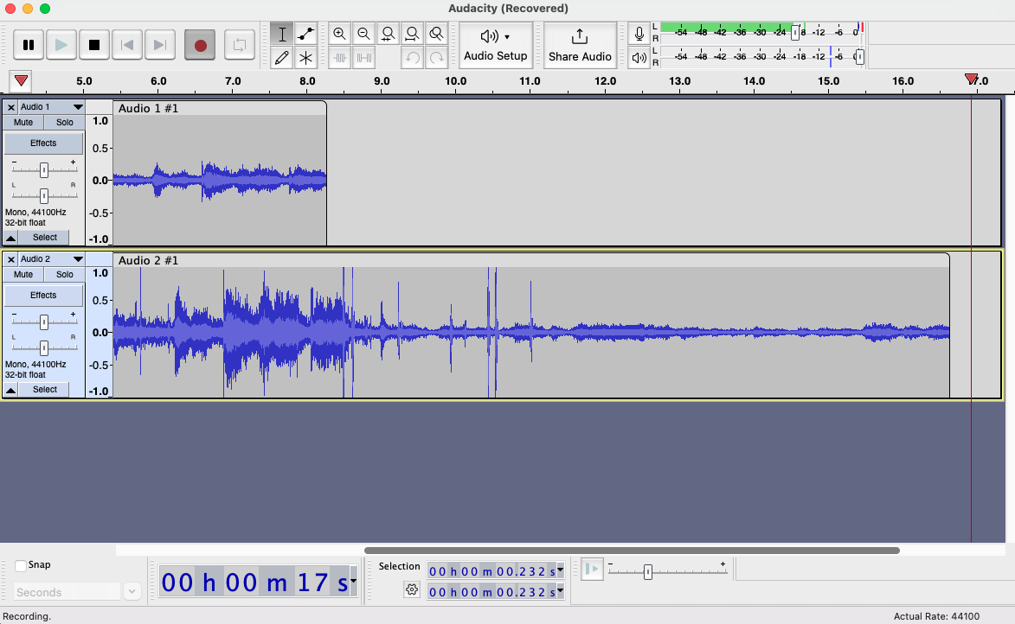


What is Audacity?
Audacity is a free, easy-to-use, multi-track audio editor and one of the more popular free audio editors used for creating podcasts.
(Multi-track: the ability to have different layers of audio in one clip.)

Slide 20
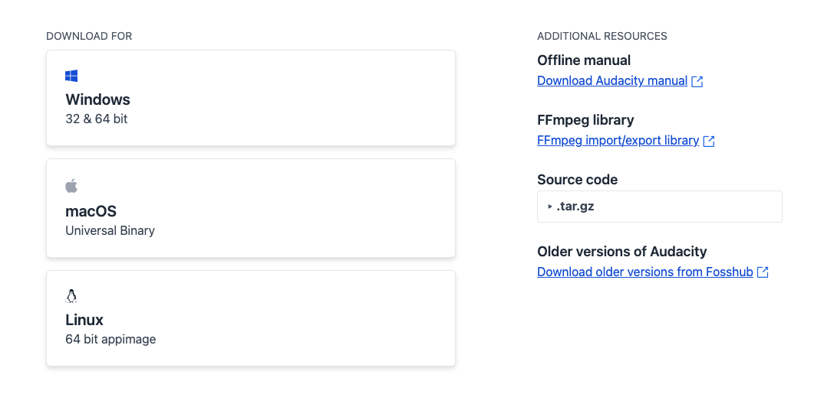
Downloading Audacity
https://www.audacityteam.org/download/

Slide 21
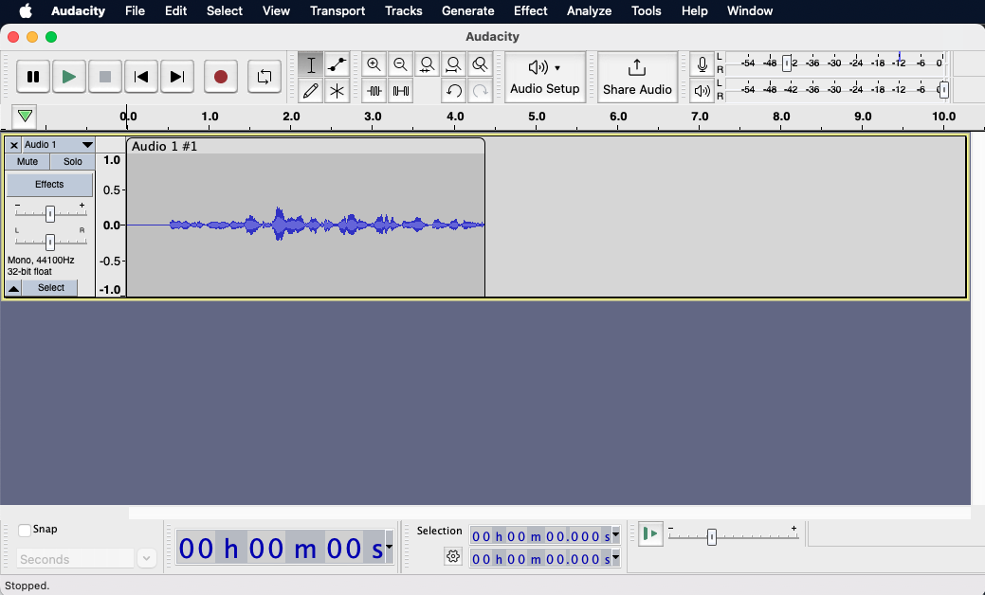
Anatomy of Audacity
Audio Editing
Main buttons (L-R): pause, play, stop, fast-forward/
backward, record
Microphone, volume, input, and output
Recordings (audio tracks) will display in this window here.
Editing, saving, effects, transporting or exporting the recording.
Output Volume Level Monitor: shows the loudness of each track in real-time
https://manual.audacityteam.org/

Slide 22
Key Terms
Track: a single audio channel or stream.
Multi-track: an audio recording or chanel with more than one track or recording of sound.
Clipping: splitting audio into separate sections—that is, making “clips”
Waveform: the curve within a track showing the duration and volume of individual sounds
Mixing: the process of audio production, or mixing tracks of recordings, music, and other desired media.
MP3 File: the most generally used audio file format. Others include .wav and .mp4.
Feel free to ask questions at any point during the presentation!

Slide 23
Basics: Audacity & Recording Audio

Slide 24
Getting Started: Tips for Recording Audio
Know where your microphone is located and keep it clear of papers/other objects
Use headphones when recording and editing
After you finish editing, listen to the file without headphones to see where the audio is too loud/quiet when played in a space.
Take ambient noise into consideration
A/C units, refrigerators, traffic, pets, roommates, loud clothing, etc.
Save frequently. Audacity does not autosave.
Notes:
After you finish recording, listen to the audio with and without headphones so that you can properly render the sound. Audio sounds different in an open spaces than it sounds inside your headphones.

Slide 25
Recording Audio cont.
Record test audio and adjust mic volume if necessary
Record a few seconds of silence at the start and end of each track
Begin way in advance, and do several takes
Editing often takes much longer than the recording itself!
Speak slowly, clearly, and conversationally
If you use too many “filler words” (um, like, so) you can always edit them out later. Stop recording and start again at the top of the sentence to avoid jarring sound cuts in post-production
Notes:
Don’t be afraid to stop and start over if you mess up! You’ll save more time in the long run. You can pause between questions and give yourself a few seconds of silence to supplement your editing process.

Slide 26

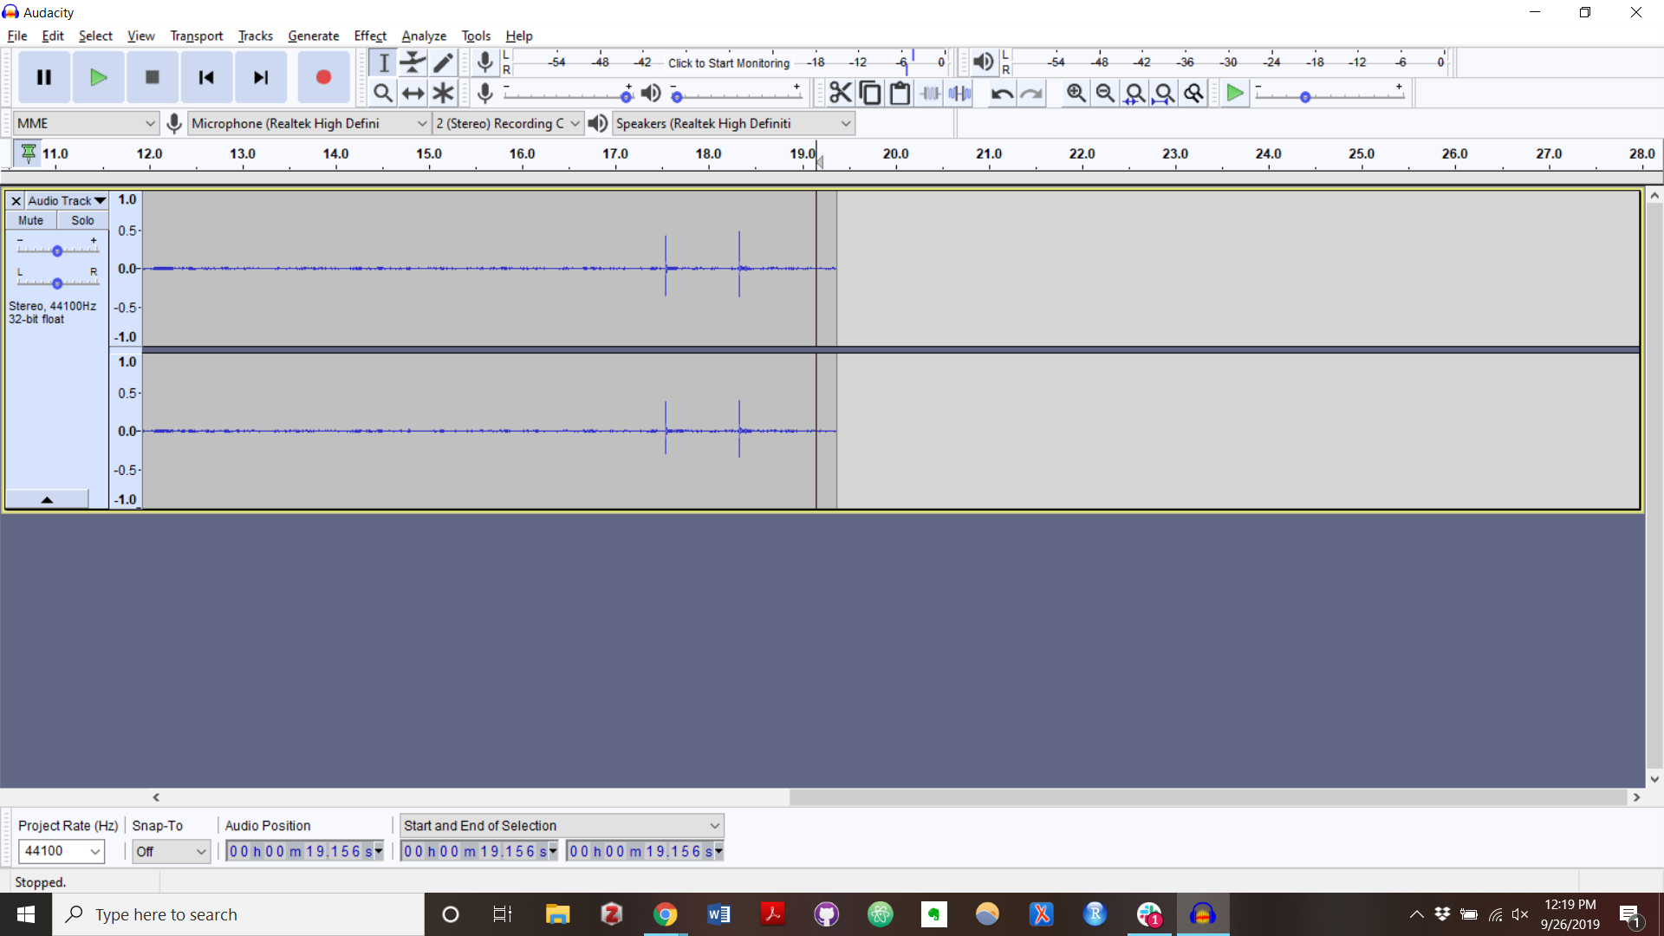

Recording
Make sure your microphone is working by checking to see that it’s selected in the microphone section of the screen. Each computer will have different microphones, so check your sound settings for your model.
To record, click the button with the red circle.
Hit the pause button to pause a recording.
Hit the stop button to stop recording.
Use Re-play to verify that the recording is the quality/ volume that you want.
Feel free to ask questions at any point during the presentation!

Slide 27
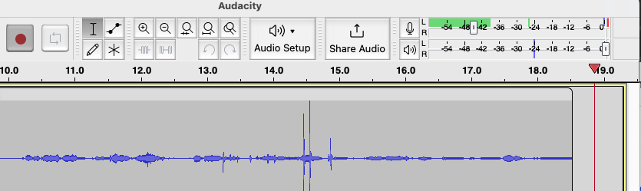
Checking volume
Keep an eye on the monitor when recording and playing back your audio—try to keep it in the green (literally).
If your volume is too loud, the monitor levels will turn yellow and red. Tracks that are too loud will have a blown-out effect when played back.
If one of your tracks is louder or softer than the others, you can adjust the volume on each track.
Tip: to hear one track without the others, you can mute the other tracks or click “solo”
Feel free to ask questions at any point during the presentation!
Notes:
You do want to be in the upper range of the green, ideally almost yellow. Anything less will be extremely quiet compared with other audio you listen to on your computer.

Slide 28


Adjusting Mic Volume
If the recording volume is too loud, you can use the slider in the recording meter to adjust the recording level
Move the slider to the right for a higher (louder) recording level and to the left for a lower quieter) recording level
Feel free to ask questions at any point during the presentation!
Notes:
You do want to be in the upper range of the green, ideally almost yellow. Anything less will be extremely quiet compared with other audio you listen to on your computer.

Slide 29
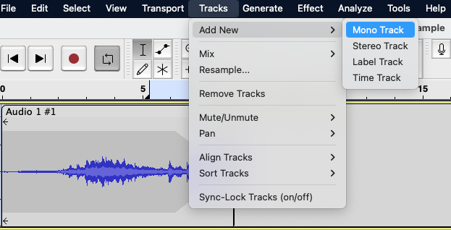
Adding Tracks
To create additional tracks in Audacity for a new recording, hit the record button and it will start a new track. Another option is:
Navigate to the Tracks menu option and select Add New. This will open a list of options. Select the Mono Track option.
Feel free to ask questions at any point during the presentation!

Slide 30
Basics: Audacity & Editing Audio

Slide 31

Toolbar: Selection and Multitool
The selection tool will be selected automatically when you open Audacity.
The multitool allows you to use all the functions of the other tools without switching to them.
The selection tool function is the default.
Hover over the waveform borders to use the envelope tool function.
Use your trackpad to zoom.
Zoom in and left click to use the draw tool function.
Feel free to ask questions at any point during the presentation!

Slide 32
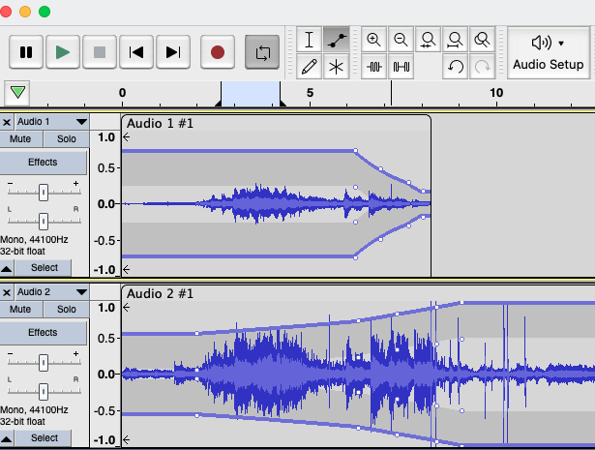
Toolbar: Envelope
The envelope tool allows you to smooth changes in volume by using control points at the top and bottom of the waveform.
Clicking on the blue border will create control points, which you can then move around to adjust the waveform envelope.
Feel free to ask questions at any point during the presentation!

Slide 33
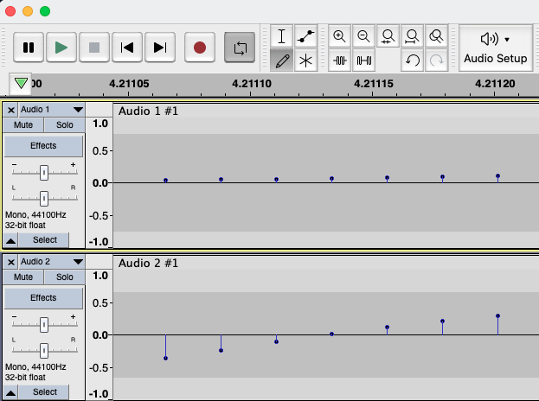
Toolbar: Zoom and Draw
The zoom tools let you zoom in and out of the waveform in order to make adjustments.
The draw tool allows you to manually redraw the waveform to change the volume or correct background noise.
You can only use the draw tool if you’ve zoomed into the waveform.
Feel free to ask questions at any point during the presentation!

Slide 34
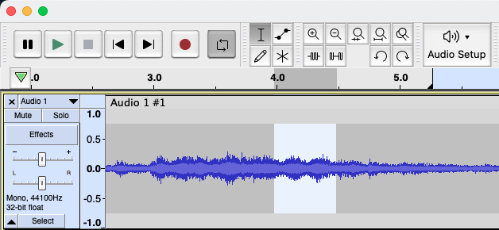
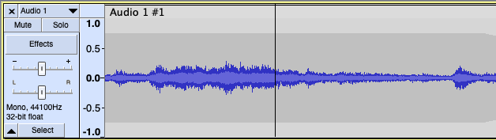
Removing Parts of Tracks
Once you have recorded audio in Audacity, you can easily edit it. Here is how to remove sections using the selection tool:
Click and drag with your cursor to select the portion your wish to remove.
Then, hit backspace or delete on your keyboard.
Tip: you can zoom in and out with the zoom tools to better see what you’re trying to delete.
Feel free to ask questions at any point during the presentation!

Slide 35
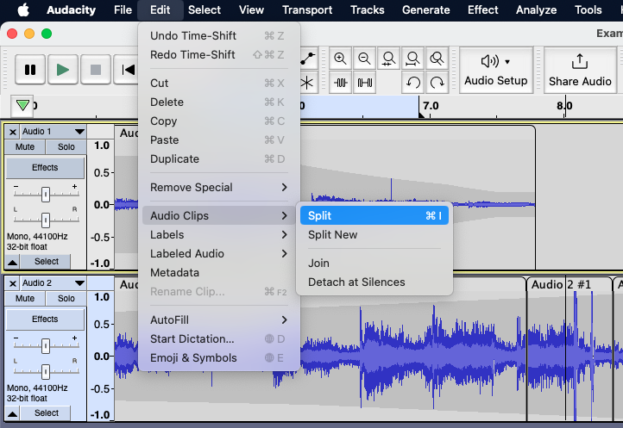
Splitting Tracks
To split a track in Audacity, follow these steps to make shorter clips:
With the selection tool, place your cursor over the section where you want to split your track.
Navigate to the Edit menu, click under Clip Boundaries and select Split.
Feel free to ask questions at any point during the presentation!

Slide 36
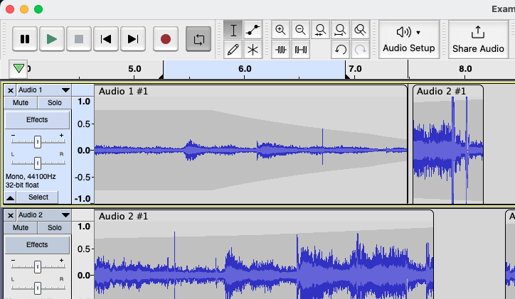
Moving Tracks
To move entire tracks or audio around in Audacity, you can click and drag them by hovering your mouse over the top of the clip.
Once you have selected the clip, click whatever clip or track you want to move and drag it into position.
Feel free to ask questions at any point during the presentation!

Slide 37
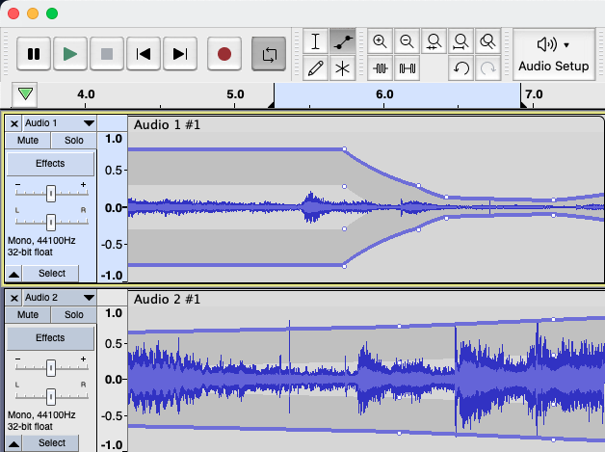
Fading In/Out
To fade music in and out on Audacity, use the envelope tool. Two yellow bars will show up on each track.
Click to add control points (little white dots) on the track you want to fade in.
Drag and move the nodes to up and down and side to side to change the volume and how gradual the volume fade is.
Add and adjust nodes at the end of the track to fade the music back in.
Feel free to ask questions at any point during the presentation!

Slide 38
Your Turn!
Visit incompetech Music
Download something you want to play around with and try to:
Remove some of your track
Choose a part to fade in or fade out
Split the track into multiple
Add a new track to your project

Slide 39
Saving, Exporting, and Sharing

Slide 40
Saving
Audacity does not auto-save! Save your recording, early and often!
Try and save after each major edit/input of a recording, just to be safe.
Save in multiple places. Always have backup.
File > Save Project > Save Project As> “Name of your podcast”
And once your project is saved...
File > Save Project > Save Project > [saves the updates to your file]
Feel free to ask questions at any point during the presentation!

Slide 41
About File Formats
Lossless Audio File Formats: better than or equal to CD-quality
WAV: uncompressed file, meaning huge file size. The best for editing raw audio files in Audacity.
AIFF: Apple’s alternative to WAV. Uncompressed, not widely used
*MP3/MP4: compressed audio file, ensures small file size. Best for exporting and distributing from Audacity.
Ogg Vorbis: Open-source alternative to MP3. Used in Spotify streaming
*Note: The DITI typically recommends you save files as mp3 (sometimes mp4, if you use a PC).
Feel free to ask questions at any point during the presentation!

Slide 42
Exporting and Sharing
Finished with your recording?
Make sure you export your project as an MP3 before you send or share it! This will ensure that other people are able to listen to it; anyone who does not have Audacity downloaded will not be able to open your project file otherwise.
File > Export > Export as MP3
Select “best quality”
Feel free to ask questions at any point during the presentation!

Slide 43
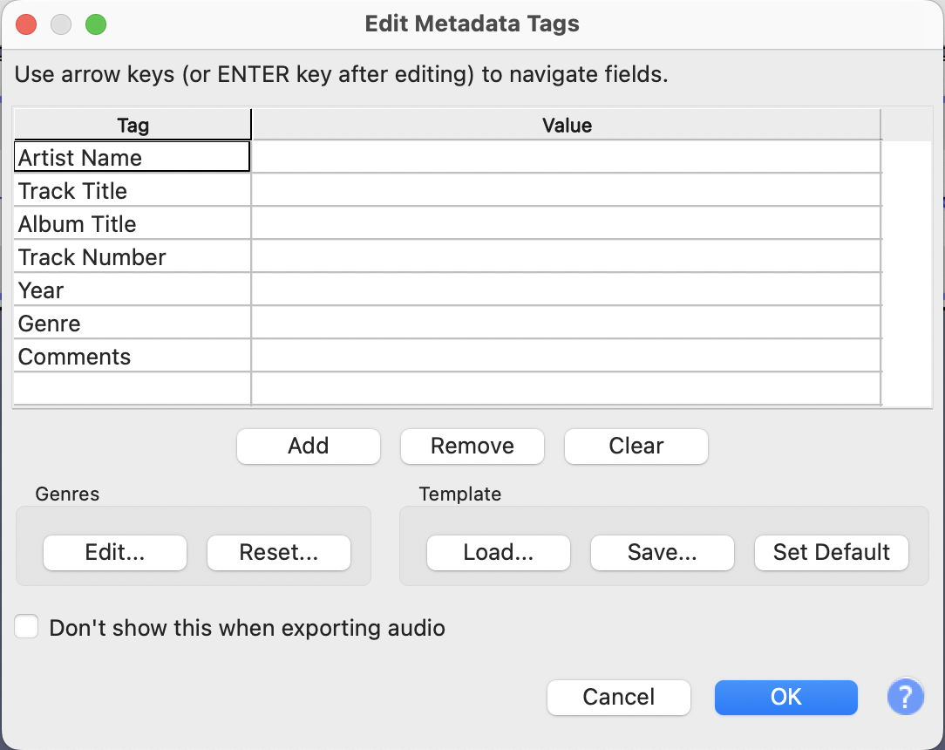
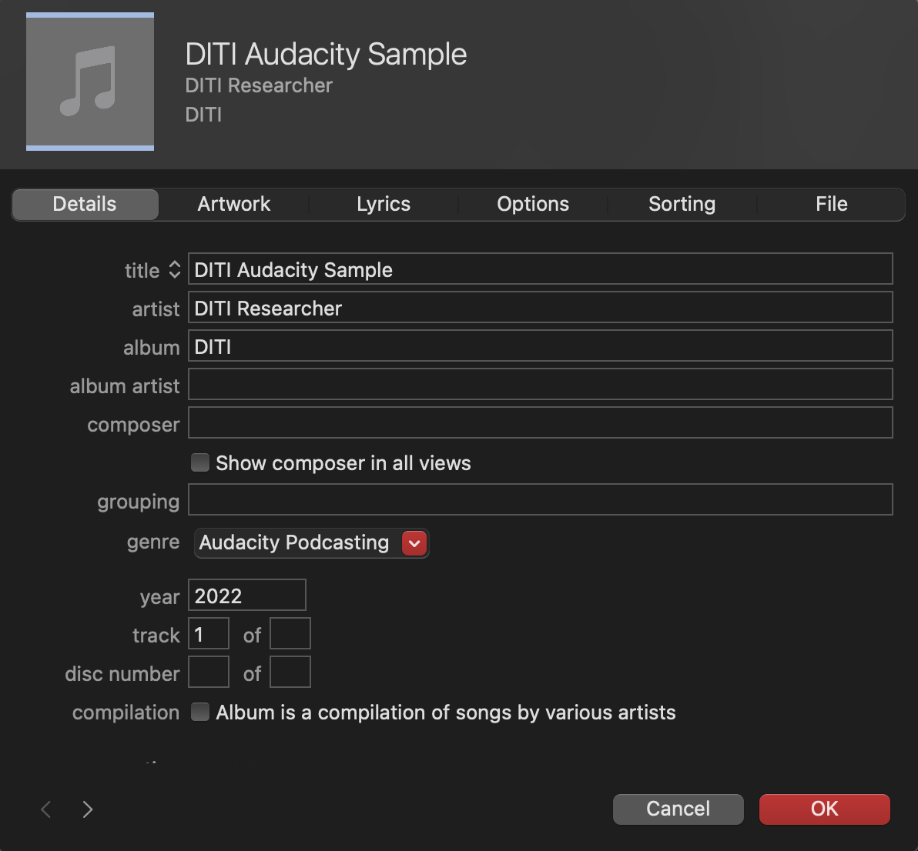
Exporting Metadata Tagging
When you export your file, Audacity will prompt you to add metadata tags to identify it.
On a Mac you can add artwork by importing your file to an Apple Music library, Control-clicking on it and choosing “Get info.”
On a PC, you can edit the MP3 metadata by clicking through to File Properties.

Slide 44
For Further Exploration
DITI Handout on Audacity
DITI Handout on Copyright and Fair Use
DITI Handout on Accessibility
DITI Handout on Data Ethics
DITI Meet the Method: Audacity
Northeastern Library Recording Studios
Northeastern Library Digital Media Toolkit

Slide 45
Thank you!
Developed by: Dipa Desai, Claire Lavarreda, Emily Sullivan, Sara Morrell, Avery Blankenship
We love feedback! Please fill our 2-minute survey: bit.ly/diti-feedback
Office Hours sign-up: https://bit.ly/diti-meeting
Contact us at: nulab.info@gmail.com
Slides and handouts available at:

