Slide 1
Introduction to Nvivo:
Qualitative Coding for Text Analysis
Presented by:
Fall 2022
Prof. Mya Poe
Feel free to ask questions at any point during the presentation!

Slide 2
Workshop Agenda
Workshop objectives
Qualitative Coding: annotating and highlighting sources
What is NVivo?
Important vocabulary and functions
NVivo demonstration
Hands-on activity
Slides & handouts at: https://bit.ly/3JDFPDr
Notes:
-Cara

Slide 3
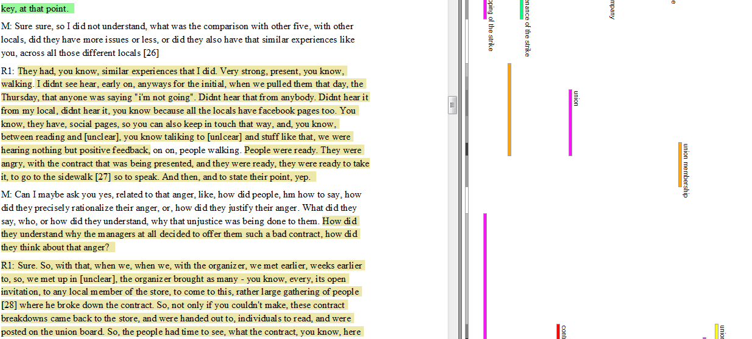
Coding in practice

Slide 4
What can NVivo do?
NVivo is designed for qualitative coding research materials, such as survey results, interviews, audio recording, text documents, articles, and other data formats. It also has other functions:
create projects that store, organize, and code documents/files
provide a method for you to code your documents with a user-created coding schema (nodes)
query, summarize, organize, and visualize information about your coding
conduct forms of computational text analysis, like word counts, on the documents themselves
Notes:
Garrett

Slide 5
NVivo is NOT cross-platform friendly
The Mac and PC versions of Nvivo–as well as the version numbers–are different and have different file types.
Mac NVivo projects end in .npvx and can only open that file project type
Windows NVivo projects end in .npv, but can open both .npv and .npvx
Version numbers (10, 11, 12) also impact which projects can be opened on which platform
Notes:
Cara – why we will be showing both Mac and Windows. Versions are very different.
But also, you should know this! When you need to send an NVivo file to someone else, save it as a .QDPX file. We will talk about this more later

Slide 6
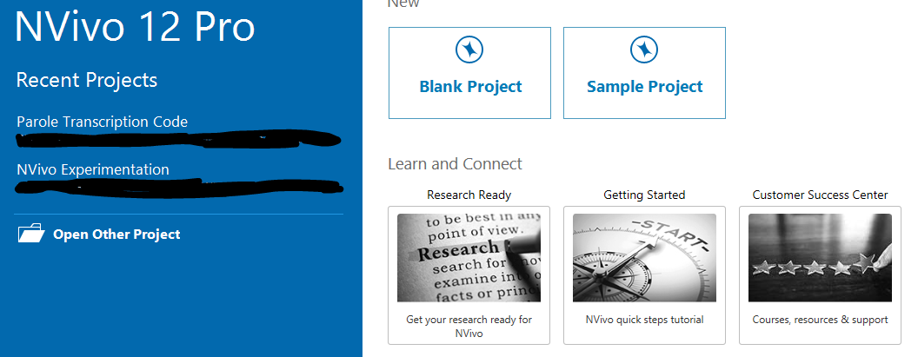
Anatomy of NVivo: Opening on Windows
Your version number (you should have version 11 or 12)
Create a new project (stores all your documents, codes, etc)
The recent projects you opened
Open another project that is not recent
Notes:
Garrett

Slide 7
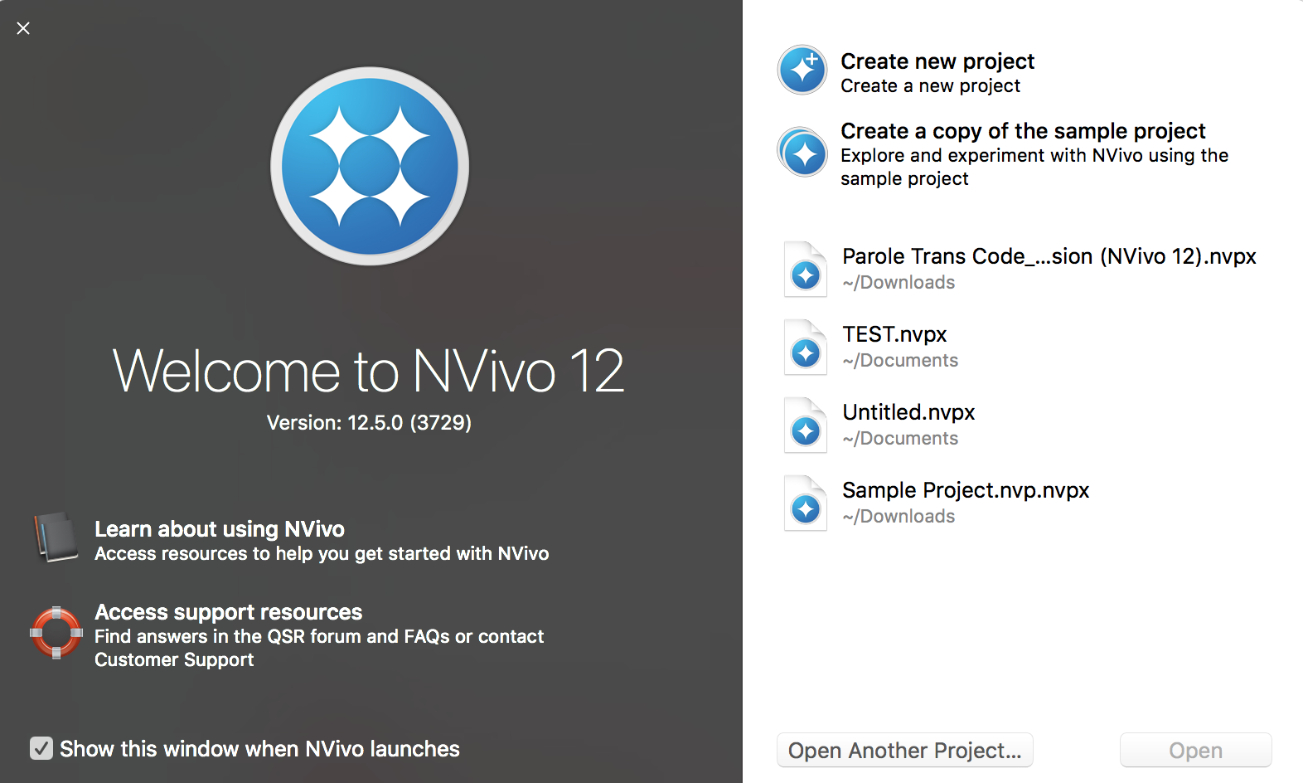
Anatomy of NVivo: Opening on Macs
Create a new project (stores all your documents, codes, etc)
Your version number (you should have version 11 or 12)
The recent projects you opened
Open another project that is not recent
Notes:
Cara

Slide 8
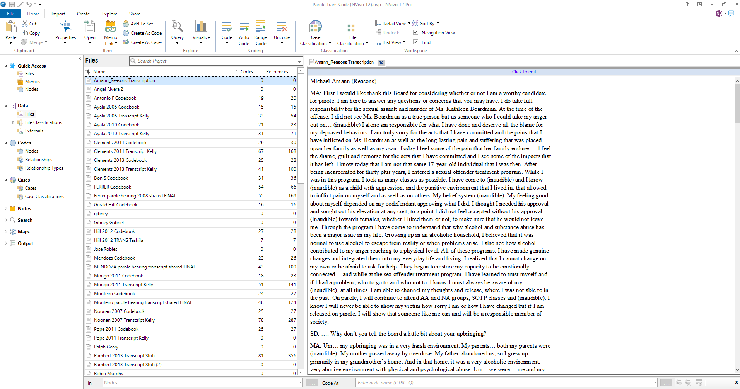
Anatomy of NVivo: Projects on Windows
Toolbar to access functions
The window that will open the files, queries, etc. You can annotate documents here.
Menu to access files, nodes, cases, notes, etc.
List of nodes, files, etc.
Notes:
Garrett

Slide 9
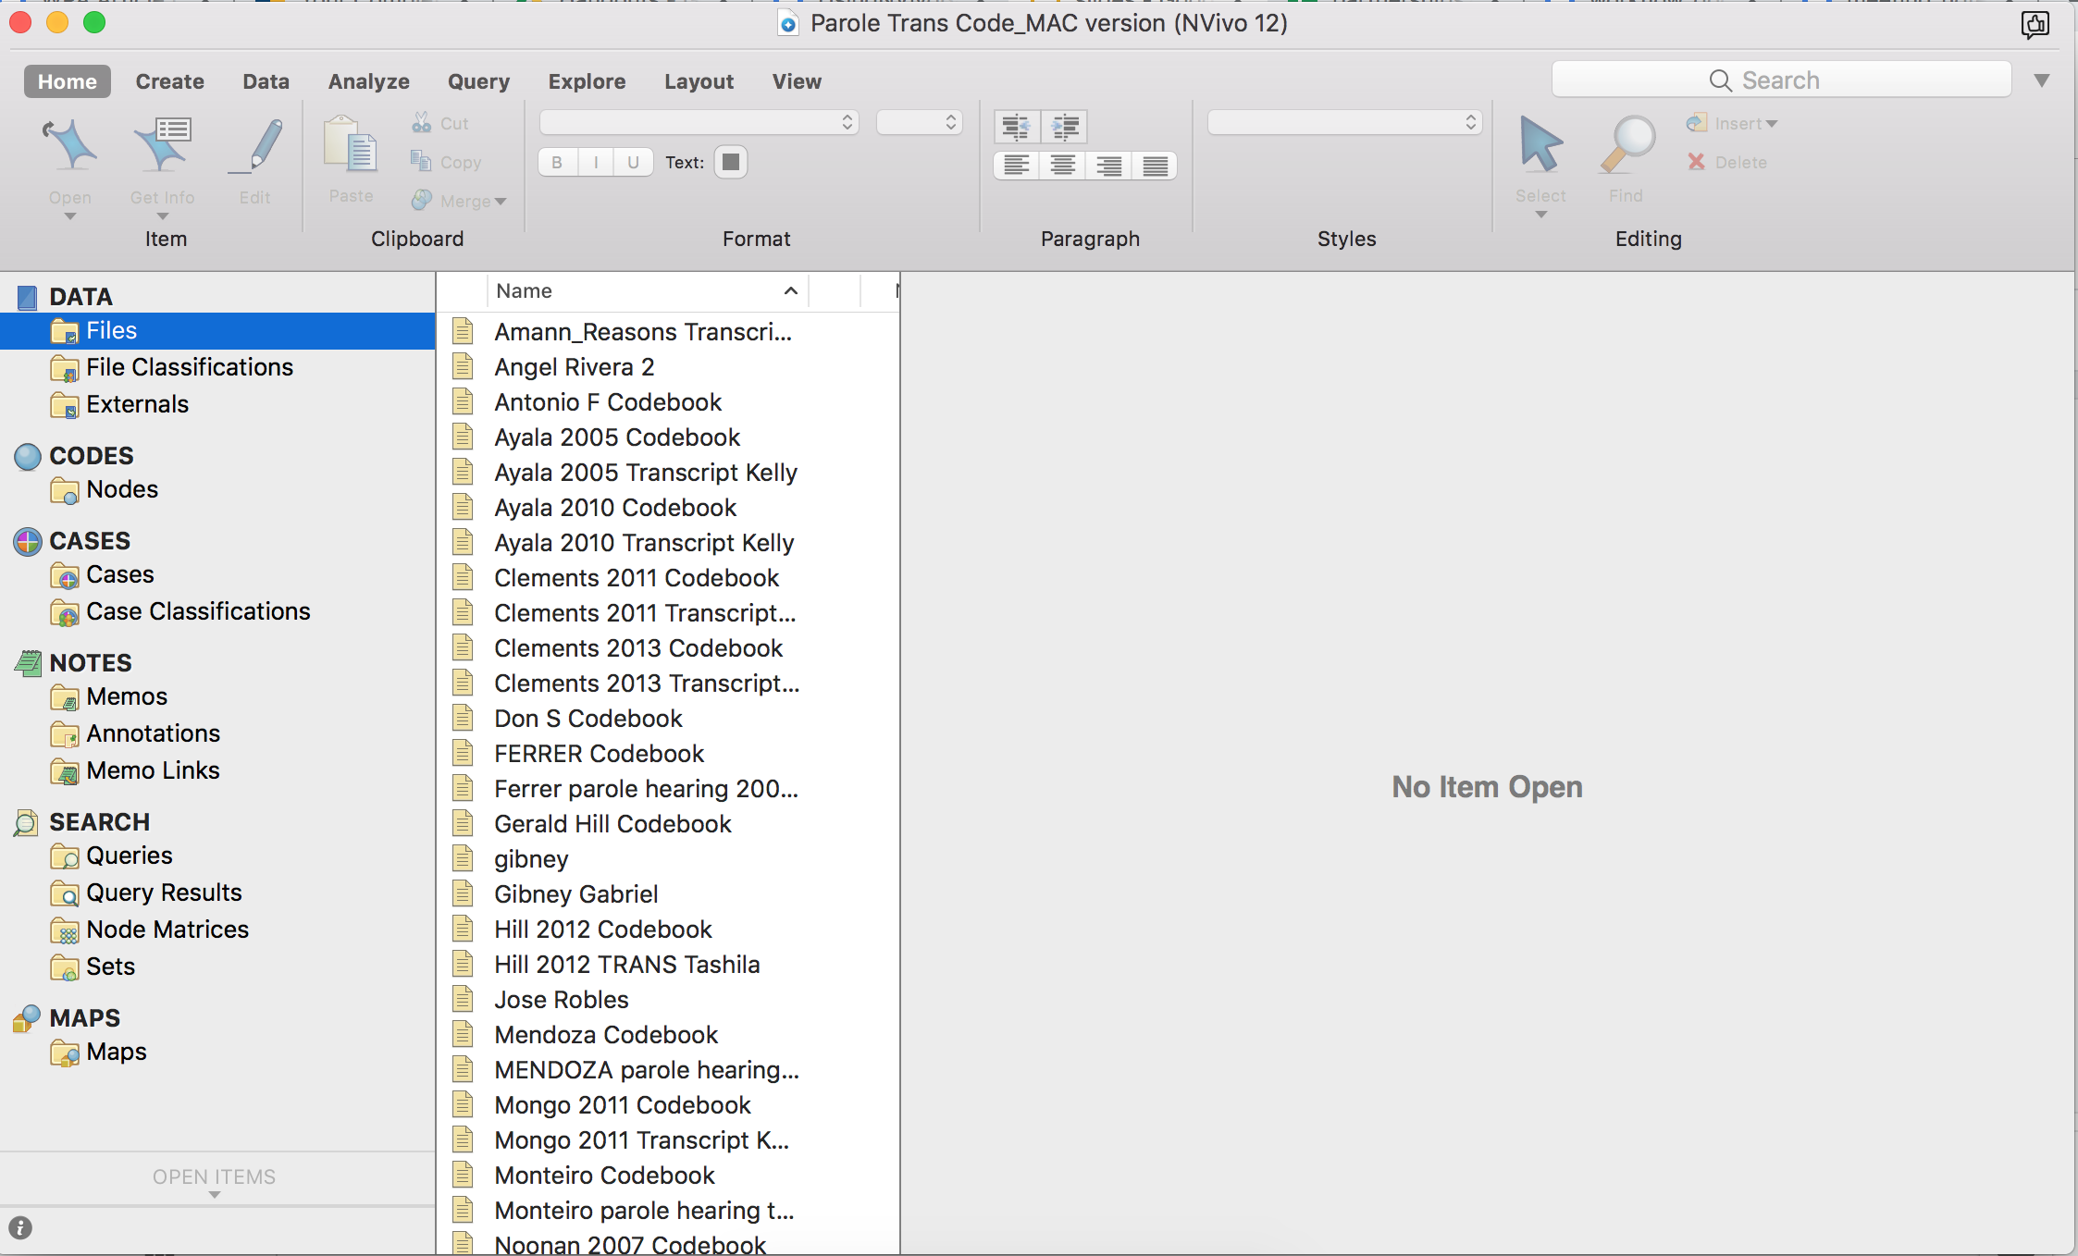
Anatomy of NVivo: Projects on Macs
Toolbar to access functions
Menu to access files, nodes, cases, notes, etc.
The window that will open the files, queries, etc. You can annotate documents here.
List of nodes, files, etc.
Notes:
Cara

Slide 10
NVivo Vocabulary
Full definitions available on the handout
Data: your research documents & files
Codes: the method to annotate the themes/concepts (same as Nodes)
Nodes: the actual themes/concepts that you create
Relationships: coding connections between two data items
Cases: units of analysis for your research.
Maps: visualization tool to see connections between the cases and nodes
Query: a flexible way to explore and analyze your files, cases, and nodes
Notes:
Garrett

Slide 11
Important Reminders
NVivo can import all types of files, including .docx, .pdf, .doc, .csv, .png, .jpeg, .txt, video/audio files, and more.
You should always save your original documents on your local computer or in cloud storage, even if these documents are imported into NVivo. NVivo can store documents, but it is more of an organization and analysis tool, rather than a storage option.
Notes:
Cara

Slide 12
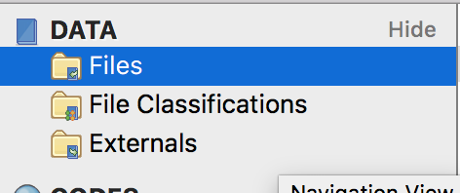
Data
The “Data” in NVivo are all the research materials you are using (scholarly articles, transcriptions, newspapers, research notes, etc.).
“Files” will be where you can access all the research materials you have imported into this project.
Notes:
Garrett

Slide 13
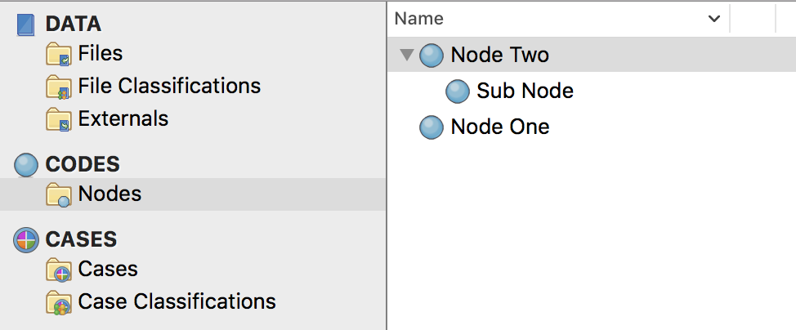
Codes and Nodes
The list of nodes you will use to code your files. The “nodes” folder will be empty until you add your own! You can add nodes and sub-nodes
Notes:
Cara

Slide 14
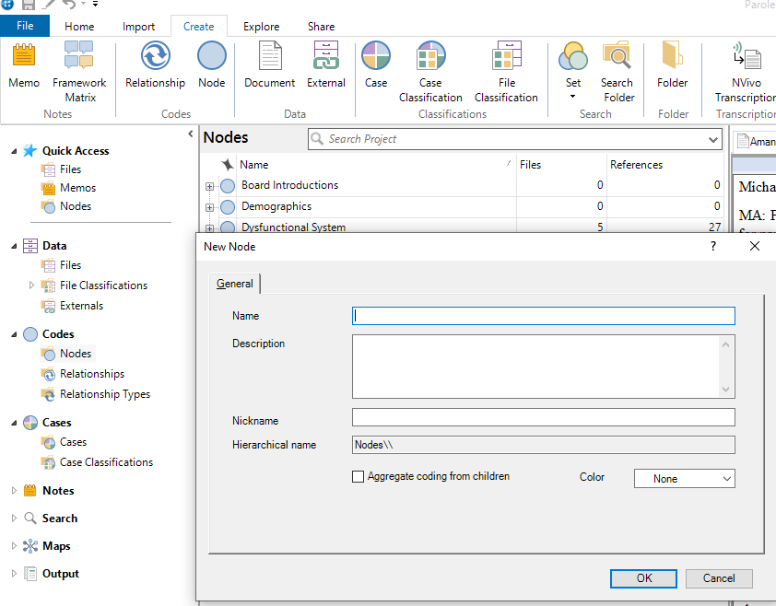
Creating Nodes (Windows)
1
Go to “Create” in the toolbar
Click “Node”
Your new node will pop up and ask for a name and description
To add a subnode, follow the same steps, but click on the original node where you want to add the subnode
2
3
Notes:
Garrett

Slide 15
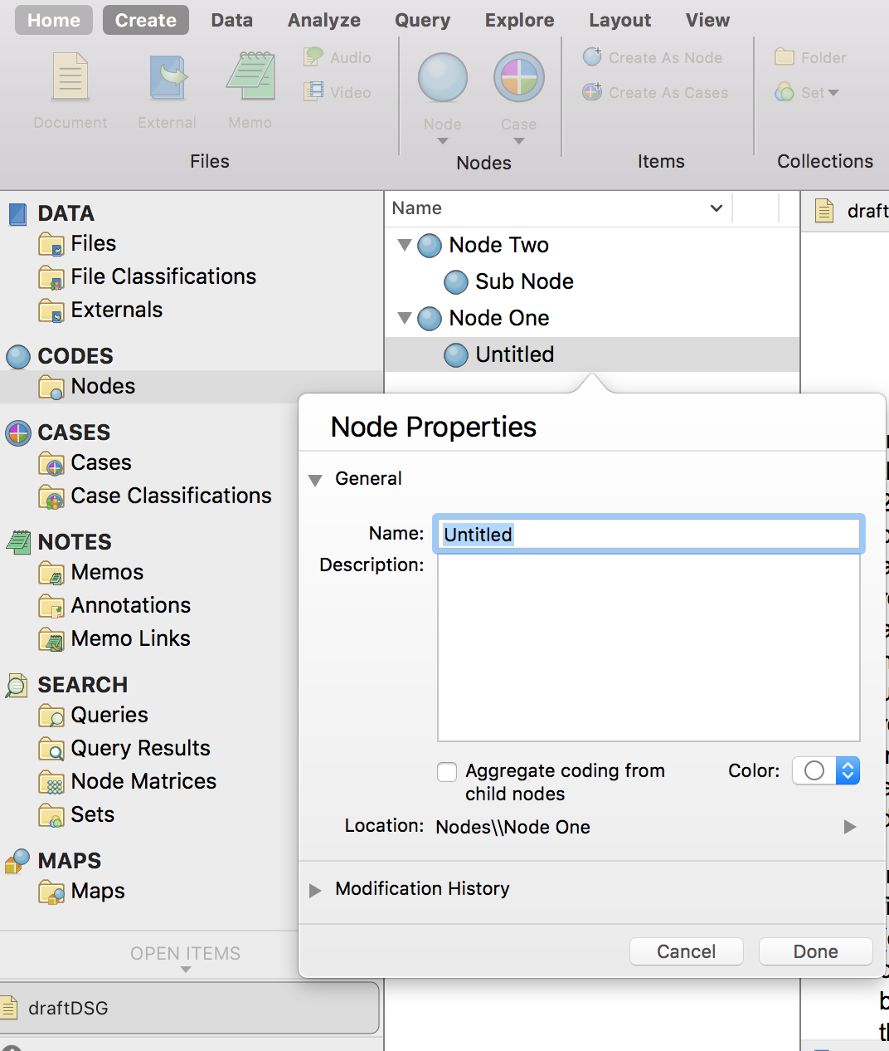
Creating Nodes (Macs)
1
2
Go to “Create” in the toolbar
Click “Node”
Your new node will pop up and ask for a name and description
To add a subnode, follow the same steps, but click on the original node where you want to add the subnode
3
Notes:
Cara

Slide 16
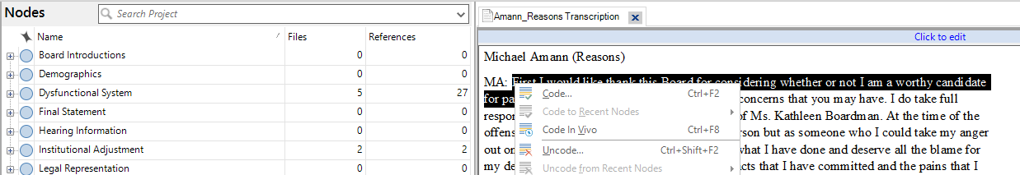
Coding Files/Documents (Windows)
Open the file you would like to annotate
Highlight the text you want to code
Drag and drop the selection onto a node
Alternatively, you can Command/Control+click and select “Code”
You can also add new nodes/cases as you annotate
Notes:
Garrett

Slide 17
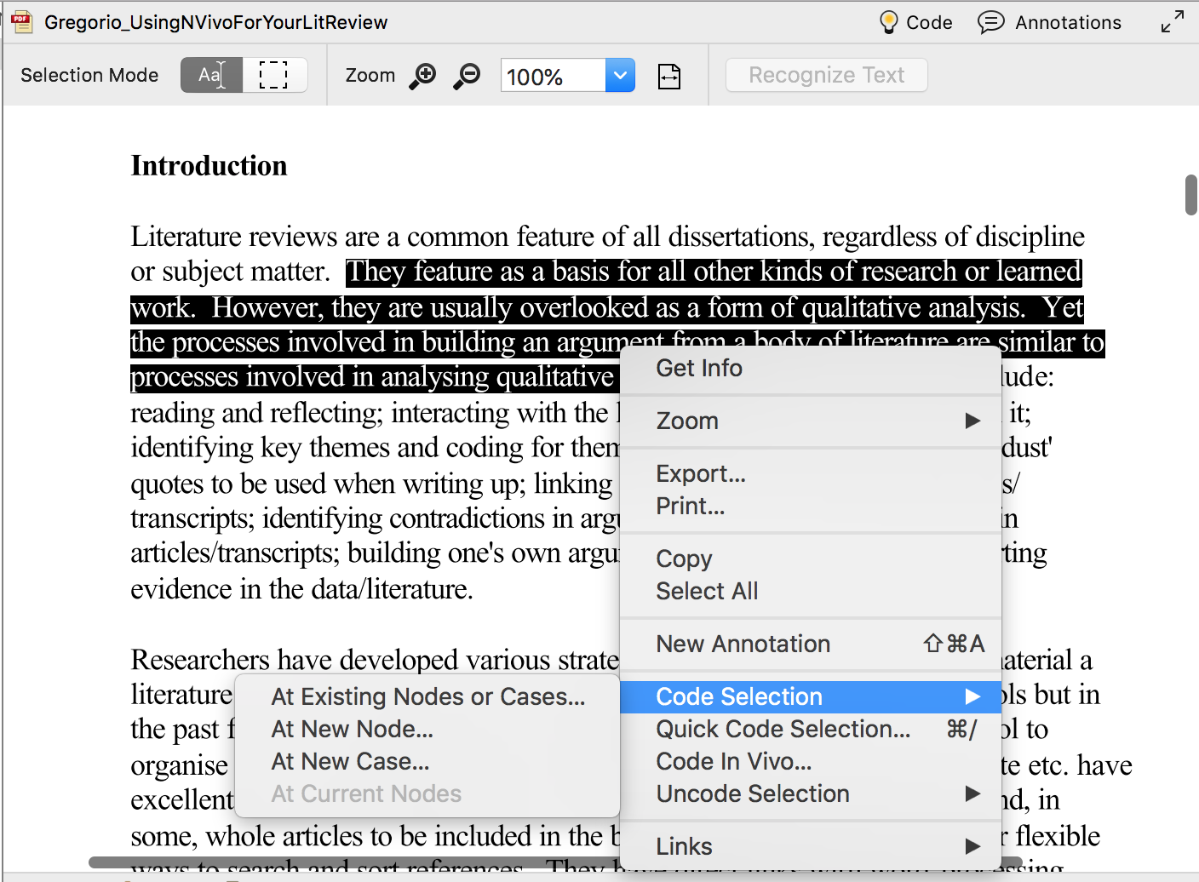
Coding Files/Documents (Macs)
Open the file you would like to annotate
Highlight the text you want to code
Command/Control+click and go to “Code Selection”
Click “At Existing Nodes or Cases”
Once you use nodes, the nodes will show up when you click “Code Selection”
You can also add new nodes/cases as you annotate
Notes:
Cara

Slide 18
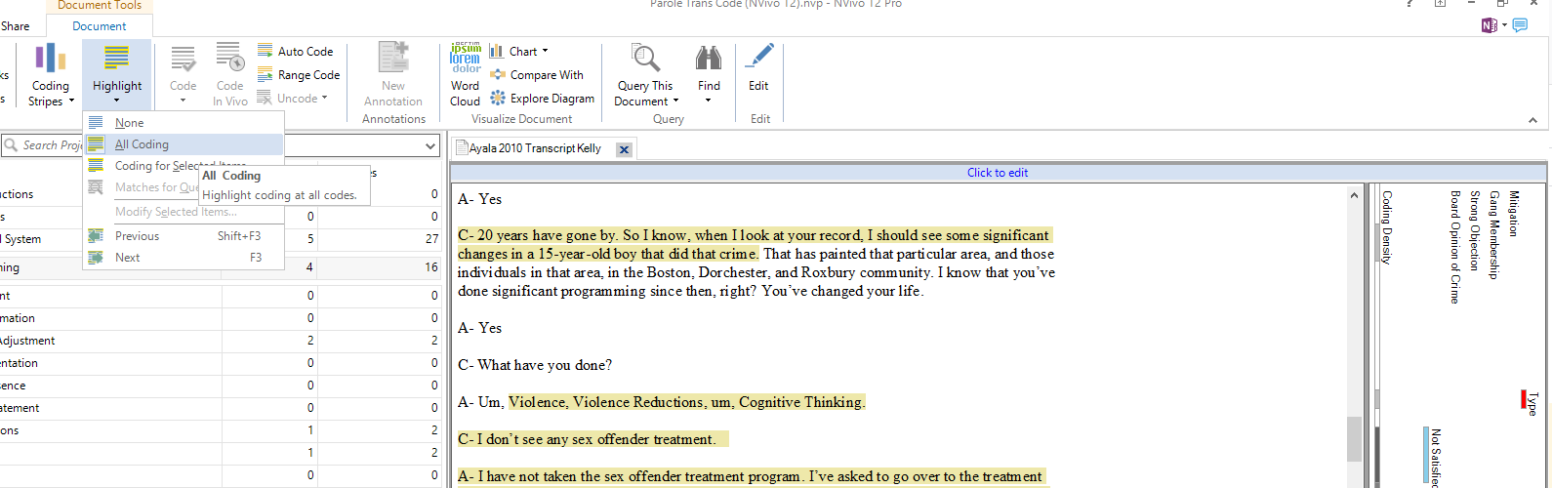
View Your Codes (Windows)
Go to “Document” in the toolbar
Click “Highlight” then “All Coding”
Click “Coding Stripes” and “All Coding” to see the code names and where they appear in the document.
If you have tagged an entire file as a “case,” everything will be highlighted. Simply choose “Coding for Selected Items”
1
2
3
Coding stripes (shows what codes appear where in the doc)
The document you are coding and annotations
Notes:
Garrett

Slide 19
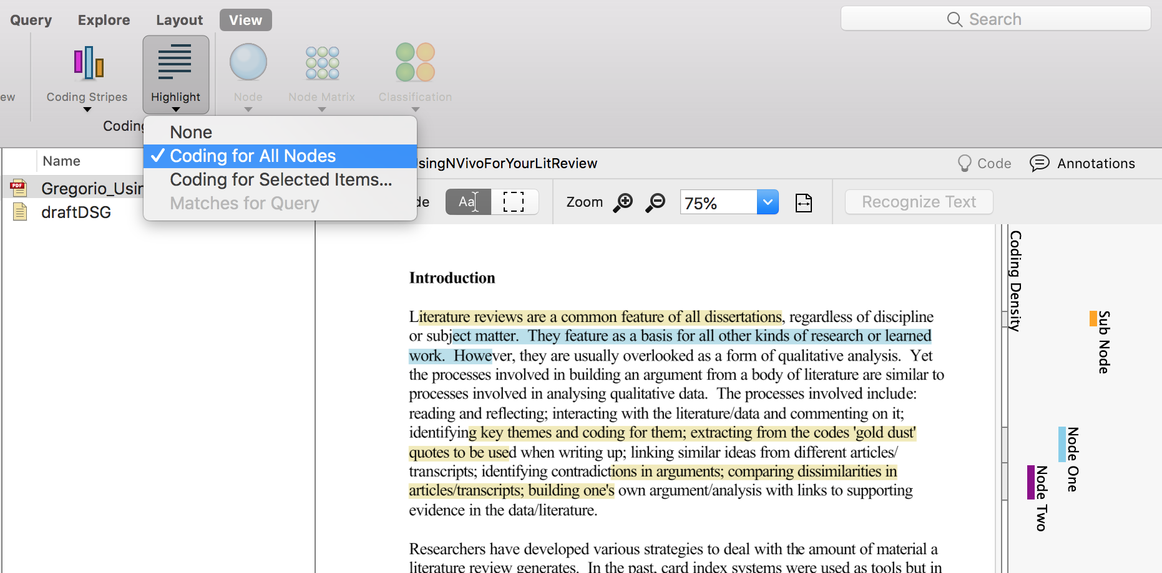
View Your Codes (Macs)
Go to “View” in the toolbar
Click “Highlight” then “Coding for All Nodes”
Click “Coding Stripes” and “All Nodes Coding” to see the code names and where they appear in the document.
If you have tagged an entire file as a “case,” everything will be highlighted. Simply choose “Coding for Selected Items”
1
Coding stripes (shows what codes appear where in the doc)
3
2
Your document you are coding and annotation (yellow = codes, blue = annotations)
Notes:
Cara

Slide 20
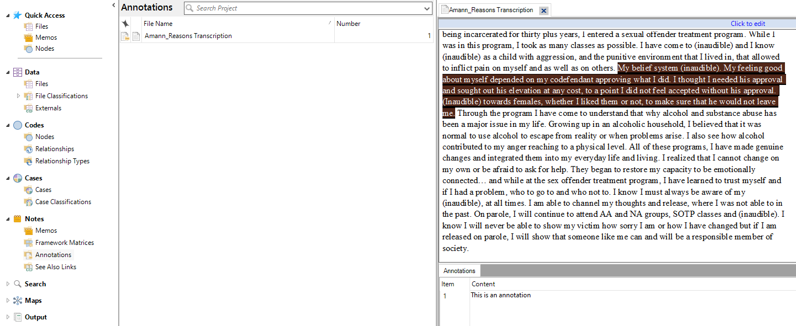
Annotating Files (Windows)
To annotate (comment), follow the same steps as coding except click “New Annotation” instead after you highlight and Command/Control click. Find all your annotations in the “Notes/Annotations” section in the left menu
The text from the document you highlighted and are annotating
List of annotations
Where you can find all your annotations listed
Your annotation
Notes:
Garrett

Slide 21
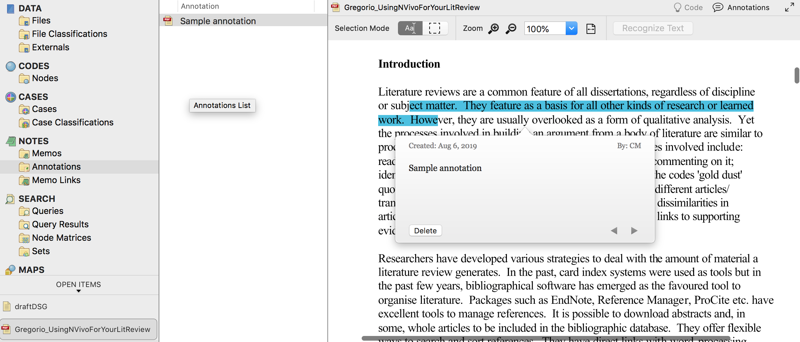
Annotating Files (Macs)
To annotate (comment), follow the same steps as coding except instead click “New Annotation” after you highlight and Command/Control+click. Find all your annotations in the “Notes/Annotations” section in the left menu
The text from the document you highlighted and are annotating
Where you can find all your annotations listed
List of annotations
Your annotation
Notes:
Cara

Slide 22
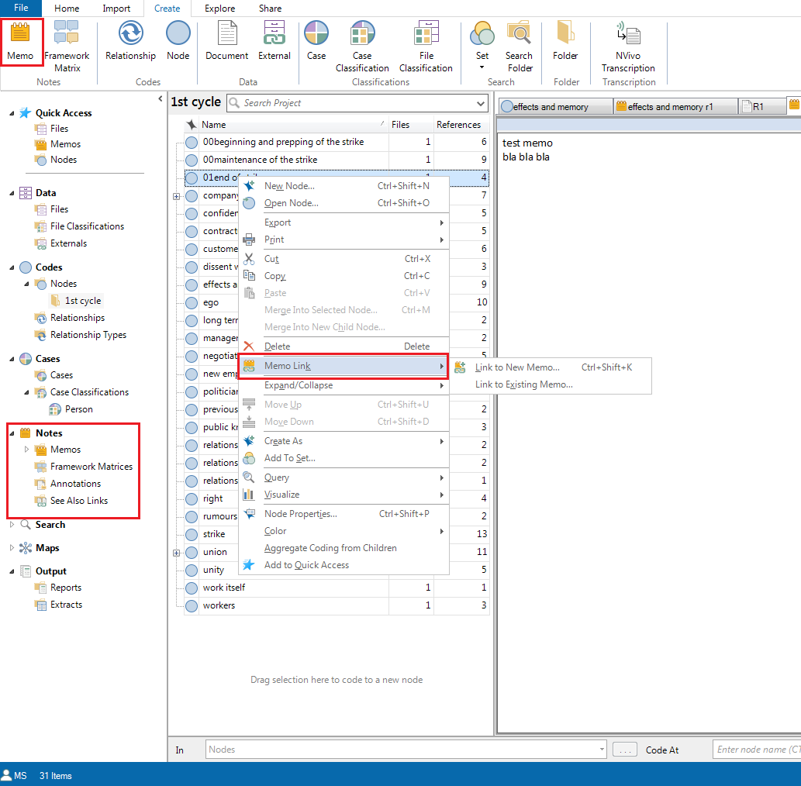
Memos (Windows)
Memos are more extended write-ups of your analytical insights
They can stand alone, but also be linked
“Memo link” - linking memo to a particular file, case, or node
Option to link the memo to a node
Menu where memos are located

Slide 23
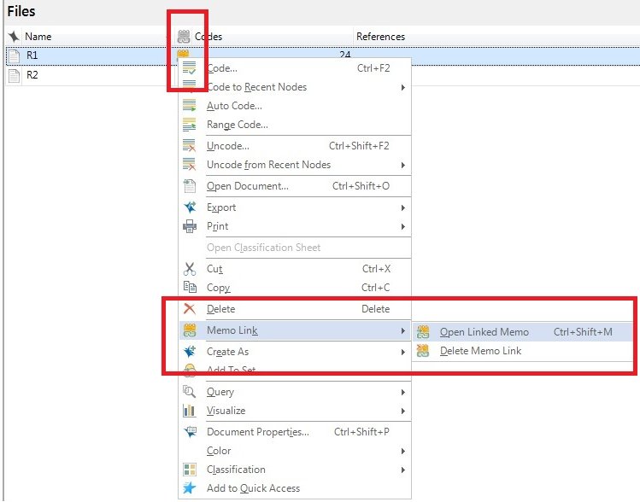
Memo links (Windows)
Showing the link between the file and the memo
Accessing the memo from the file

Slide 24
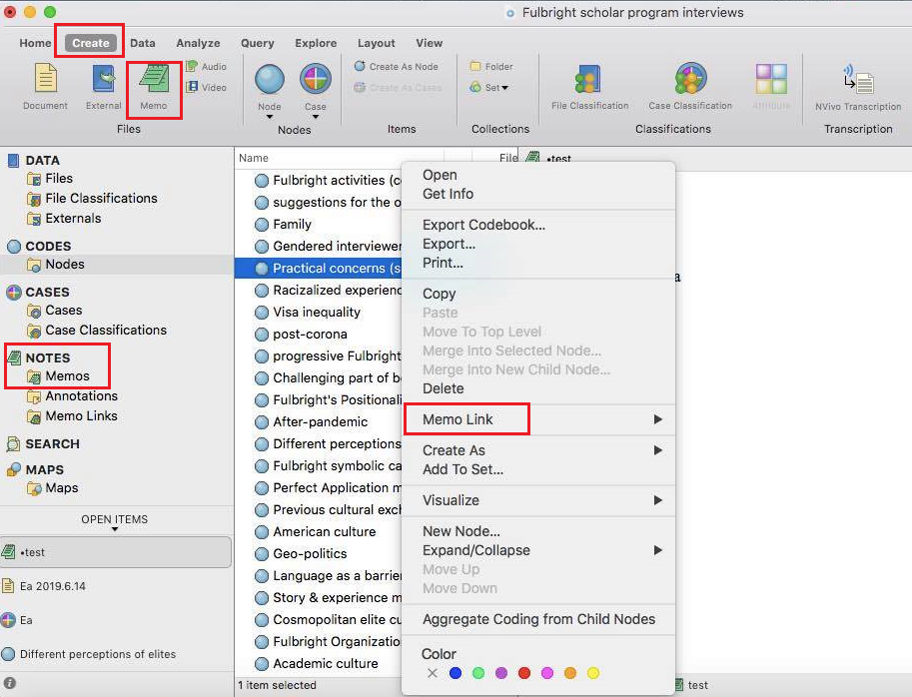
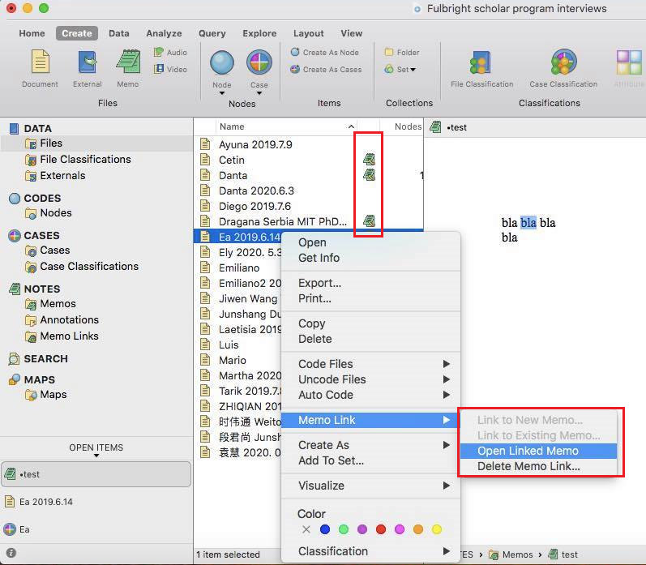
Memos and memo links (Macs)
Navigating memo creation
Showing the link between the file and the memo
Menu where memos are located
Accessing the memo from the file
Option to link the memo to a node

Slide 25
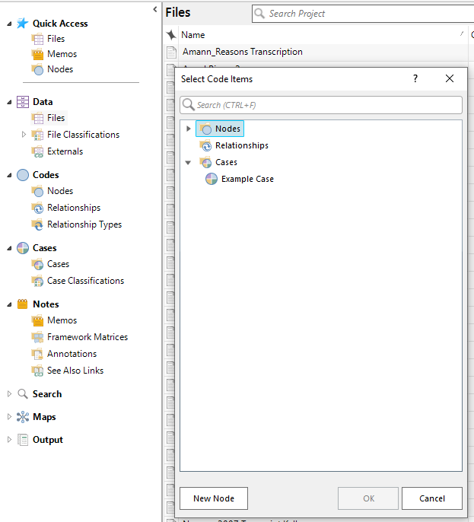
Cases (Windows)
To add a “case” to a file, it’s the same method as adding a node, except you choose the “Cases” folder and the proper case.
Cases are the types of research texts in your project; they can be organized based on your selections. “They might represent people, places, events, organizations or other entities that you want to analyze and compare.” For example, if you have several transcripts from different trials, but want to categorize the type of trial for each text, you would use cases to do so.
-“About Cases”, NVivo
Notes:
Cara

Slide 26
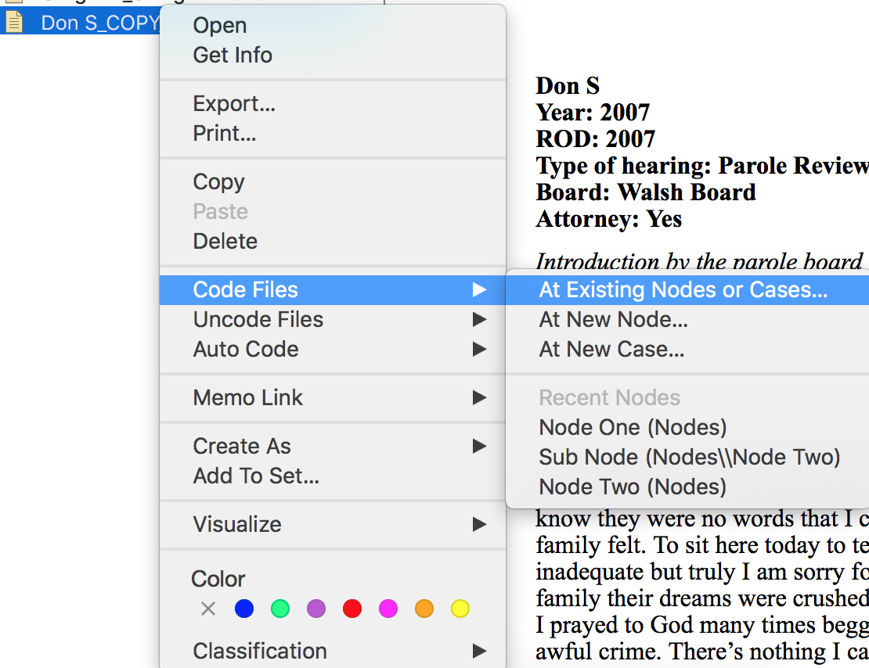
Cases (Macs)
To add a “case” to a file, it’s the same method as adding a node, except you choose the “Cases” folder and the proper case.
Notes:
Cara

Slide 27
Querying
Querying, or asking something from your data, in NVivo provides multiple ways to explore both your codes and your texts.
Word Frequency: Counts the number of times words (with stopwords removed) appear in one or more files
Coding: Shows the number of codes, the text that was coded, and the files
Crosstab: cross-references nodes and case classifications. For example, you might want to know how often a particular node appears in both scholarly articles and your primary texts.
Notes:
Garrett

Slide 28
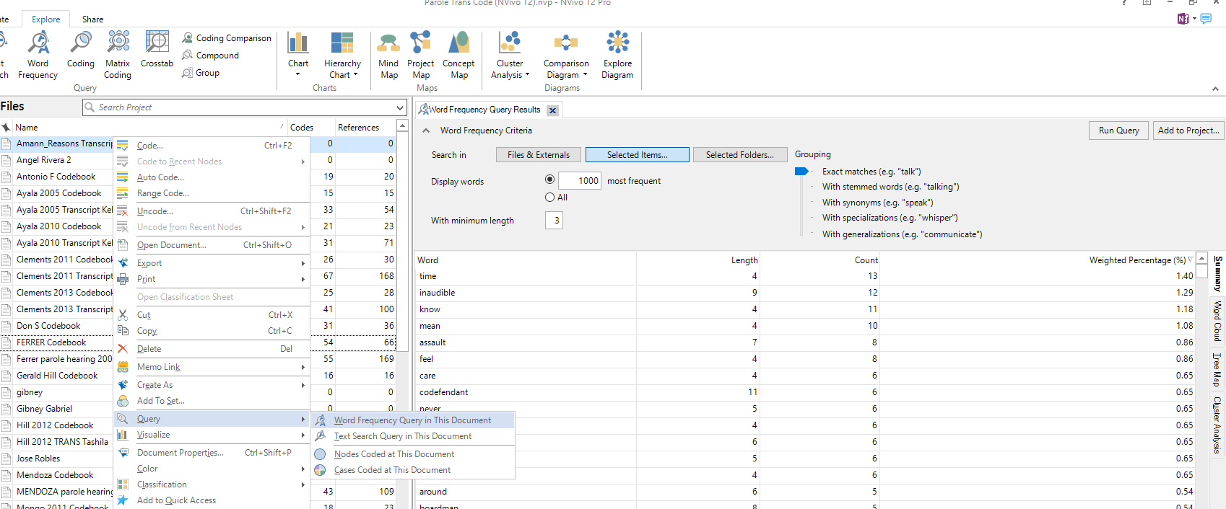
Word Frequency Example (Windows)
“Query” can be found in the “Explore” Tab
Alternatively, you can Command/Control+click on a file and select “Query”
To query multiple items, select the items you would like to query in the “Selected Items” tab and then click “Run Query”
Notes:
Garrett

Slide 29
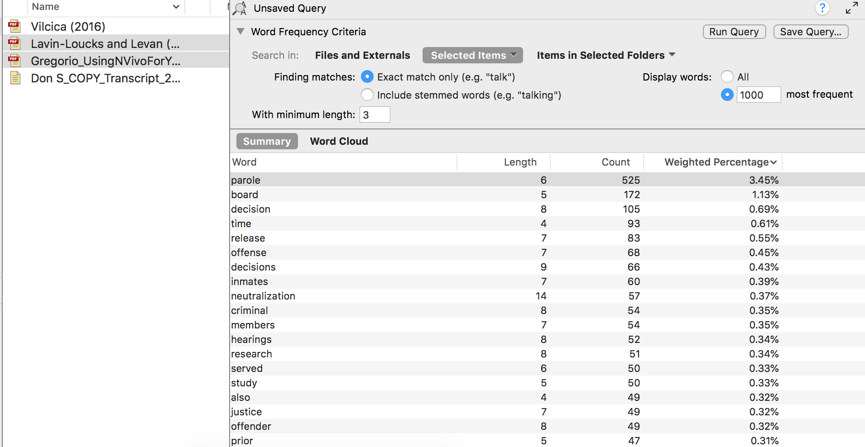
Word Frequency Example (Mac)
Select the items you would like to query in the “Selected Items” tab and then click “Run Query”
Notes:
Cara

Slide 30
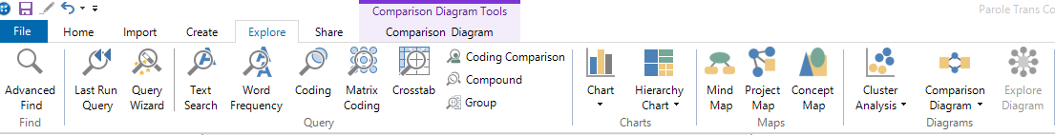
Exploring Codes (Windows)
Chart: bar chart of the number of times codes were used in a file Hierarchy chart: visualizes number of codes used in a file Explore Diagram: explore the codes used in a file Comparison Diagram: compare the nodes used in multiple files
Notes:
Garrett

Slide 31
Qualitative Coding is about Interpretation and Arguments
The nodes you create are arguments themselves; you are choosing what information you value and want to extract from the transcripts
Notes:
Cara

Slide 32
Thank you!
If you have any questions, contact DITI at nulab.info@gmail.com
Sign up for DITI office hours! https://calendly.com/diti-nu
Taught by:
Developed by: Yana Mommadova, Tieanna Graphenreed, Emre Tapan and Dipa Desai, DITI/NULab Fellows
DITI/NULab Fellows
Slides, handouts, and data available at: Update bitly link here

