Slide 1
Introduction to Twine:
Narrative and Storyboarding
Taught By Kasya O’Connor Grant & Claire Lavarreda
ENGW3302: Advanced Writing in the Sciences
Dr. Philip Gilreath
Spring 2024
Feel free to ask questions at any point during the presentation!

Slide 2
Workshop Agenda
Workshop objectives
What is Twine?
Important vocabulary and functions
Twine Demonstration
Hands-on activity
Link to module materials: https://bit.ly/sp24-gilreath-twine

Slide 3
Workshop Objectives
In today’s workshop, we will learn:
The key functions of Twine as they relate to this class
Twine-specific vocabulary to aid independent work
How Twine can be used for storytelling and storyboarding

Slide 4
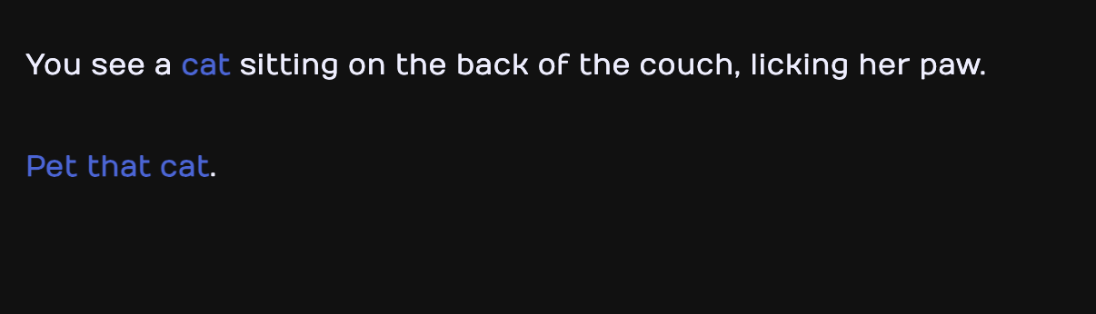
Twine Example
Cat Petting Simulator 2014 - nenongrey

Slide 5
What is Twine?
Twine is a narrative tool that is open-source and free to use.
Through a combination of passages (individual portions of text) and links (connections between passages), Twine allows users to create interactive narratives that are not restricted to the linear form. It publishes to HTML and can therefore be included on a variety of platforms in order to showcase your work.
Twine is particularly useful for the following projects:
‘Choose-your-own-adventure’ storytelling
Storyboarding as a means of project-planning

Slide 6
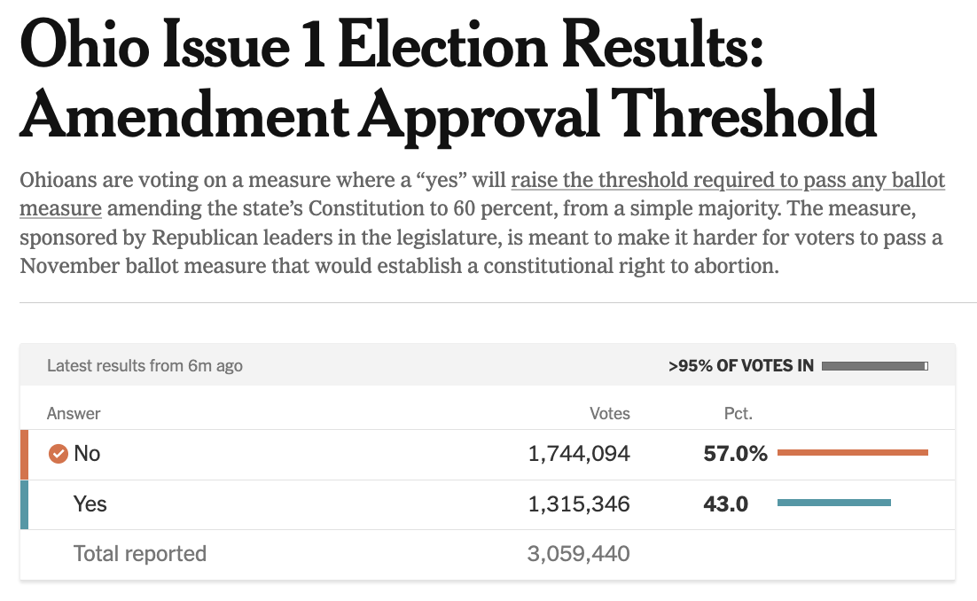
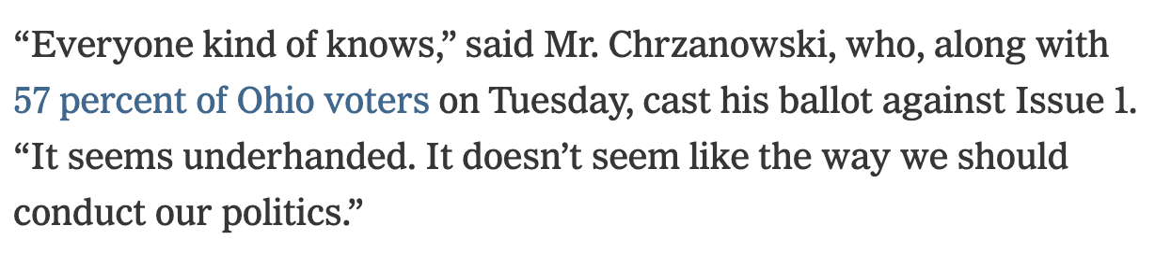
Twine Vocabulary
Twine functions through the use of hypertext, a digital text that is connected to other digital texts through links.
You come across hypertext all the time in your daily online activities.
From “Why Ohio Voters Said No To Ballot Measure” - Campbell Robertson, NYTimes

Slide 7
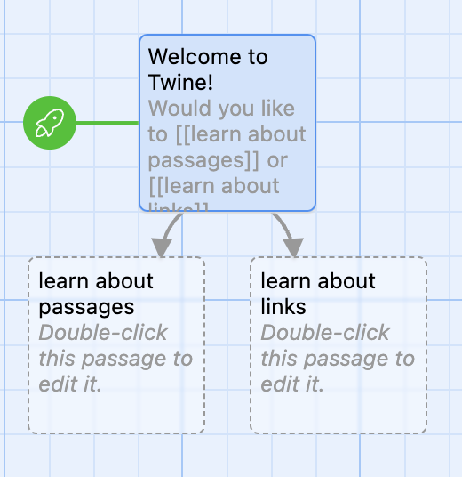
Twine Vocabulary
Twine narratives are called stories and are made up of passages (individual portions of text) and links (the connections between passages).
These are passages.
This is a link.

Slide 8
How are stories, passages, and links used?

Slide 9
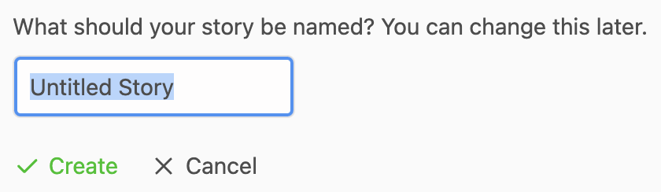
Twine Stories
When beginning a project on Twine, you will be asked to create a story. These can be titled in whatever way you prefer. In order to create a new project, navigate to the top left of the page and click on ‘+ New’.

Slide 10
Twine Passages
Twine stories are organized around passages, or individual portions of text that the user navigates through.
When used as a means of storytelling, these can be thought of as distinct pieces of dialogue, plot points, arguments, etc.
When used as a means of storyboarding/planning, these can be thought of divisions of time, priority, or sequence.

Slide 11
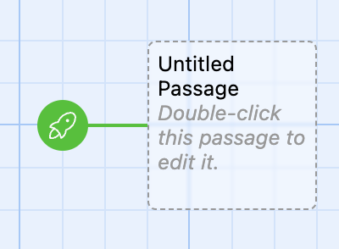
Twine Passages
When you open your story there will already be an untitled passage on your board. Double-click this passage box in order to edit it.

Slide 12
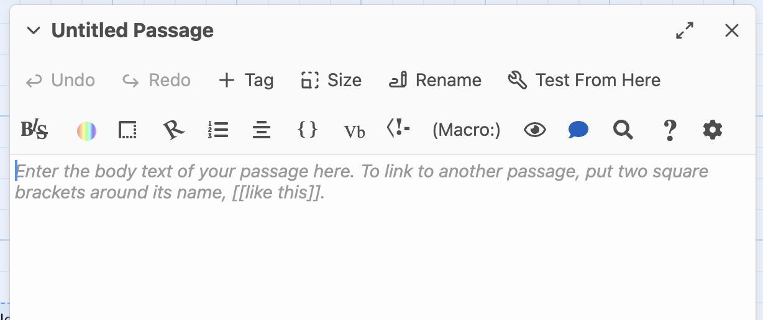
Twine Passages
Once you do click on the passage, a box will appear where you can edit the name and content of the passage.

Slide 13
Twine Links
Twine passages are connected by links, which allow the user to move from one passage to another. A passage can be linked to a single other passage, or it can be linked to several, allowing the user to choose where they go next.
For example, this passage has two links:

Slide 14
Creating Twine Links
If you would like your user to go directly from one specific passage to another, you can create one link. If you would like your user to have a choice of where they will go next, you can create multiple links.
To create a link, double-click the passage you would like to link from. Within the body text, add double brackets around the text you wish to link to the next passage. For example:
Welcome to Twine! Would you like to [[learn about passages]] or [[learn about links]]?
Twine will then automatically create two new passages (titled whatever is within your brackets) and link to these.

Slide 15
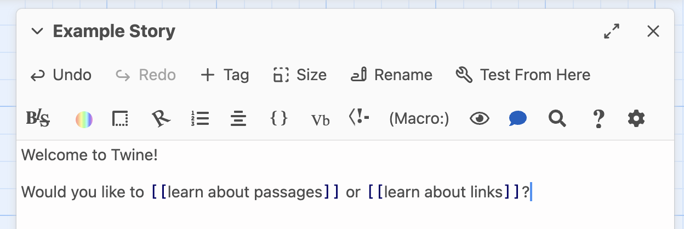
Creating Twine Links

Slide 16
Desktop App vs. Browser
Twine can be freely downloaded to your personal computer and used as an application. This allows you to save your work directly to your device and allows you to work on projects without internet.
Twine can also be used online in your browser. While this is an attractive option if you are concerned about your device’s storage, it is not a good option if you are hoping to work on your project over multiple sessions as the browser platform does not save your work on their server. Rather, it saves it on your personal browser cache which can lead to accidental deleting of a project.
For this reason, we recommend you download Twine here: https://twinery.org/.
Notes:
NVivo is a software originally built for qualitative coding that has multiple types of text analysis formats, including qualitative coding, annotating, storing information, labeling the overall files, doing basic text analysis visualizations like word counts, and more.

Slide 17
Demonstration of Tool
Together we are going to practice creating a simple interactive game about starting your undergraduate degree at Northeastern.
What are some mistakes you made when you first arrived at Northeastern? What is some advice you wish you’d known?
Link to jamboard: http://bit.ly/gilreath-twine-jamboard

Slide 18
Your Turn
Using the following excerpt, practice:
Starting a story
Creating passages
Linking passages

Slide 19
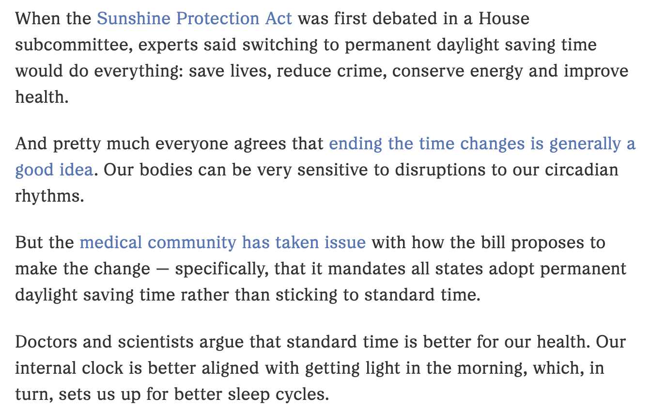
From “What to know about the political debate around daylight saving time” - Emily Olson

Slide 20
Group Discussion
What did you find surprising or interesting in your exploration of the tool?
How does Twine help you rethink your choices around narrative structure?
What are some challenges you faced? How might you work with these as you move forward?

Slide 21
Thank you!
For more information on the DITI, please see: https://bit.ly/diti-about
Schedule an appointment with us! https://bit.ly/diti-meeting
If you have any questions, contact us at: nulab.info@gmail.com
We'd love your feedback! Please fill out a short survey here: https://bit.ly/diti-feedback

