Slide 1
Excel or R: which tool for which job
A practical guide to picking the right tool for a task — and to using the two together, which is what most real projects actually do.
ECON 3291: Development Economics • Professor Silvia Prina
Taught by Sean P. Rogers · DITI Research and Teaching Fellows
Fall 2026

Slide 2
What this module is for
O V E R V I E W
2
You can already do the work in both. This is about deciding which one to open.
Choose
match the tool to the job, and say why
Combine
use them together in one workflow
Translate
look up how to do a task in either
The honest answer is rarely “always use R”. It is “use the one that fits this job”, and quite often the answer is to use both, in a particular order.

Slide 3
The short version
P A R T 1 O F 5
3
If you remember one slide, make it the next one.

Slide 4
Which tool, when
T H E S H O R T V E R S I O N
4
Match the job to the tool. Most decisions are already covered here.
If the job is… | Reach for | Because
A styled deliverable — a formatted sheet someone will read — and simple analysis | Excel | The formatting is the product, and the stats are not the hard part
Statistical testing over thousands of rows of CSV, with no styling needed | R | Scale, real test output, and a record of what you ran
Getting to know a dataset you have never opened before | Excel first | Look at it before you trust it — names, types, blanks, quirks
Cleaning messy data | Both | Eyeball and fix oddities in Excel, automate rules in R
Anything you will re-run, or hand to someone who must check it | R | The script is the record of what you actually did

Slide 5
Five situations
P A R T 2 O F 5
5
Concrete cases, with a recommendation and the reasoning.

Slide 6
You need to hand over a polished spreadsheet
F I V E S I T U A T I O N S
6
EXCEL
The deliverable is a formatted sheet, and the analysis is straightforward.
• The formatting is not decoration — it is the product. Conditional colours, frozen headers, column widths and a print layout are the job.
• The statistics are means, counts, shares, maybe a simple regression. Nothing Excel struggles with.
• Whoever receives it will open it, click into cells, and change numbers themselves.
• Producing this from R means writing styling code to recreate what you can do by hand in minutes.
Doing it in R and exporting to .xlsx is possible — but only worth it if you will remake the same sheet repeatedly.

Slide 7
Statistical testing over thousands of rows
F I V E S I T U A T I O N S
7
R
Large CSV, real tests, and nobody needs it to look like a spreadsheet.
• Excel slows down, and its row limit is a real ceiling. R does not care about the size.
• You get proper test output — coefficients, standard errors, t, p and intervals — without computing anything by hand.
• Anything past simple OLS is either awkward or absent in Excel.
• Re-running on a new extract is one command, not an afternoon of re-pointing formulas.
This is the case where the gap is largest. If the output is a number in a paper rather than a cell in a sheet, use R.

Slide 8
You have never opened this dataset before
F I V E S I T U A T I O N S
8
EXCEL FIRST
Look at the raw file before you point any code at it.
• Read the actual column names. They are often abbreviated, inconsistent, or not what the documentation claims.
• Check what one row represents, and whether an ID repeats.
• Scan for the quirks that break an import: merged cells, a title row above the headers, blank rows, text in a numeric column, trailing spaces.
• Then load it into R knowing what you are getting, instead of debugging a silent failure later.
A column that reads as text because three cells contain “n/a” will produce wrong answers in either tool. Excel shows you that in seconds.

Slide 9
The data is messy and needs cleaning
F I V E S I T U A T I O N S
9
BOTH
Split the work: eyeball and fix in Excel, automate the rules in R.
• Excel is better for the irregular things — a handful of typos, one stray value, a column that needs looking at to understand.
• R is better for anything with a rule: recode every value matching a pattern, fix all the dates, drop every row failing a condition.
• The test is whether you can state the fix as a rule. If you can, write it down in R. If it is genuinely one-off, fix it by hand.
• Record the hand-fixes somewhere, or your cleaned file becomes impossible to reproduce.
Keep the raw file untouched. Clean into a copy, always.

Slide 10
You will run this again, or someone must check it
F I V E S I T U A T I O N S
10
R
Repetition and scrutiny are what scripts are for.
• A problem set repeats similar operations on the same data all semester. Write it once.
• When the data is corrected in week 9, you change one line and re-run everything.
• A grader, co-author or reviewer can read exactly what you did, in order.
• In six weeks you will not remember whether you filtered to the baseline round. The script will.

Slide 11
Using them together
P A R T 3 O F 5
11
The order matters more than the choice.

Slide 12
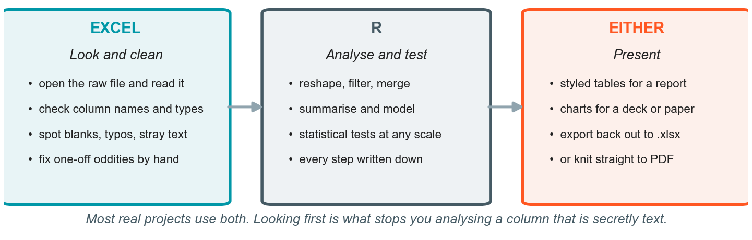
A workflow that uses both
U S I N G T H E M T O G E T H E R
12
This is what most real projects look like — not one tool, but a sequence.

Slide 13
Handing data between them
U S I N G T H E M T O G E T H E R
13
Moving in either direction is a single line.
# Excel → R
library(readxl)
df <- read_excel("data.xlsx", sheet = 1) # straight from .xlsx
df <- read.csv("data.csv") # or save as CSV first
# R → Excel
write.csv(results, "results.csv", row.names = FALSE)
writexl::write_xlsx(results, "results.xlsx") # keeps it as a real workbook
R
Prefer CSV in between
CSV is the safe interchange format: no formulas, no formatting, no surprises. Save as CSV whenever a file has to cross between tools.

Slide 14
Things that break on the way across
U S I N G T H E M T O G E T H E R
14
Five failures that account for most bad imports. All five are visible in Excel.
What breaks | How it shows up | What to do
Dates | numbers where you expected dates, or the wrong century | check every date column immediately after import
Leading zeros in IDs | 00123 arrives as 123, and your merge silently loses rows | read the ID column as text
Merged cells, title rows | the header ends up as data, column names become X1, X2 | delete them before exporting
Text in a numeric column | the whole column imports as text, so mean() fails | find the stray “n/a” or space
Unquoted commas | fields split across columns, row lengths differ | export CSV with quoting on
Every one of these is obvious in thirty seconds of looking, and invisible if you go straight to code.

Slide 15
Reference: how you do it in each
P A R T 4 O F 5
15
Keep these five slides. They are the fastest way to translate when you are stuck.

Slide 16
Loading and looking
R E F E R E N C E : H O W Y O U D O I T I N E A C H
16
The first three things you do with any dataset.
Task | Excel | R
Open the data | File → Open | df <- read.csv(path)
How many rows? | =COUNTA(A2:A551) | nrow(df)
What are the columns? | read row 1 | names(df) / str(df)
Look at the top | scroll | head(df)
Describe everything | a grid of formulas | summary(df)

Slide 17
Describing a variable
R E F E R E N C E : H O W Y O U D O I T I N E A C H
17
Excel does one statistic per formula; R can do the whole table in one call.
Task | Excel | R
Mean / median | =AVERAGE(r) / =MEDIAN(r) | mean(x) / median(x)
Std. deviation | =STDEV.S(r) | sd(x)
Minimum / maximum | =MIN(r) / =MAX(r) | min(x) / max(x)
Several variables | fill the formulas across | sapply(df[vars], ...)

Slide 18
Counting and subsetting
R E F E R E N C E : H O W Y O U D O I T I N E A C H
18
Both tools make you be explicit about rows versus entities.
Task | Excel | R
Count rows | =COUNTA(A2:A551) | nrow(df)
Count distinct entities | =SUMPRODUCT(1/COUNTIF(r,r)) | length(unique(df$id))
Rows meeting a rule | =COUNTIFS($E:$E,1) | sum(df$g == 1)
Proportion meeting it | =COUNTIFS(...)/COUNTA(...) | mean(df$g == 1)
Keep a subset | Filter, then copy visible rows to a new tab | base <- df[df$round == 0, ]

Slide 19
Creating and comparing
R E F E R E N C E : H O W Y O U D O I T I N E A C H
19
One formula filled down, versus one statement applied to a whole column.
Task | Excel | R
New indicator | =IF(I2<=750,1,0) then fill down | df$e <- ifelse(df$p <= 750, 1, 0)
Conditional mean | =AVERAGEIFS(D:D,$B:$B,0) | mean(base$hhe)
Means by group | one AVERAGEIFS per cell | group_by(g) %>% summarise(mean(x))
Cross-tabulate | PivotTable, or a COUNTIFS grid | table(df$a, df$b)

Slide 20
Relationships and models
R E F E R E N C E : H O W Y O U D O I T I N E A C H
20
The gap widens as the task gets more statistical.
Task | Excel | R
Scatter plot | select → Insert → Scatter | ggplot(d, aes(x, y)) + geom_point()
Correlation | =CORREL(r1, r2) | cor(x, y)
Correlation on a subset | filter, copy visible rows to a new sheet, then CORREL | cor(base$x, base$y)
Regression | =LINEST(y, X, TRUE, TRUE) | lm(y ~ x, data = d)
Add a control | rearrange into adjacent columns | lm(y ~ x + z, data = d)
Read the result | count across a grid, backwards | summary(m)

Slide 21
Why the regression output is not equally readable
R E F E R E N C E : H O W Y O U D O I T I N E A C H
21
LINEST returns
An unlabelled block of numbers.
Coefficients in reverse column order.
The intercept last, not first.
No t-statistics and no p-values.
#N/A padding in the unused cells.
summary() returns
A labelled table, one row per variable.
In the order you wrote the formula.
The intercept clearly named.
t and p computed for you.
Fit statistics underneath.
Same model, same coefficients. The difference is how easy each is to misread.

Slide 22
One argument worth making
P A R T 5 O F 5
22
Choose on fit, not on loyalty — but know what each one hides.

Slide 23
Three errors a spreadsheet will not catch
O N E A R G U M E N T W O R T H M A K I N G
23
These are the characteristic failure modes. All three produce a plausible-looking number.
The error | What it looks like | Why nothing warns you
Off-by-one column | You point at the column beside the one you meant | The formula is valid and returns a real number
Rows counted as entities | A panel counted once per period, not once per unit | COUNTIF is doing exactly what you asked
Hand transcription | A number retyped into a write-up or a table | Nothing links the copy back to the source
This is not hypothetical
All three have appeared in published materials for this exercise, including this course's.

Slide 24
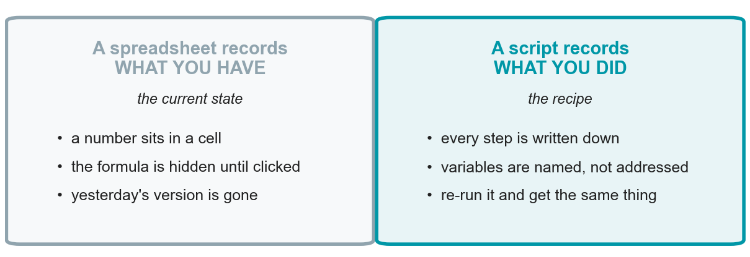
State versus recipe
O N E A R G U M E N T W O R T H M A K I N G
24
This is the real difference, and it is what should tip a borderline decision.
When a number looks wrong, a spreadsheet leaves you guessing and a script tells you.

Slide 25
The honest costs of each
O N E A R G U M E N T W O R T H M A K I N G
25
Excel costs you
No record of what you did, only what you have.
Errors that look identical to correct work.
Rework whenever the data changes.
A hard ceiling on size and on method.
R costs you
A slower first hour, and unhelpful error messages.
You cannot see your data unless you ask to.
Styling output takes real effort.
Colab times out; packages shift under you.
Neither list is a reason to avoid a tool. Both are reasons to pick deliberately.

Slide 26
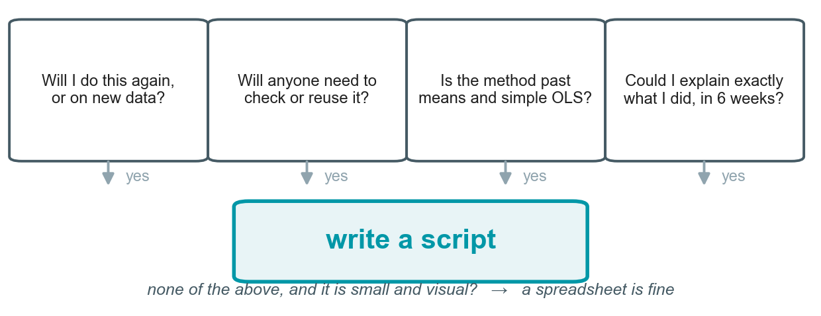
When it is a close call
O N E A R G U M E N T W O R T H M A K I N G
26
Four questions. A yes to any one of them tips it towards writing a script.

Slide 27
Where to go from here
O N E A R G U M E N T W O R T H M A K I N G
27
Four habits worth carrying out of this session.
Look first
open any new dataset in Excel before you analyse it, whatever you plan to use
Script the repeat
if you will run it twice, write it down the first time
Cross-check
do the work in R, verify a number or two in Excel — disagreement is informative
Keep the tables
the which-tool-when slide and the five reference slides are the usable part
When the two disagree, find out which is wrong before assuming it is R.

Slide 28
Thank you!
Developed by Sean P. Rogers, DITI Research and Teaching Fellows
All materials: https://github.com/NULabNortheastern/digitalassignmentshowcase/tree/main/coding_quantitative/fa26-prina-econ3291-excel_r
Please fill out this survey to give us feedback: https://bit.ly/diti-feedback
For more information on DITI, please see: https://bit.ly/diti-about
Schedule an appointment with us! https://bit.ly/diti-meeting
If you have any questions, contact us at: nulab.info@gmail.com

