Slide 1
Introduction to Recording and Editing Audio with Audacity
Taught by: Hunter Moskowitz & Kasya O’Connor Grant
Spanish
Prof. Laura Acosta-Ortega
Fall 2023
Feel free to ask questions at any point during the presentation!

Slide 2
Objectives
Understand podcast anatomy
Learn best practices for audio recording
Learn about and explore Audacity as a podcast editing tool
Learn how to:
Record audio
Clip audio
Add/move/delete tracks
Add sound effects and/or background music
Save and export projects
Slides and handouts available at:

Slide 3
Podcast Anatomy

Slide 4
Podcasts
Podcasts typically begin with an opening segment of 10–30 seconds of music and audio wherein the creator identifies the podcast title, host, and episode topic—this creates a trademark/signature and indicates to the listener that the podcast is about to begin. Be as creative as you want!
Notes:
*Consider the emotions and perceptions sounds evoke in listeners when choosing music and sound effects for your intro (spooky violins, dramatic horns, happy guitars, etc.)

Slide 5
Podcast Anatomy: Intro/Opening Segment
Intros/Opening segments are listeners’ first impressions of a podcast. From the opening segment alone, listeners make assumptions about the podcast’s Audience, Genre, Style, and overall Structure.
This means that within a short span of time, the podcast’s opening segment must accomplish several goals like:
Grabbing attention: several successful podcasts set the tone using Media (e.g., theme song music, sound effects, archival audio clips)
Identifying an audience: Acknowledging/naming people who might be interested
Establishing listener expectations: Explaining the goal and theme of the podcast

Slide 6
Podcast Anatomy: The Body
Your podcast should have an argument or perspective, not just a recitation of facts. Try to keep your tone persuasive and conversational. Like any good piece of reporting, your podcast should be organized and rehearsed ahead of time. Do your research and have your script written before you start recording; know how your show is laid out and how much time you have.
Write out large numbers and/or complicated words/names out phonetically (twenty-two thousand and thirty-four vs. 22,034)
Mark out spaces in the script for pauses, sound clips/effects, transitions between topics, etc.
Notes:
interviewing-specific podcasting - CT
https://www.podcast.co/create/tips-for-better-podcast-interviews

Slide 7
Podcast Anatomy: The Outro
Podcasts typically end with a closing segment of 10–30 seconds of music and audio acknowledging the creator names the creator(s), institutional affiliation, and audio/production credits, and acknowledgments including people whose work or advice has significantly influenced or contributed to the episode.
An outro script for your class might sound something like “This podcast was made by [student name]...opening music created by [artist name], sound effects taken from [repository name]... with special thanks to [name] for their contribution.” It may also include outro music.
As in your opening segment, you can use music and sound effects to make your closing segment dynamic and interesting.

Slide 8
Best Practices for Podcasting

Slide 9
General Best Practices
Test your mic and technology before you start.
Record some test audio and play it back before you begin.
Have a plan for the conversation and transitions.
Give yourself a script. As you record, mark out spaces for transitions in the recording (topic-to-topic, parts of the episode).
Don’t panic over filler words (e.g., um, uh, yeah, like). Edit these out later.
Prepare phonetic pronunciations for names, long numbers, and complicated terminology. This is particularly important for recording in a language that you may be less familiar with.
Include transcripts for accessibility (use software like Otter AI).
Use open access media/music (Free Music Archive, YouTube)
Notes:
-Enabling Live Transcription or Closed Captions in Zoom prior to the interview. This can be done through the Zoom web portal.

Slide 10
Environmental Considerations
Ideally, find a room with good sound absorption to prevent the “echo effect”
Yes: carpet, cushions, bookshelves, clothes (bedrooms, closets)
No: larger spaces with hard, smooth surfaces (kitchens, bathrooms)
Consider: Does the room have an echo? Hard floors/countertops/stainless steel surfaces?
Put some distance between yourself and the microphone (depending on your equipment).
Being too close can make the audio too loud or garble sound as you speak. If you are positioned too far away the audio will be too quiet or too muffled to salvage.
Stay hydrated!
Keep a drink nearby (water, juice, etc.) to soothe your throat and keep it relaxed.
Notes:
Carpets, Curtains, Bedding, and Wooden furniture (like full bookshelves) are great for sound absorption.
Typically, you can save some audio that’s too loud. It’s more difficult to save audio that’s too quiet. But the best practice is to find a position that feels comfortable for you! Practice recording a phrase at different distances and play it back to help find the right position.

Slide 11
Recording Considerations for Interviews
Remote Recording (via Skype, Zoom).
If you record via Zoom, save your recording to your computer not the cloud.
Ease in to recording with low-stakes conversation
Interviews are like playing catch. Start with questions that allow everyone to get comfortable. Be yourself!
Don’t rush, and know you can start over
You don’t need to get everything in a single take, and you won’t use all the audio that you record. So don’t be afraid to pause frequently and remember you can start over (or cut something altogether!)
Notes:
Recording Considerations:
-Options for transcription in case you accidentally saved recording to cloud or forgot to turn on Live Transcription:
-Automatic transcription and downloading via web portal for Cloud Recordings
-Free transcription of thirty-minute segments in OtterAI
Some softball questions:
How was your week? What were the highlights?
Any weekend plans?
What did you have for breakfast

Slide 12
Making Podcasts: Audacity

Slide 13
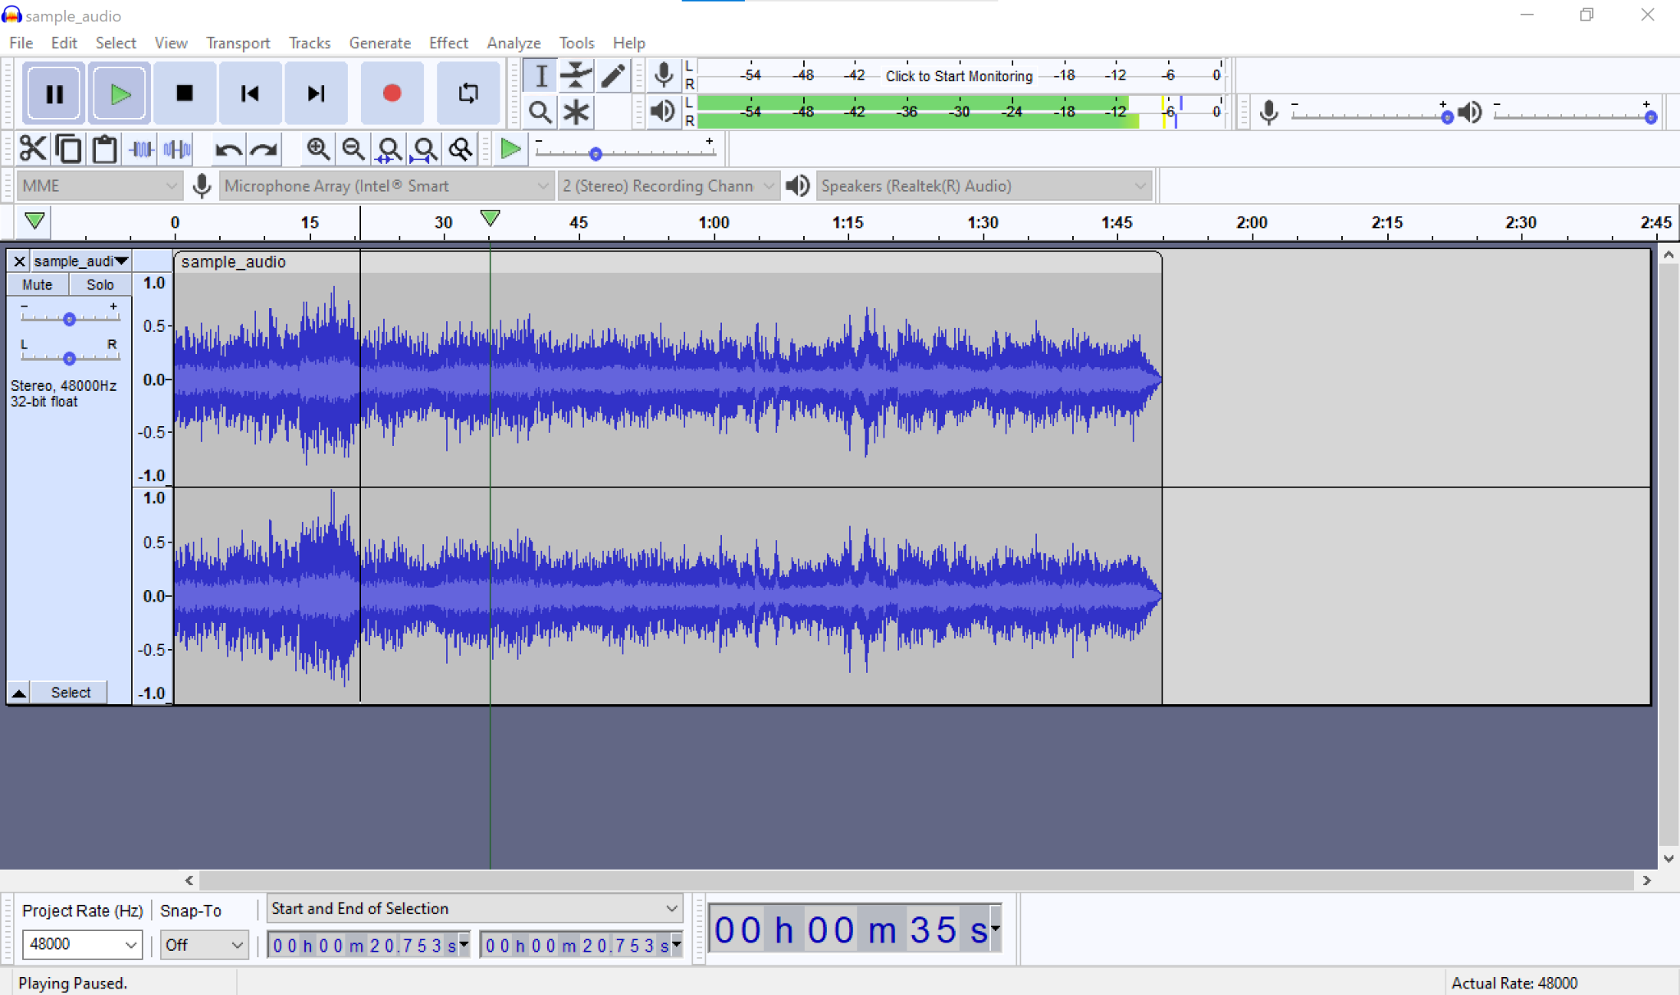


What is Audacity?
Audacity is a free, easy-to-use, multi-track audio editor and one of the more popular free audio editors used for creating podcasts.
(Multi-track: the ability to have different layers of audio in one clip.)

Slide 14
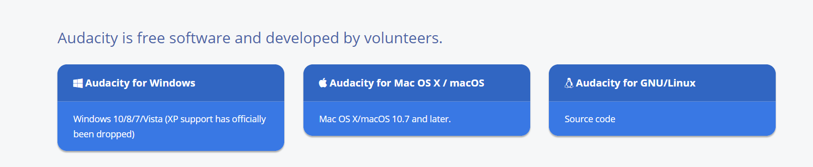
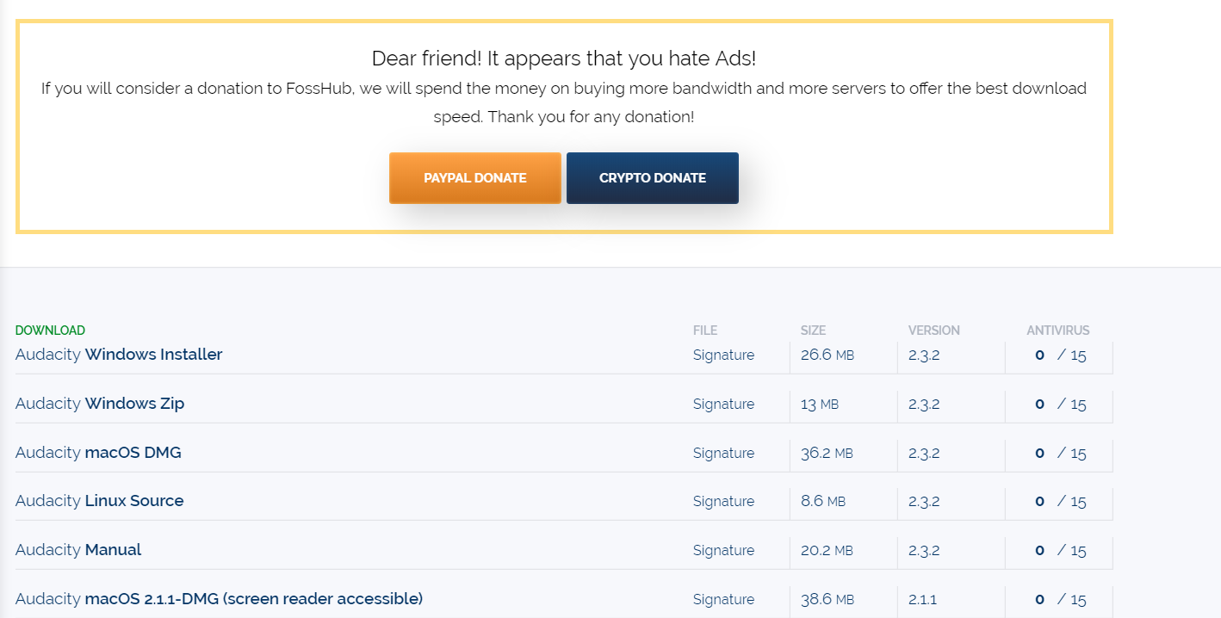
Downloading Audacity
https://www.audacityteam.org/ --- Audacity is platform-agnostic!
Choose if you want it for Windows, Mac, or Linux.
For PC users: download Windows Installer
For Mac users: download MacOS.dmg
Notes:
They should already have it downloaded, but just in case

Slide 15
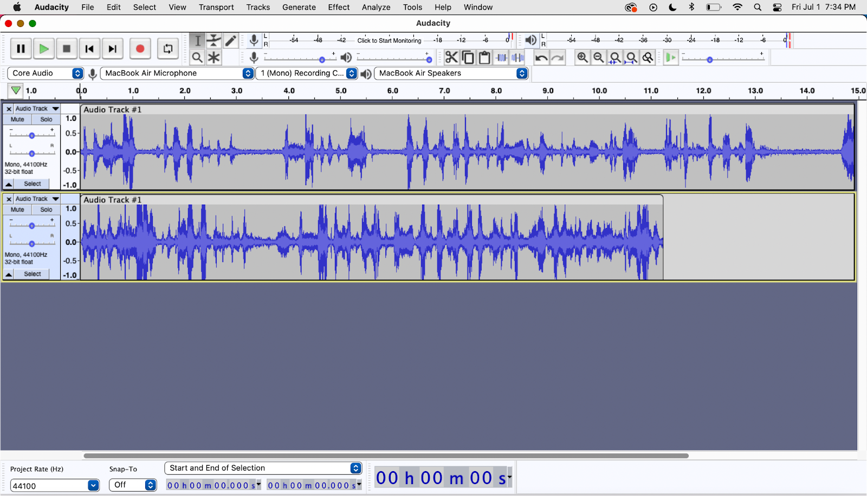
Anatomy of Audacity
Main buttons (L-R): pause, play, stop, fast-forward/
backward, record
Microphone, volume, input, and output
Recordings (audio tracks) will display in this window here.
Editing, saving, effects, transporting or exporting the recording.
Output Volume Level Monitor: shows the loudness of each track in real-time
Tip: try for -12 to -6db
Other Audacity tools
https://manual.audacityteam.org/

Slide 16
Key Terms
Track: a single audio channel or stream.
Multi-track: an audio recording or chanel with more than one track or recording of sound.
Clipping: splitting audio into separate sections—that is, making “clips”
Waveform: the curve within a track showing the duration and volume of individual sounds
Mixing: the process of audio production, or mixing tracks of recordings, music, and other desired media.
MP3 File: the most generally used audio file format. Others include .wav and .mp4.
Feel free to ask questions at any point during the presentation!

Slide 17
Basics: Audacity & Recording Audio

Slide 18
Getting Started: Tips for Recording Audio
Know where your microphone is located and keep it clear of papers/other objects
Use headphones when recording and editing
After you finish editing, listen to the file without headphones to see where the audio is too loud/quiet when played in a space.
Take ambient noise into consideration
A/C units, refrigerators, traffic, pets, roommates, loud clothing, etc.
Save frequently. Audacity does not autosave.
Notes:
After you finish recording, listen to the audio with and without headphones so that you can properly render the sound. Audio sounds different in an open spaces than it sounds inside your headphones.

Slide 19
Recording Audio cont’d.
Record test audio and adjust mic volume if necessary
Record a few seconds of silence at the start and end of each track
Begin way in advance, and do several takes
Editing often takes much longer than the recording itself!
Speak slowly, clearly, and conversationally
If you use too many “filler words” (um, like, so) you can always edit them out later. Stop recording and start again at the top of the sentence to avoid jarring sound cuts in post-production
Clarity is very important if learning a new language!
Notes:
Don’t be afraid to stop and start over if you mess up! You’ll save more time in the long run. You can pause between questions and give yourself a few seconds of silence to supplement your editing process.

Slide 20

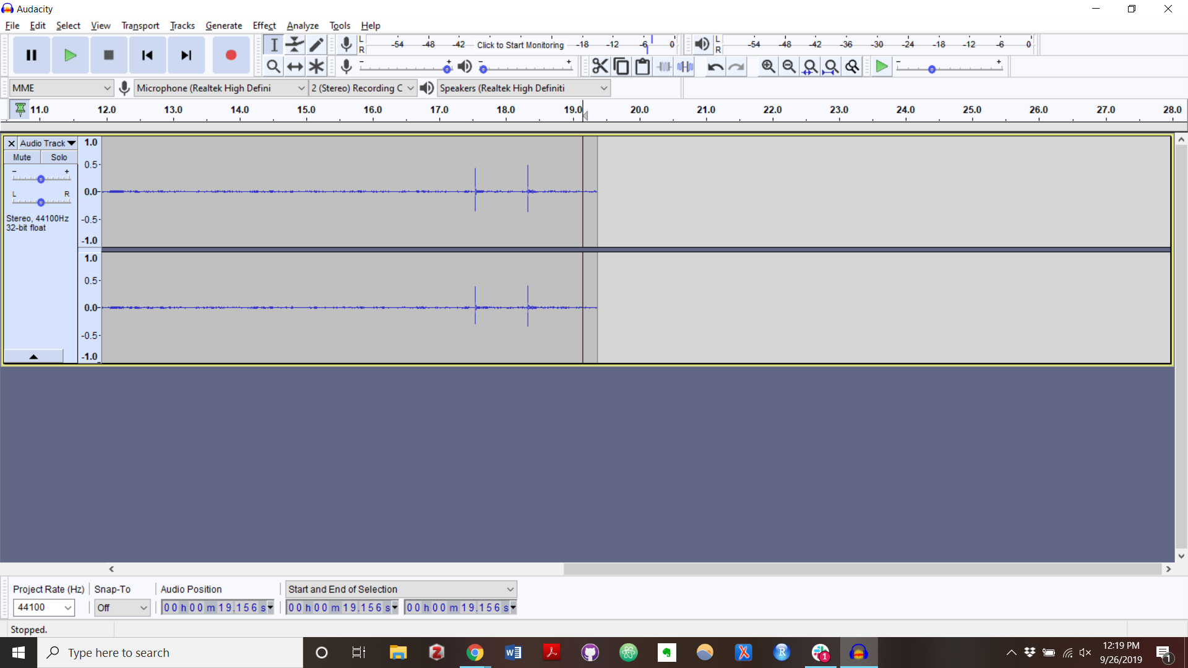

Recording
Make sure your microphone is working by checking to see that it’s selected in the microphone section of the screen. Each computer will have different microphones, so check your sound settings for your model.
To record, click the button with the red circle.
Hit the pause button to pause a recording.
Hit the stop button to stop recording.
Use Re-play to verify that the recording is the quality/ volume that you want.
Feel free to ask questions at any point during the presentation!

Slide 21
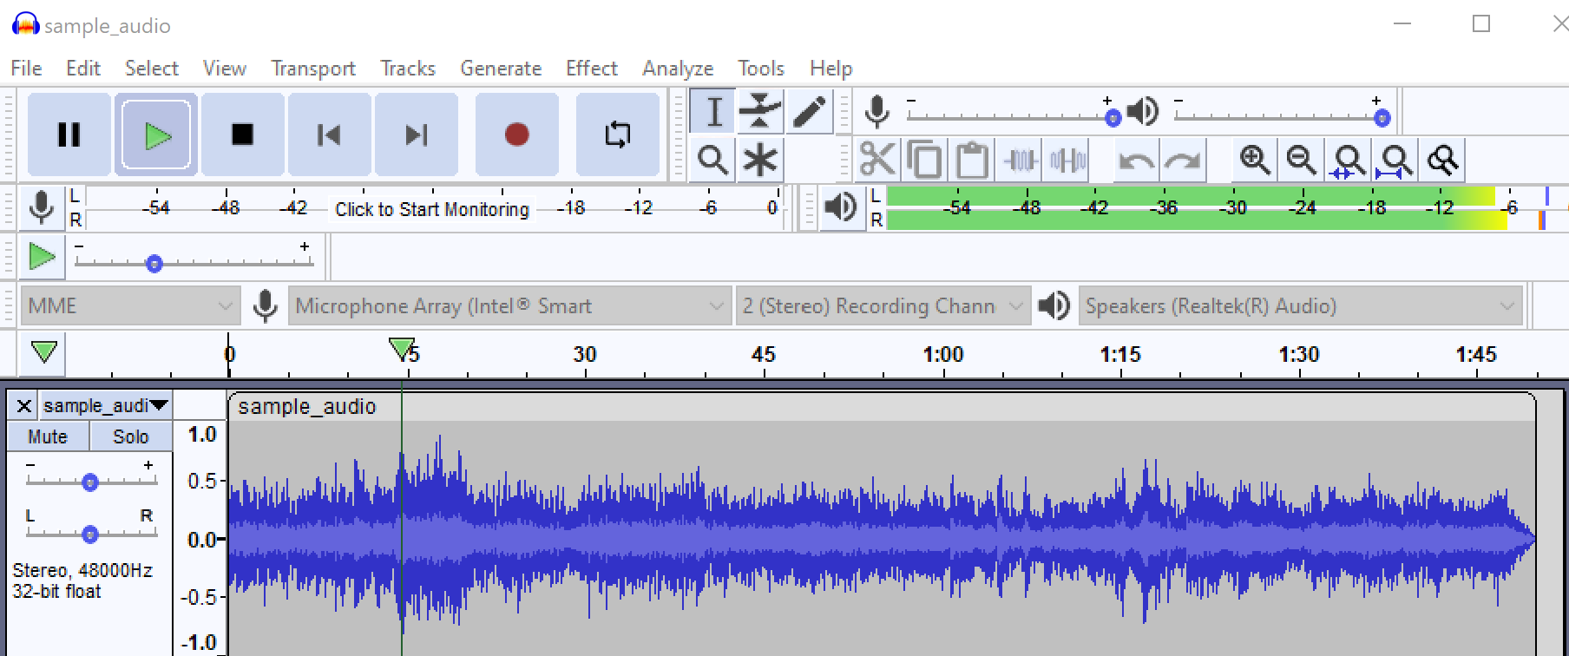
Checking volume
Keep an eye on the monitor when recording and playing back your audio—try to keep it in the green (literally).
If your volume is too loud, the monitor levels will turn yellow and red. Tracks that are too loud will have a blown-out effect when played back.
If one of your tracks is louder or softer than the others, you can adjust the volume on each track.
Tip: to hear one track without the others, you can mute the other tracks or click “solo”
Feel free to ask questions at any point during the presentation!
Notes:
You do want to be in the upper range of the green, ideally almost yellow however. Anything less will be extremely quiet compared with other audio you listen to on your computer.

Slide 22
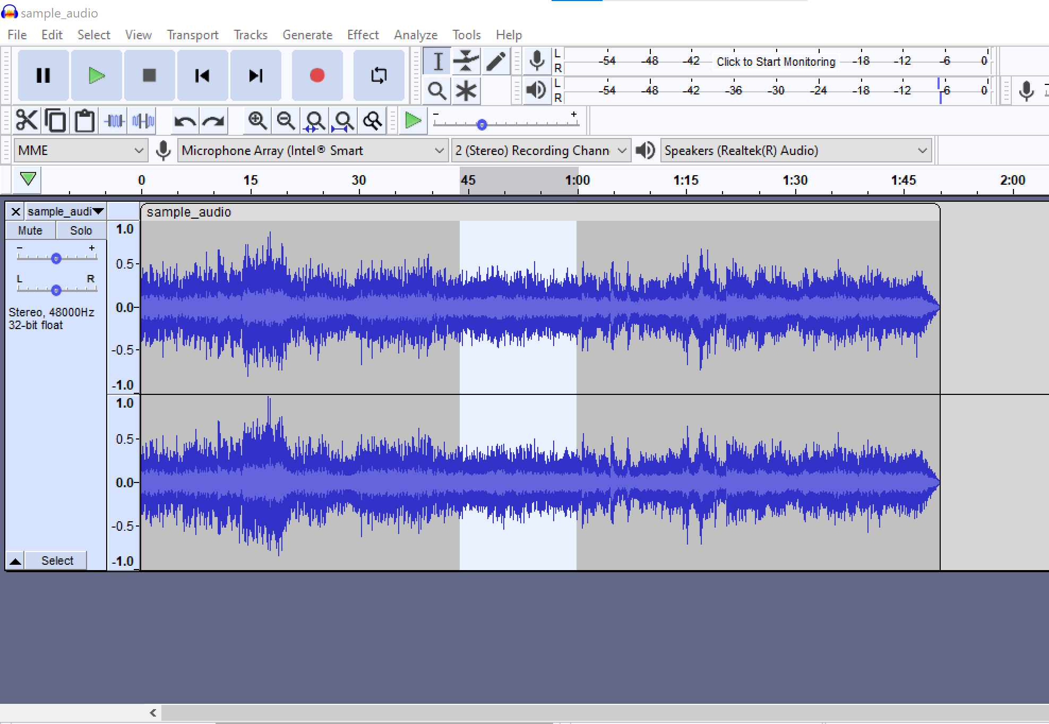
Moving Tracks
To move entire tracks or audio around in Audacity, you can click and drag them by hovering your mouse over the top of the clip.
Once you have selected the clip, click whatever clip or track you want to move and drag it into position.
Feel free to ask questions at any point during the presentation!

Slide 23
Basics: Audacity & Editing Audio
Notes:
Free Music Archive, YouTube

Slide 24
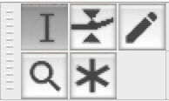
The Audacity Toolbar
The selection tool will be selected automatically when you open Audacity.
The most useful tool is the multitool, which allows you to use all the functions of the other tools without switching to them.
The selection tool function is the default.
Hover over the waveform borders to use the envelope tool function.
Use your trackpad to zoom.
Zoom in and left click to use the draw tool function.
Feel free to ask questions at any point during the presentation!

Slide 25
The Audacity Toolbar (Cont’d.)
The envelope tool allows you to smooth changes in volume by using control points at the top and bottom of the waveform.
Clicking on the blue border will create control points, which you can then move around to adjust the waveform envelope.
The zoom tool lets you zoom in and out of the waveform in order to make adjustments.
The draw tool allows you to manually redraw the waveform to change the volume or correct background noise.
You can only use the draw tool if you’ve zoomed into the waveform.
Feel free to ask questions at any point during the presentation!

Slide 26
Removing Parts of Tracks
Once you have recorded audio in Audacity, you can easily edit it. Here is how to remove sections using the Selection Tool (F1):
Click and drag with your cursor to select the portion your wish to remove.
Then, hit backspace or delete on your keyboard.
Tip: you can zoom in and out with the Zoom Tool (F4) to better see what you’re trying to delete.
Feel free to ask questions at any point during the presentation!

Slide 27
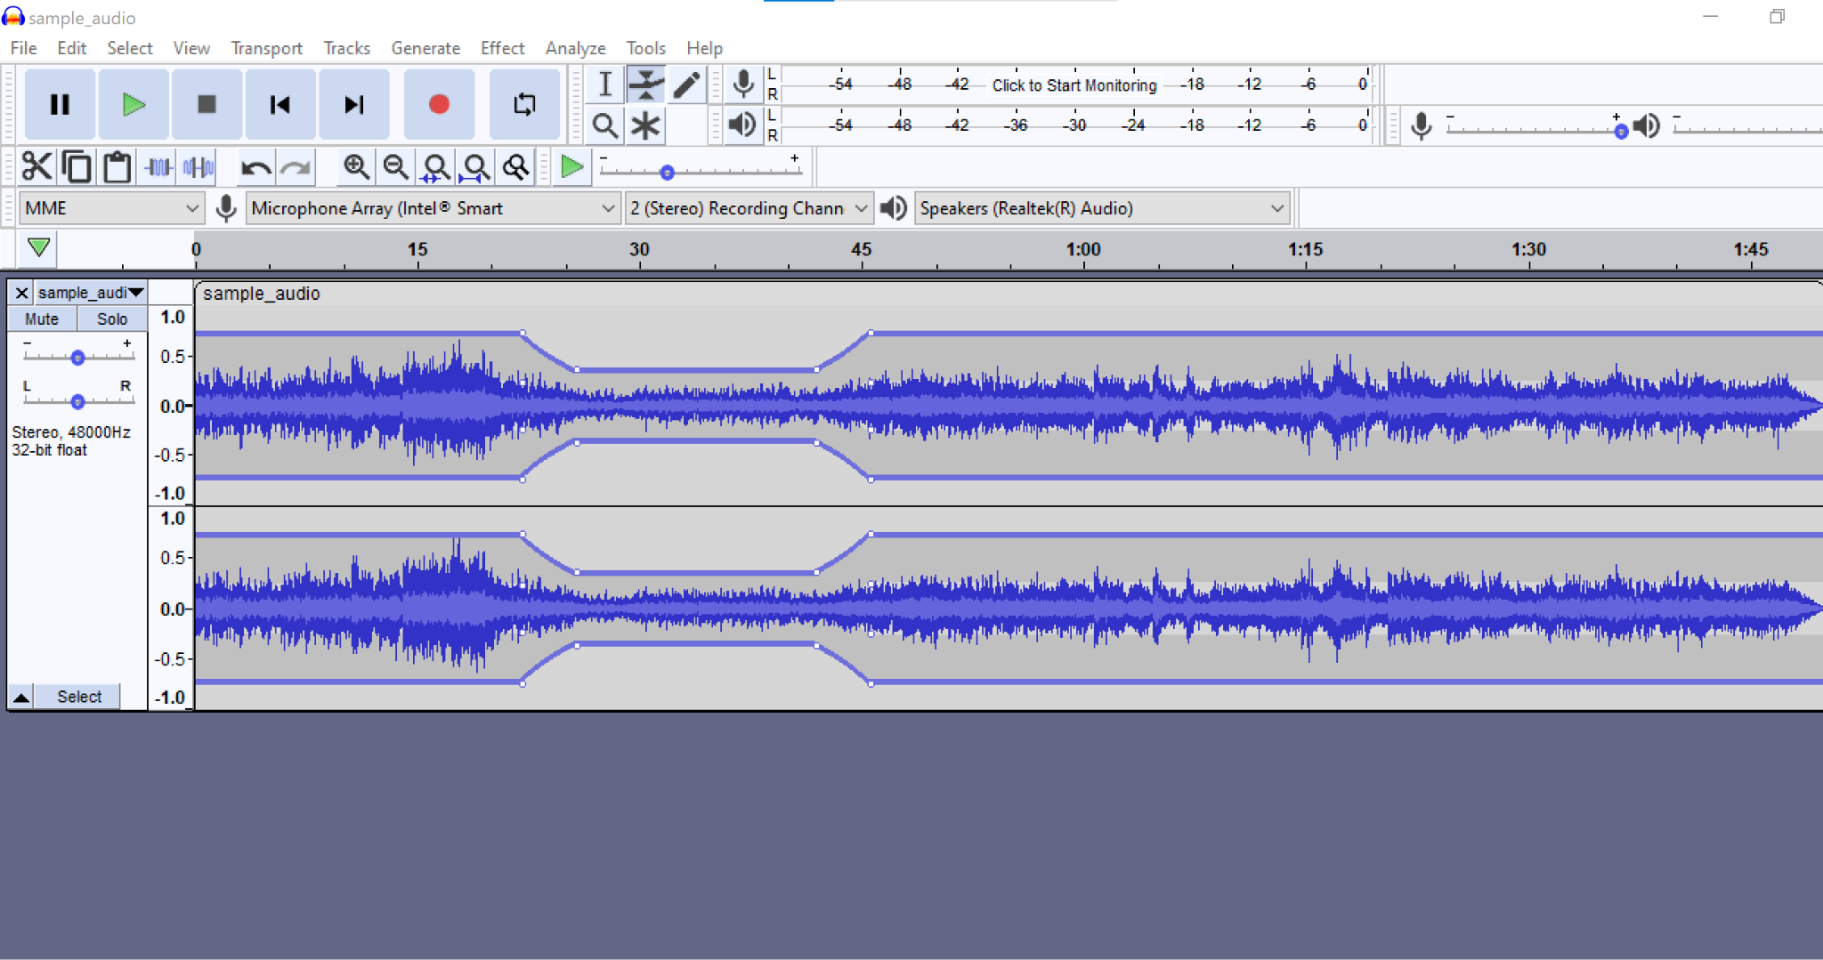
Fading In/Out
To fade music in and out on Audacity, use the Envelope Tool (F2). Two yellow bars will show up on each track.
Click to add control points (little white dots) on the track you want to fade in.
Drag and move the nodes to up and down and side to side to change the volume and how gradual the volume fade is.
Add and adjust nodes at the end of the track to fade the music back in.
Feel free to ask questions at any point during the presentation!
Notes:
Demo this with audacity, as the nodes can be little finicky

Slide 28
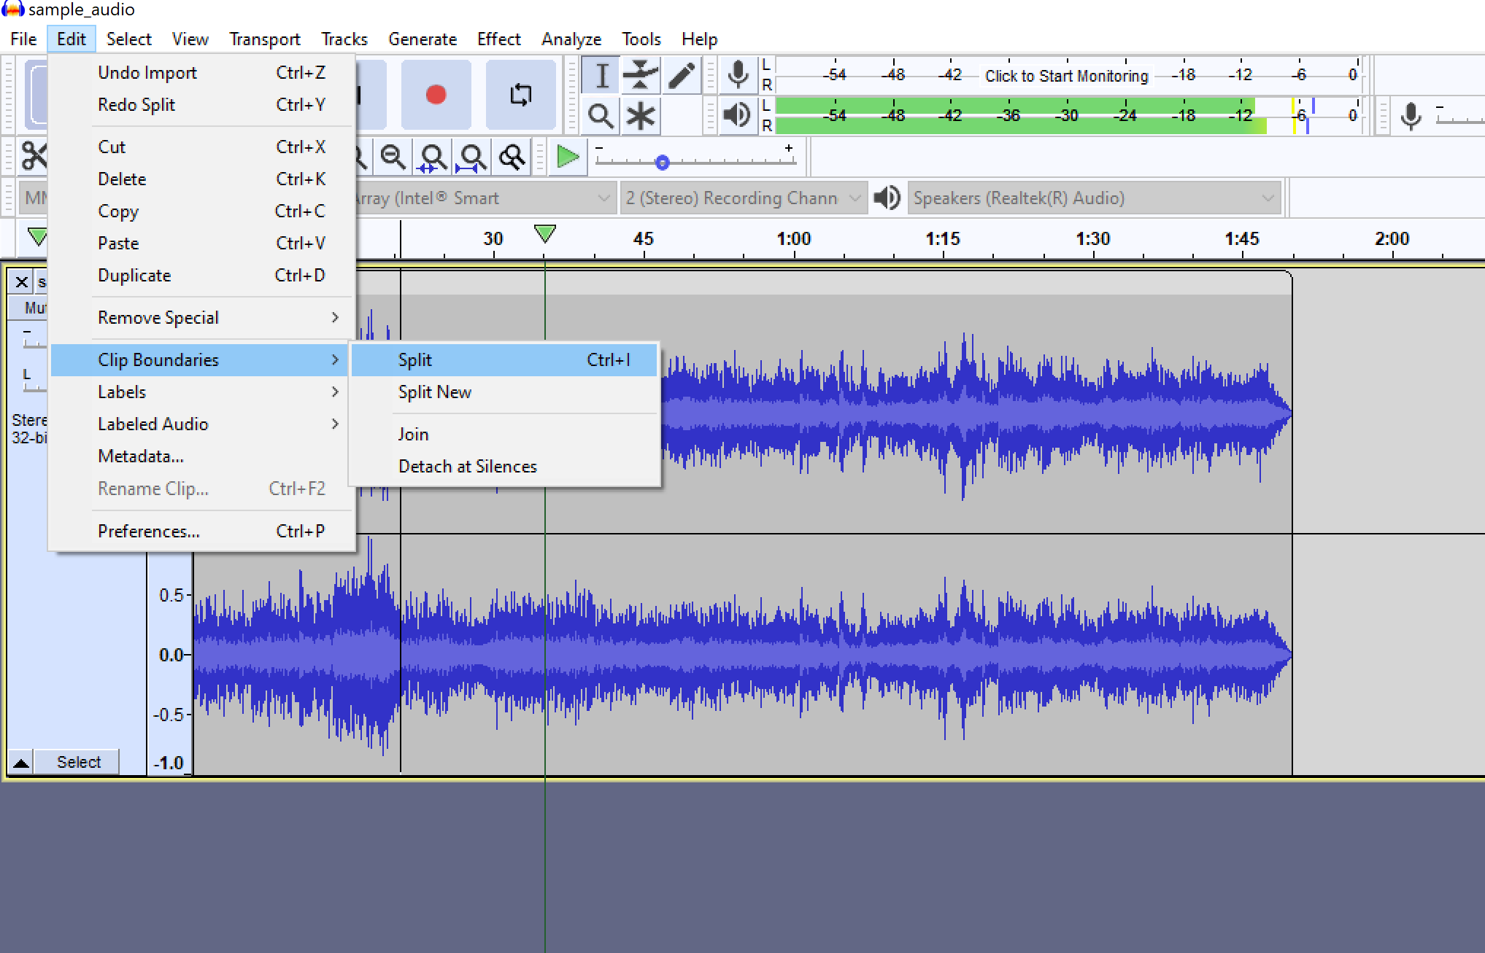
Splitting Tracks
To split a track in Audacity, follow these steps to make shorter clips:
With the Selection Tool (F1), place your cursor over the section where you want to split your track.
Navigate to the Edit section, click under “Clip Boundaries” and select “Split”, or press Ctrl+I.
Feel free to ask questions at any point during the presentation!

Slide 29
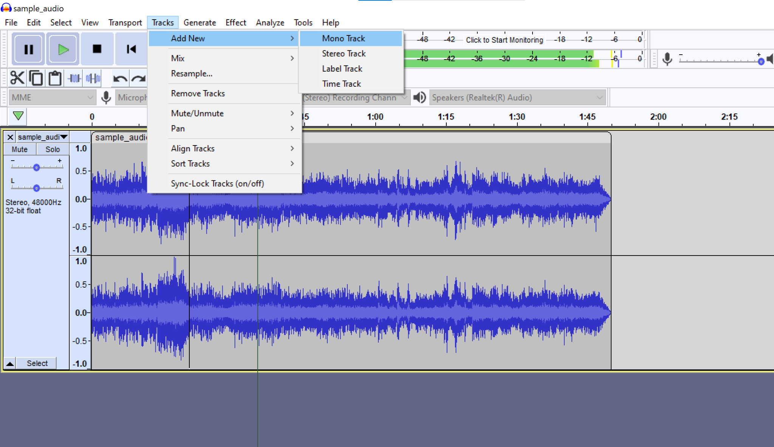
Adding Tracks
To create additional tracks in Audacity for a new recording, hit the record button and it will start a new track. Another option is:
Navigate to the “Tracks” menu option and select “Add New.” This will open a list of options. Select the “Mono Track” option. You can also add a new mono track by pressing Ctrl+Shift+N.
Feel free to ask questions at any point during the presentation!
Notes:
10-15 min demo
Free Music Archive (freemusicarchive.org), studio.youtube.com (must be signed in to access)

Slide 30
Your Turn!
Visit freemusicarchive.org OR
studio.youtube.com and click on the ‘Audio Library’ tab
(you have to be signed into Google for this one)
Download something you want to play around with and try to:
Remove some of your track
Choose a part to fade in or fade out
Split the track into multiple
Add a new track to your project

Slide 31
Saving, Exporting, and Sharing

Slide 32
Saving
Audacity does not auto-save! Save your recording, early and often!
Try and save after each major edit/input of a recording, just to be safe.
Save in multiple places. Always have backup.
File > Save Project > Save Project As> “Name of your podcast”
And once your project is saved...
File > Save Project > Save Project > [saves the updates to your file]
Feel free to ask questions at any point during the presentation!

Slide 33
About File Formats
Lossless Audio File Formats: better than or equal to CD-quality
WAV: uncompressed file, meaning huge file size. The best for editing raw audio files in Audacity.
AIFF: Apple’s alternative to WAV. Uncompressed, not widely used
*MP3/MP4: compressed audio file, ensures small file size. Best for exporting and distributing from Audacity.
Ogg Vorbis: Open-source alternative to MP3. Used in Spotify streaming
*Note: The DITI typically recommends you save files as mp3 (sometimes mp4, if you use a PC).
Feel free to ask questions at any point during the presentation!

Slide 34
Exporting and Sharing
Finished with your recording?
Make sure you export your project as an MP3 before you send or share it! This will ensure that other people are able to listen to it; anyone who does not have Audacity downloaded will not be able to open your project file otherwise.
File > Export > Export as MP3
Select “best quality”
Feel free to ask questions at any point during the presentation!

Slide 35
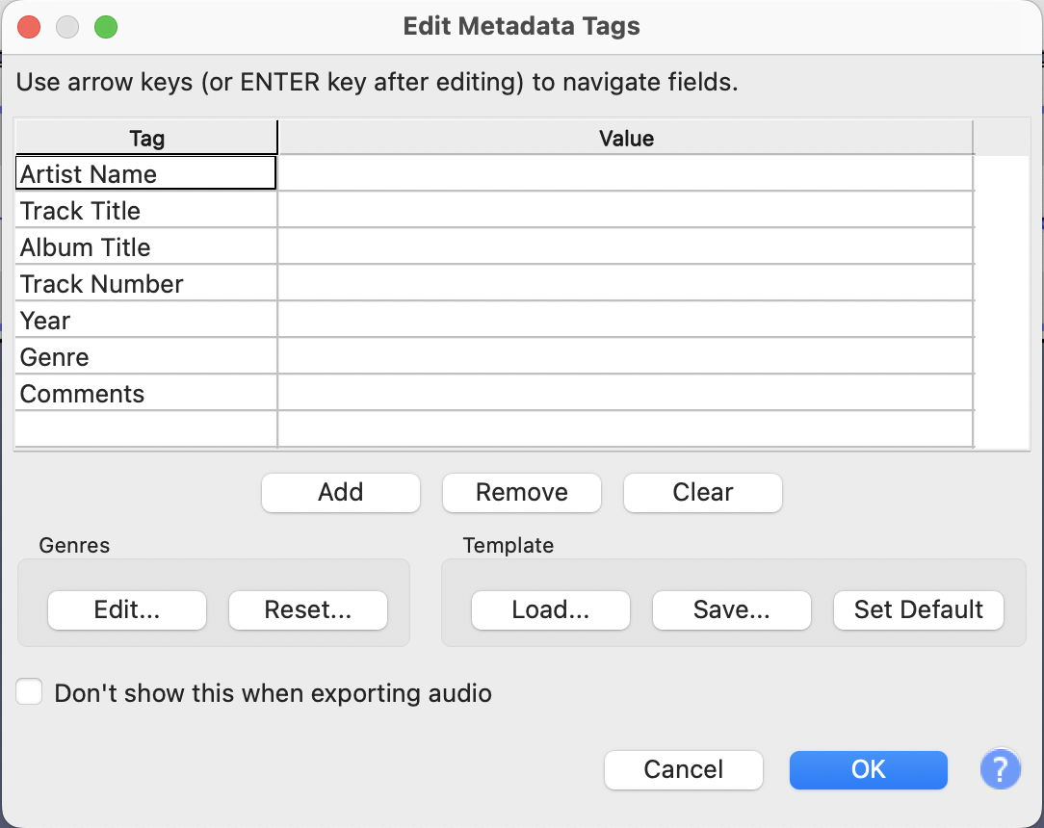
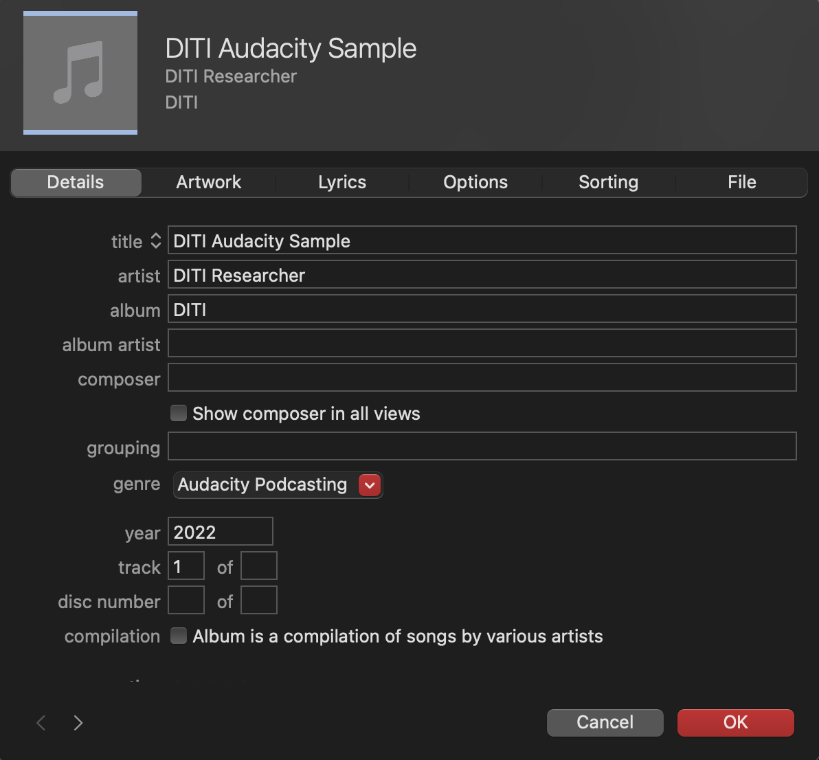
Exporting Metadata Tagging
When you export your file, Audacity will prompt you to add metadata tags to identify it.
In order to add artwork, you should import your file to an Apple Music library, right click on it and click “Get info.” You will see the metadata tags you entered in Audacity, and will be able to upload artwork for your podcast.
Feel free to ask questions at any point during the presentation!

Slide 36
Thank you!
Hunter Moskowitz
Digital Integration Teaching Initiative
Research Fellow
Kasya O’Connor Grant
Digital Integration Teaching Initiative
Research Fellow
We love feedback! Please fill our 2-minute survey: bit.ly/diti-feedback
Office Hours sign-up: calendly.com/diti-nu/
Contact us at: nulab.info@gmail.com
Slides and handouts available at:

