Slide 1
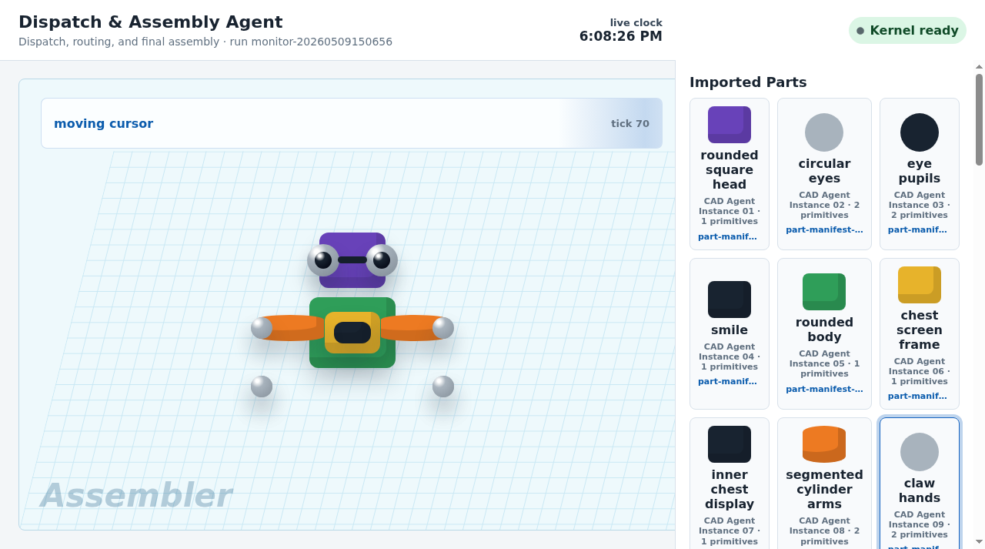
POSTER-INSPIRED RUN
The richer prompt generates a better CAD Agent Factory demo.
Instead of asking for only five coarse parts, the new run asks for eyes, pupils, smile, display layers, claws, wheels, and hubs.
11
17
6
CAD Agent workers
source primitives
old Kernels cleaned
Fresh website result
Final model assembled from imported worker manifests.
Poster robot CAD demo run monitor-20260509150656
01

Slide 2
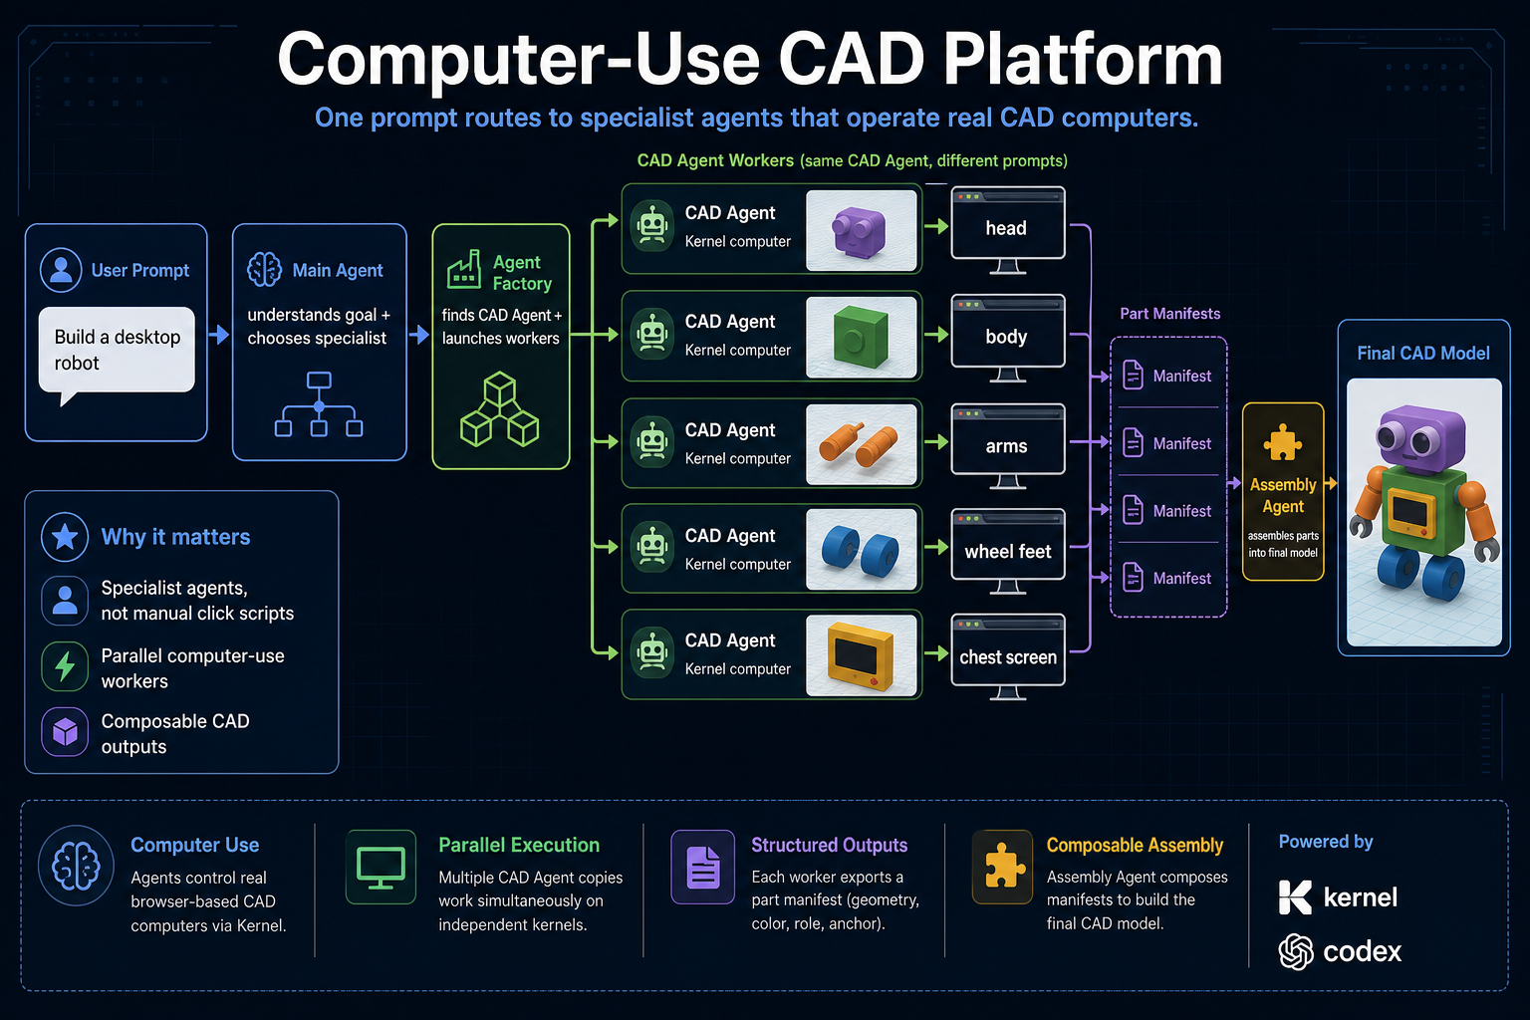
PROMPT UPGRADE
The prompt now names the visual details the CAD workers must build.
Judge-facing prompt
Build a polished poster-style toy robot with a purple rounded square head, large silver circular eyes, black eye pupils, a small black smile, a green rounded body, a yellow chest screen frame, a black inner chest display, orange segmented cylinder arms, silver claw hands, blue wheel feet, and dark wheel hubs.
Why it works: each comma-separated visual detail becomes a specialist CAD Agent worker.
Target style from the generated poster
Poster robot CAD demo run monitor-20260509150656
02

Slide 3
FRESH PROJECT PROOF
Fresh project now cleans old CAD Kernels before creating the new run.
Cleanup
Run ID
6
monitor-20260509150656
old CAD Agent Kernel browsers deleted before this run
This matters for the demo: the final robot is not old state from a previous Kernel.
Generated CAD Agent workers
rounded square head
circular eyes
eye pupils
smile
rounded body
chest screen frame
inner chest display
segmented cylinder arms
claw hands
wheel feet
wheel hubs
Poster robot CAD demo run monitor-20260509150656
03

Slide 4
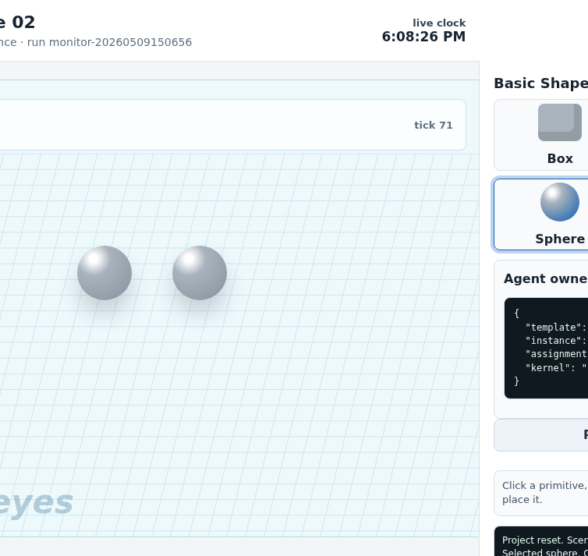
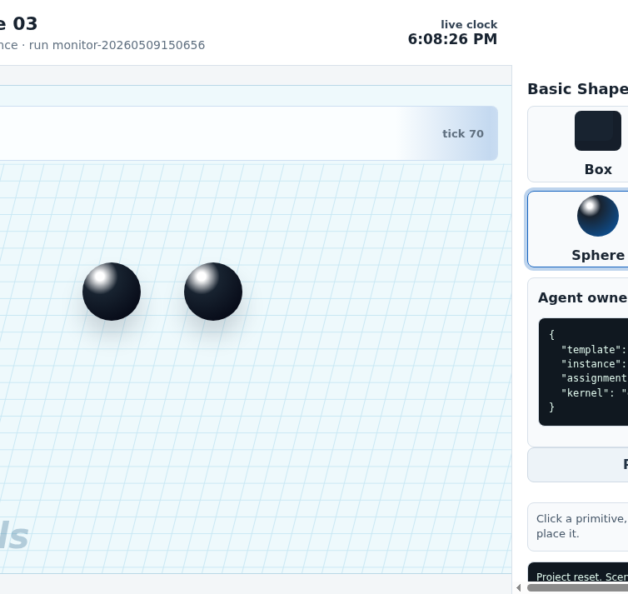
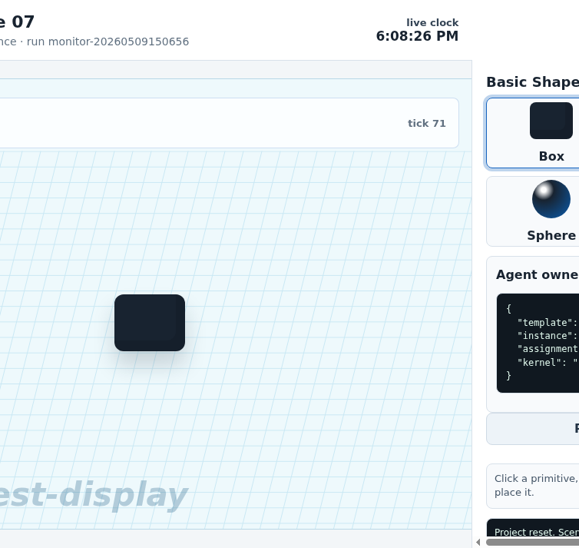
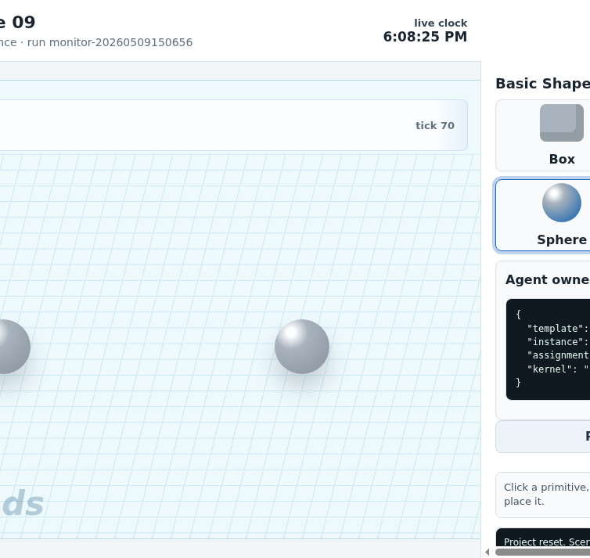
WORKER OUTPUTS
The CAD Agent workers now build small visual details, not just big blocks.
large silver eyes
black pupils
inner chest display
silver claw hands
This is the key demo improvement: the same CAD Agent template can be copied into detail workers when the main agent writes better prompts.
Poster robot CAD demo run monitor-20260509150656
04

Slide 5
ASSEMBLY PROOF
Assembly imports 11 worker manifests into one robot.
11
imported components
17
source primitives
12
Kernel computers
The final object is assembled from structured worker outputs, not from a fixed one-off drawing.
Poster robot CAD demo run monitor-20260509150656
05

Slide 6
DEMO TALK TRACK
What changed: better prompt, better planner, clean run.
01
Prompt quality matters
The poster robot needs explicit visual details: eyes, pupils, smile, screen layers, claws, hubs.
02
Factory scales detail
More details become more CAD Agent workers; the template stays the same.
03
Fresh is real
Old CAD Kernel browsers are cleaned before new workers are created.
04
Assembly proves composition
The result imports manifests from workers instead of reusing a hardcoded scene.
Poster robot CAD demo run monitor-20260509150656
06

