Slide 1

Submitted by
Nanditha N N

Slide 2
Cloud Computing
Cloud computing is a general term for anything that involves delivering hosted services over the internet.
Cloud computing is the on-demand availability of computer system resources, especially data storage and computing power, without direct active management by the user.
Large clouds often have functions distributed over multiple locations, each location being a data center.
These services are divided into three main categories or types of cloud computing
Iaas (Infrastructure as a service)
Paas (Platform as a service)
Saas (Software as a service)

Slide 3
AWS
Amazon Web Services, Inc. is a subsidiary of Amazon providing on-demand cloud computing platforms and APIs to individuals, companies, and governments, on a metered pay-as-you-go basis.
CEO: Adam Selipsky (17 May 2021–)
Headquarters: Seattle, Washington, United States
Founder: Amazon.com
Parent organization: Amazon.com

Slide 4
What exactly AWS Do?
AWS provides servers, storage, networking, remote computing, email, mobile development, and security. AWS accounts for about 13% of Amazon's total revenue as of Q2 2021.
The AWS technology is implemented at server farms throughout the world, and maintained by the Amazon subsidiary.
Fees are based on a combination of usage (known as a "Pay-as-you-go" model), hardware, operating system, software, or networking features chosen by the subscriber required availability, redundancy, security, and service options.

Slide 5
Services Provided by AWS
Amazon Web Services (AWS) is the world's most comprehensive and broadly adopted cloud platform, offering over 200 fully featured services from data centers globally.
Some of the commonly used services are
Amazon EC2
Amazon EBS
Amazon S3
Amazon EFS
Amazon Route53

Slide 6
Amazon EC2
Amazon Elastic Compute Cloud is a part of Amazon.com's cloud-computing platform, Amazon Web Services, that allows users to rent virtual computers on which to run their own computer applications.
C2 setup involves creating an Amazon Machine Image (AMI), which includes an operating system, apps, and configurations.
That AMI is loaded to the Amazon Simple Storage Service (S3), and it's registered with EC2, at which point users can launch virtual machines as needed.
AWS EC2 helps users to avoid the investment in hardware up front, so the user can deploy and develop applications easier.
It is used to launch many virtual servers, configure networking and security, and managing storage.

Slide 7
AMZON EBS
Amazon Elastic Block Store provides raw block-level storage that can be attached to Amazon EC2 instances and is used by Amazon Relational Database Service. Amazon EBS provides a range of options for storage performance and cost.
Amazon Elastic Block Store (Amazon EBS) is an easy-to-use, scalable, high-performance block-storage service designed for Amazon Elastic Compute Cloud (Amazon EC2). Close.
EC2 instances support two types for block level storage: EC2 Instances can be launched using either Elastic Block Store (EBS) or Instance Store volume as root volumes and additional volumes.

Slide 8
AMAZON S3
Amazon Simple Storage Service is a service offered by Amazon Web Services that provides object storage through a web service interface.
Amazon S3 uses the same scalable storage infrastructure that Amazon.com uses to run its global e-commerce network.
mazon Simple Storage Service (Amazon S3) is an object storage service that offers industry-leading scalability, data availability, security, and performance.
You can use Amazon S3 to store and retrieve any amount of data at any time, from anywhere.
The Amazon S3 stores data as objects within buckets. An object consists of a file and optionally any metadata that describes that file. To store an object in Amazon S3, the user can upload the file that he/she wants to store in the bucket.

Slide 9
AMAZON EFS
Amazon Elastic File System is a cloud storage service provided by Amazon Web Services designed to provide scalable, elastic, concurrent with some restrictions, and encrypted file storage for use with both AWS cloud services and on-premises resources.
Amazon's Elastic File System (EFS) is a scalable storage solution that can be used for general purpose workloads.
An EFS can be attached to multiple Amazon Web Services (AWS) compute instances and on-premises servers, providing a common resource for applications and data storage in many different environments.
Getting started with Amazon Elastic File System
Create your Amazon EFS file system.
Create your Amazon EC2 resources, launch your instance, and mount the file system.
Transfer files to your EFS file system using AWS Data Sync.
Clean up your resources and protect your AWS account.

Slide 10
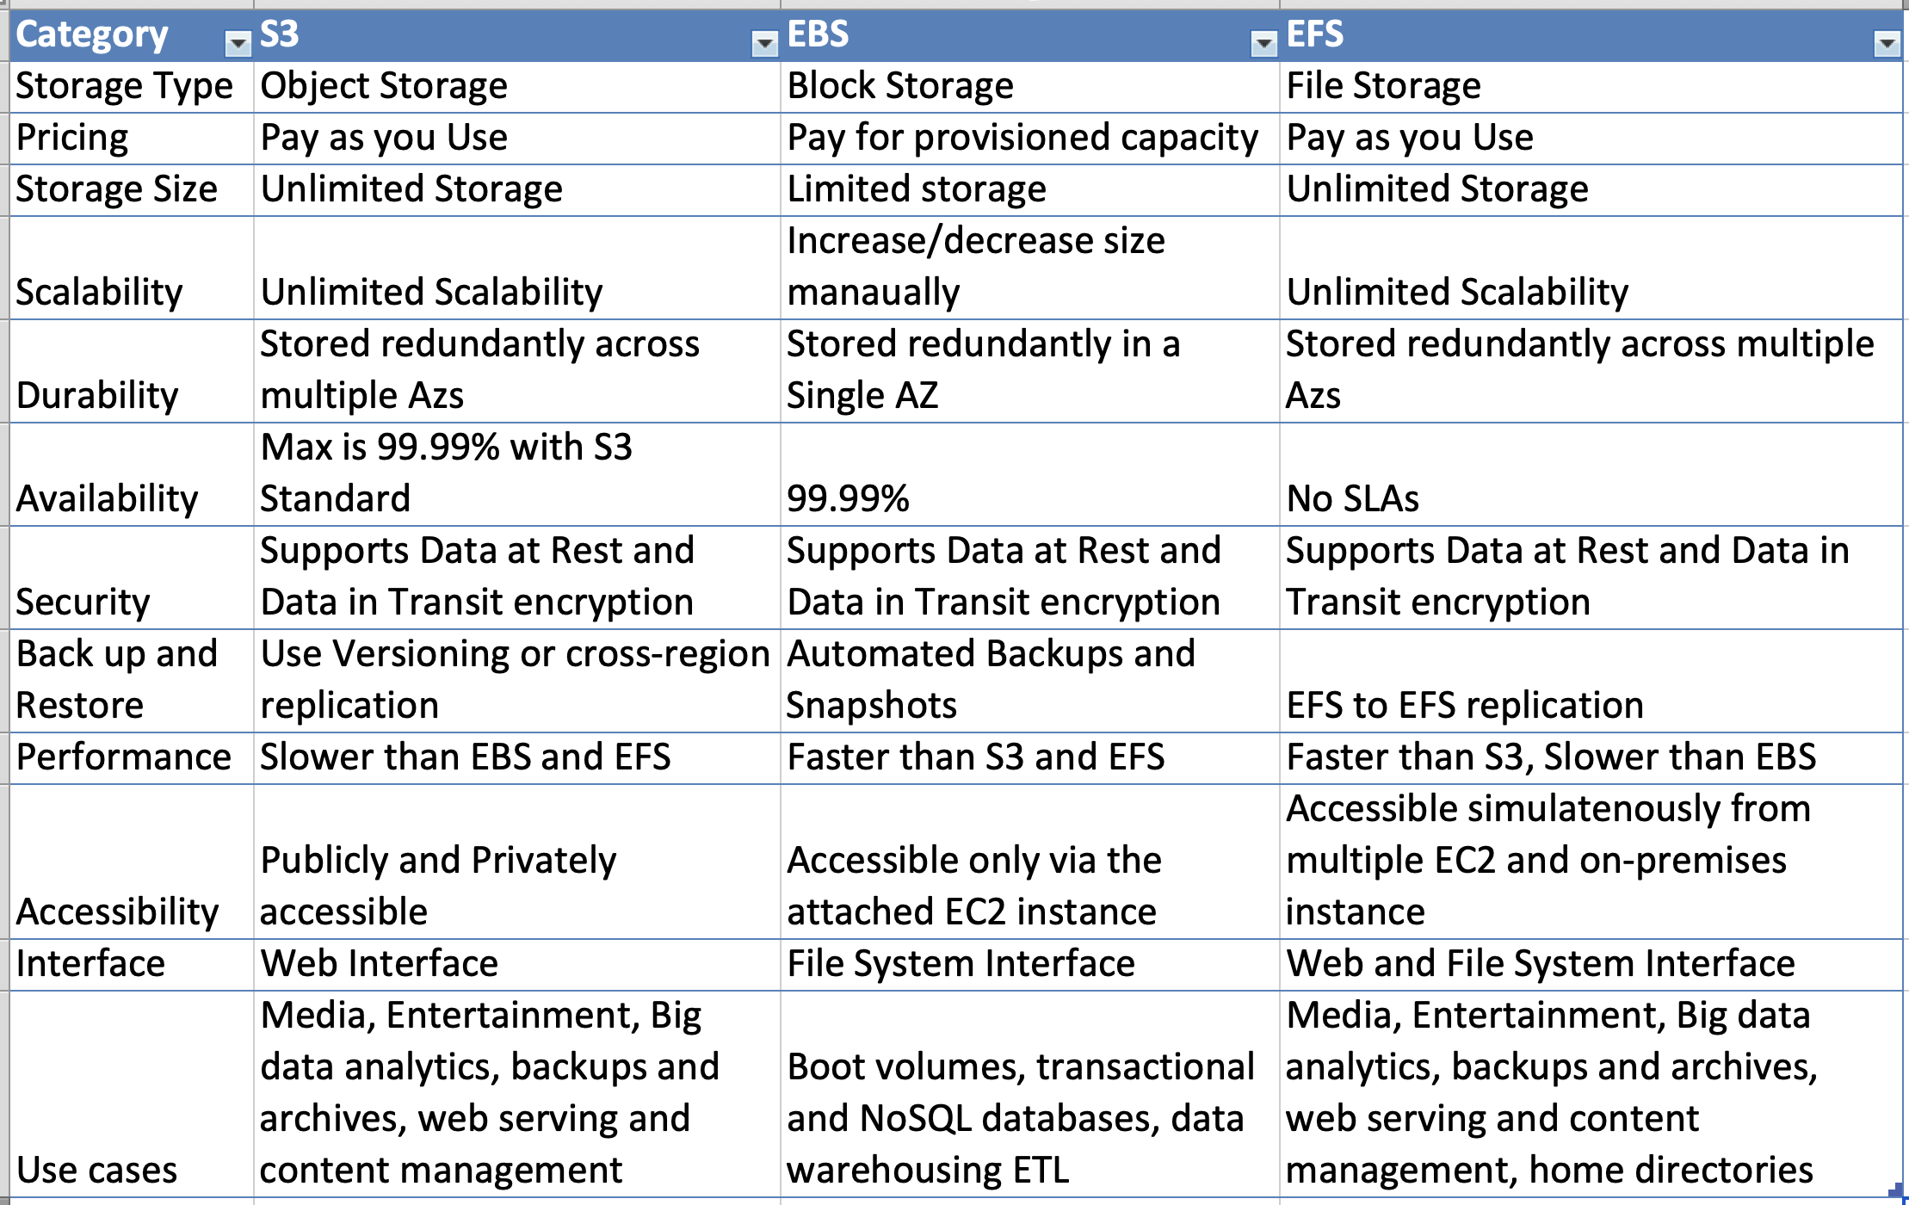

Slide 11
AMAZON Route53
Amazon Route 53 is a scalable and highly available Domain Name System service. Released on December 5, 2010, it is part of Amazon.com's cloud computing platform, Amazon Web Services.
Amazon Route 53 is a highly available and scalable cloud Domain Name System (DNS) web service.
It is designed to give developers and businesses an extremely reliable and cost effective way to route end users to Internet applications by translating names like www.example.com into the numeric IP addresses like 192.0.
Route 53 is a Domain Name System (DNS) service that performs global server load balancing by routing each request to the AWS region closest to the requester's location.

Slide 12
Advantages of AWS
Easy to Use
No Capacity Limits
Provides Speed and Agility
Secure and Reliable

Slide 13
Disadvantages of AWS
Limitations OF Amazon EC2
Security Limitations
Technical Support Fee
General cloud Computing Issues

Slide 14
THANK YOU

