Slide 1
NETWORKING
MOHAK CHETHAN K

Slide 2
What is Network?
Set of devices connected through links
The nodes of a computer network may include personal computers, servers, networking hardware, or other specialized or general-purpose hosts

Slide 3
Types of Network
LAN(Local Area Network)
WAN(Wide Area Network)

Slide 4
Networking devices
Routers
Hub
Switches
Modem

Slide 5
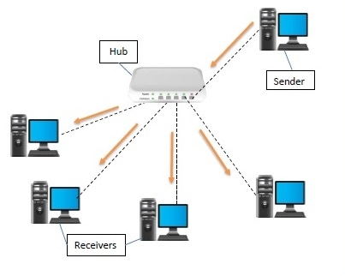
HUB
A hub is a physical layer networking device which is used to connect multiple devices in a network
They are generally used to connect computers in a LAN
A hub has many ports in it
A computer which intends to be connected to the network is plugged in to one of these ports

Slide 6
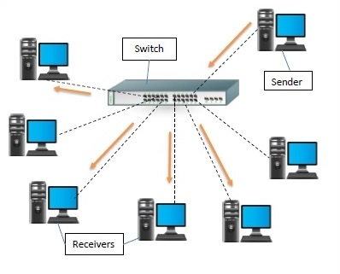
SWITCHES
A switch is a data link layer networking device which connects devices in a network and uses packet switching to send and receive data over the network.
Like a hub, a switch also has many ports, to which computers are plugged in

Slide 7
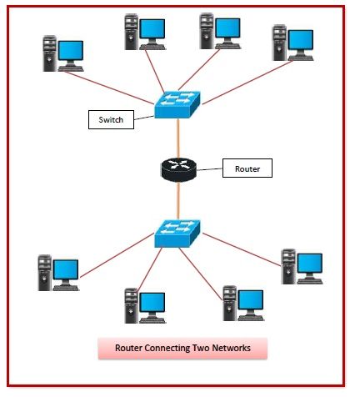
ROUTER
They are responsible for receiving, analyzing, and forwarding data packets among the connected computer networks
Routers provide protection against broadcast storms.

Slide 8
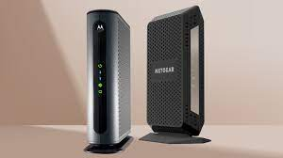
MODEM
Modem is a device that enables modulation and demodulation.
The data stored on the computer is digital whereas a telephone line or cable wire can transmit only analog data

Slide 9
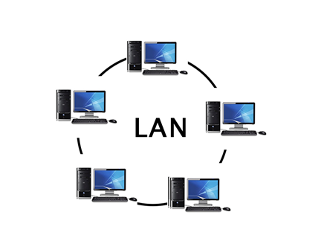
LAN
A group of computers connected to each other in a small area such as building, office
Used for connecting two or more personal computers through a communication medium such as twisted pair, coaxial cable, etc

Slide 10
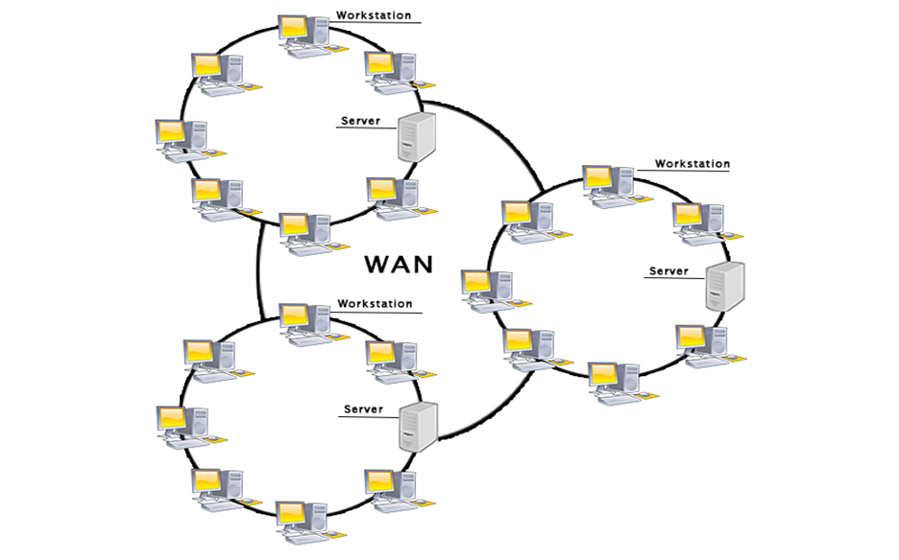
WAN
It is a network that extends over a large geographical area such as states or countries
It is widely used in the field of Business, government, and education.

Slide 11
IP ADDRESS
It is a short form of "Internet Protocol Address”
It is a unique number provided to every device connected to the internet network
It is represented in an integer number separated by a dot (.)
For example, 192.168.2.33

Slide 12
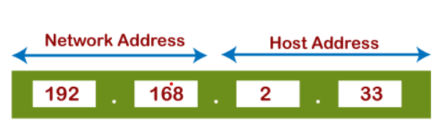
Network Address: The network address specifies the unique number which is assigned to your network.
Host Address: A host address is a specific address number assigned to each host machine

Slide 13
TYPES OF IP ADDRESS
IPV4(Internet Protocol version 4)
IPV6(Internet Protocol version 6)

Slide 14
IPV4
IPv4 is version 4 of IP
It is a current version and the most commonly used IP address.
It is a 32-bit address written in four numbers separated by a dot (.) i.e., periods.
This address is unique for each device. For example, 66.94.29.13

Slide 15
IPV6
IPv6 is the next generation of IP addresses
The main difference between IPv4 and IPv6 is the address size of IP addresses
The IPv4 is a 32-bit address, whereas IPv6 is a 128-bit hexadecimal address
IPv6 provides a large address space, and it contains a simple header as compared to IPv4.

Slide 16
THANK YOU

