Slide 1
AGILE
By Vageesh T K

Slide 2
Different Methodologies followed by Software Industry
Waterfall Model
Agile Model

Slide 3
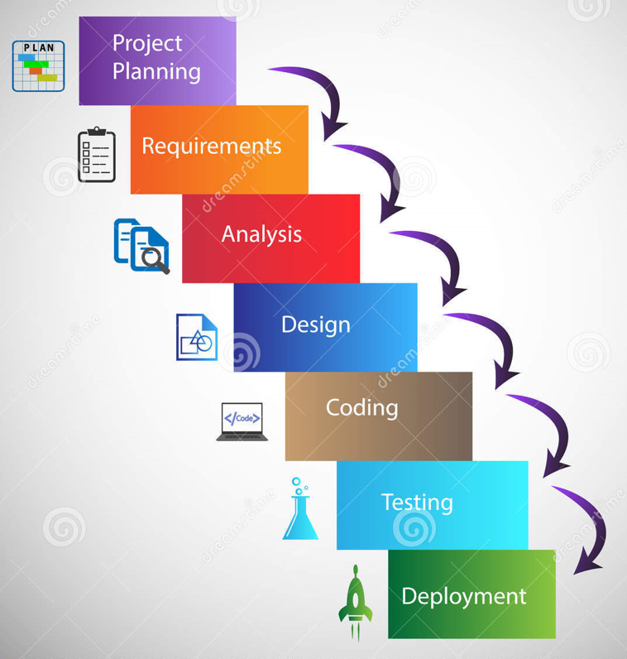
Waterfall Software Practices are Traditional, Plan-Driven Practices for Developing Systems and Software Development Life Cycle (SDLC) Approach. And it is based on Developing in Stages: Gather and Analyze Software Requirements, Design, Develop, Test and Deploy into Operations. The output of one stage is required to initiate the next stage.
The Waterfall

Slide 4
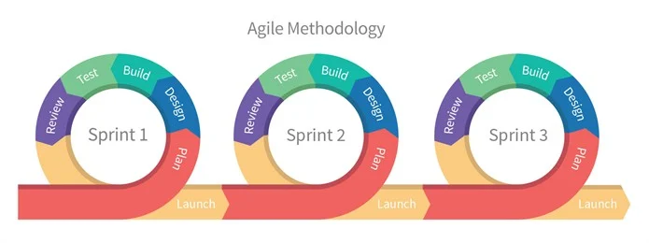
The Agile
The need for a Quick Adaptation and Rapid Delivery of Products was the engine behind Agile Software Development Practices birth. The changing Business needs during Development require a solution. The Methodology allows for the Exploration of New Ideas and Quicker Determinations about which of those Ideas are Viable.
Some of the Agile Frameworks used are Scrum and Kanban. Where Scrum’s Key Components are iterations and velocity, the Key Component with Kanban is its Work in Progress Status.

Slide 5
Principles of Agile are
Our highest priority is to satisfy the customer through early and continuous delivery of valuable software.
Welcome changing requirements, even late in development. Agile processes harness change for the customer’s competitive advantage.
Deliver working software frequently, from a couple of weeks to a couple of months, with a preference to the shorter timescale.
Business people and developers must work together daily throughout the project.
Build projects around motivated individuals. Give them the environment and support they need, and trust them to get the job done.
The most efficient and effective method of conveying information to and within a development team is face-to-face conversation.

Slide 6
Principles of Agile are
Working software is the primary measure of progress.
Agile processes promote sustainable development. The sponsors, developers, and users should be able to maintain a constant pace indefinitely.
Continuous attention to technical excellence and good design enhances agility.
Simplicity–the art of maximizing the amount of work not done–is essential.
The best architectures, requirements, and designs emerge from self-organizing teams.
At regular intervals, the team reflects on how to become more effective, then tunes and adjusts its behavior accordingly.

Slide 7
AGILE is Used for
With Agile software development, teams can quickly adapt to requirements changes without negatively impacting release dates.
Not only that, Agile helps reduce technical debt, improve customer satisfaction and deliver a higher quality product.
Mainly used for software development, where demands and solutions evolve through the collaborative effort of self-organizing and cross-functional teams and their customers

Slide 8
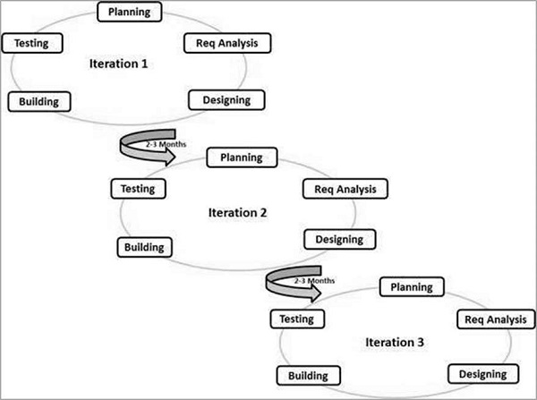
Agile SDLC
Agile SDLC model is a combination of iterative and incremental process models with focus on process adaptability and customer satisfaction by rapid delivery of working software product. Agile Methods break the product into small incremental builds. These builds are provided in iterations.

Slide 9
Steps in SDLC
Planning
Gathering Requirements & Analysis
Defining
Design
Building
Testing
Deployment

Slide 10
Scrum
Scrum is a framework for developing, delivering, and sustaining products in a complex environment, with an initial emphasis on software development, although it has been used in other fields including research, sales, marketing and advanced technologies.
Scrum has three roles:
product owner,
scrum master and
The development team members.

Slide 11
Scrum roles
Product Owner : The Product Owner (PO) is a member of the Agile Team responsible for defining Stories and prioritizing the Team Backlog to streamline the execution of program priorities while maintaining the conceptual and technical integrity of the Features or components for the team.
Scrum Master : The scrum master helps the team enhance and streamline the processes by which they achieve their goals. They do so as a team member, or collaborator, ideally not as someone in control. The best scrum teams are self-organizing, and therefore don't react well to top-down management.
The Development team : During sprint execution, the development team members perform the tasks of designing, building, integrating, and testing product backlog items into increments of potentially shippable functionality. For this, they self-organize and mutually decide how to plan, manage, carry out, and communicate the work.

Slide 12
How does a Scrum Master track Sprint progress?
Daily Scrum meetings
Scrum retrospectives
Sprint planning
Escaped defects
Defect density
Sprint burndown
Team velocity

Slide 13
User Story
A user story is an agile software development/ project management tool that provides teams with simple, natural language explanations of one or more features of the project that’s written from the perspective of the end-user.
The user story doesn’t go into detail but only mentions how certain types of work will bring value to the end-user. The end-user, in this case, could be an external component or an internal customer/colleague within the organization.
They also form the building block of agile frameworks like epics and other initiatives.
They ensure that the teams work towards the goals of the organization, with the help of epics and initiatives.
The requirements to make a user story a reality are added later, after discussions with the team.
They are recorded on post-it notes, index cards, or project management software.

Slide 14
How are user stories, epics, and tasks different?
User Stories: They provide the team with simple explanations of the business’ requirements created from the end user's perspective.
Epics: An epic is a collection of related user stories. They are usually large and complex.
Tasks: Tasks are used to break down user stories further. They’re the smallest unit in Scrum that is used to track work. A person or a team of two people usually work on a task.

Slide 15
Sprint and Velocity
Sprint: Sprint is a terminology used in Scrum, used to describe a time-boxed iteration.
During a sprint, a specific module or feature of the product is created.
The duration of a sprint can vary between a week or two.
Velocity: Velocity is a metric used to measure the amount of work completed by a team during a sprint. It refers to the number of user stories completed in a sprint.

Slide 16
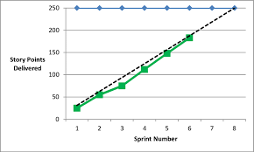
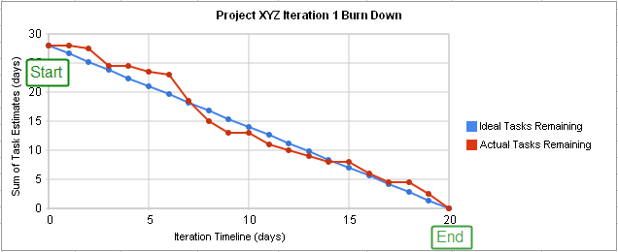
What is a Burnup and Burndown Chart?
A burnup chart is a tool that’s used to track the amount of work that’s been completed and to represent the total amount of work that needs to be done for a sprint/project.
A burndown chart represents how fast working through user stories is. It shows total effort against the amount of work for each iteration.

Slide 17
User story structure with an example.
The User Story Structure is defined below -
As a <role of user>,
I want <To achieve a goal / perform a task>,
So that <I may achieve some value/goal>.
Example:
User Story of a person’s online course purchase -
As a Customer,
I want to purchase educational courses online from ed-tech websites,
So that I do not have to visit a training center.

Slide 18
Advantages of Agile
More flexibility.
More productivity.
More transparency.
Products of superior quality.
Decreased risk of missed goals.
Greater involvement and satisfaction of stakeholders.

Slide 19
Disadvantages of Agile
Poor resource planning.
Limited documentation.
Fragmented output.
No finite end.
Difficult measurement.

Slide 20
Thank You

